Slide 1
Four Lokomotion
Hong Jai Cho
Jon Francis
Young Woong Park
Anthony Rowles

Slide 2
Status Update
Rotating gaming device with four screens.
Project idea is finalized.
Complete parts list ready.
Planning to test with a subset of the parts.
Freescale TWR-MCF5225X Microcontroller development board
Freescale TWR-LCD 3.2” TFT LCD
Freescale TWR-ELEV PCI-X communications connector

Slide 3
Architecture
Bus
Notes:
No direct competitors
Hand-held version could compete in the digital toys market with a target price near $50
Scaled-up model could be marketed as an arcade game with a unique style of interaction

Slide 4
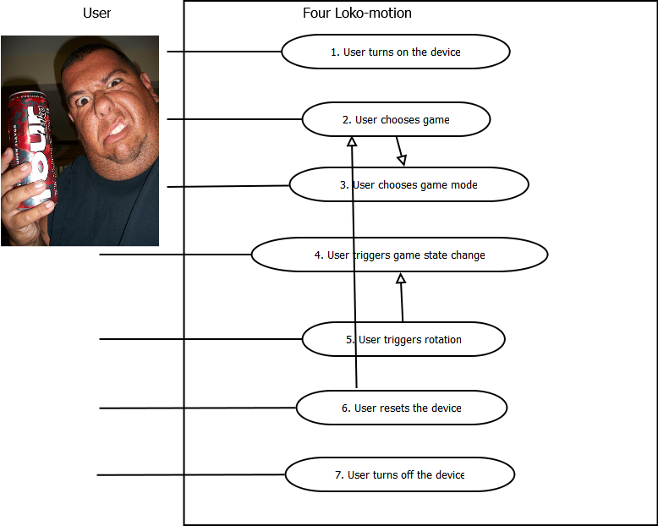
Use Cases

Slide 5
Reliability Use Cases
Hardware failure
When the motor stops: keep the game on a single screen, backup motor
When one of the displays fails: mark the display as ‘unavailable for use’ and skip over that screen during rotation
Software failure
Reset the system with correct motor orientation

Slide 6
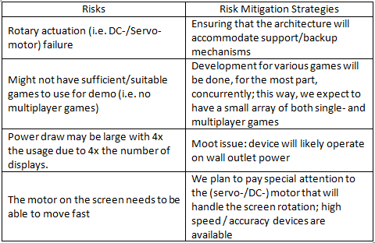
Risks & Mitigation

