Slide 1
Full Music Jacket (aka BlueCoat, MaVo-JaJo, iJacket)
Javier Novales, Volkan Eren,
John Sexton, Maxim Buevich

Slide 2
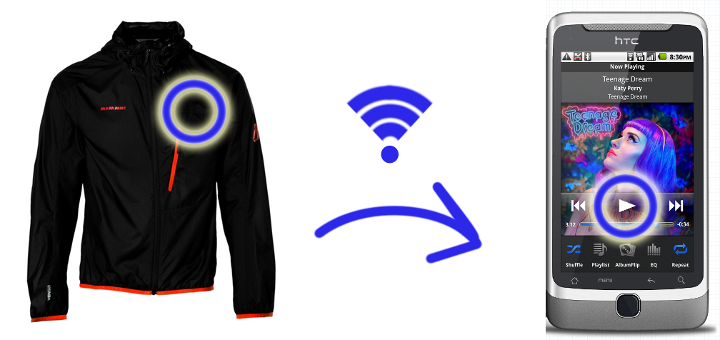
FMJ Concept
FMJ: Intuitive and convenient jacket-based interface for a smart phone.
Touch-based control, wireless, discrete
Handles common operations for music and calls

Slide 3
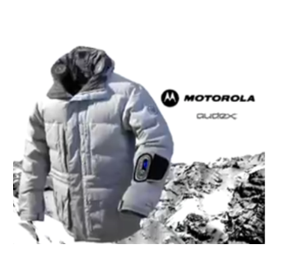
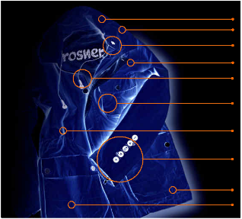
Competing Products
The Burton–Motorola Audex Jacket [$450.00]
Expensive, sleeve control, heavy (speakers)
Rosner MP3Blue Jacket [Unknown]
Sleeve control, no wireless

Slide 4
Requirements
Allow user to control music and interrupting calls without touching the phone.
Reliable pressure sensor operation
React gracefully to sensor malfunction or loss of wireless communication.
Be physically robust.
Possible Accessories
Wireless audio, flashy jacket light-show (LED, EL)

Slide 5
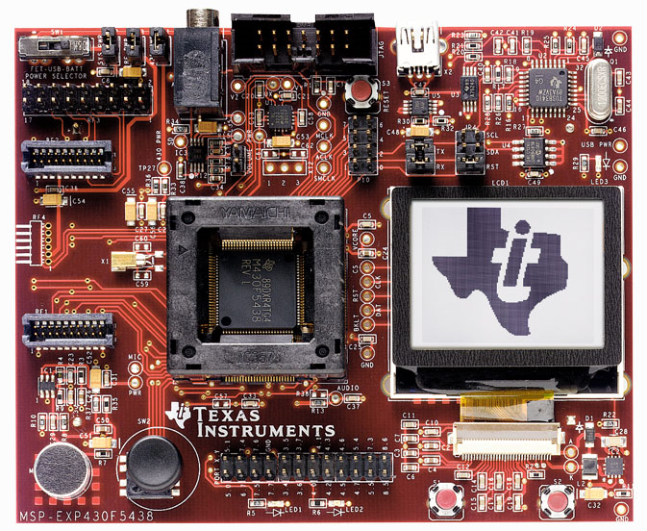
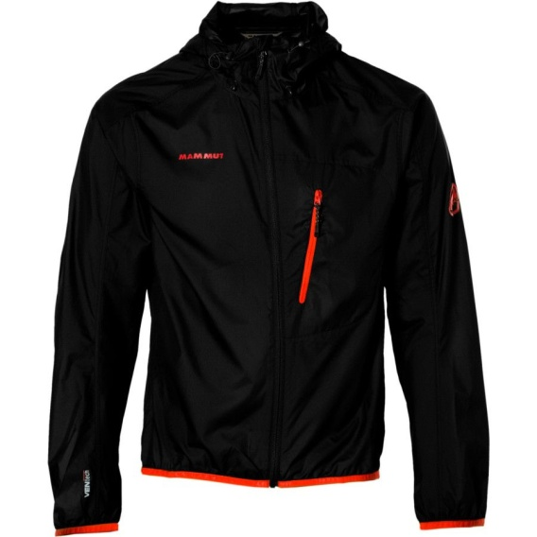
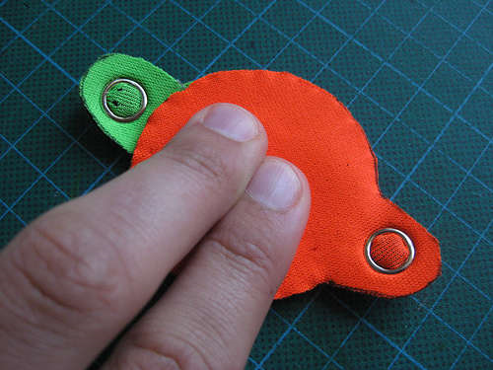
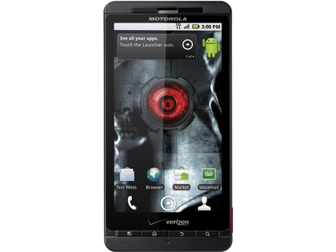
Technical Specifications

