Slide 1
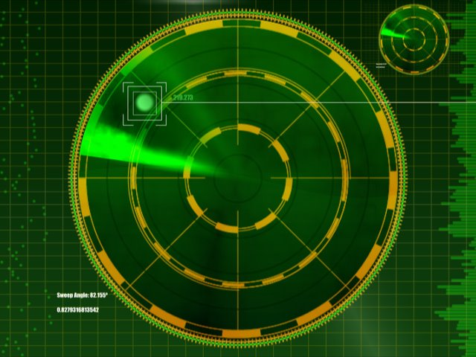
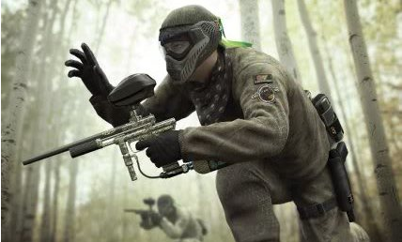
ScouTrak
Team:
Jesse Salazar
Rajeev Sharma
Mitch Luban
Owen Jarrett

Slide 2
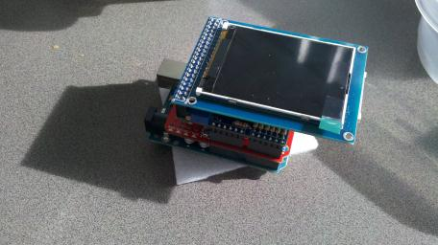
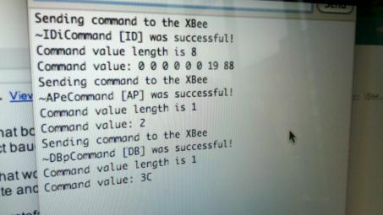
Status update
Mounted display indicating location of important objects by triangulating from RSSI readings
Project updates
RSSI values can be polled
Timing issues resolved
RSSI values displayed on LCD
Triangulation and RSSI-to-distance functions are written
Currently have two sets of unfiltered RSSI data
No performance data yet

Slide 3
Experimentation plan
Set up XBee routers and take RSSI measurements at various distances
Xbee packetdata returns integer value with a typical range of 40-70, depending on distance
Distance: 1-24 meters, more measurements taken at close distances
Take 40-50 readings at each distance, take average, use for triangulation later
Currently have data for UC gym
Need data for Gates 6115 (different RSSI values)

Slide 4
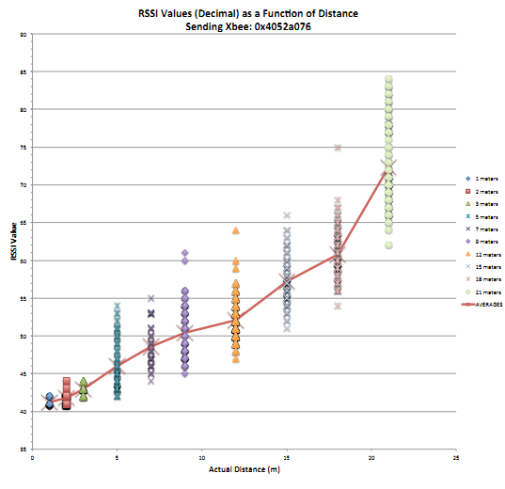
Initial data
More variation at greater distances
Use closest base stations for triangulation
Use running average filter, remove outliers
Some variation based on antenna angle
Might use accelerometers if time permits

Slide 5
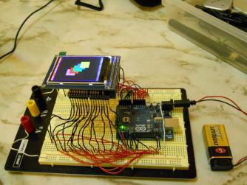
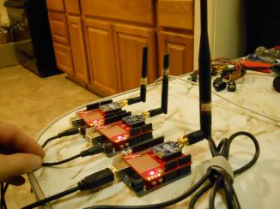
Looking forward
Learned that Arduino pins are scarce
Needed to rewire Arduino pins to interact with both Xbee shield and LCD
Next two weeks:
Integrate triangulation/RSSI lookup code
Optimize for performance
Take performance measurements
Further refine measurement accuracy (accelerometers)
Considering project enclosures if time permits

