Slide 1
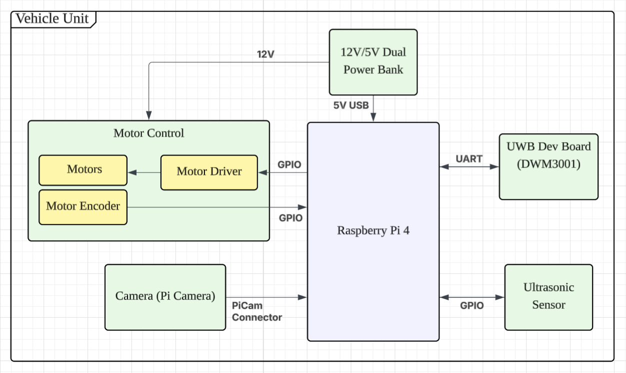
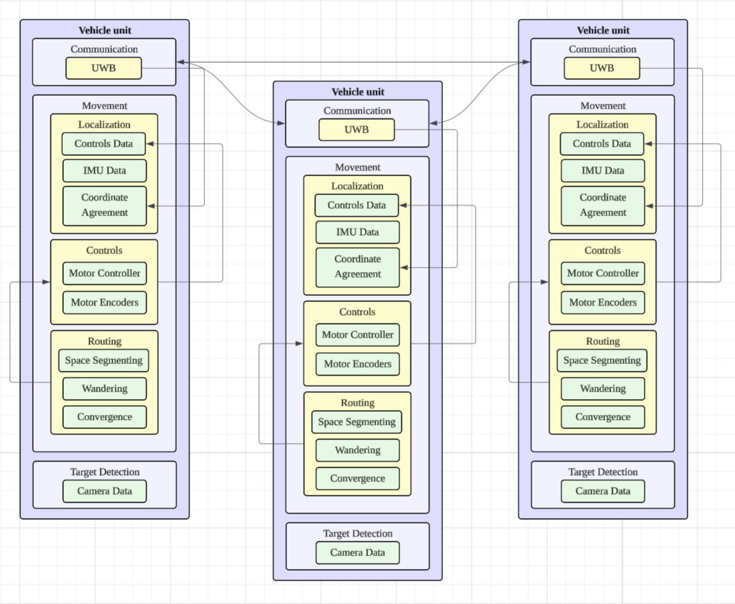
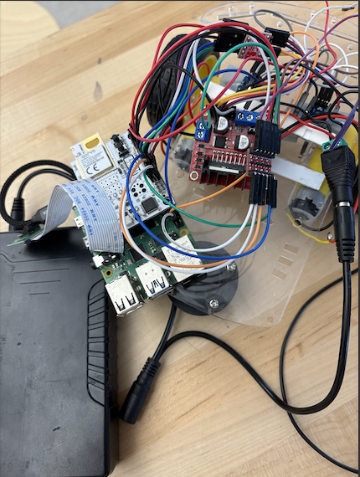
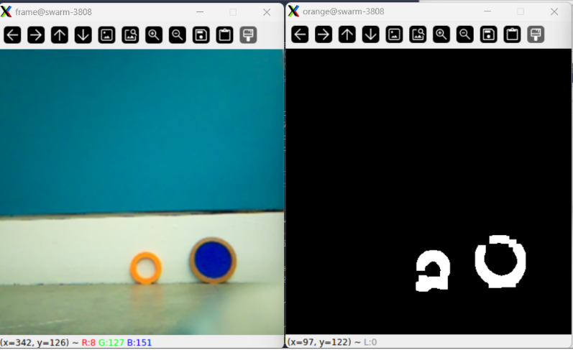
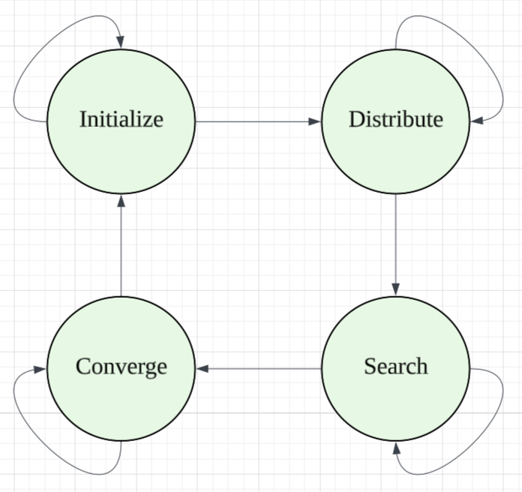



SWARM
(Space Wandering Autonomous Rescue Machines)
C6: Isaac Kim, Jacob Rohozen, Tyler Weed
18-500 Capstone Design, Spring 2026
Electrical and Computer Engineering Department
Carnegie Mellon University
Product Pitch
System Description
Search and rescue missions depend on finding a victim in need as quickly as possible. In large open areas, however, these missions often require an abundant amount of infrastructure, such as predeployment of localization anchors or human monitoring at centralized hubs.
We aim to find the victims as quickly as possible with minimum amount of infrastructure by introducing an autonomous and distributed system of search and rescue rovers. These decentralized rovers are capable of communicating with each other to divide large areas and deliver supplies at the target location.
System Architecture
Inside the rover
UWB Dev Board
Motor Driver
Raspberry Pi 4
Power Bank
System Evaluation
100% functionality for operating system duplication.
Is able to identify while moving
100% success in UART communication between Pi and UWB
All systems can update in <50ms total (camera, ranging, sonar, motor PID)
Visual Detection system correctly identifies target in ≥ 95% of frames
Initialization: Rovers set up communication protocols, area partitions, and localization.
Distribution: Rovers move to their partitioned areas and prepare to begin search.
Search: Each rover executes their search patterns. Obstacle maneuvering and mitigation occurs.
Converge: Once a rover identifies the target, all rovers converge at the target based on their localization.
Communication protocols are in a continuous loop while rover movements are in separate state machines.
Use-Case Requirements:
Metric | Target | Actual
Battery Life | ≥ 30 minutes | ≥ 1 hour
Speed | ≥ 1 ft/s | ≥ 1 ft/s
Obstacle Avoidance | ≥ 10cm away | ≥ 10cm
Communication | ≥ 95% msgs recvd | ≥ 95% msgs recvd
Distance Measurements | ≤ 30cm error | ≤ 20cm error
Conclusions & Additional Information
Getting consistent movement was a very big challenge for the project. This makes it difficult to explore the space reliably. Another challenge was making the rovers easily scalable. They each require a lot of internal wiring that can be difficult to replicate.

