Slide 1



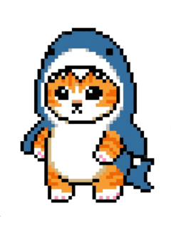
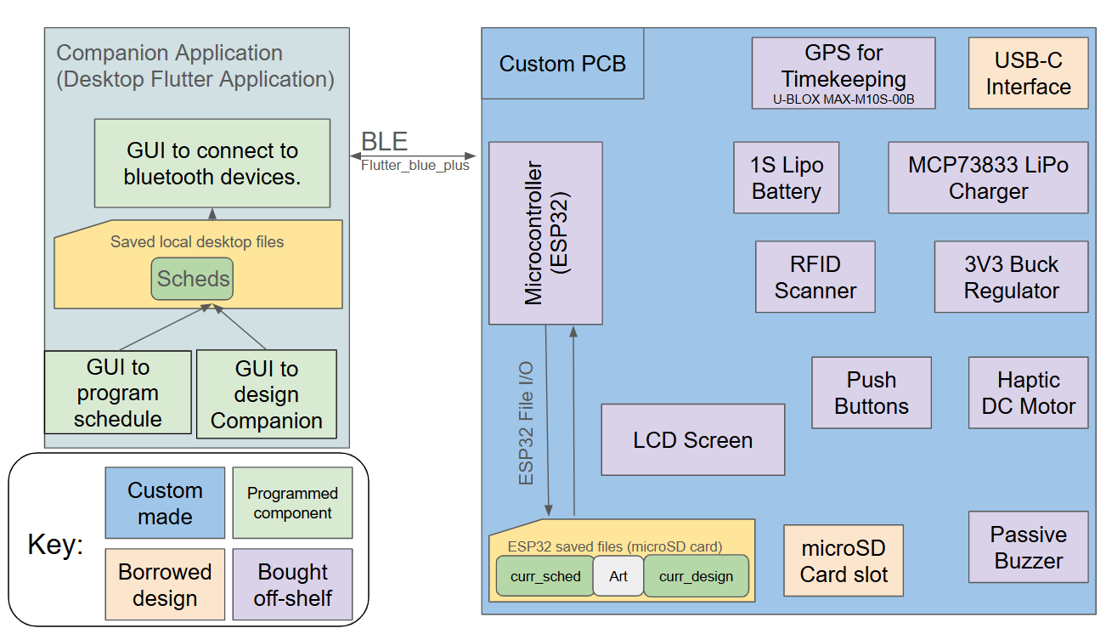
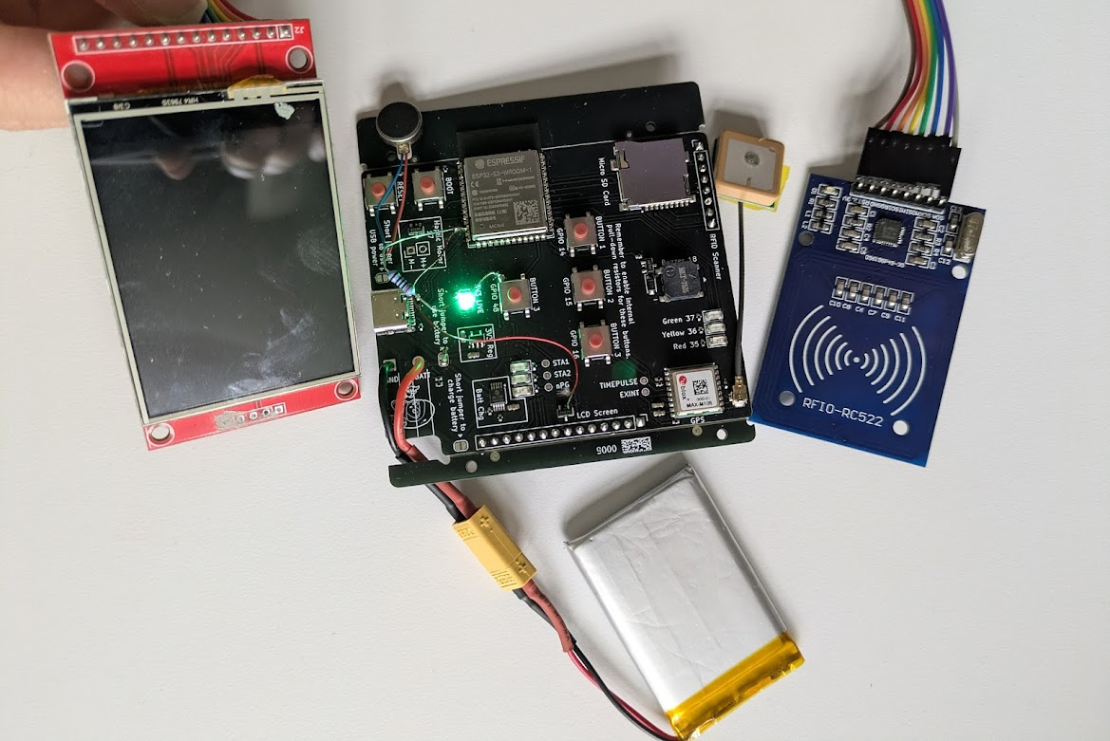
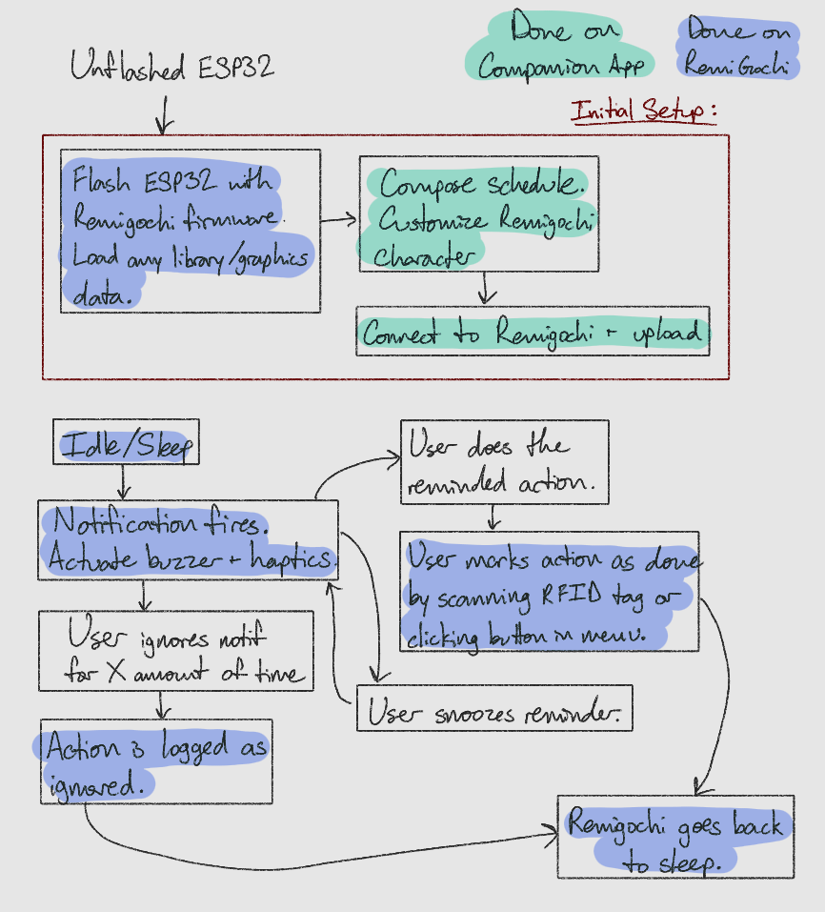



Remigotchi
B5: Italia Grant, Delaynie McMillan,
and Felipe Marples Rodriguez
18-500 Capstone Design, Spring 2026
Electrical and Computer Engineering Department
Carnegie Mellon University
What is a Remigotchi?
System Description
Remigotchi is a small portable device that motivates users to take relevant self care actions through a virtual pet that responds when users take care of themselves.
Inspired by the Tamagotchi craze of the 90’, the main purpose of the Remigtochi is to provide a distraction free way to be reminded to take self care actions, separate from one’s smartphone.
The key features of Remigotchi and its companion app is a rapid response and upload time, with a GPS module that accurately tells the time and provides on-time reminders.
The Remigotchi system relies on two major components, a companion application and the device proper. The companion application is a simple desktop application written in the dart langauge using common flutter libraries. The main purpose of the application is to allow users to create and save schedules filled with events they wish to be reminded of. The app then connects to the device using a Bluetooth Low Energy library to send schedule data to the device.
The device, a custom PCB board with numerous onboard features then interprets the schedule and using its onboard GPS, accurately finds the correct time to give the user reminders, to which they respond to with push buttons and an RFID scanner
System Architecture
Figure 1: Block diagram for both the remigotchi system, as well as the companion desktop application.
Figure Three: Remigotchi Device
Haptic Buzzer
Onboard SD card
GPS module
Screen
lipo battery
RFID Scanner
System Evaluation
Use-Case Requirements:
Metric | Target | Actual
Battery Life | ≥ 12 hours | ≤10 hours
GNSS Fix Time (Cold Start) | < 5 minutes | ≈ 4 minutes
GNSS Fix Time (Hot Start) | < 1 minute | < 5 seconds
Button Response time | < 100 ms | ≈ 75 ms
Connection Time from App to device | ≈ 1.5 seconds | ≈ 2.2 seconds
Time to send small schedule | ≈ 1000 ms | 400 ms
Time to send large Schedule | ≈ 3000 ms | 1500 ms
Figure 2:
Software Flow state for Remigotchi Device
In addition to the tests whose results are shown above, we also asked various students to test the user response to our project in order to make sure that the average user experience was smooth and helpful
Conclusions & Additional Information
This project was a valuable experience in designing and implementing systems that integrate together multiple technologies. We developed our minimum viable product while leaving room for future enhancements like advanced RFID scanning and graphical improvements. It also strengthened our skills in application-device integration, custom printed circuit boards, and embedded systems.
Visit our wordpress blog!
https://course.ece.cmu.edu/~ece500/projects/s26-teamb5/

