Slide 1


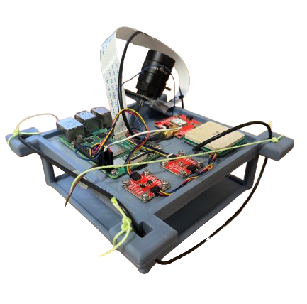
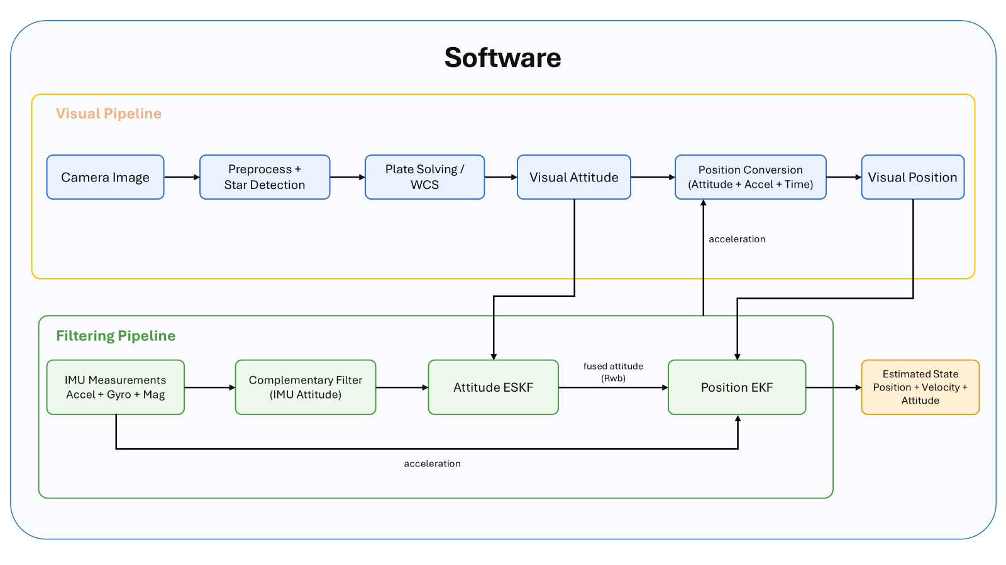
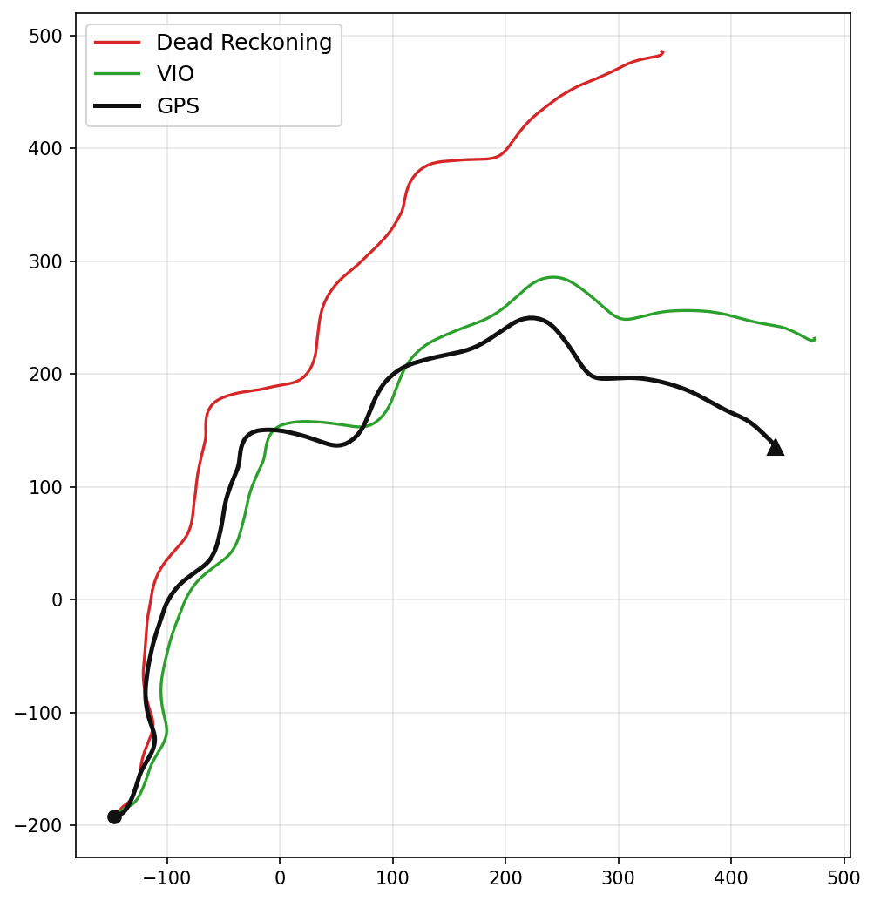
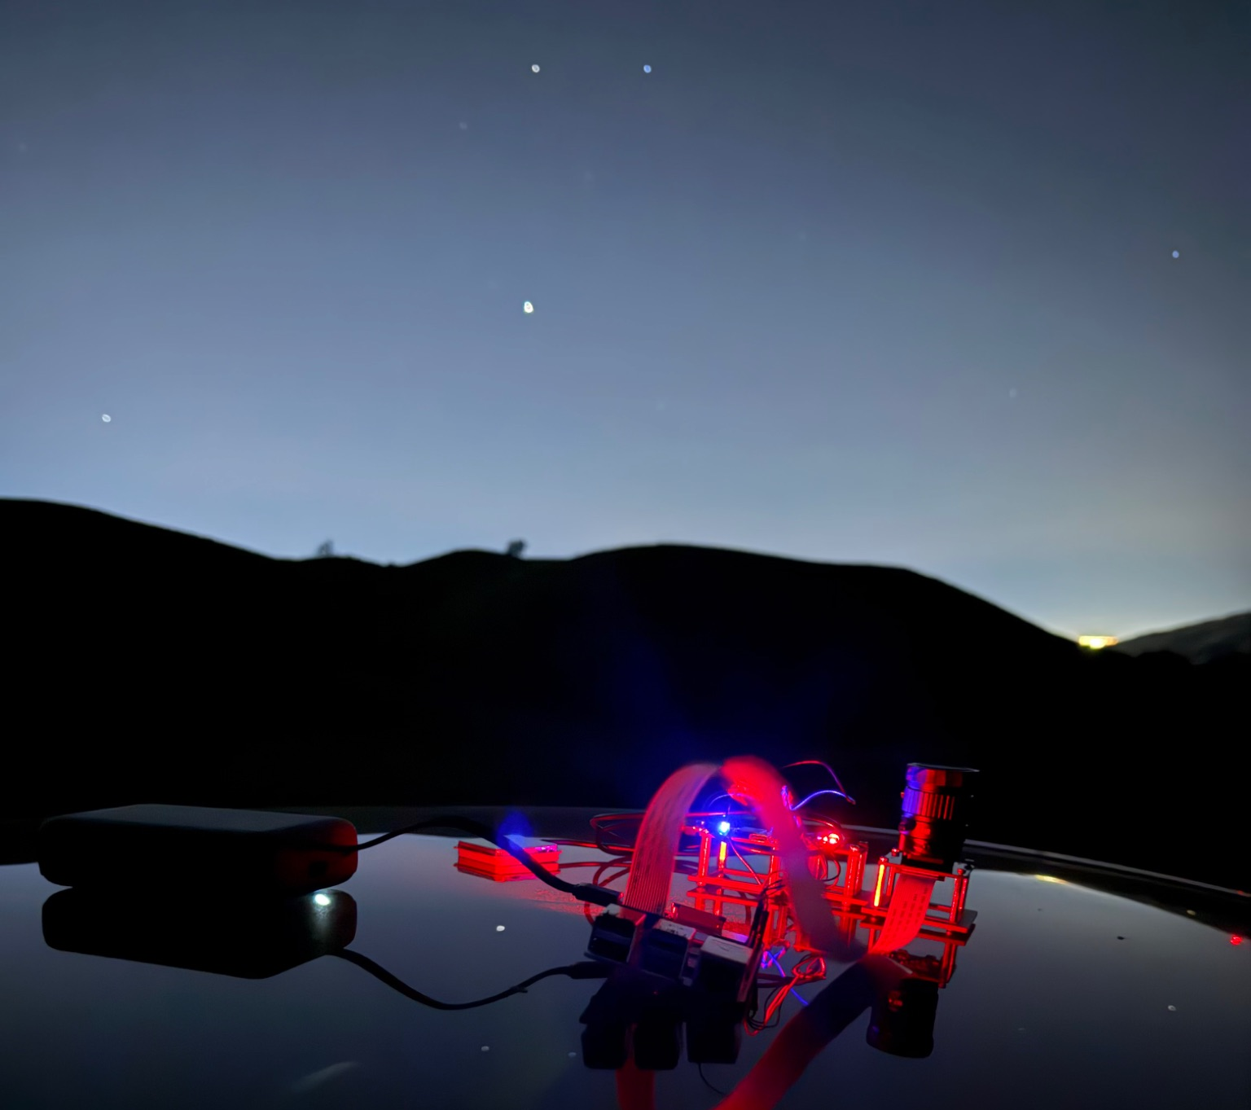
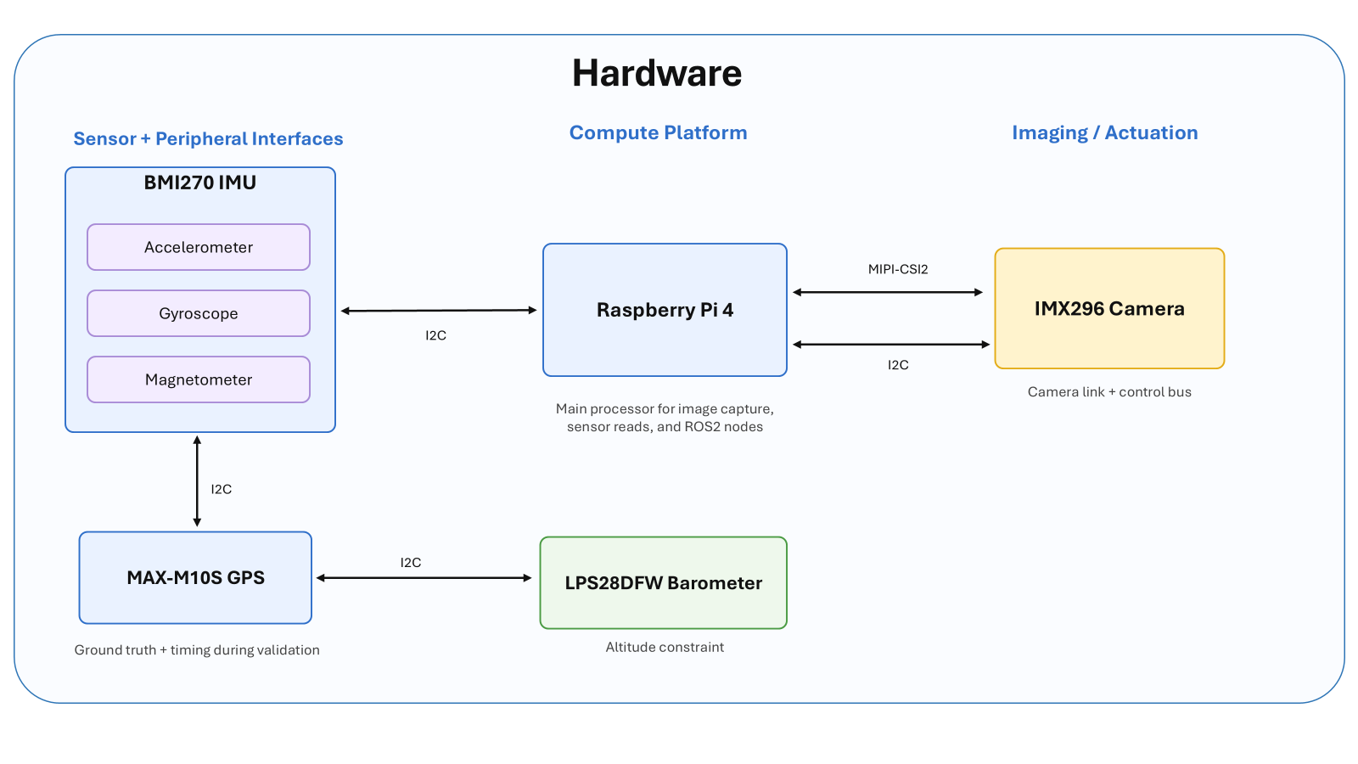
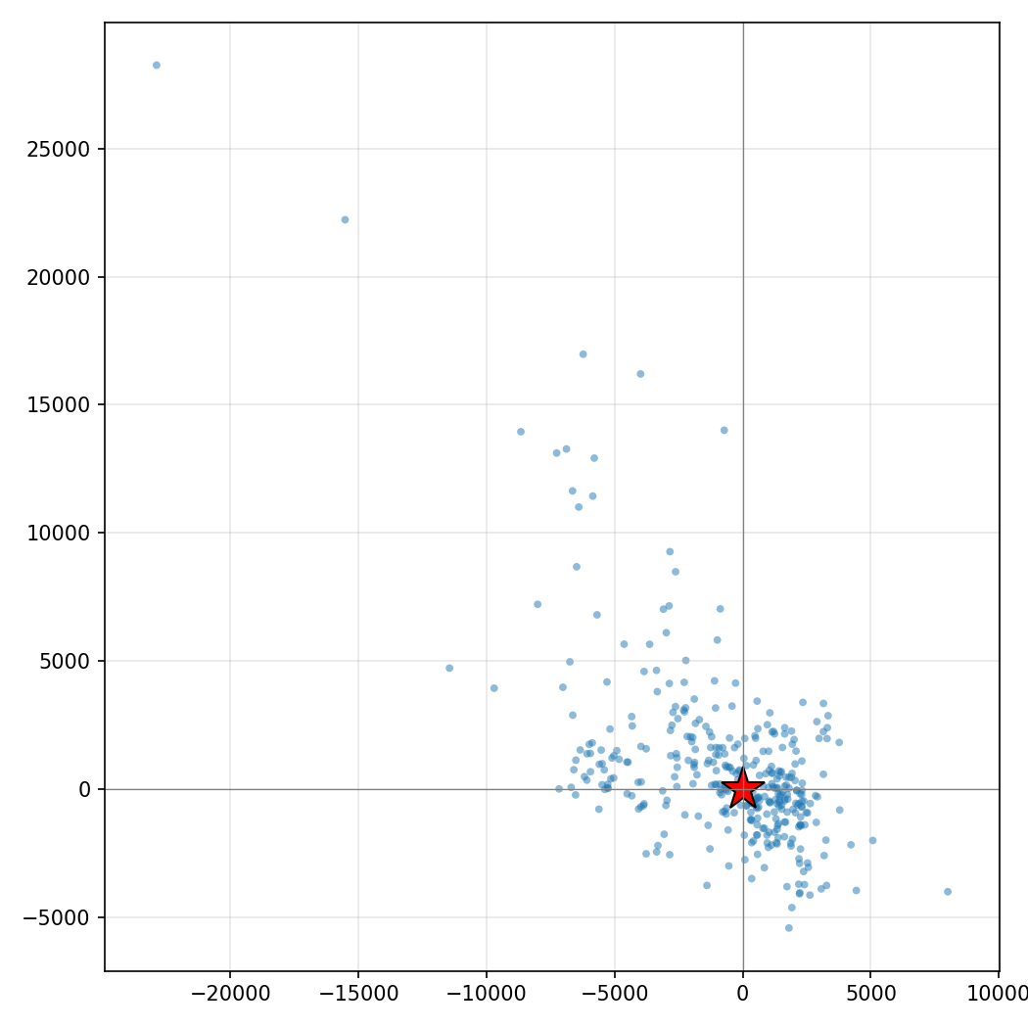
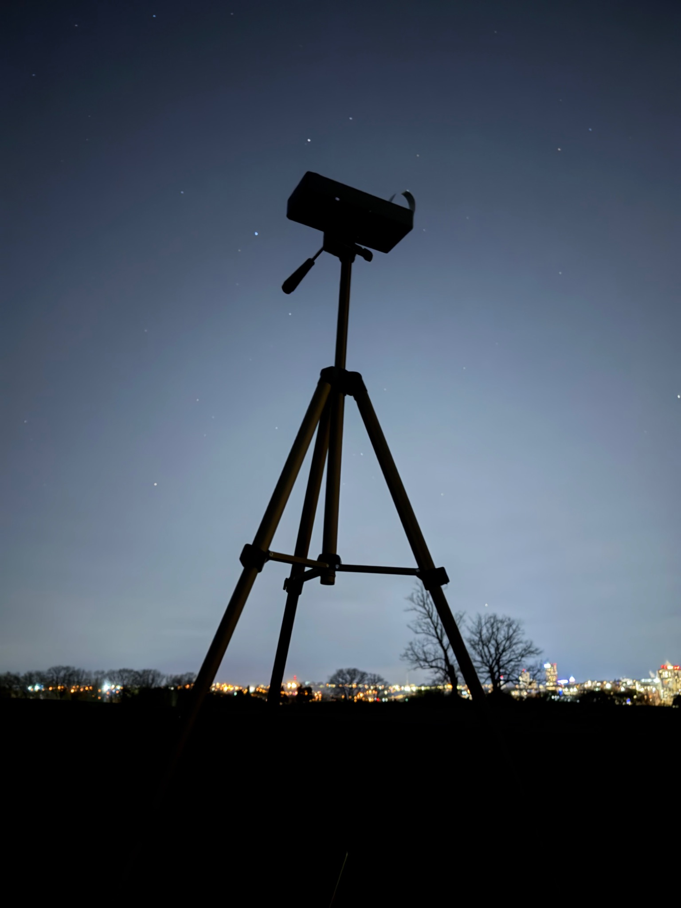
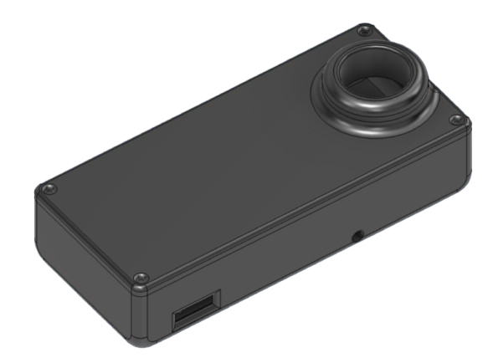
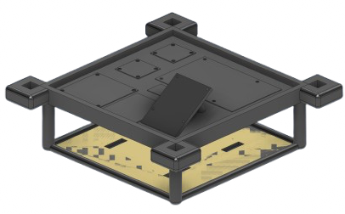
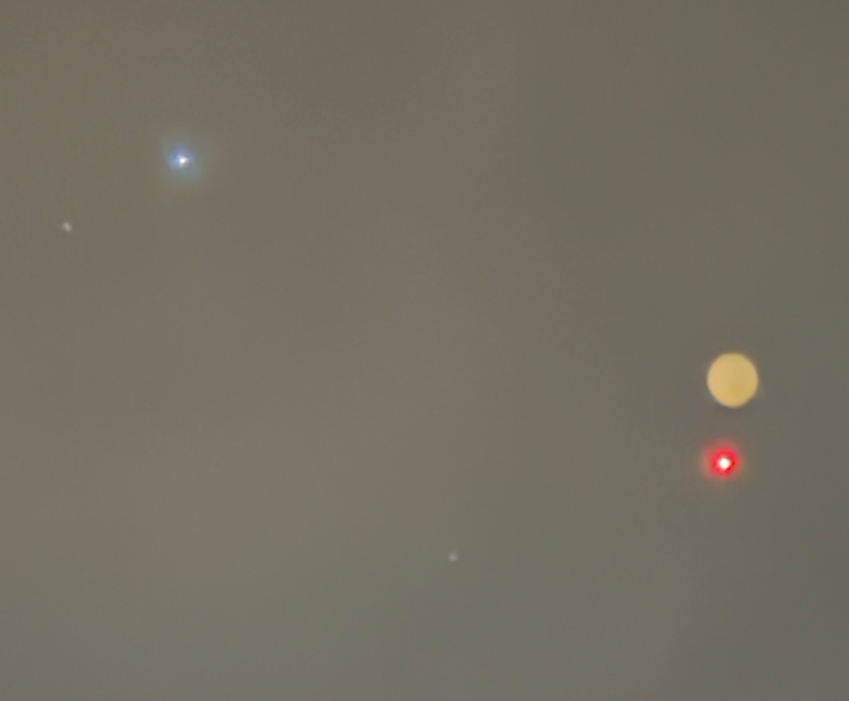
Low-Cost Strapdown Stellar-Inertial
Positioning for High-Altitude Platforms
Team B0: Julius Arolovitch, Rachel Lee, Eddie Zhang
18-500 Capstone Design, Spring 2026
Electrical and Computer Engineering Department
Carnegie Mellon University
Product Pitch
System Description
GNSS-denied UAV navigation has matured rapidly, but most proven techniques degrade or fail at night: visual odometry loses features, terrain matching needs daylight imagery, and pure inertial navigation drifts unboundedly. Celestial positioning has guided high-altitude and spaceborne platforms since the first star tracker in 1959, but legacy systems rely on gimbaled optics too heavy and expensive for small UAVs.
We present a low-cost, strapdown stellar-inertial positioning module that fuses intermittent star fixes with IMU propagation to deliver <3km positioning, an improvement over prior work, at under 300g and $300 improving nighttime GNSS-denied navigation to long-endurance fixed-wing and balloon platforms previously priced out of celestial navigation.
Max-M10S GNSS
IMX296 Camera
IMX296 Camera
GNSS Antenna
Raspberry Pi 4
LPS28DFW Barometer
BMI270 IMU
System Architecture
System Evaluation
Stellar-inertial and dead reckoning trajectories against GPS course on moving vehicle test
 | IMU + Barometer | VIO + IMU + Barometer
Final Trajectory Error | 360.4m | 105m
Final Heading Error | 52.4° | 19.2°
Hardware Design
Static test on a tripod global positioning accuracy test in San Jose, CA
 | Median | p95 | Requirement
Static Global Positioning Error | 2.1km | 6.5km | 10km
Component | Requirement | Achieved
Power Draw | 5W | 2.23W
Per-Image Compute Latency | 1000ms | 3ms
Time Synchronization | 50ms | 500us
Calibration | 0.5px | 0.32px
On-drone enclosure
Balloon gondola
9ft-diameter weather balloon
System power efficiency, accuracy, compute latency verification

