Slide 1
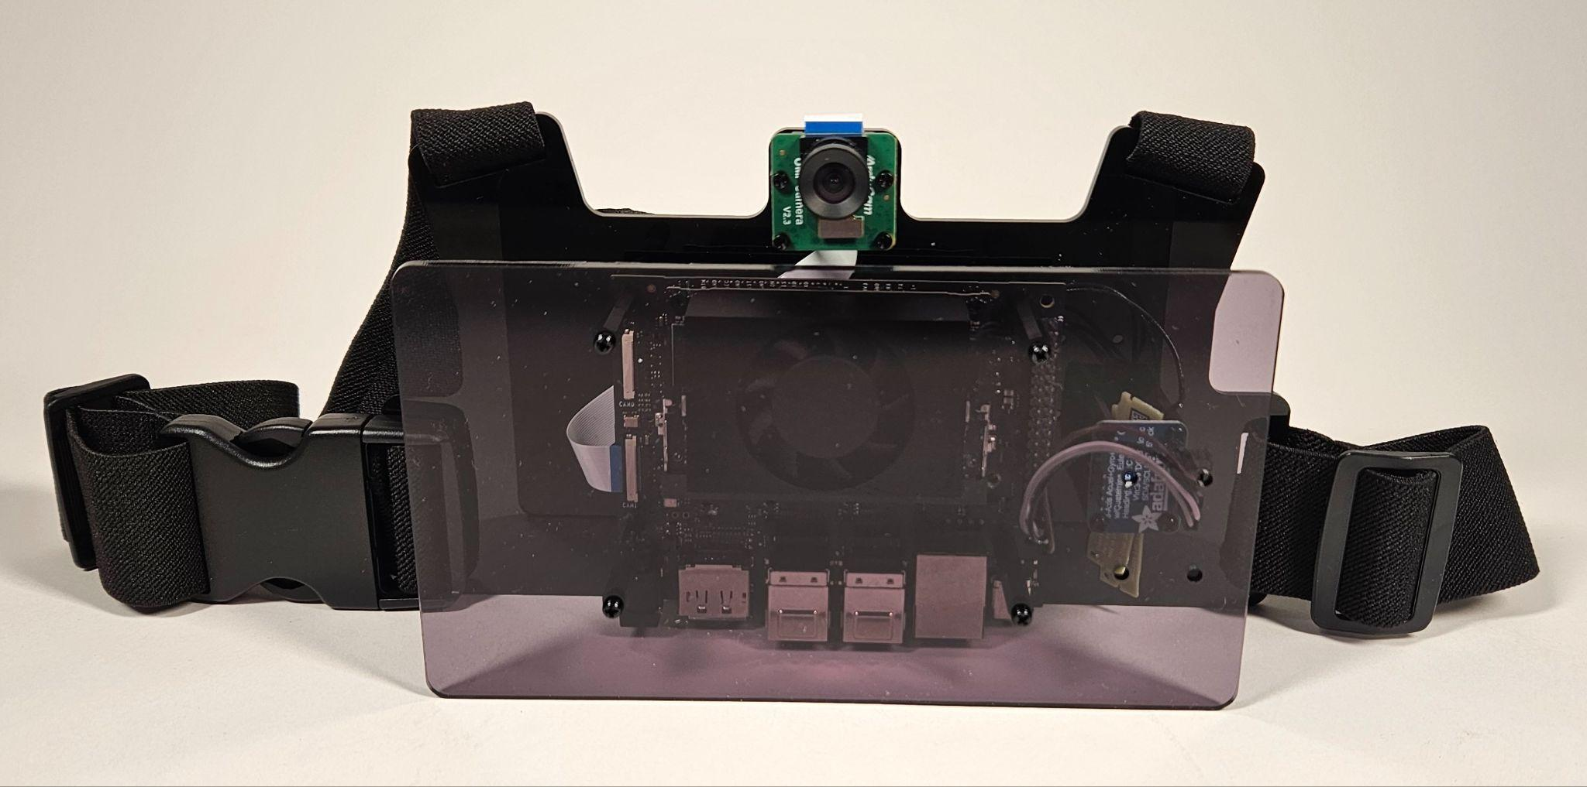
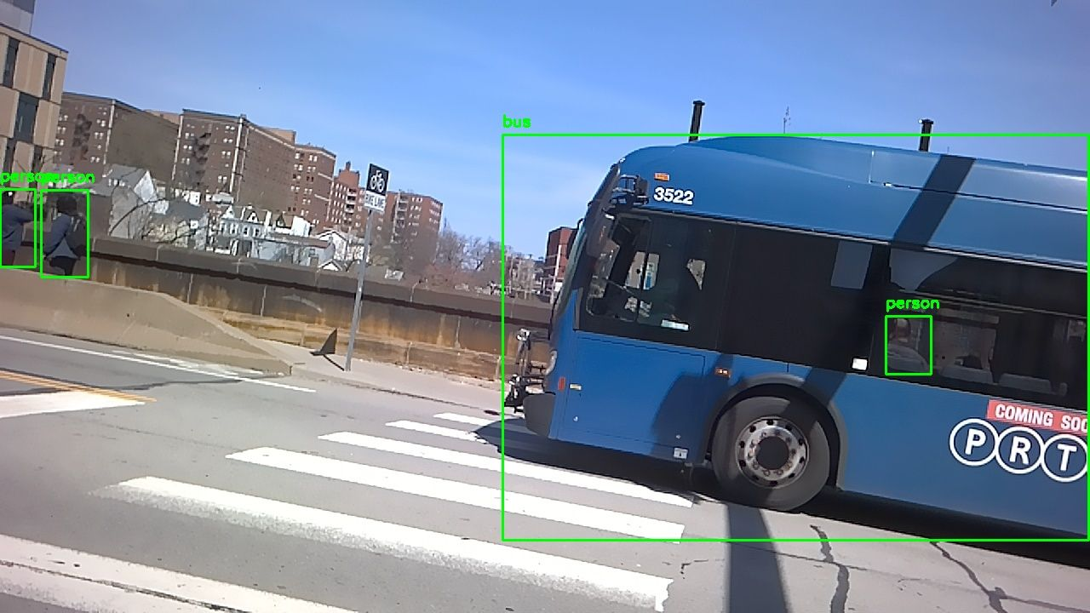
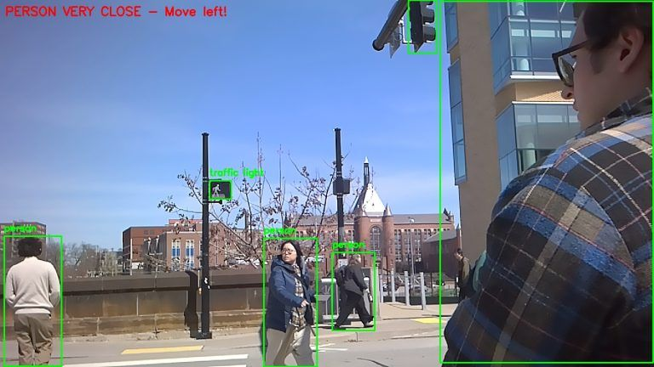
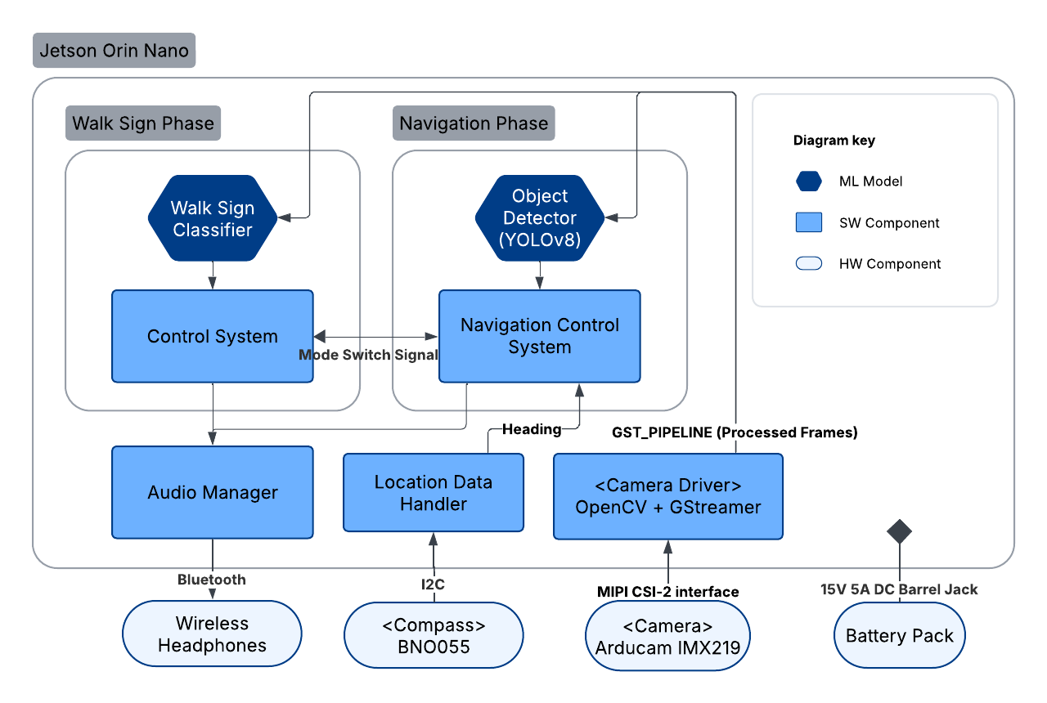
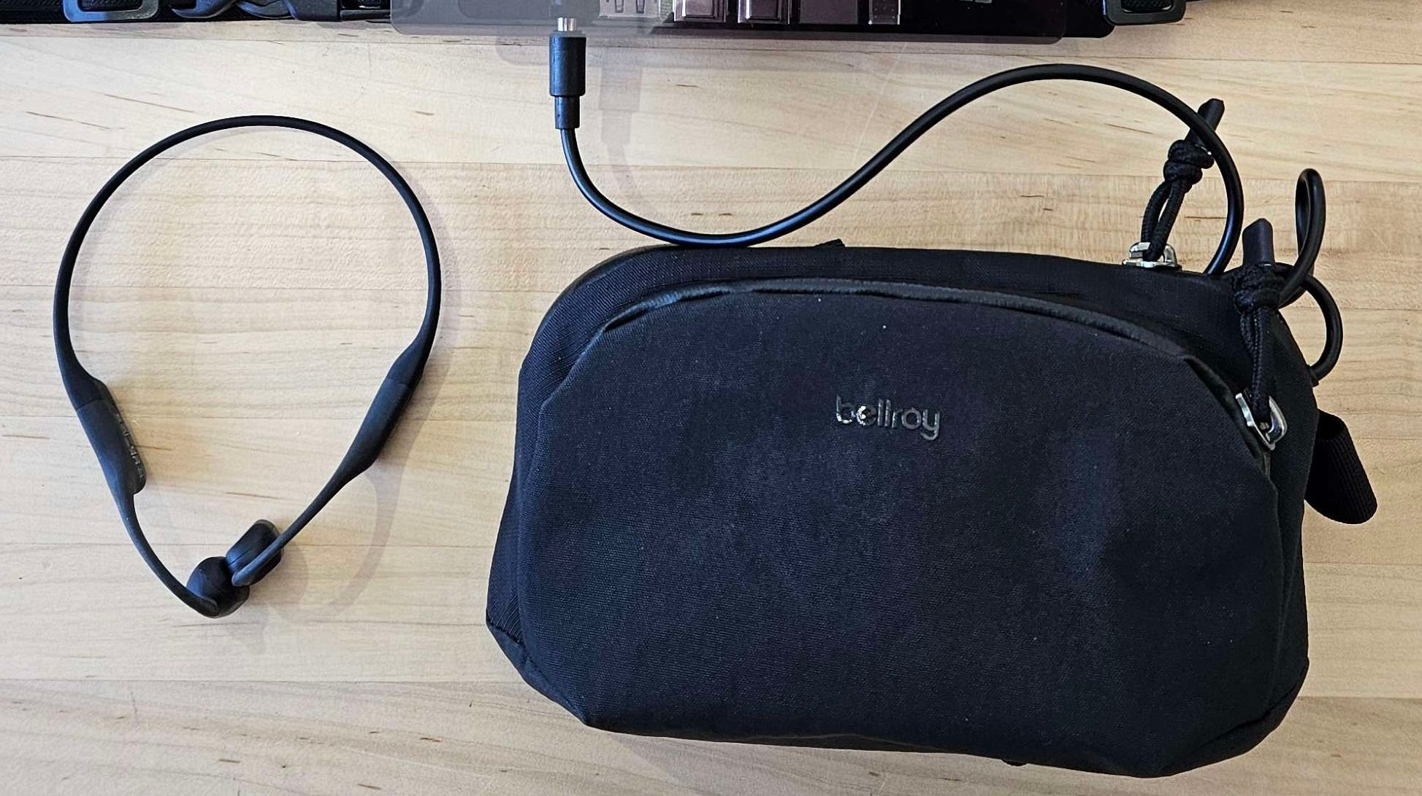
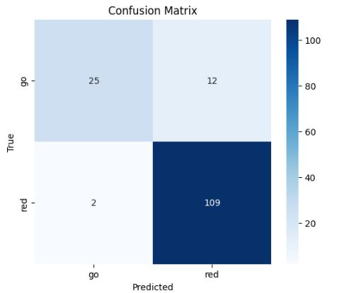
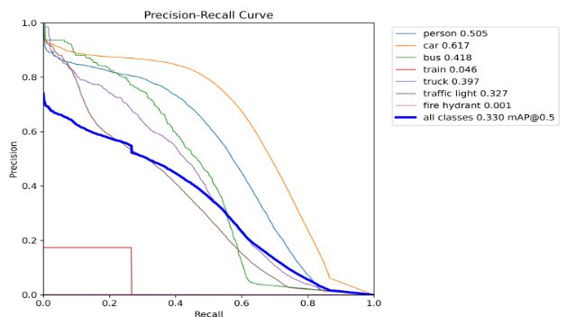
The Self Driving Human
Team D3: William Shaw, Max Tang, Andrew Wang
18-500 Capstone Design, Spring 2025
Electrical and Computer Engineering Department
Carnegie Mellon University
Product Pitch
System Description
Visually impaired pedestrians rely on aids like tactile paving, audible signals, and guiding strips to locate crosswalks, determine when it is safe to cross, and stay oriented while crossing. However, many intersections still lack this essential infrastructure. The Self-Driving Human offers a solution: a chest harness equipped with cameras, sensors, and computer vision models that help users identify safe crossing times and navigate around obstacles within the crosswalk.
To ensure user safety, the Self-Driving Human meets certain design requirements such as a 98% walk sign and obstacle detection accuracy, less than 150ms latency, and an 11hr battery life.
The Self-Driving Human uses a Jetson Orin Nano microcontroller, Bluetooth bone-conducting earphones, an external battery, and an IMU sensor. A ResNet50 image classification model and a YOLOv12 object detection model run on the Ampere GPU on board.
Camera
Adjustable Straps
Side release buckle
WiFi & BT Antenna
Jetson Orin Nano
IMU Sensor
System Architecture
USB-C to DC Converter
Bluetooth Bone-Conducting Headphones
Battery Bank
Fig 2 and 3. System Diagram - Harness, Headphone, and Battery Pack
System Evaluation
Fig 1: Flowchart Diagram of Our System
The camera feeds images into our software component, which starts in the walk sign image classification phase. When a “WALK” signal is detected, the system passes control to the object detection and navigation subsystem, where audio feedback is relayed back to the user via the wireless headphones. The IMU sensor simultaneously detects the user’s heading and helps provide audio feedback to keep them within the crosswalk.
Fig 4. Confusion Matrix for Walk Sign Classification, evaluated on test data collected around CMU
Fig 5. Precision-Recall Curve for YOLO Object Detection Model, evaluated across all relevant classes on a held out test dataset around CMU
Conclusions & Additional Information
Use Case Requirements:
Overall, we were able to meet most of our design requirements and integrate all submodules into one complete system. One lesson we learned was to begin the complete integration process earlier, as submodules that work independently may not alway work together.
Metric | Target | Actual
Classification AUROC on a Single Test Frame | ≥ 0.9 | 0.936
Classification Accuracy on Sequences of Test Frames | ≥ 95% | 98.2%
Model Inference Latency | ≤ 100 ms | Walk Sign: 33 ms Object Detection: 90 ms
Audio Latency | ≤ 500 ms | 100 ms
Veering Angle Detection | ≤ 20° | 80°
Battery Life | ≥ 6 hrs | 8 hrs
https://course.ece.cmu.edu/~ece500/projects/s25-teamd3/
Notes:
This is a text-only section to summarize the application area, use case, most critical requirement(s), and your product developed this semester. It is important to include some highlight test results (especially in relation to the use-case requirements).
This font is 36 point.
Use at least 24 point font, since it is relatively easy to read at a few feet from the poster. Smallest font is 18 point, which should be used sparingly since it will be quite difficult to read at a distance.

