Slide 1
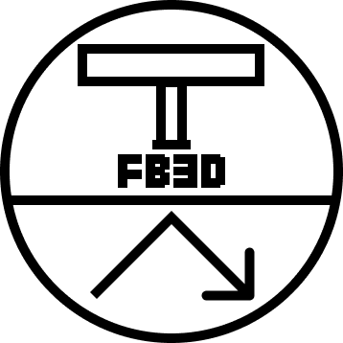
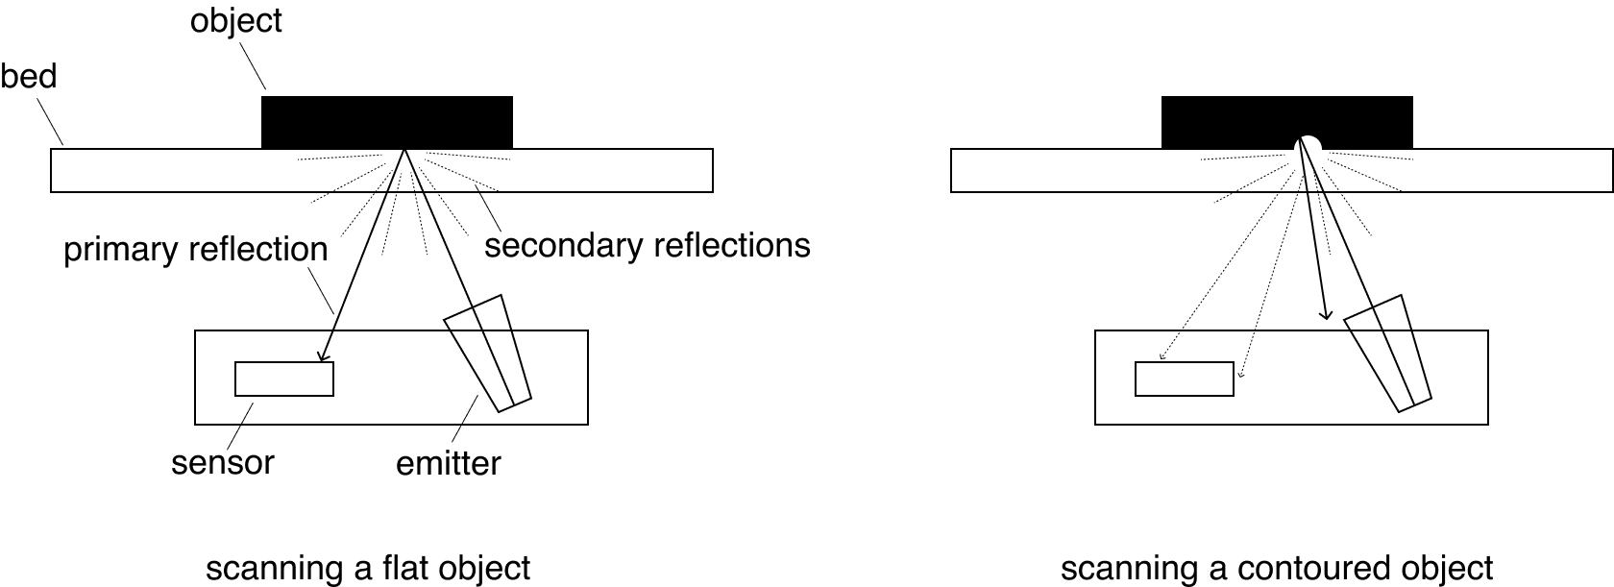
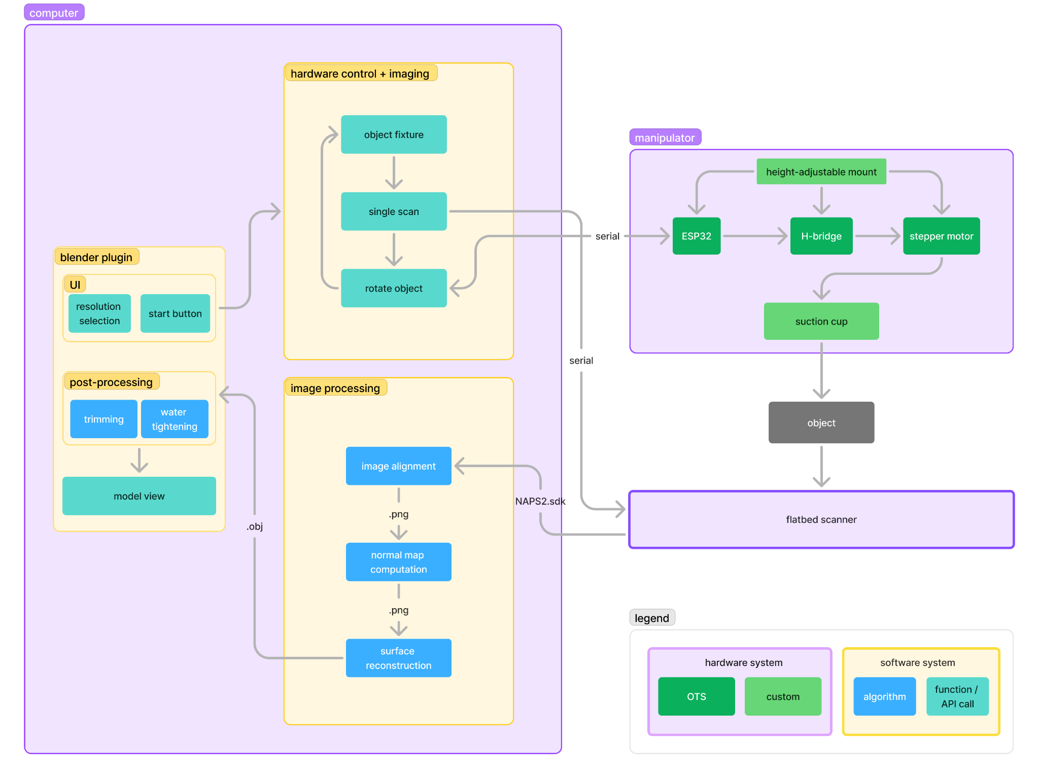
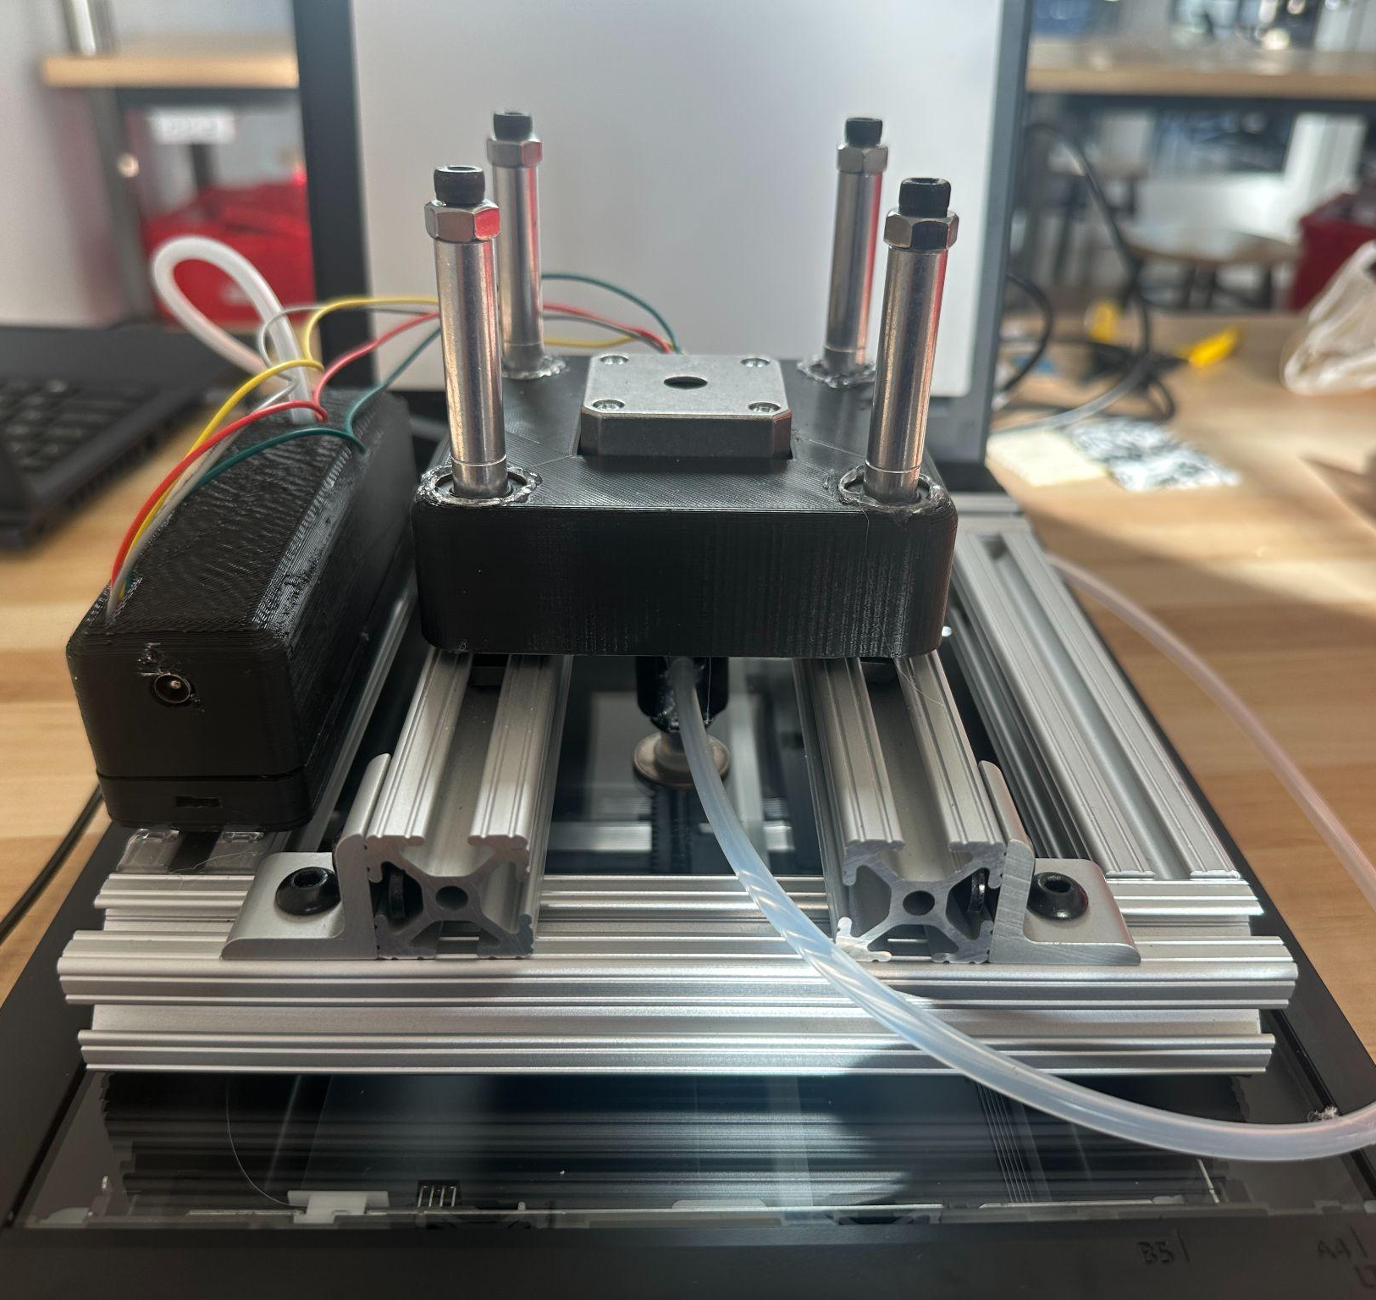
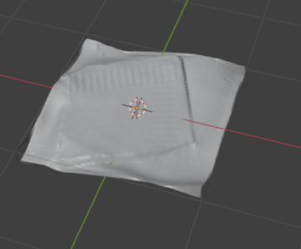
Flatbed 3D Scanning
A5: Yon Maor, Theo Cockrell, Sophia King
18-500 Capstone Design, Spring 2025
Electrical and Computer Engineering Department
Carnegie Mellon University
Product Pitch
System Description
3D scanning is a developing technology that already sees plenty of use in commercial quality control, art and history research, and hobbyist projects. Current state of the art falls short of an accessible price point and at scanning small features. This 3D scanning process utilizes off-the-shelf flatbed scanners with our open source hardware and software to perform a photometric-stereo-based scanning approach. This offers a less expensive, detail-focused alternative to existing 3D scanning solutions. Initial tests show very high quality scans at a variety of different resolutions, and within an acceptable scan time.
[flatbed scanning physics]
Our custom hardware uses an ESP32 to control a stepper motor and suction cup that precisely rotate the object 4 times. At each rotation, a scan is taken. The four scans are aligned and used to compute a normal map, which is then used to generate a height map. This height map is then automatically imported into Blender.
System Architecture
[system diagram]
[The Manipulator on a Scanner]
Electronics Housing, 12V Power port, Micro-USB port
Linear bearings and spacers slide to accommodate larger objects
Suction cup holds object, activates for rotations
System Evaluation
We had planned on evaluating the scanner using 3D object similarity metrics, but were unable to follow through due to several technical challenges. Instead, we evaluate the scans by inspection.
[An Object and its Scanned Model]
Conclusions & Additional Information
The system implementation is similar to our initial ideation. It is low-budget, relatively easy to set up, fully automated, generates small detailed 3D scans, fast, and has three distinct subsystems of hardware, software control, and signal processing.
Due to technical difficulties, we were unable to generate scans until later than expected and so couldn’t do official metrics of our scanner compared to available commercial 3D scanners. Creating tasks that are modular and do not depend on other subsystems being completed was a valuable lesson, as we bottlenecked the rest of our feature development while trying to get the scan generation working.
Features that could be implemented to extend our project would be automatic post-processing of the model (trimming extra space and watertight the model), allowing variable number of scans, and quantifying our scans’ quality with metrics comparing the models from different scanners.
Use-Case Requirements:
Metric | Target | Actual
Scan Time | ≤ 5 minutes | ≤ 2 minutes
Scan Area | 6in. x 6in. | 6in. diameter
https://course.ece.cmu.edu/~ece500/projects/s25-teama5/

