Slide 1
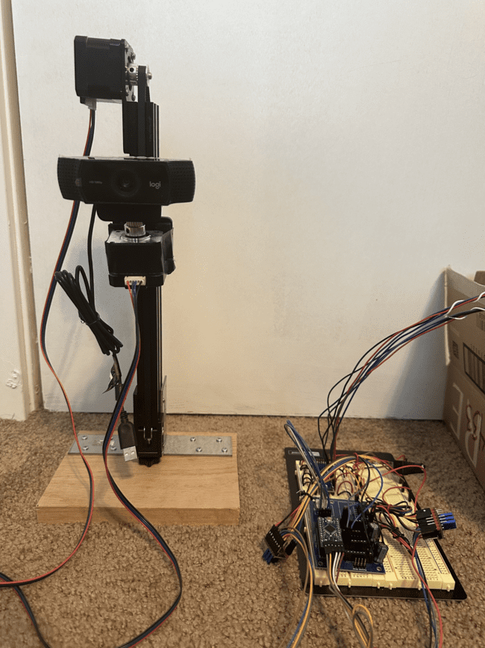
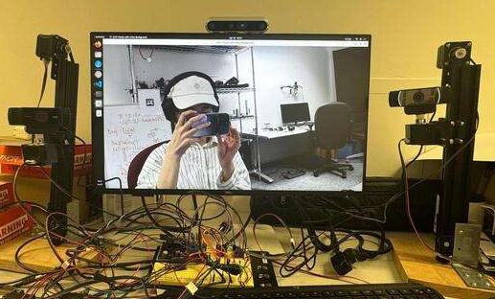
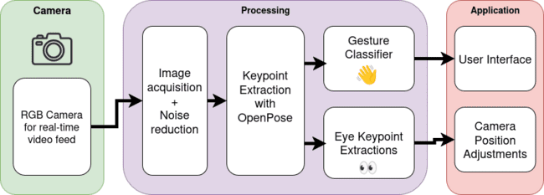
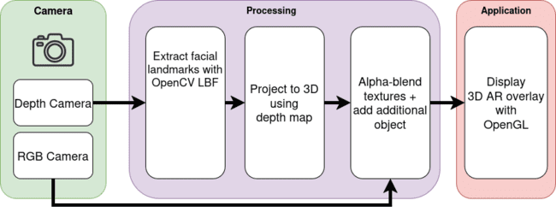
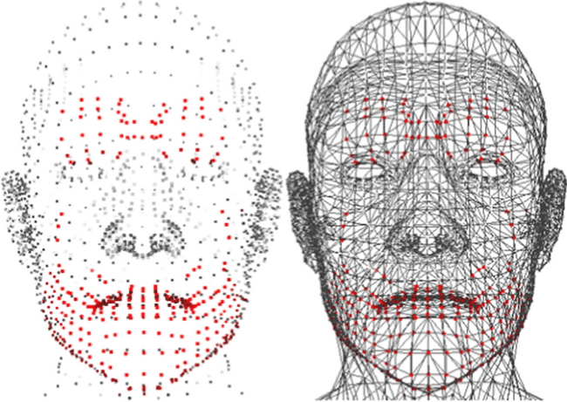
UsAR Mirror
Team A4: Steven Lee, Anna Paek, Shengxi Wu
18-500 Capstone Design, Spring 2025
Electrical and Computer Engineering Department
Carnegie Mellon University
https://course.ece.cmu.edu/~ece500/projects/s25-teama4/
Product Pitch
System Description
Augmented reality mirrors are transforming retail by enabling customers to virtually try on accessories, driving engagement and foot traffic—while operating 24/7 without traditional fitting rooms. Yet today’s solutions suffer from alignment errors and slow rendering, plus steep hardware and maintenance costs. Our more affordable, high-performance AR mirror overcomes these barriers by combining off-the-shelf components (cameras, displays, and consumer-grade compute) for multi-viewpoint immersion; real-time rendering on specialized GPU hardware; a library of AR filters; paired with an intuitive gesture-based UI.
Our solution achieves a real-time rendering frame rate of 160 FPS, end-to-end input latency of 55 ms, input recognition accuracy of 95%, and a range of view of 90 degrees.
Stepper motor for linear motion
Stepper motor for rotation
Built-in tilting feature from webcam
Arduino & user inputs for camera control
System Architecture
UI + AR Overlay
Figure 4: Camera Hardware Rig
Depth + RGB Camera
Camera Modules
Output
Webcams
Realsense
Monitor
Display
Depth Camera
Central Controller
RGB Camera
Laptop
Camera Slider System
(1 for each webcam)
3D Reconstruction + Rendering Module
User Interface
Camera Pan Actuator
Motor Driver Module
Vertical Actuator
Gesture Recognition + Eye Tracking Module
Local Storage Module
Figure 1: Overall System Architecture
Multi-viewpoint RGB Cameras
Figure 5: Full Hardware + Software Setup
System Evaluation
Use-Case Requirements:
Metric | Target | Actual
Gesture input latency | ≤ 200 ms | 55 ms
Gesture input accuracy | ≥ 90% correct | 95% correct
AR filter rendering framerate | ≥ 15 FPS | 160 FPS
AR filter drift range | ≤ 5 px | 3-5 px
Face model generation latency | ≤ 50 ms | 20 ms
Head pose estimation error | ≤ 5 px | 10-15 px
Head pose estimation latency | ≤ 150 ms | 2 ms
Camera control precision (rotation) | ≤ 5 deg/step | 3.7 deg/step
Camera control precision (translate) | ≤ 0.05 in/step | 0.031 in/step
Camera control range (rotation) | ≥ 90 deg | 180 deg
Camera control range (translate) | ≈ 11.8 in | 10-11 in
Figure 2: Gesture Recognition Pipeline
Trade-offs:
Gesture algorithm:
Position-based inputs (hand location on screen) vs. Velocity-based inputs (velocity of hand).
Chose position-based inputs, for superior accuracy, robustness, and ease of use in a UI.
Camera control system:
Speed (faster motor) vs. Precision (better accuracy).
Chose precision, for superior accuracy, reliability of operation, lower power consumption.
AR overlay detection backend:
dlib vs. OpenCV DNN + LBF vs. MediaPipe Face Mesh.
Chose OpenCV DNN for balance of ease of integration and face model latency/robustness.
Figure 3: AR Overlay Pipeline
Conclusions & Additional Information
Overall, the UsAR Mirror realized our vision of a cost-effective, multi-view AR system—achieving sub-second 3D reconstruction, smooth overlay rendering, and robust gesture control. Working as a team taught us to test all components together early, keep each part’s interfaces clear, and check performance across the whole setup. In the future, others could add smarter face-and-motion tracking, split heavy processing between device and cloud, support multiple users at once, and bake in on-device privacy safeguards to make this mirror even more useful for retail, video calls, or personal use.

