Slide 1
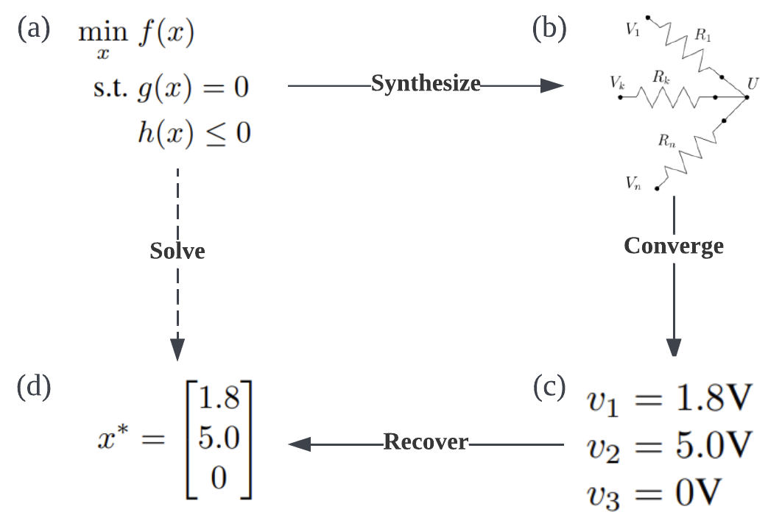
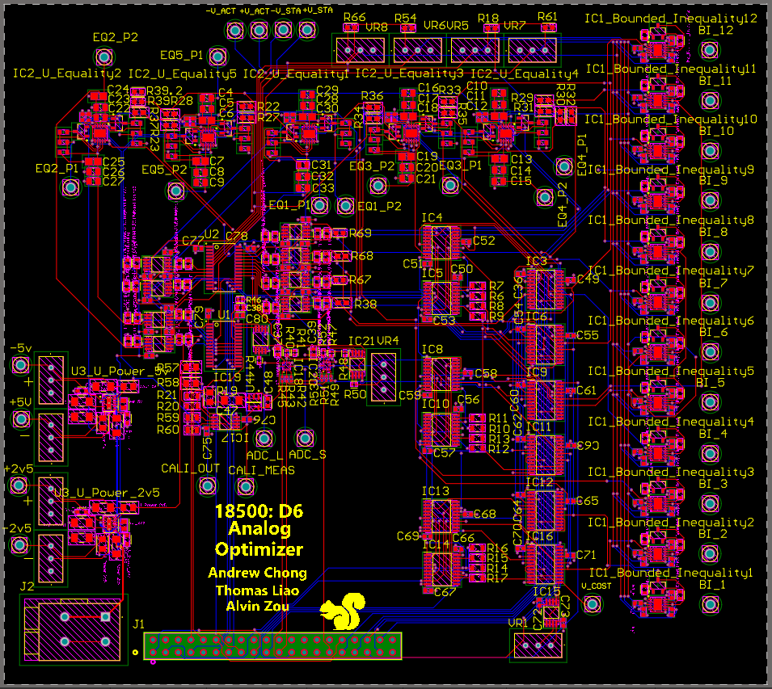
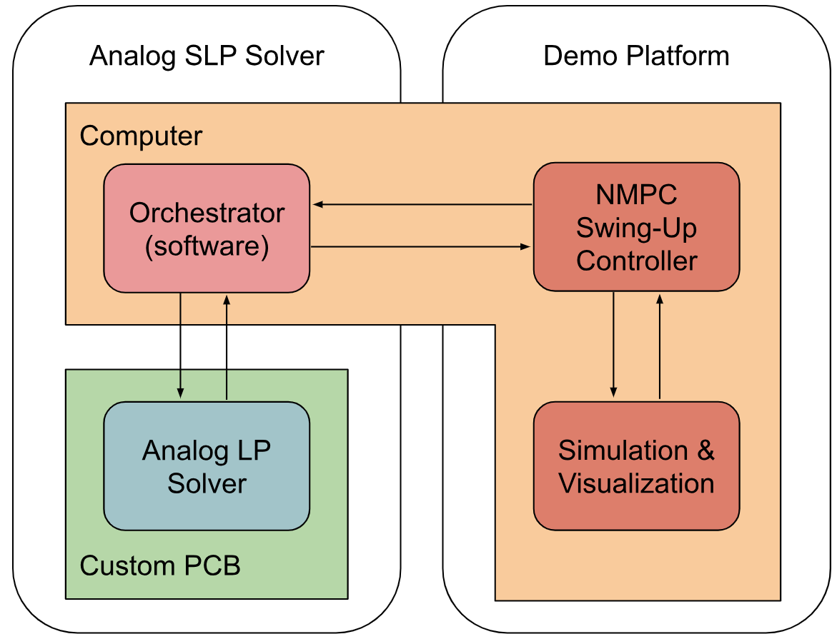
Analog Sequential Linear Programming Solver
D6: Andrew Chong*, Thomas Liao*, Alvin Zou*
18-500 Capstone Design, Spring 2024
Electrical and Computer Engineering Department
Carnegie Mellon University
Product Pitch
System Description
Our design is an analog computer that implements the Sequential Linear Programming (SLP) algorithm, which solves continuous Nonlinear Programming (NLP) problems. We aim to solve these problems faster and more efficiently than current digital solutions.
We demonstrate that our design can solve Nonlinear Model Predictive Control (NMPC) problems, which is a class of NLP problems. In particular, our analog computer swings up a damped inverted pendulum with optimal cost by solving a sequence of NMPC problems.
Our analog computer solves LPs by acting as the physical analogue of the mathematical problem. Instead of solving the LP arithmetically, we configure the analog circuit such that its steady state corresponds to the LP’s solution.
System Architecture
Our system features a heterogeneous architecture that consists of a digital computer and an analog computer. The NMPC problem is first converted to a form solvable by SLP on the digital computer, which then invokes the analog computer to solve Linear Programming (LP) subproblems repeatedly. For each subproblem, the digital computer configures the analog computer accordingly and measures its state to recover the solution. This is repeated until the NMPC problem is solved.
Figure 2. Procedure of solving optimization problems with the analog computer
Equality Constraint
Power
Cost &
Solution
Recovery
Calibration
Inequality
Constraint
Figure 3. PCB layout of the analog computer
System Evaluation
For our analog circuit, we verified that the results produced by the simulation matched the results produced by the digital solver. We also verified that it could solve LPs 47.02% faster.
Figure 1. High-level system architecture
Conclusions & Additional Information
Our results demonstrate that an analog SLP solver can outperform its digital counterpart, highlighting the potential of analog computers in mathematical optimization. This design can be extended to implement Sequential Quadratic Programming (SQP) for better convergence and robustness.
Lessons Learned:
Verify previous work done by others before expanding it.
Decouple the project and perform risk management.
Share responsibilities and work at a maintainable pace.
Table 1. Accuracy of the solution produced by the simulated analog computer
With our software, we verified that the SLP solver can correctly solve the stated problem. We also
verified its accuracy by comparing
it against a reference solver.
* Equal contribution, listed in alphabetical order

