Slide 1
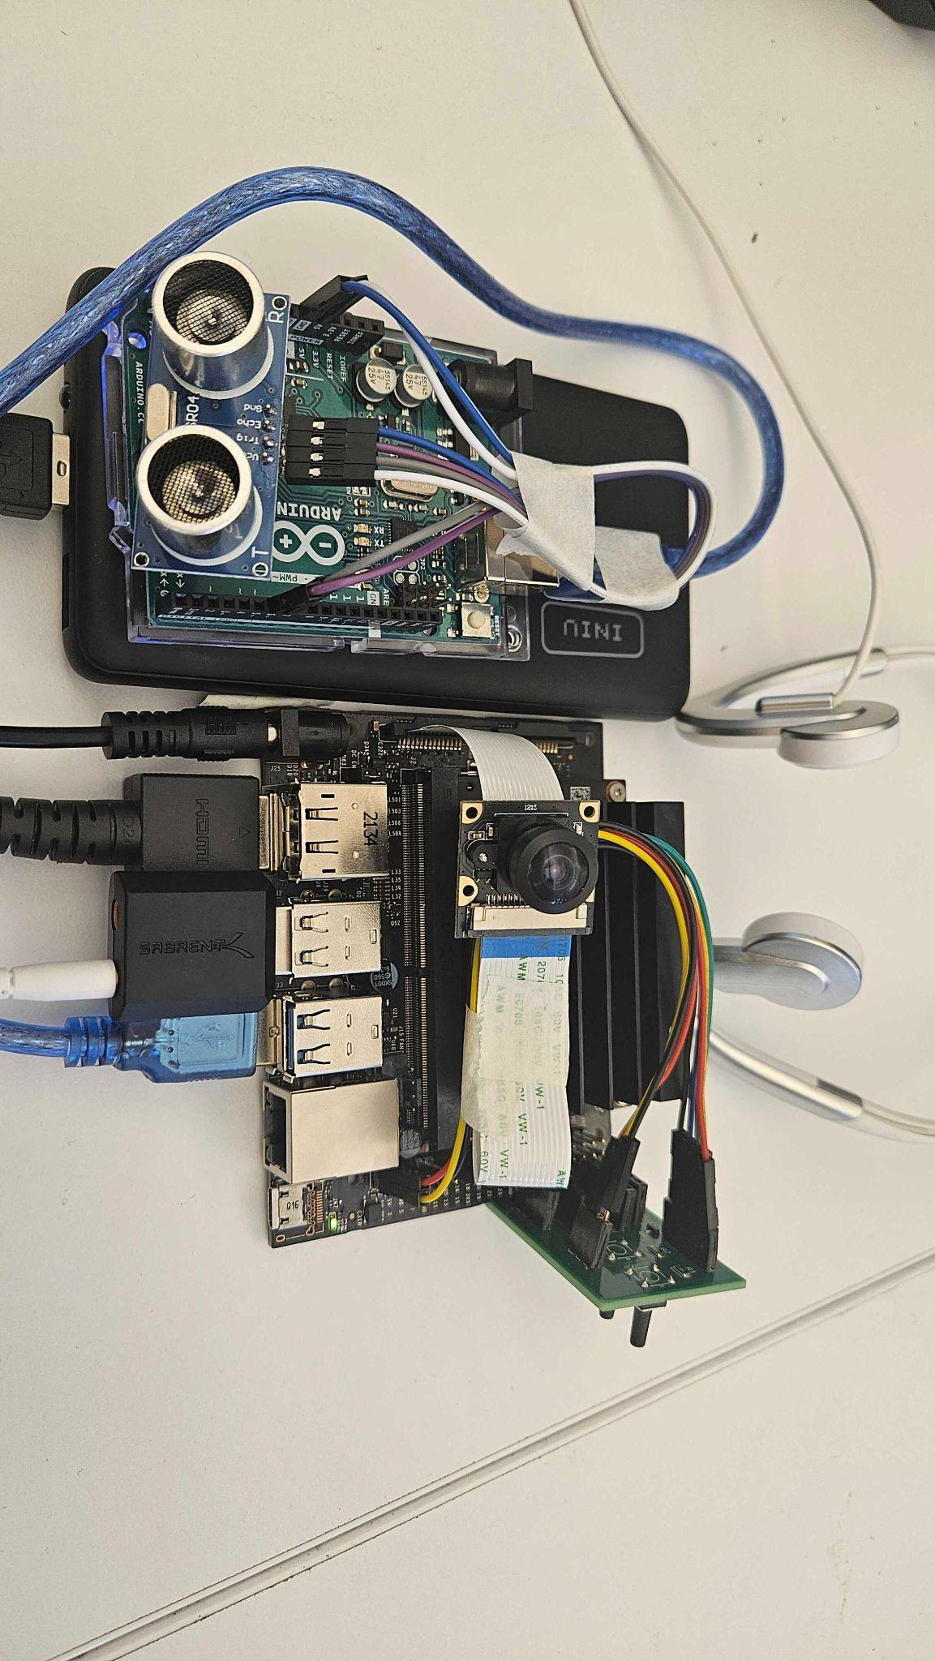
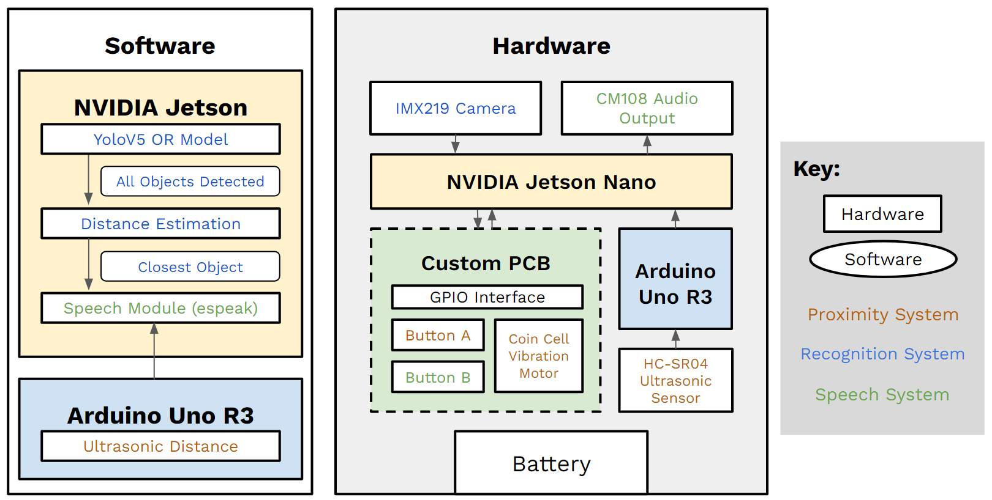
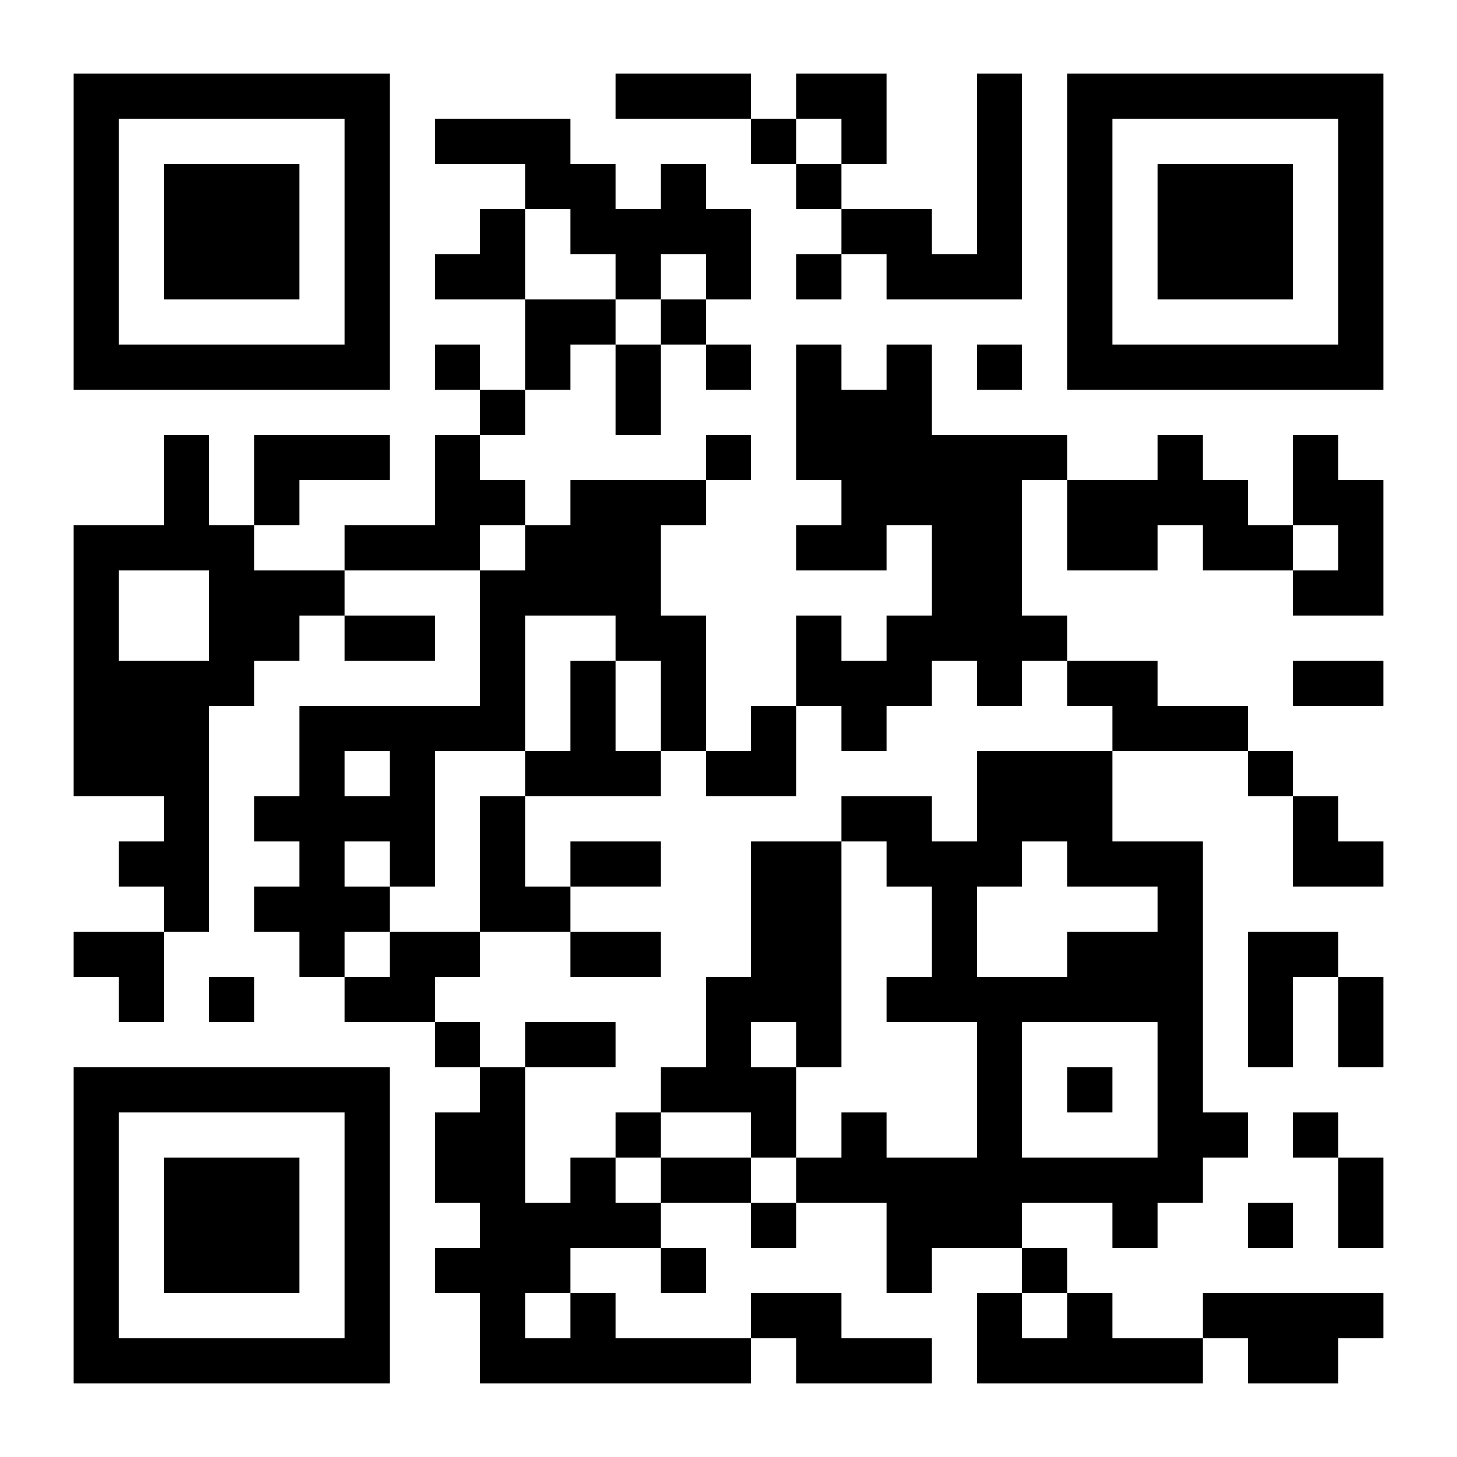
SightMate
D2: Meera Pandya, Josh Joung, Shakthi Angou
18-500 Capstone Design, Spring 2024
Electrical and Computer Engineering Department
Carnegie Mellon University
Product Pitch
System Description
The goal is to provide users with an automated wearable navigation device that will alert the user of obstacles in their vicinity and identify obstacles. The detection will primarily focus on common indoor objects to provide visually impaired people the ability to explore unknown indoor spaces without the need of guide dogs. This device is aimed to be used alongside tactile aids such as walking canes.
Our use case requirements, derived from research and interviews with LAMP volunteers, include accuracy (>70%), weight (<450g), detection range (>2m), recognition delay (<2.5s), and battery life (>4h). The device successfully meets all requirements with 95% accuracy, 426g of weight, up to 4m detection distance, 1.88s recognition delay, 4.86 hours for 60% of battery life, and user-certified practicality in a noisy environment.
The system integrates object recognition (OR), speech, and proximity modules, utilizing the NVIDIA Jetson Nano as the CPU. Hardware components, including a camera and bone-conducting headphones, connect to the Jetson via custom PCBs and GPIO pins, facilitating efficient data exchange and voltage regulation. Concurrency is achieved through Python multithreading, allowing the OR model to run alongside an Arduino-based distance detection using an US. The DE module leverages Pandas to extract the box width of detected objects from the OR model. By comparing this data with pre-collected reference measurements, it estimates the distance of the objects and identifies the closest one. The speech module incorporates the pyttsx3 speech engine, providing versatile text-to-speech capabilities through bone-conducting headphones that allow the user to stay in tune with their surroundings. This setup minimizes data latency and enables real-time interaction by processing sensory inputs in parallel.
System Architecture
Battery
Bone Conducting Headphones
Arduino Uno
Ultrasonic
Sensor
Control Buttons
Jetson Nano
Camera
System Evaluation
The device is divided into three subsystems: the proximity system, the recognition system, and the speech system. The proximity system will detect obstacles in the user’s path using an ultrasonic sensor (US), and will notify the user using a vibration motor which will be toggled on and off using button A. The recognition system will use a camera module sending a frame to the OR model, which will identify the closest obstacle among all obstacles detected using the distance estimation (DE) module. Lastly, the speech system will take the OR model’s output and convert it into speech output if the user chooses to identify the object using control button B.
As the first step of the evaluation, the unit testing has been conducted for an individual module. After achieving respective success, the integrated modules on the Jetson Nano has been tested for the usability and functionality.
A tradeoff of using a pre-trained model instead of a trained model with our own indoor object dataset is that although it has a limited number of indoor objects to detect, it has a much greater accuracy.
A tradeoff of using an arduino and US instead of the DE module is that although it adds 25g to the weight and increase the battery usage, it has far less uncertainty. Regardless, the weight and battery all meet the requirements.
Testing Metrics and Results
Testing | Metrics | Result
OR Model | > 70% on identifying the closest object | 95% (38/40 images, 5 objects)
Proximity Module (Arduino & US) | accurately detect objects within 2m with ± 30 cm uncertainty | Within ± 1 cm of actual object distance 2 - 400 cm range
Speech Module | user testing for surrounding sounds | 100% (20 trials for person, couch, chair, cat, cellphone)
Vibration Module | > 95% accuracy on vibration | 100% (20/20 on person, 20/20 on nothing)
Device Controls (buttons) | 100% accuracy on controls | 100% (20/20 on button A, 20/20 on button B)
Module Integration (weight) | < 450g on the overall product weight | 217g (device) + 209g (battery) = 426g < 450g
Battery Life | > 4 hours of running | 4.86 hours for 60% battery, headless
Recognition Delay | < 2.5s recognition | 1.88s on average to recognize the object
Conclusions & Additional Info
Senior Capstone is a whole rounded experience that allowed us to explore multiple fields in ECE and apply our cumulative knowledge from previous courses to a real life application. We also got to learn new skills such as programming the NVIDIA Jetson Nano to use ML effectively, considering the use case requirements, discussing the ethics, and creating a schedule for the entire semester.
Trade-offs
Learn more about our project and the progression from ideation, to design, prototyping, and finally testing.
OR Model | Accuracy (%)
Pre-trained model | 84.4
Trained model | 36.2
Distance Measurement | Uncertainty (%)
Arduino & US | 0.06
DE Module | 21.5
Key Terms:
OR: Object Recognition
US: Ultrasonic Sensor
DE: Distance Estimation
Notes:
Product Pitch:
This is a text-only section to summarize the application area, use case, most critical requirement(s), and your product developed this semester. It is important to include some highlight test results (especially in relation to the use-case requirements).
This font is 36 point.
Use at least 24 point font, since it is relatively easy to read at a few feet from the poster. Smallest font is 18 point, which should be used sparingly since it will be quite difficult to read at a distance.
System Architecture
Include figure(s) that convey your system architecture along with an explanatory description. Please make sure this is an updated architecture, e.g. you can have 2 block diagrams, one for HW and one for SW. (or a state or flow diagram for SW if that is more descriptive).
System Description
Describe the technical aspects of your system, including the software and hardware components (e.g. relevant electrical and mechanical aspects)
In the pictures you include for your system, you MUST include labels that point to the critical subsystems.
(In general, it is highly recommended to include a picture of your product in this section!)
System Evaluation
Describe the approach to testing the system. Include graphs, tables, images of test results showing that you met the use case requirements.
Ideally show trade-offs that you reported in the Final Presentation.

