Slide 1
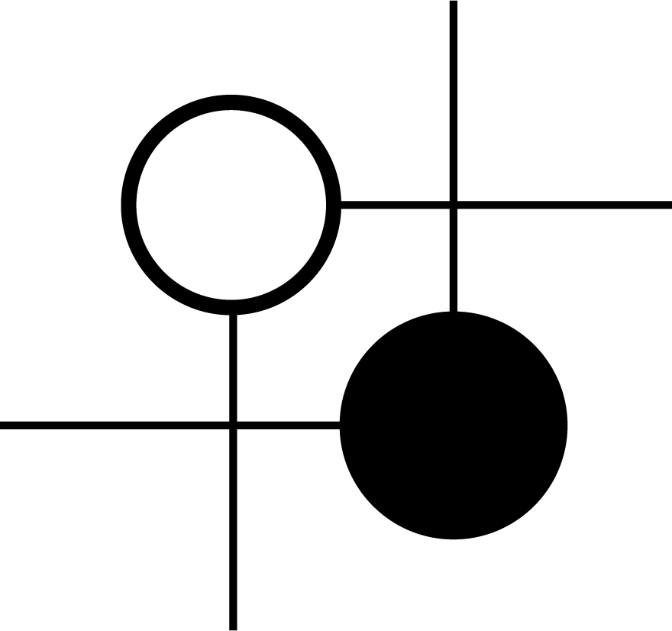
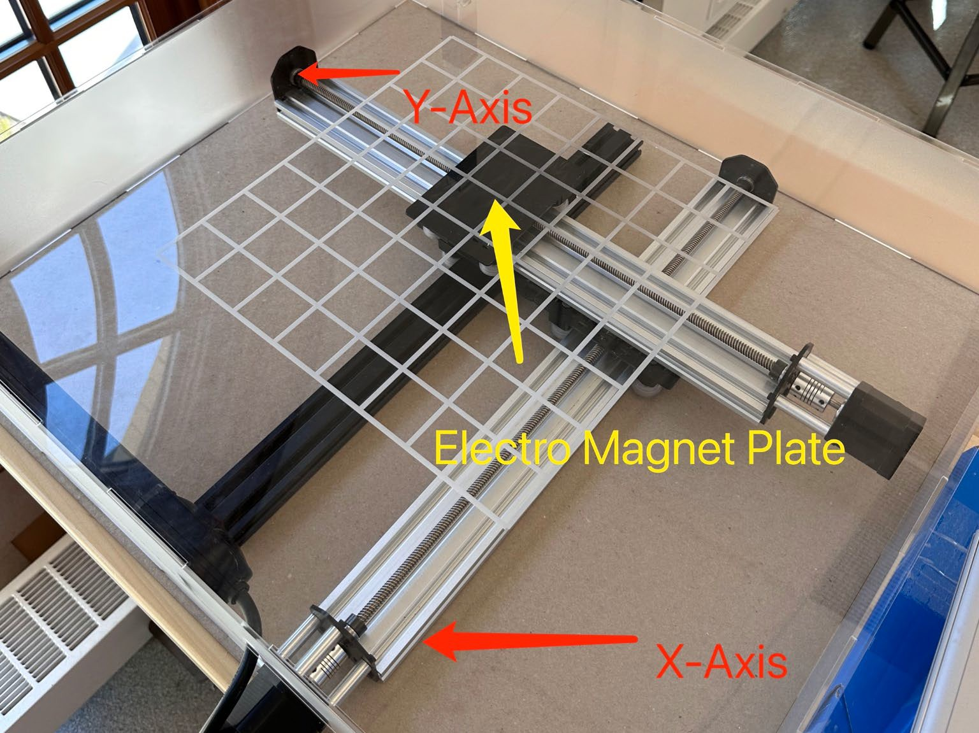
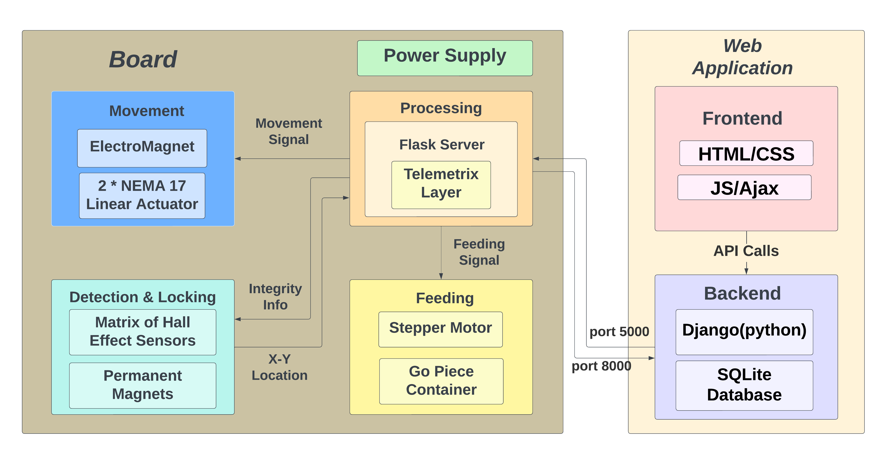
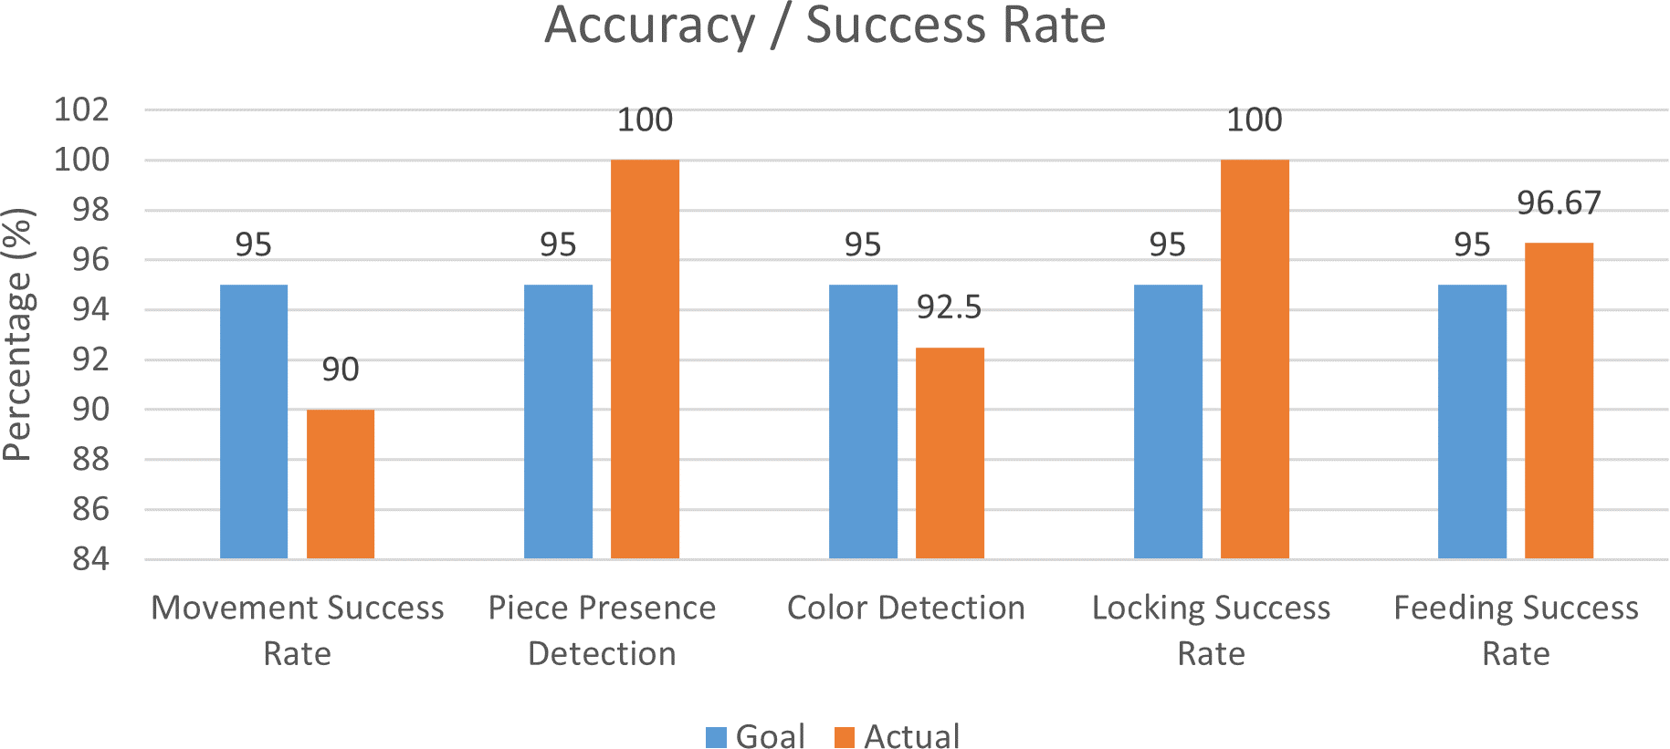
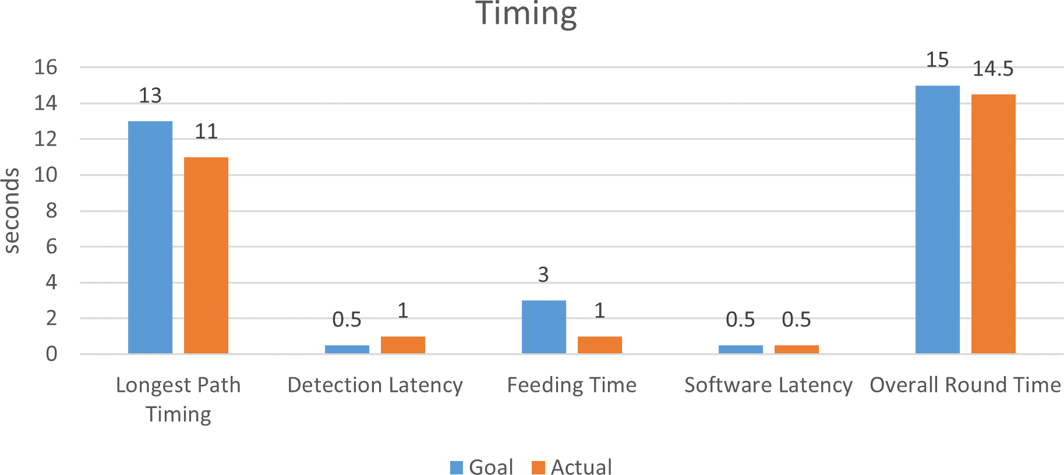
MaGomoku
Team C4: Shuailin Pan, Sizhe Chen, Zipiao Wan
18-500 Capstone Design, Spring 2024 Electrical and Computer Engineering Department
Carnegie Mellon University
Product Pitch
System Description
In an era where connectivity defines our interactions, MaGomoku revolutionizes the way we play Gomoku, a strategy board game cherished worldwide. Addressing the need for a more connected and interactive gameplay, our product delivers a seamless, automated networked experience that bridges distances by enabling enthusiasts and casual players alike to compete on a physical board, regardless of their location.
Our system consists of the following subsystems:
- Movement
The movement system utilizes an electromagnet to attract magnets embedded in go pieces.
The electromagnet is then mounted on an x-y gantry to allow for precise maneuvers guiding pieces along specific paths to their destinations.
By integrating an x-y stepper motor movement gantry with magnets, MaGomoku picks up and places game pieces, mirroring an opponent's moves as if they were right across the table. This real-time simulation of moves, combined with hall effect sensors that discern between different game pieces, elevates the traditional game into an intuitive, engaging, and dynamic platform.
Detection
The detection system employs 3 custom PCBs, each consists of a 3x9 hall effect sensor matrix connecting to two 16-channel analog multiplexer.
Together, the 3 PCBs construct a 9x9 hall effect sensor matrix that scans the entire board to read the strength of the different magnets within black and white go pieces, thus achieving piece detection.
Locking
To achieve more accurate detections and a smoother gameplay, we put one permanent magnet below each hall effect sensor to attract and lock the go pieces to a consistent location on the Gomoku board.
Feeding
The feeding system comprises a vertical magazine for holding go pieces and a stepper motor responsible for pushing out the pieces to be retrieved by the electromagnet in the movement system.
Software
Our software uses Django and HTML/CSS for the webapp and Telemetrix to parse the hardware data from Arduino. Additionally, Flask is employed to establish local communication and exchange data between the hardware program and webapp.
Movement
System Architecture
Hall Effect Sensor
Embedded Magnet
Detection & Locking
Magazine
System Evaluation
Stepper Motor Rotates Flag Pushing out GO Pieces
Feeding
Software
Project Website

