Slide 1
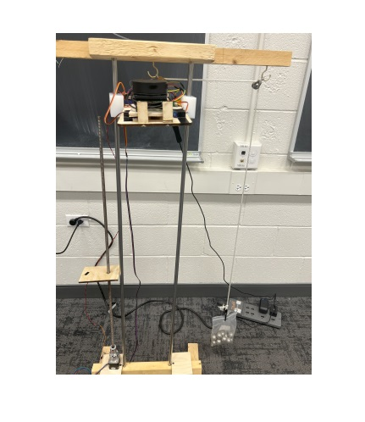
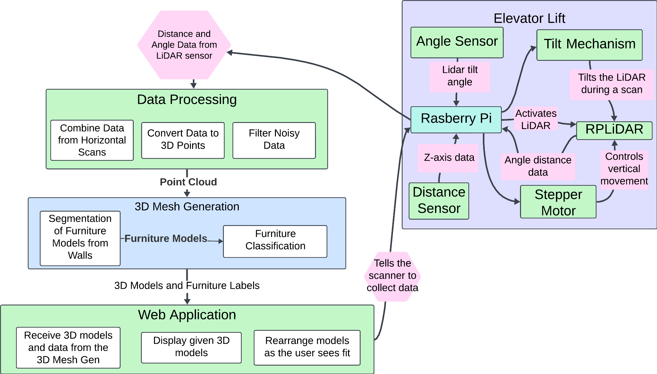
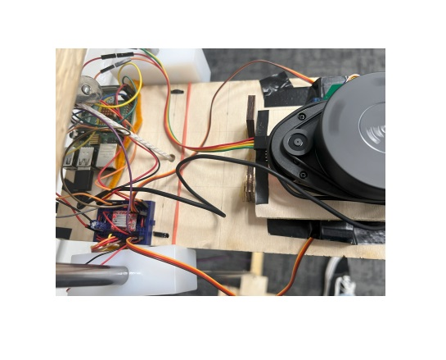
TailorBot Room Designer
Team C2: Zuheib Abdi, Grace Ajayi, Alana Gerald
18-500 Capstone Design, Spring 2024
Electrical and Computer Engineering Department
Carnegie Mellon University
https://course.ece.cmu.edu/~ece500/projects/s24-teamc2/
Product Pitch
System Description
TailorBot Room Designer improves interior space analysis by utilizing LiDAR technology to create accurate 3D models of any room. We developed a solution for acquiring precise and efficient room measurements. The system is designed to scan a room and generate a detailed 3D model, allowing users to measure dimensions, identify space utilization, and visualize potential furniture placements without manual intervention.
TailorBot demonstrated an average dimensional accuracy rate of 95%, with discrepancies within the 3-inch requirement across test environments. The complete scan-to-model display process achieved was under 5 minutes.
The scan is conducted through the use of our lifting mechanism consisting of a elevator system with a counterweight to maintain its stability and position. The majority of the circuitry and components for the scan lay on the stand, including the angle sensor and tilting mechanism. A stepper motor positioned to the side of the rails help move the stand up in a controlled manner.
The scanner can be controlled by the web app. A scan is complete, a point cloud will be generated which will be used to generate a 3D recreation of the room. Users can then manipulate and move things around in this recreation.
Elevator Lift
System Architecture
Sensor Stand
Stand
RPI
Tilt Sensor
RPLiDAR
Servo
Motor Driver
Stepper Motor
Counterweight
System Evaluation
To develop a minimum viable product, our team defined critical use-case requirements for the TailorBot. The system is required to deliver accurate and consistent distance and angle sensor readings, maintain room dimension accuracy within a 76.2mm margin and identify furniture types with over 70% accuracy.
In our controlled test environment—a furnished room without windows to ensure consistent lighting conditions—we conducted a series of tests to validate these requirements. For room dimensions, we performed scans to create 3D models of the room, comparing the model's width and depth with actual measurements taken manually with a tape measure. This method allowed us to assess the accuracy of the room dimension measurements directly. For the Z-axis accuracy, we compared the height readings from the distance sensor against manual measurements, ensuring the vertical positioning accuracy of the scanner. Additionally, we measured the time it took from the completion of the scan to the display of the model in the web application, testing the efficiency of our system's processing and rendering capabilities.
System Architecture Diagram
Data Processing: This subsystem is essential for transforming raw LiDAR scan data into usable 3D points. It combines data from multiple horizontal scans to construct a coherent dataset. Each scan undergoes a process where noisy data elements are filtered out to ensure the accuracy and clarity of the 3D points. This subsystem sets the foundation for accurate 3D modeling by providing cleaned and aligned data ready for further processing and analysis.
3D Mesh Generation: After data processing, the 3D mesh generation subsystem takes over. It is responsible for segmenting the cleaned 3D data into distinct models representing furniture and walls. This segmentation is crucial for the subsequent classification process. Once segmentation is complete, the subsystem applies furniture classification algorithms to label each segmented model according to its identified furniture type. This step is vital for the detailed visualization and interaction capabilities in the web application.
Web Application: The final component of our system architecture is the web application subsystem. It is tasked with receiving the processed 3D models and related data from the 3D mesh generation subsystem. Once received, it displays these models in an interactive interface that allows users to visualize and manipulate the room's layout. Users can rearrange furniture models within the 3D space, providing a dynamic tool for room planning and design adjustments. This subsystem enhances the user experience by offering a hands-on approach to interior design modifications.
Test | Performance
Room dimension accuracy | 0.15 m error for room width and depth
Z-axis positioning of scanner accuracy | 0.022 m error
Web application response time | Average time for model generation: 10.4s
Accurate furniture classification | 65% classification accuracy
Conclusions
TailorBot has evolved significantly from its initial concept to its current implementation. None of us had a lot of experience in the tools and techniques needed for this project, so it’s good to see how far it’s come. One of the biggest challenges was ensuring all components worked harmoniously during system integration. This required us to move away from our original plans and adapt our strategies. To continue this project further, we’d want to improve the system's ability to manage unconventional room shapes and furniture arrangements.
Test Results

