Slide 1
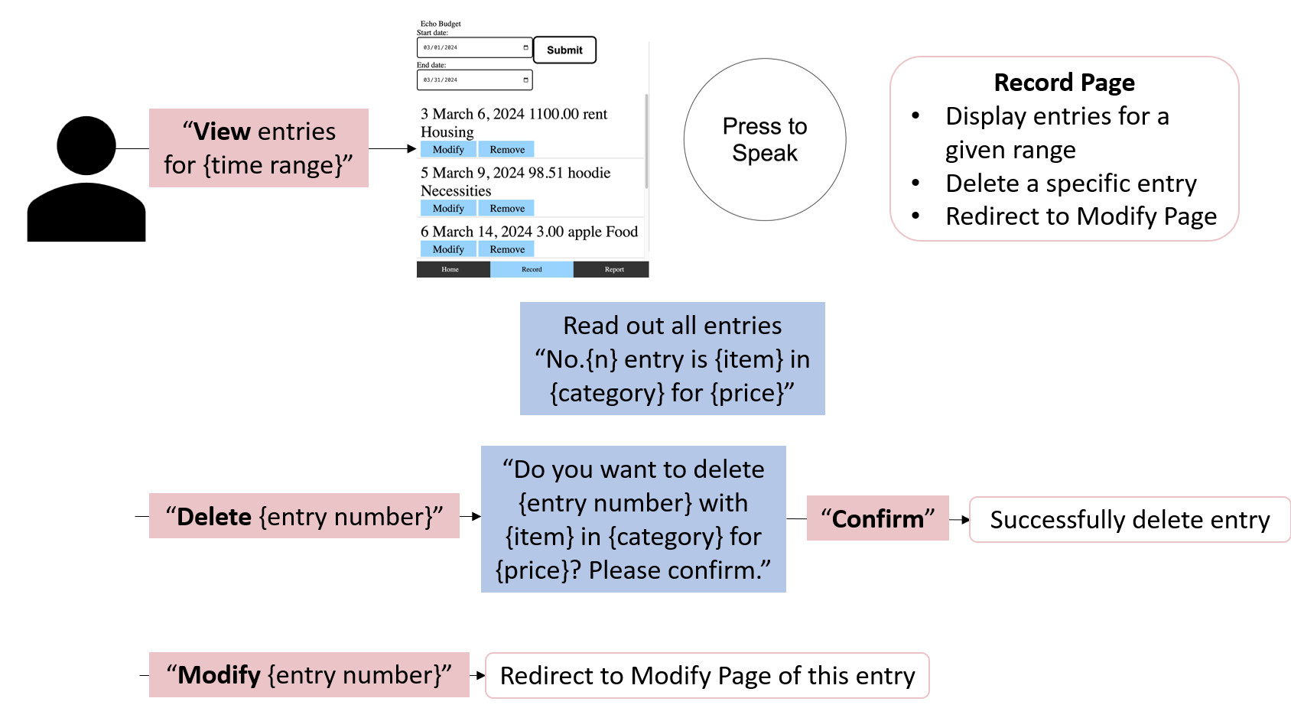
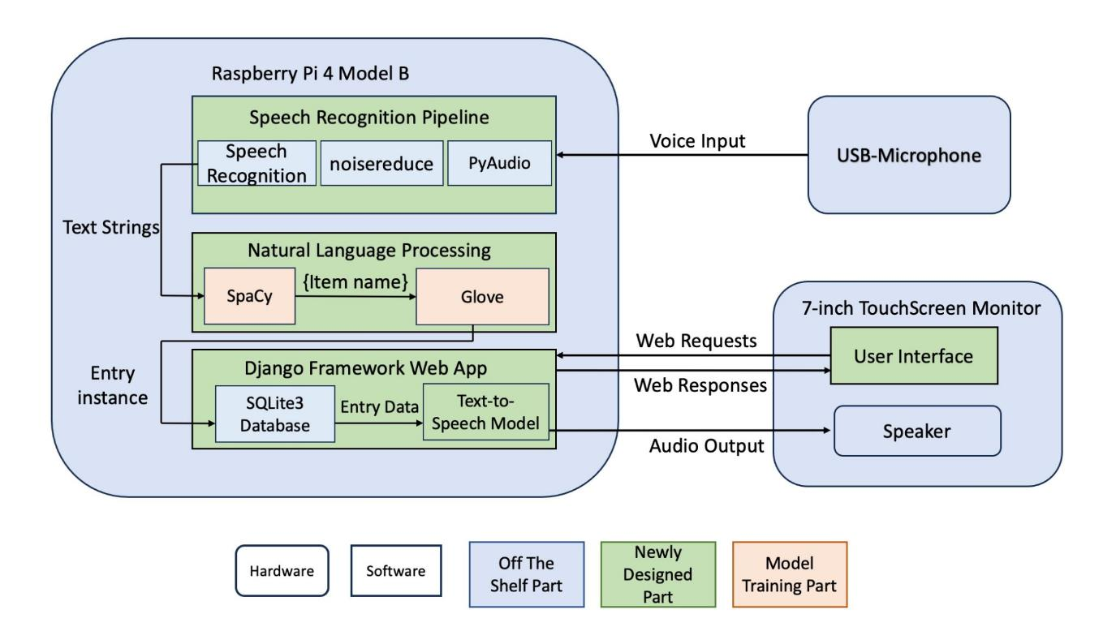
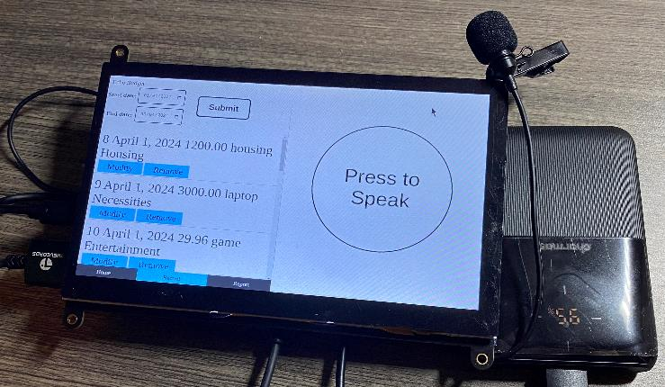
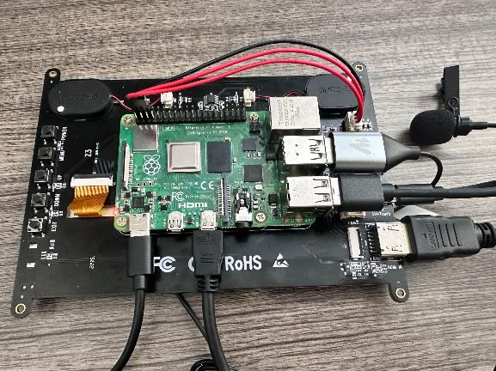
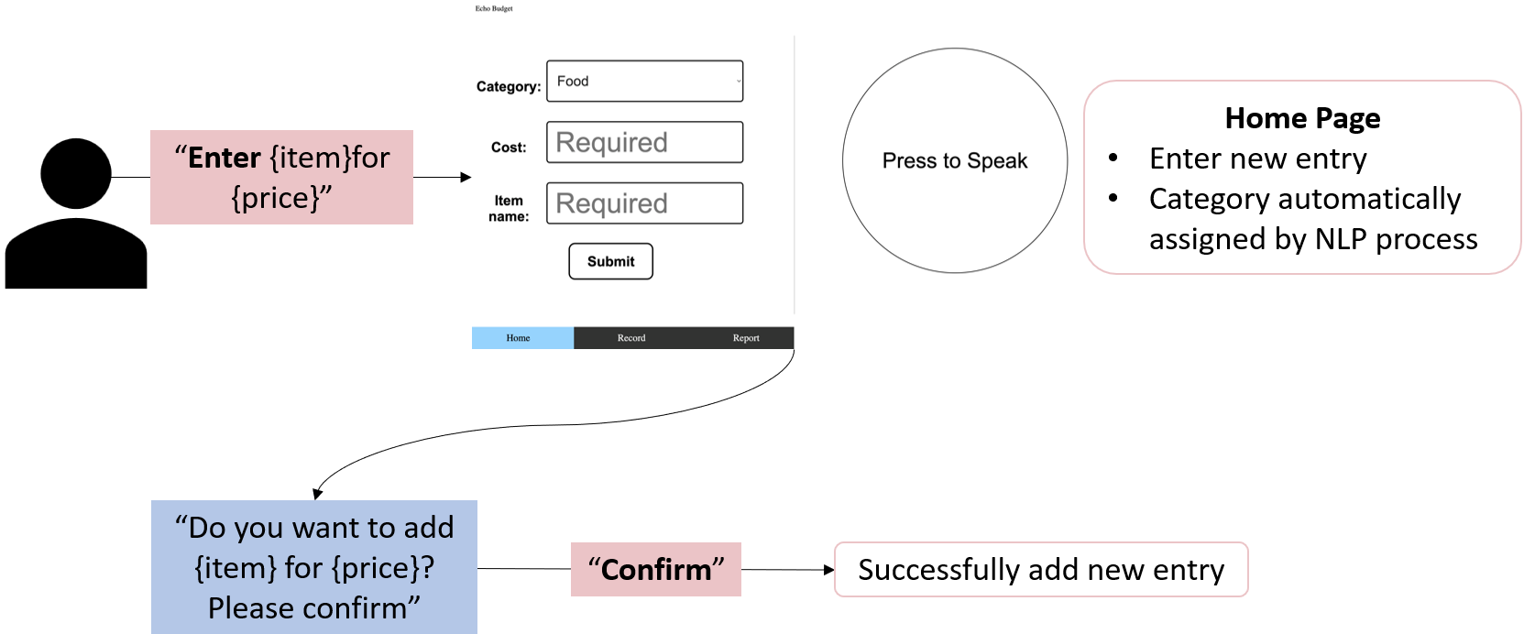
EchoBudget
B0: Lynn Sun, Yuxuan Xiao, Yixin Yang
18-500 Capstone Design, Spring 2024
Electrical and Computer Engineering Department
Carnegie Mellon University
Product Pitch
EchoBudget is a web-based application that provides money-tracking functionalities with audio input. Traditional money-tracking apps are not accessible for visually impaired people and the elderly due to a lack of visual aids and complex user interfaces. To meet their needs for money tracking, we propose to implement an application that records, shows, and analyzes
spending solely with audio input and output.
We successfully implemented full functionality for money tracker apps, allowing customers to use their voice to enter new entries and edit or remove existing entries. Our application could also display existing entries and generate reports of expenses for a given range depending on users’ audio requests. Our whole system weighs 500 grams, making it easy for customers to carry around. The overall accuracy of the system is about 95 percent and it would take less than 10 seconds for any command to be processed, giving user a smooth interaction with our system.
System Architecture
Our system performs all functionalities on a Raspberry Pi 4 with a touchscreen monitor and a USB microphone. Customers could interact with the system via finger tapping and audio inputting. After an initial tutorial that provides users with a basic introduction to the web application through the built-in speaker, the primary user interface would be displayed on the monitor screen.
Customers then could start to deliver voice command inputs by clicking the big “Press to Speak” button on the screen. The audio signals would be transmitted to the speech recognition subsystem where the voice input would be transmitted to text strings. Our natural language processing (NLP) subsystem will then parse the text string, extract the necessary information for the web app, and assign categories to items if needed.
Based on the received commands, different pages of the web application would be rendered. And the web app would complete the tasks assigned by the users.
System Description
Microphone
Power bank
Monitor
Back of our system
System Evaluation
Test | Ideal | Actual
Latency (voice command) | 4 seconds to render the page | 4.52 seconds
Battery life | 2 hours with monitor on | 4 hours
Portability | 500 grams | 500 grams
Noise reduction | 90% accuracy of whole system under 70dB | 90%
Audio to text | Less than 20% of word error rate | 98.3%
NLP parsing | Accuracy larger than 95% Takes less than 3 seconds | 96% 2.5 seconds
Item classification | 90% accuracy | 90%
Voice response | All audio requests should be assisted with a voice response | All voice responses implemented
The graph below shows how customers could interact with our application. The red boxes contain the commands given by the user and the blue boxes will be the audio feedback given by our system to the users.
Design Tradeoffs
Train one model for Spacy | Train two models for Spacy
Require less storage | Increase parsing accuracy Only lengthen the runtime by a little bit
Click button to stop | Automatic speech termination detection
More flexibility on voice input time May cause potential waste if forget to press twice | User does not need to press again Fixed voice inputting time (8 seconds)
Allow users to give commands without restriction | Standardized voice input keywords
More user-friendly, but hard to process | Enhance action performance accuracy
Add each item name to Glove model | Only add item name to model when entry is modified
More accurate, but may overfit | Reduce wait time and storage
Conclusions & Additional Information
Although our current system has good performance, we have some restrictions on user’s behaviors. For example, we want users to use imperative sentences in English as the commands. One potential improvement is to allow customers to create their customized categories. Another potential improvement would be to have a better NLP model. This would allow customers to use voice commands with any sentence structure they like. We may also consider supporting other languages in the future.
https://course.ece.cmu.edu/~ece500/projects/s24-teamb0/

