Slide 1
Team A5 – Chargin'
Callum Bagnall, Luca Garlati, Anirud Vineet Durani
Add your 12 slides after this slide… [remember, 12 min talk + 3 min Q/A]
For more information about formatting or importing slides see: https://gsuite.google.com/learning-center/products/slides/get-started/
Make sure to cover (refer to the Proposal Presentation Guidance):
Use Case - Who is your customer, what product do they want to buy?
Use-Case Requirements - What do they expect your product to do? [Answer this Quantitatively]
Technical Challenges - What do you need to technically achieve so your product can meet these requirements?
Solution Approach - Show us step by step what your proposed solution path(s) looks like – incorporate flow diagrams
Testing, Verification and Metrics – Detail your testing & verification plan (and how you will measure & verify the results) of your product
Tasks and Division of Labor - Technical Task List to build your proposed system, WHO is going to do WHAT in your team?
Schedule - Gantt Chart (task timeline, demo system/components, MVP, stretch goal, include slack time)
Consider that this slide already works as a introduction slide so use your first slide wisely
You can edit the first slide to your liking by deleting any of the guidance text and Heilmeier image; however you must keep your team name and teammate names.
Remember – Relevant figures (and tables) can be worth “a thousand words”!

Slide 2
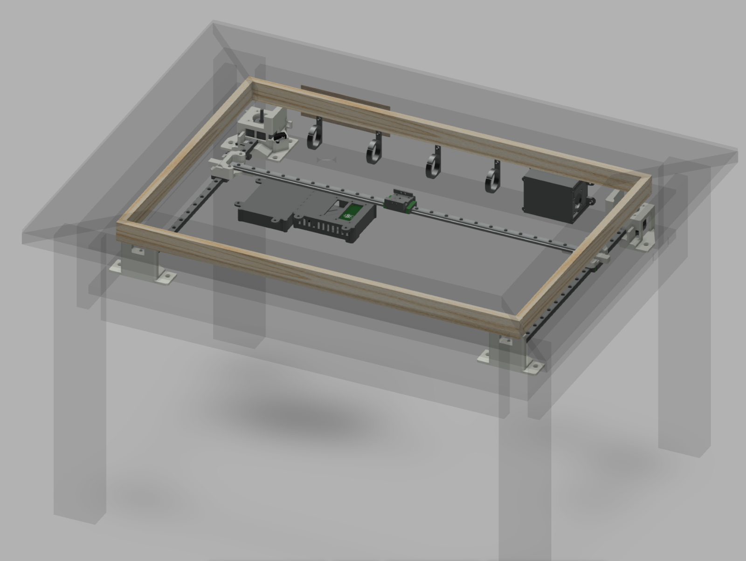
CHARGIN’
TEAM A5:
Anirud Durani
Callum Bagnall
Luca Garlati
https://www.diymachines.co.uk/kinetic-sand-art-coffee-table-self-drawing

Slide 3
Use Case
Chargin’: A wireless charging table that tracks your devices and brings the charger directly to it.
Consumers want convenience over all else.
A table that charges your phone no matter the placement is the near the pinnacle of convenience for charging devices.
What’s Changed:
Use of Hall-Effect Sensors
Translation Using a H-Gantry

Slide 4
Use Case Requirements
Large Footprint:
Table size of 55x70cm gives plenty of space to charge and allows for multipurpose use
Rapid Execution:
Fast detection and translation (2sec total) makes charging near seamless
Accurate Detection:
Accuracy leads to an efficient charge (95% detection rate, 2mm accuracy)
Cool Temperature:
A cool surface protects both users and devices from burns and damage (50°C max)
Small Frame:
Keeping the table thin (~5cm) makes for a sleek look and allows for use of the table’s underside

Slide 5
Design Requirements
Attribute | Target (SI) | Target (Imp.) | Notes
Footprint | 40cm x 60cm | 15.8” x 23.6” | Not useful if too small
Thickness | 5cm | 2” | Cumbersome if too thick
Weight | 5 kg | 11 lbs | Can’t be heavier than the table itself
Detection | 0.5 sec | 0.5 sec | Very rapidly determine phone location
Accuracy | 95% | 95% | Correctly identify phones reliably
Movement | 1 m/s | 2.2 mph | ~1.5 seconds to traverse 50x50cm table diagonal
Top Thickness | 5 mm | 0.2” | Can’t charge if phone is too far from coil
Surface Temp | 50°C | 122°F | Dangerous for phone and user if too hot

Slide 6
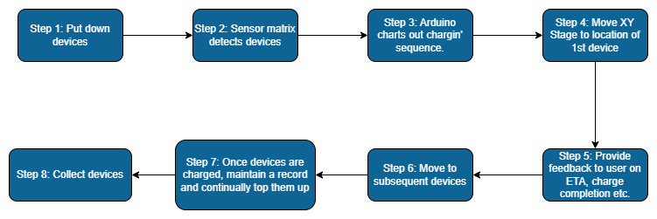
How Chargin’ Works

Slide 7
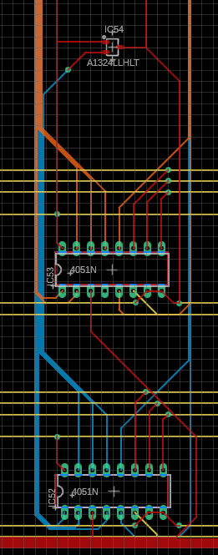
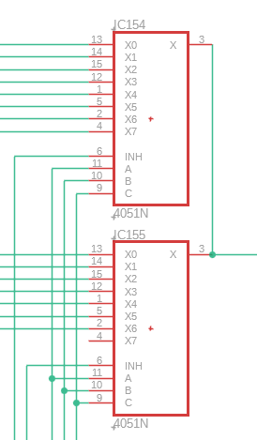
Solution Approach
Chargin’: A place-and-forget solution.
Public Welfare: Aims to make the life of the user more convenient. The pad manages charging sequence, speed etc.
Public Safety: Reduces the potential for naked cables and water damage.
Public Health: Improves accessibility of chargers for visually impaired people.

Slide 8
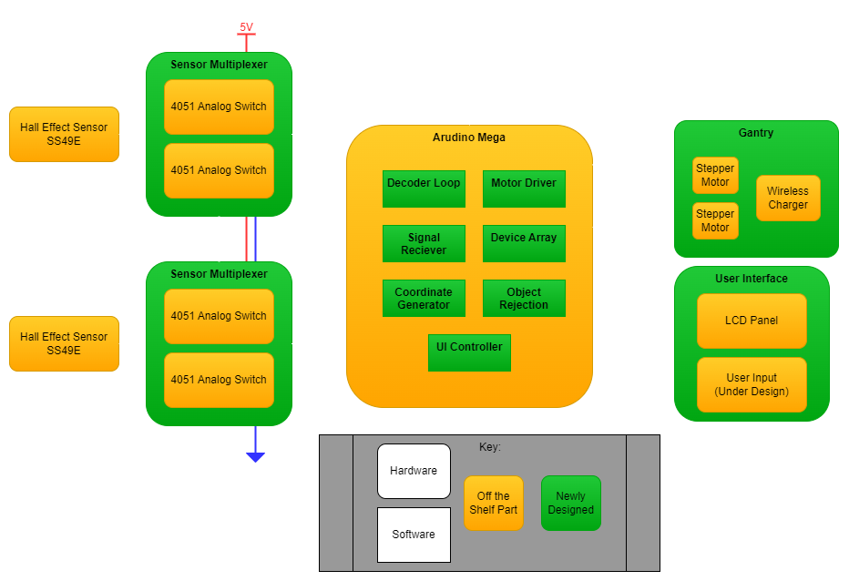

Slide 9
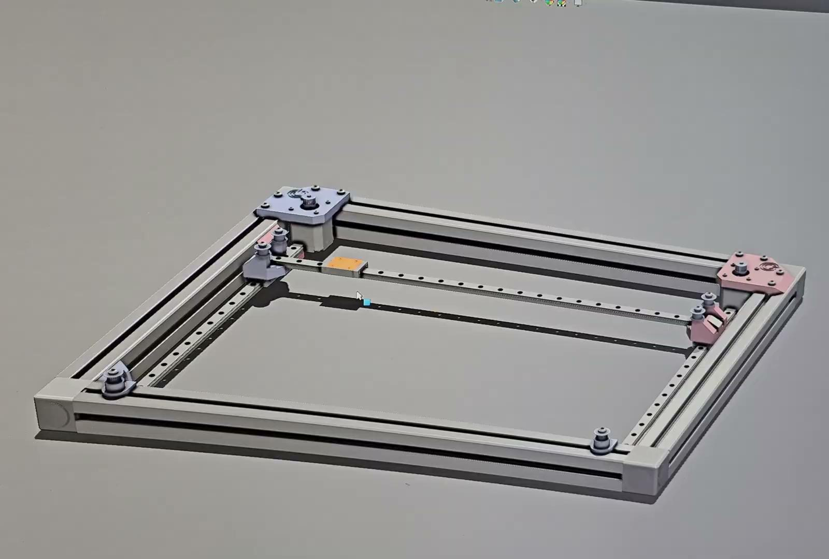
Implementation Plan
Design
Gantry
Sensor Matrix
Develop
Motor Driver
Coordinate Generator
Sensor Poll
User Interface
Acquisition
Microcontroller/Arduino
4051 ICs
Hall Effect Sensors
Motors/Stage Parts

Slide 10
Design Verification
Requirement | Test | If we fail…
Detection Speed | Place a device on the table and log time between placement and gantry movement | Optimize detection code
Accuracy | Place a device and measure offset between charging transmitting and device receiving coils | Add more sensors or interpolate with multiple
Translation Speed | Log the time it takes for the gantry to move from one corner of the table to the other | Increase motor speed and reduce belt friction
Temperature | Leave a phone to charge to full and then measure both the phone’s and table’s temperature | Lower transmission power and add heat sinks
Efficiency | Relate input energy with battery charge for multiple levels of device charge | Reduce coil distance and increase magnetic coupling

Slide 11
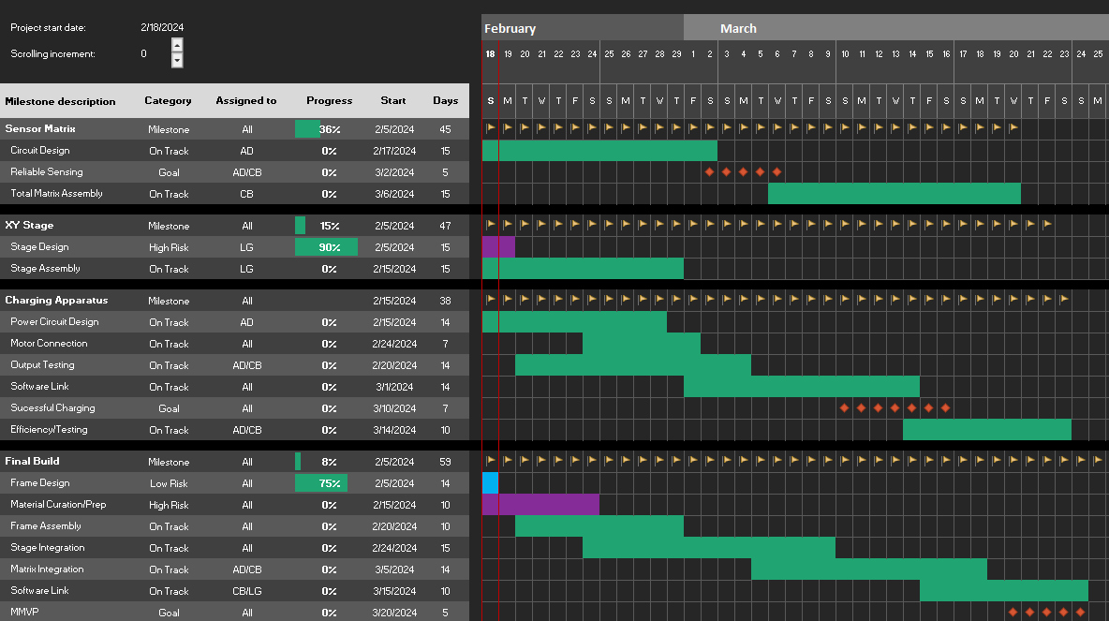
Management & Current Tasks
Anirud
Sensor Testing
Power Circuit Design
Matrix Testing
Callum
Sensor Matrix Design
Matrix Assembly
Matrix Testing
Luca
Stage Design
Stage Assembly

Slide 12
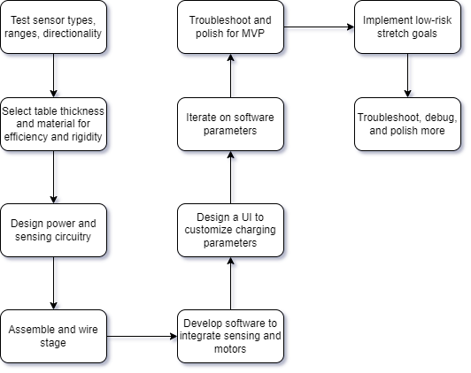
Scheduling Approach

