Slide 1
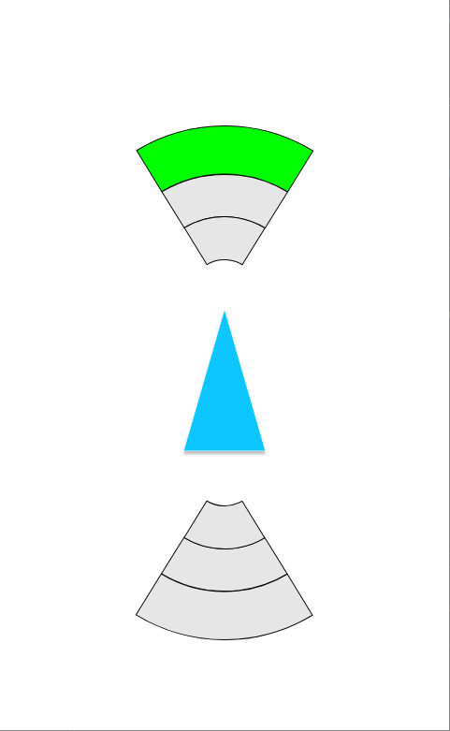
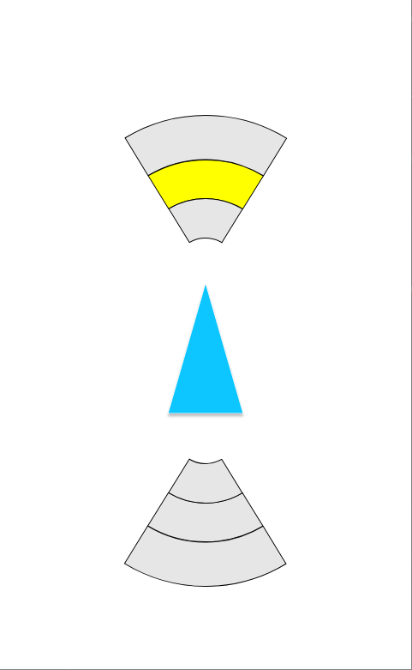
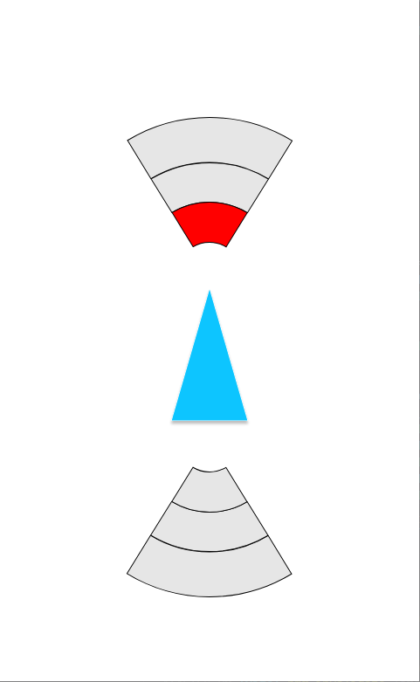
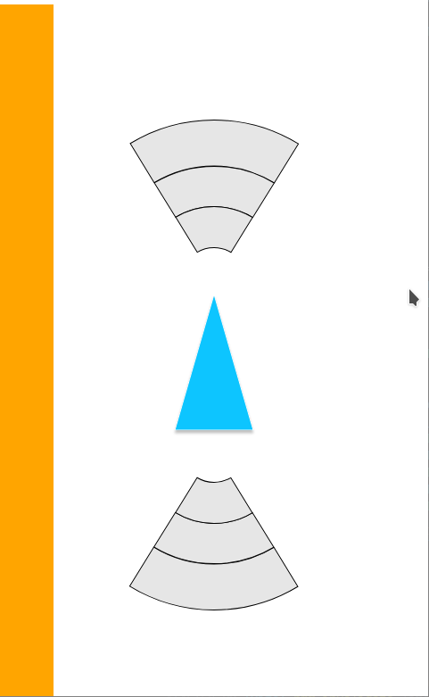
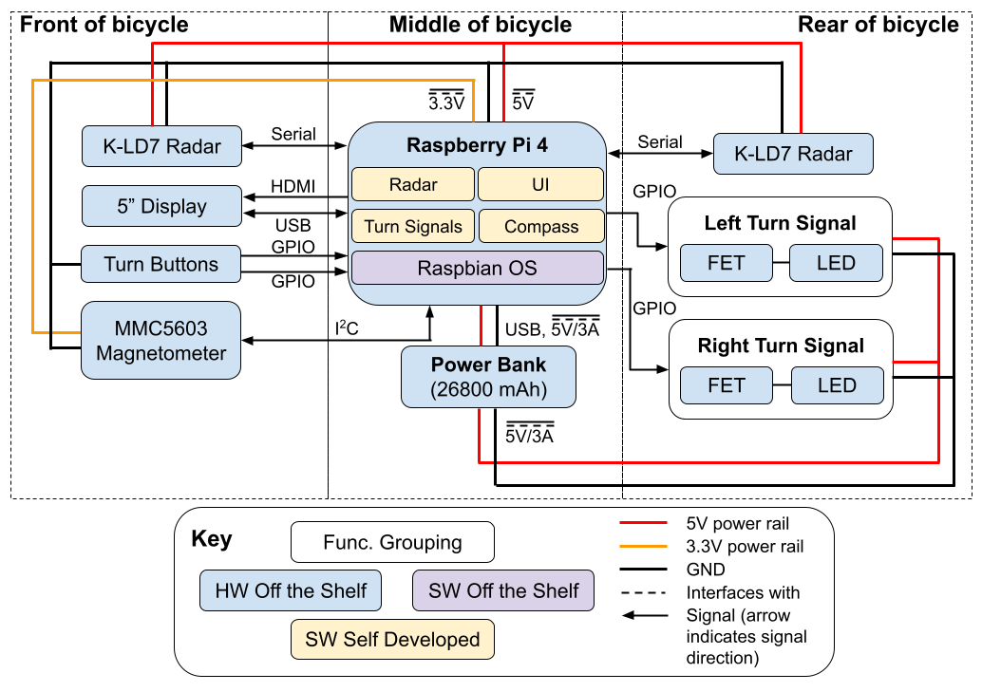
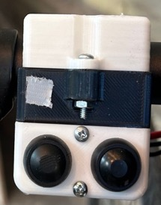
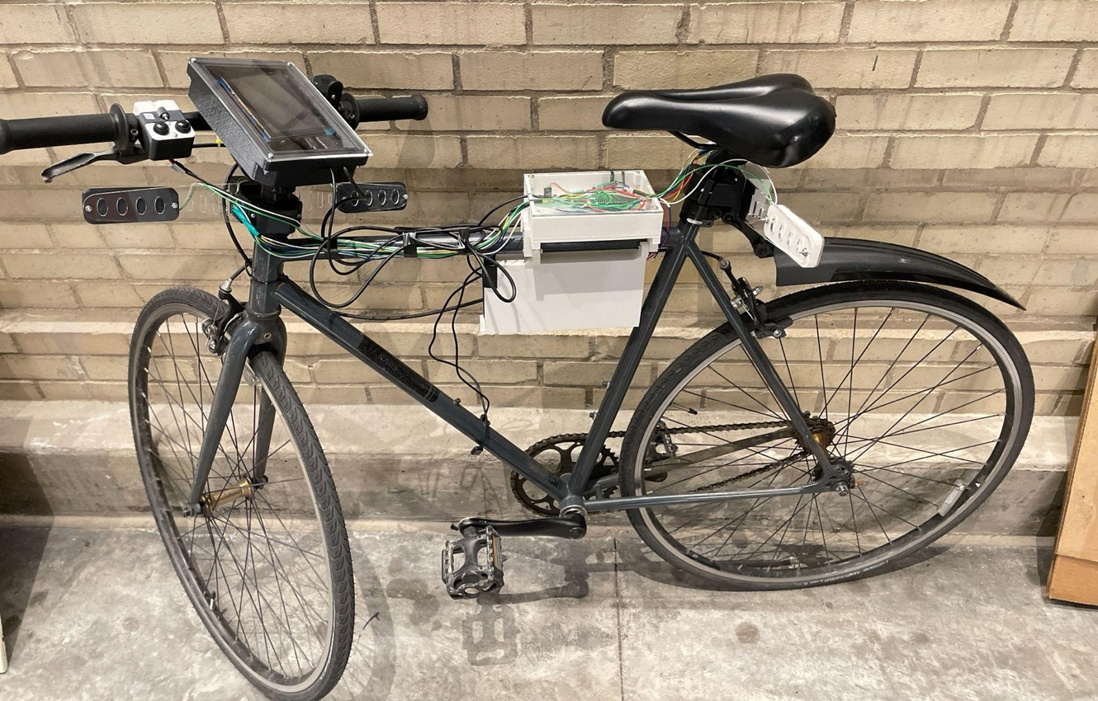
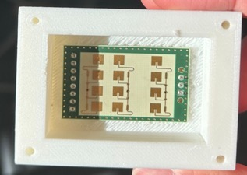
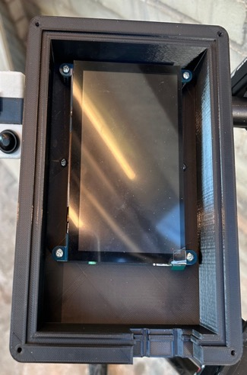
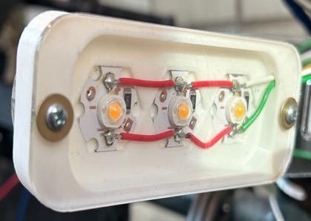
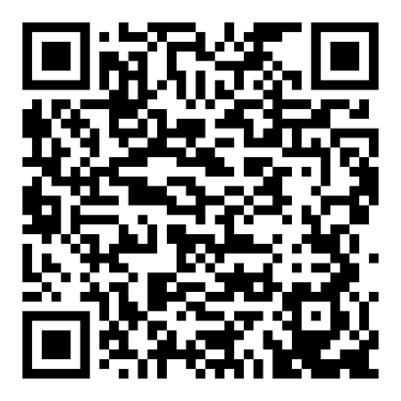
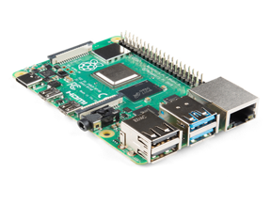
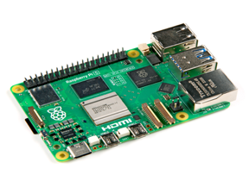
Bike Buddy
A3: Jason Lu, Johnny Tian, Jack Wang
18-500 Capstone Design, Spring 2024
Electrical and Computer Engineering Department
Carnegie Mellon University
Product Pitch
System Description
Bike Buddy is a system that is intended to improve safety for bicyclists by allowing them to have better situational awareness and giving other road users a better understanding of cyclists’ intentions. This is accomplished through a system incorporating microwave radars that detect vehicles located behind and in front of the bicycle, along with turn signals mounted on the rear and front of the bicycle. An embedded computer integrates information from the radars and provides visual alerts to the bicyclist on a centrally mounted display. The radar achieves ~95% distance detection accuracy with a max range of around 24 meters.
User Interface
The screen displays the distance to vehicles in front and behind you, along with orange bars to indicate a vehicle on your side. Internally, the UI is built using the same tech that websites are built in!
UI screenshots: from left to right, it shows a car in front at (1) far distance (2) medium distance (3) close distance (4) a car on the left side behind
Vehicle Sensing
2 microwave radars, one mounted in front and one in the back, perform detections for blind spot indication and forward/rear range detection.
Turn Signals
Turn signals are activated by pressing buttons mounted on the handlebar and will flash LEDs both in front and on the back of the bicycle. They can be deactivated by pressing the buttons again or turning the entire bicycle in either direction. Changes in the bicycle’s direction are picked up by the magnetometer, which functions as a compass.
System Architecture
Overall System Block Diagram
Turn signal buttons
Battery pack
Raspberry Pi + Magnetometer
Rear radar
5” Screen
Turn signals - 3 LEDs on each side
System Evaluation
Software Block Diagram
Use-Case Requirements:
Metric | Target | Actual
Battery Life | ≥ 2 hours | ≥ 2 hours
Detection Lead Time | ≥ 1.5 seconds | * Varied
Turn Signal Brightness (night/day) | ≥ 500 / 100 ft. | –/ ≥ 104 ft
Conclusions & Additional Information
Design Requirements:
What Worked:
A system that has blind spot detection, range display, and auto-deactivating turn signals was built
Logistical
Slack time & parallelization are important
Technical
Using a magnetometer as a compass is not trivial - IMU would be a good alternative
Potential Improvements:
Incorporate GPS map data into detection, so the system knows the road
Compromise:
The system that alerts the rider when at risk of colliding with a vehicle based on the distance and velocity were unable to work reliably enough, so it was disabled
Metric | Target | Actual
Max Detection Range | ≥ 14m | 25.13 m (Rear) 11.84 m (Side)
Distance Accuracy | ≤ ±10% deviation | 5.44%
Velocity Accuracy | ≤ ±10% deviation | 7%
Power Consumption | ≤ 13.4 A | ≤ 1.64 A
More Info?
Scan Me!
** Test results continue to be updated. Please see our website for the most recent results.
Embedded System Tradeoff Factors:
Performance
Power draw
Heat
USB max current
https://course.ece.cmu.edu/~ece500/projects/s24-teama3/

