Slide 1
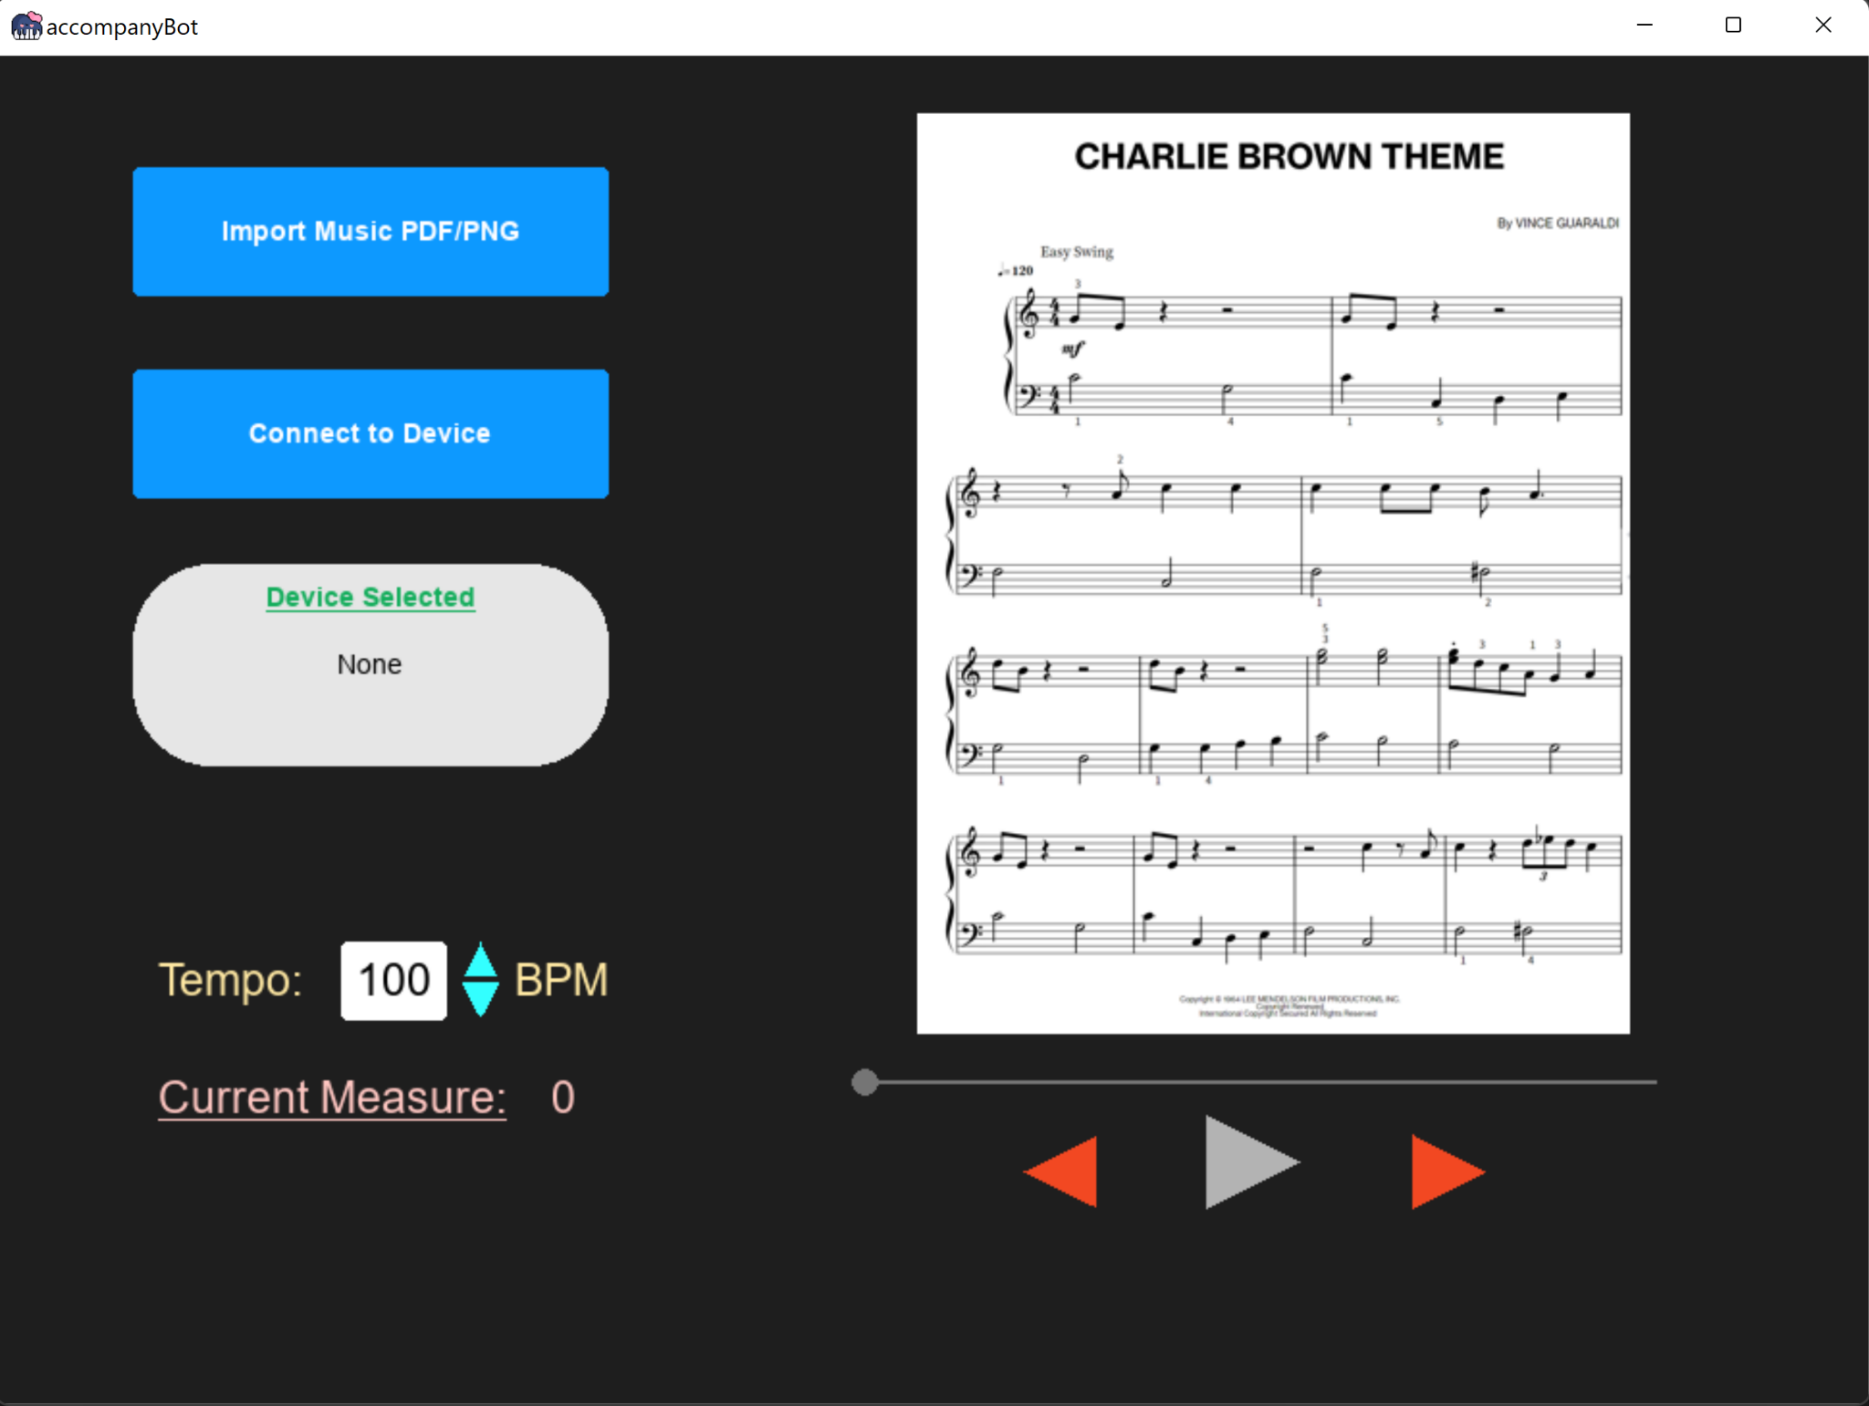
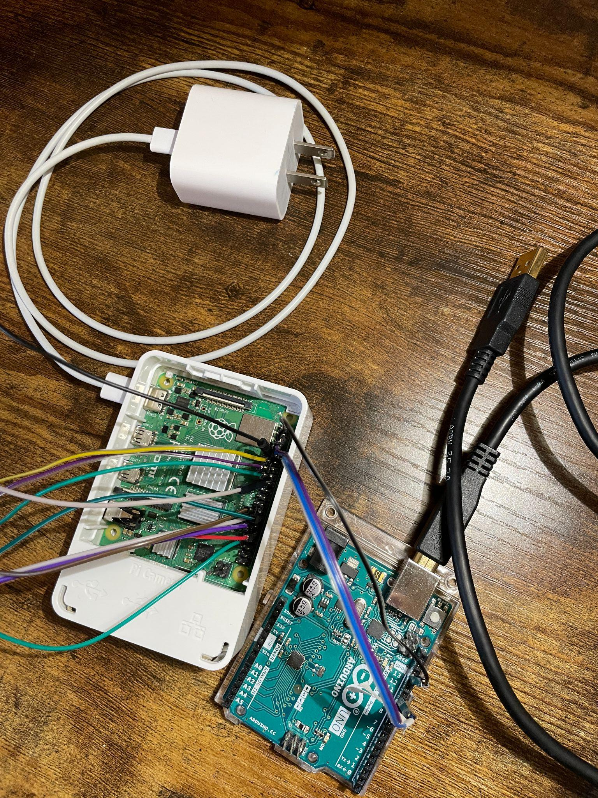
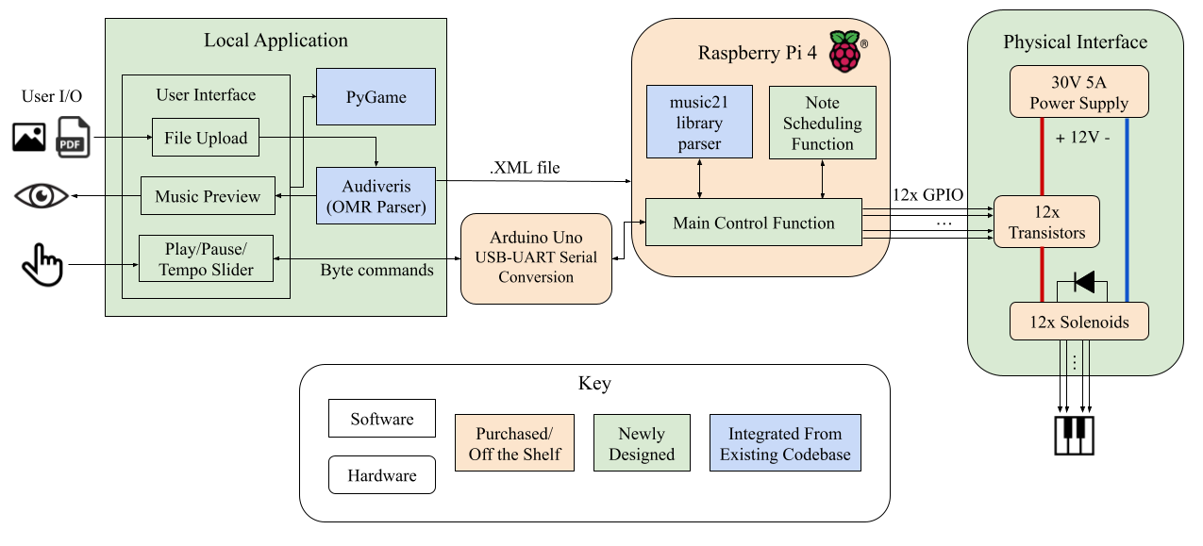
The accompanyBot
Team D7: Aden Fiol, Rahul Khandelwal, Nora Wan
18-500 Capstone Design, Spring 2023
Electrical and Computer Engineering Department
Carnegie Mellon University
Product Pitch
Piano icon created by Freepik = Flaticon at https://www.flaticon.com/free-icons/piano
System Description
The accompanyBot is a piano playing robot that aims to enhance the playing experience for musicians in need of piano accompaniment for practicing and performing. From a streamlined GUI on a local application, users can upload their sheet music and control piano player actions with low latency. Our design ensures that notes are played accurately and at the correct tempo while also offering users the freedom of tempo variability.
Our product provides the appeal of live acoustics compared to MIDI recordings while offering a cheaper alternative to hiring professional accompanists or purchasing high-end player pianos on the market today.
Software:
pyGame Application
Dynamically handles user inputs and actions
Interfaces with note scheduling and OMR process
Audiveris Optical Music Recognition (OMR)
Converts notated sheet music into organized, descriptive, text logs, readable by the notes scheduler
Fig. 1. GUI application
System Architecture
RPi Power Cord
The Local Application provides an interface that allows users to upload their sheet music. The sheet music is then parsed with Optical Music Recognition software into an XML file that is sent to the Raspberry Pi using SCP. Additional user features such as pausing, playing, changing the tempo, jumping measures etc. are sent to the Raspberry Pi serially through an Arduino Uno.
The Raspberry Pi 4 takes the XML file and parses it with the help of the music21 Python library. The main control function then converts the parsed music into scheduled GPIO signals that play at specific time instances. It also takes in byte commands sent via The Arduino Uno acting as a USB-to-UART serial converter.
The Physical Interface consists of 12 solenoids, a chassis to suspend the solenoids over the keyboard, and a circuit that controls the solenoids. The circuit is made of switching transistors that are turned on and off by the Raspberry Pi and diodes used to prevent voltage flyback caused by the solenoids from damaging our other systems.
USB cable to connect to laptop
Hardware:
Arduino Uno
Serves as a proxy between GUI and Raspberry Pi
Raspberry Pi4
Hosts notes scheduling algorithm
Communicates metrics for software application
Sends digital signals to switching MOSFETS
UART Wires
GPIO Pins to connect to MOSFETS
Fig. 2. Arduino and RPi
Controlling Circuit
Robotic “Hand”
Adafruit 25N Push/Pull Solenoids to press on piano keys
Adafruit N-channel MOSFET switches for solenoid “fingers”
Chassis
MOSFETs
Solenoids
Fig. 3. Chassis and Solenoid
System Evaluation
OMR Accuracy - Reconverted XML file back to pdf and visually compared output to the original
Tempo Accuracy - Measured tempo with a metronome
Computer/RPi Latency - Recorded system times when start/stop signals are sent and received and computed the difference
Power - Inspected power and current readings on DC power supply
Fig. 4. System Block Diagram
Design Requirement Metric | System Performance
> 95% OMR accuracy of note pitches and note values for 400+ DPI music scores | ~99% accuracy for easy to moderate playing difficulty scores of 240 DPI
100% tempo accuracy | 100% accurate between 30BPM-150BPM
< 150 ms latency between pressing the start/stop button and hearing a | Round trip communication latency of ~70ms
< 60W average power consumption | Max power of 46.8W
Conclusions & Additional Information
Scan the QR code to check out our blog!
While our product cannot outperform a virtuoso pianist, the accompanyBot is capable of performing simple pieces for accompaniment. Through the process, we discovered reading music is a hard task and a complete automated solution is yet to exist. Another challenge we faced was underestimating the time for integration and prototyping.
Our system is a solid proof of concept for playing one octave and has the potential to be expanded to play the entire range of keys on a piano, with cost being the limiting factor.
Table 1: Quantitative Testing Results
http://course.ece.cmu.edu/~ece500/projects/s23-teamd7/

