Slide 1
D4 - Synesthesia
Design Review Presentation
Abhishek Agarwal
Parth Maheshwari
Rachana Murali Narayanan

Slide 2
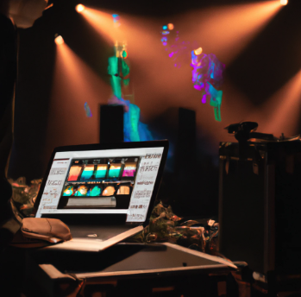
Use Case & Requirements
Automating light shows for performers using minimal equipment and real-time signal processing
Requirement | Target Metric
Latency | Lighting output in < 100 ms of audio input
Setup time | < 5 mins of 1 hr performer setup time
Signal Processing | Extract > 90% of the auditory features of hand labeled audio file
Manual adjustments | < 3 adjustments per minute per song
Our sandbox visualization
Notes:
https://support.biamp.com/Tesira/Video/Video_and_network_latency
Automate light show programming for musical performers
Reduce lighting preparation time for performers
Produce light shows that reflect nuances of the music better than current systems

Slide 3
Signal Processing
Genre Classifier
Show
Sampling & windowing
Shazam Recognition API
Feature extraction
Audio Stream
Spotify Features API
Global Musical Parameters
Lighting Engine
Light Set
Lighting Logic
UI & Manual Overrides
Key
Software
Execution Queue
Hardware
API/Off The Shelf
Newly Designed
Signals

Slide 4
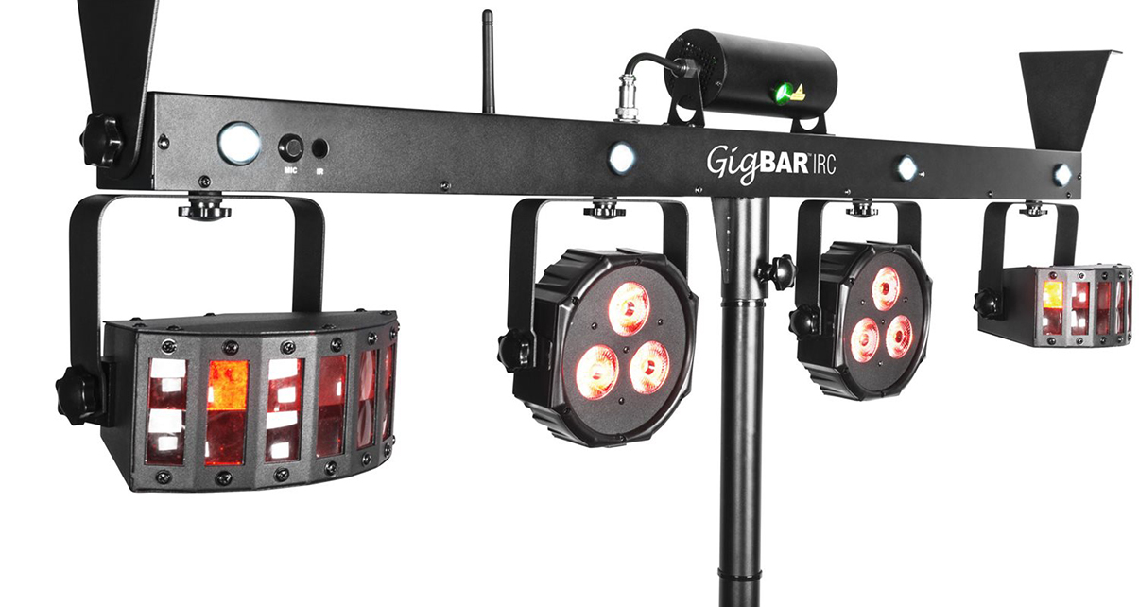
Implementation - Show
Show
Audio stream: wav/mp3 or mic input
Musical Parameters: Spotify audio features, and filtered 6 features with maximum variability among genres
Light Set:
Controller : DmxPy API calls to control the lights compatible with USB DMX Pro
Light Modules: {fade, flash, blackout, setColor, hold, etc} functionality for different types of lights
Strobe
Par
Derby
Laser
Modularity allows us the ability to daisy-chain light sets together
Audio Stream
Global Musical Parameters
Light Set
Light Output
Light Controller
Par
Strobe
Laser
Derby
Notes:
controlling any USB-DMX device that is compatible with Enttec's USB DMX Pro
https://pypi.org/project/DmxPy/
Light Set (Daisy Chain) (Multiple groups of lights together) ->

Slide 5
Implementation - Lighting Engine
Logic: Used to trigger function commands for lights
Use current state, features to filter function calls, parameters, and timings
Randomization of output to make lighting more interesting
Queue: Interface directly with Light Set and execute light function commands to maintain order
Implementation:
Keep an ordered queue of requests (FIFO)
Route request to specific light
Execute requests on multiple lights at once
Lighting Engine
Current state, global params, audio features
Lighting Logic
Lighting calls to queue
Lighting Logic
Function calls
Execution Queue
Updated pin values in light set
Execution Queue

Slide 6
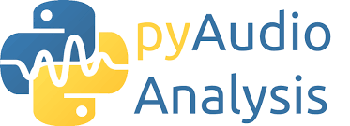
Implementation - Signal Processing
Audio stream: .wav file/mp3 or select any other audio source
Sampling and windowing : Normalize, segmentation
Features extraction
Timbral Features (instrumentations, sound sources such as speech, environmental signals)
Rhythmic Features (main beat, strength of the track)
Pitch features (melody of the music)
Signal Processing
Sampling & windowing
Feature extraction
Normalize
Segment into chunks
Feature extraction
coefficient dataframe for each chunk
Compare and iterate
Audio input
Notes:
Zero crossing rate
Normalize the audio to remove background noise, and frequencies
Segment the audio into separate windows, chunk and compare previous window to current window to evaluate current state
Timbral features are generally characterized by the properties related to instrumentations or sound sources such as music, speech, or environment signals. The features used to represent the timbral texture of a music track include zero crossing, spectral centroid, spectral flux, spectral rolloff, Mel-frequency cepstral coefficients (MFCC), Daubechies wavelet coefficients histograms (DWCH), and octave-based spectral contrast (OSC), etc.
Rhythmic features provide the main beat and its strength of a music track. Several beat-tracking algorithms have been proposed to estimate the main beat and the corresponding strength. Pitch features, mainly derived from the pitch histogram, describe the melody of the music
Amplitude: Root Mean Square (RMS) method. Min, max, mean, SD
Harmonics
Envelope: identify inflections in amplitude
Spectral content: Distribution of energy across the frequency spectrum of a sound.
Phase/Timbre
BPM

Slide 7
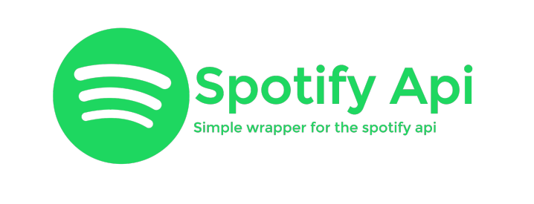
Implementation - Genre Classifier
Pass song through Shazam’s song detection API
Get song title and poll Spotify through API calls and extract features:
Send musical parameters to relevant engines for further processing and analysis
Genre Classifier
Shazam Recognition API
Danceability
Valence
Tempo
Energy
Loudness
Liveness
Spotify Features API

Slide 8
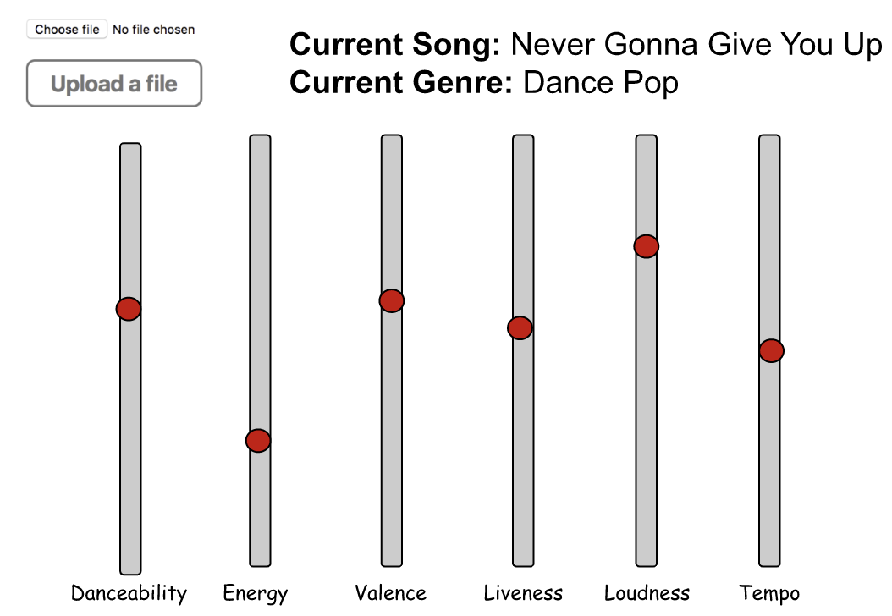
User Interface & Manual Overrides
Django-based UI with 1 second AJAX calls
Audio Input from Local System or Microphone
Calls the Genre Classifier to output 6 meta-characteristics
User modifications to change the feel of the lights
UI & Manual Overrides

Slide 9
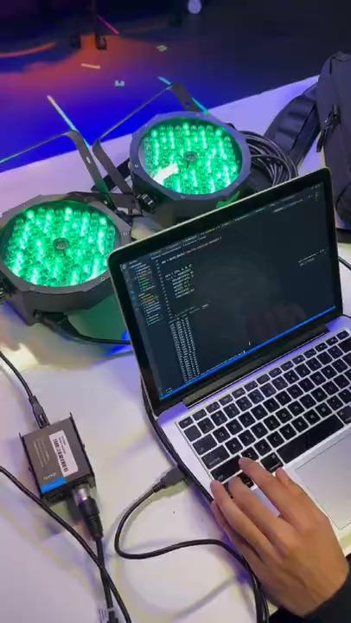
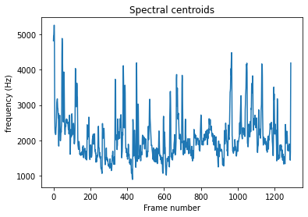
Current Tests & Proof of Concept
Test : Simple Fade Test : Signal Decomposition

Slide 10
Testing and Verification
Test | Target Metric | Testing Process
Latency | Lighting output in < 100 ms of audio input | Record the difference in timestamps as audio enters signal processor and as light functions are executed
Setup time | < 5 mins of 1 hr performer setup time | Use a focus group of 5 people to estimate setup time
Signal Processing | Extract > 90% of the auditory features of hand labeled audio file | Hand label 3 different audio files and then determine what percentage of those the processor picks up
Manual adjustments | < 3 adjustments per minute per song | Test on a sample audio with different genres and determine how many adjustments are needed
Notes:
Control groups : watching lights, no sounds (detecting if genre is switching up well), rate the entire experience overall, test with the performers themselves

Slide 11
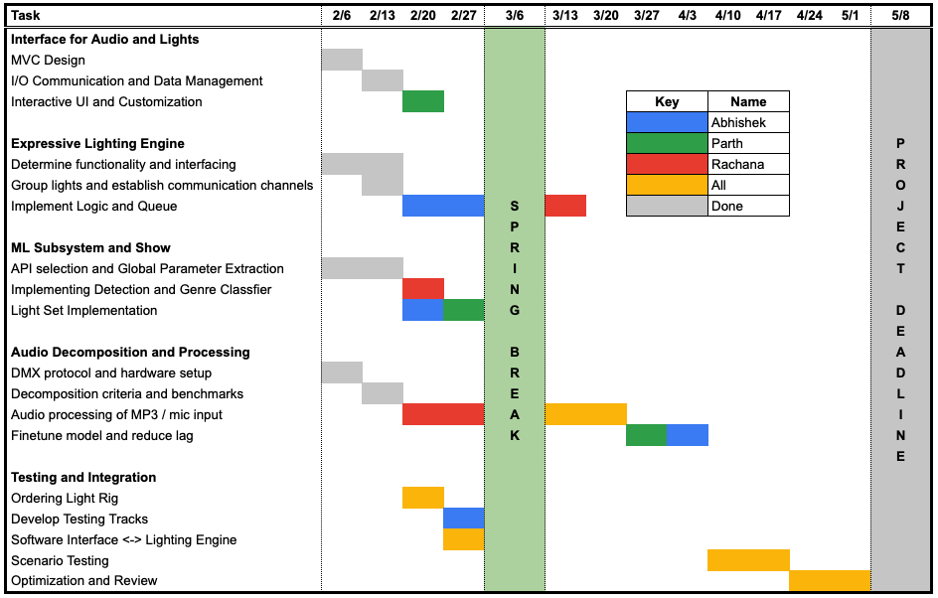
Scheduling

Slide 12
Conclusions
Subsystems for signal processing, lighting engine, and audio detection
A system to control lights to match audio inputs in real time
A proof of concept to control multiple lights independently and in unison
Notes:
Updated architecture to better utilize OOP and integrate all subsystems
Finalized and tested communication protocol between software and lights

