Slide 1
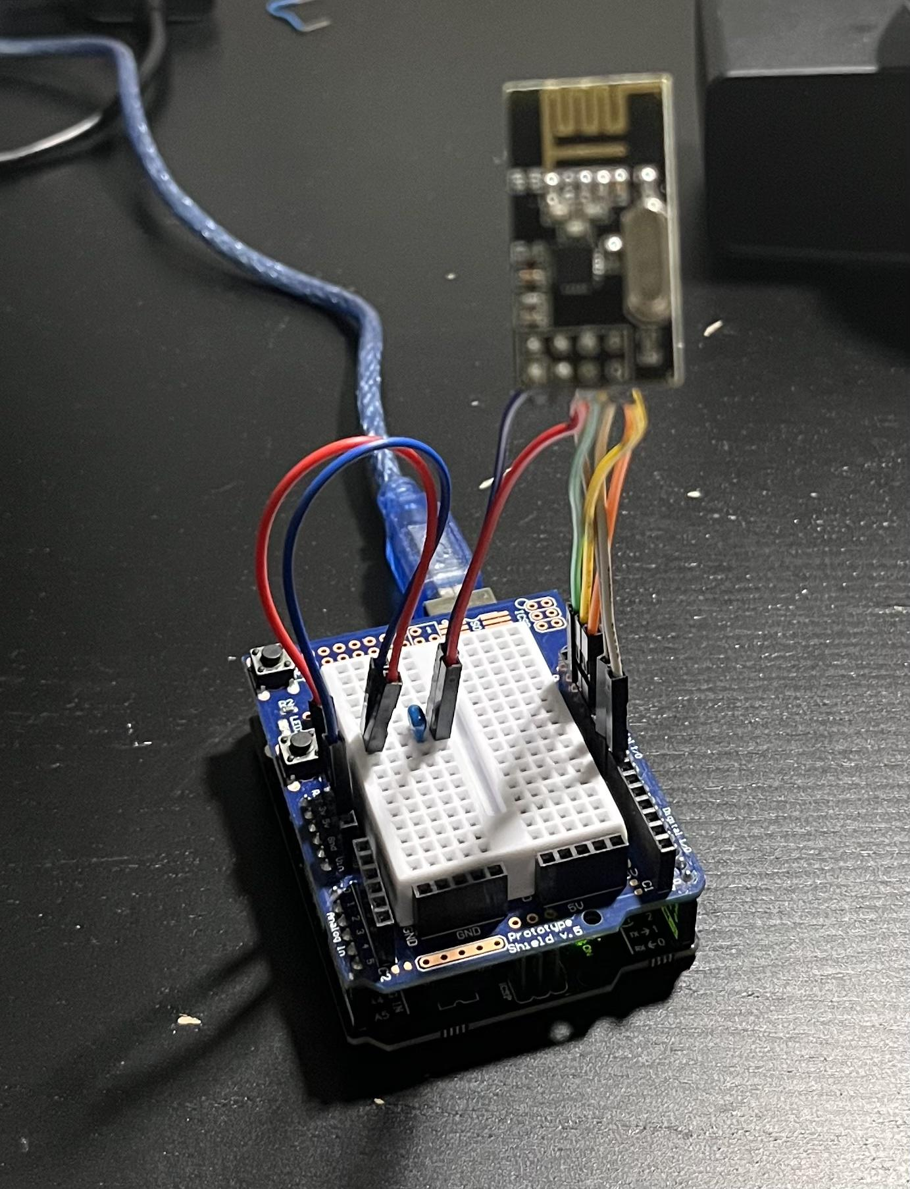
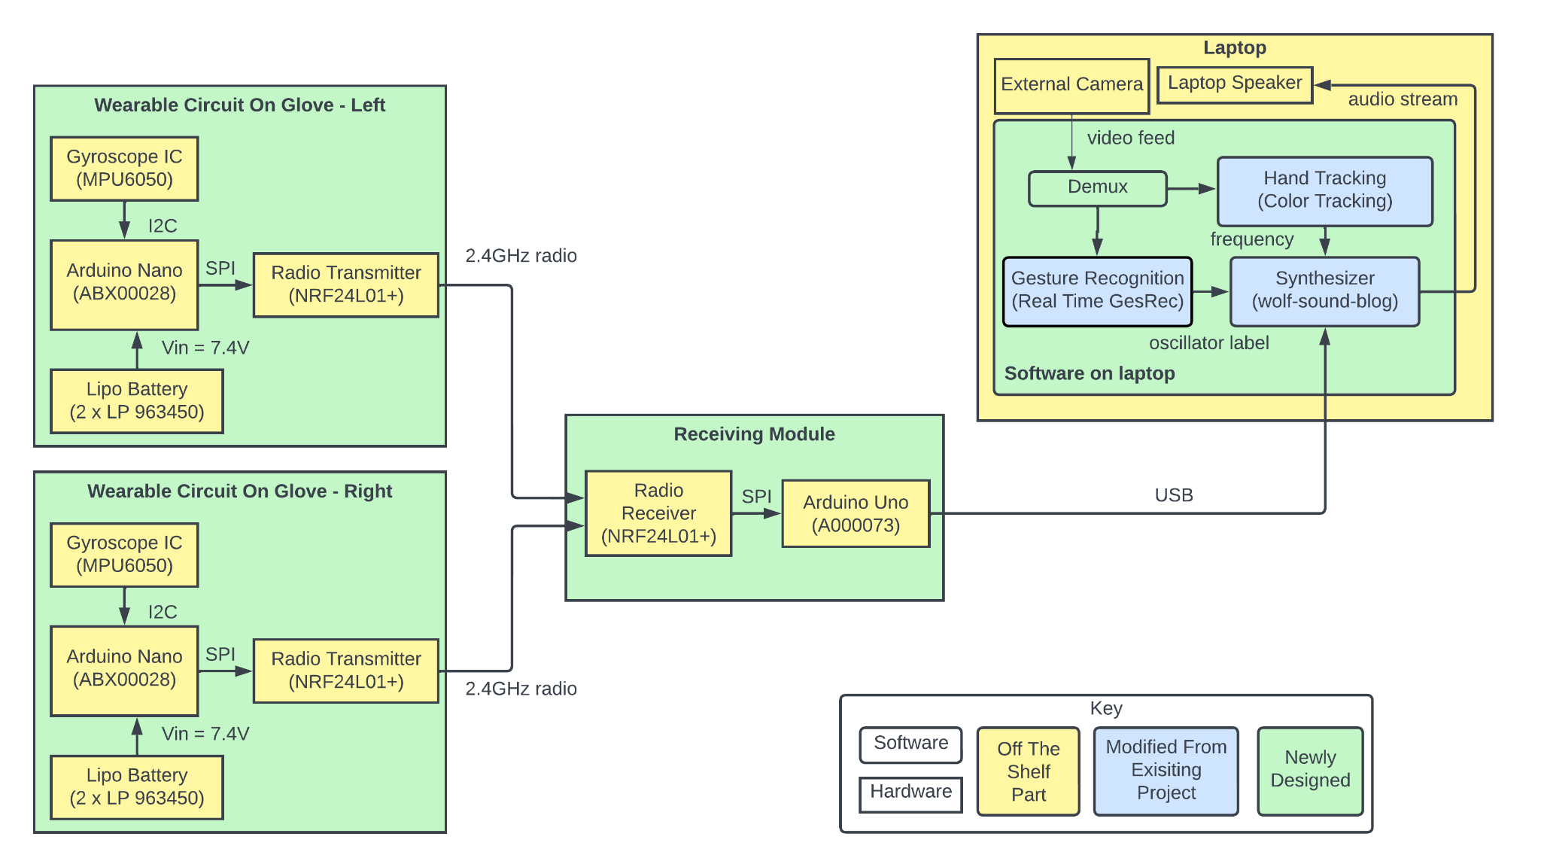
The Emperor's New Instrument
Team D1: Oscar Chen, Yuqi Gong, Karen Song
18-500 Capstone Design, Spring 2023
Electrical and Computer Engineering Department
Carnegie Mellon University
Product Pitch
System Description
Our product is a real-time music synthesizing system that responds to hand movements and gestures. Using computer vision, the system maps gestures and hand positions to predefined oscillators and frequencies. It also employs wireless gloves to translate hand rotations into volume and pitch bending, and a software synthesizer to produce music on the laptop speaker. The system satisfies the user requirements of immediate feedback with a latency of 8.33ms, accurate sound production with a volume offset of ±0.1db, and long battery life of approximately 21+ hours after one full charge. This project allows people to play music with great freedom in musical expressions and at an affordable price.
Wearable Circuit Glove: Each hand glove consists of two LiPO batteries in series, an arduino nano, a gyroscope (MPU6050) and a radio transmitter (NRF24L01+).
Receiver Module: Consists of a NRF24L01+ radio receiver, which can listen to up to 5 different NRF24L01+ radio transmitters. It collects data from the gloves, and send them to the synthesizer program using the Arduino Uno via USB.
Software Module: Consists of mainly three parts, the color tracking model (for position tracking), the gesture recognition model , and the synthesizer.
System Architecture
A
Back
Radio Transmitter
B
"Our system consists of three major subsystems: a pair of wearable gloves, a receiving module, and software that runs on a laptop. Each wearable glove is equipped with a mounted circuit that contains a 3-axis gyroscope IC, an Arduino Nano, a radio transmitter, and two LiPo batteries. The circuit detects the rotation angles of both hands and sends them to the receiving module via 2.4GHz radio.
The receiving module comprises a radio receiver and an Arduino Uno. It collects the angle information via radio and forwards it to the laptop via USB. The software system synthesizes sounds based on the video feed and the information sent by the receiving module.
The software system contains four parts, a demux, a gesture recognition program, a hand tracking program, and a synthesizer. It also collects video feed from an external camera and writes audio streams to the laptop’s speaker.
Gyroscope
Radio
Receiver
Arduino Nano
Palm
Colored Tape
Arduino Uno
Batteries
C
The above image is a screenshot of our color detection module
System Evaluation
We calculated battery life by measuring voltage and current..
Latency is measured as the time between hand angle change and music effect playback.
The volume is tested by comparing the decibel readings of full volume and half volume.
We measured the weight of all components in our system, excluding the laptop.
For plug and playability, we successfully set up our system on three MacBooks and two Windows laptops. The success rate was 100%.
Criteria / Metric | Latency | Portability | High Sound Production Accuracy | Battery Life | Plug-and- Playability
Requirement | ≤ 10 ms | ≤ 4.8 pounds | ± 0.5dB Error | ≥ 5 hours | ≥ 90%
Test Results | 8.33ms | 0.485 pounds | 0.1dB | ≈ 21.6 hours | 100%
Conclusions & Additional Information
Design Trade-Offs:
Camera module
Laptop camera: Variable resolution, no low-light color correction
External webcam: Fixed resolution, adjustable fill light
Battery
9V alkaline battery: 7hr battery life, non-rechargeable
Two 3.7V LiPo batteries: >20hr battery life, rechargeable
Tracking
Hand tracking: >8ms to just track a frame (without rendering)
Color tracking: <2.5ms to both track and render a frame
Our system has performed in accordance with our intended specifications, as indicated by the test results. One thing we learned from this project is that initial design plans are not always foolproof, and there should always be extra time allocated for risk mitigation. If we decide to scale up the project, we might add even more instruments, while enabling real-time transitions between these instruments using gestures.
http://course.ece.cmu.edu/~ece500/projects/s23-teamd1/

