Slide 1
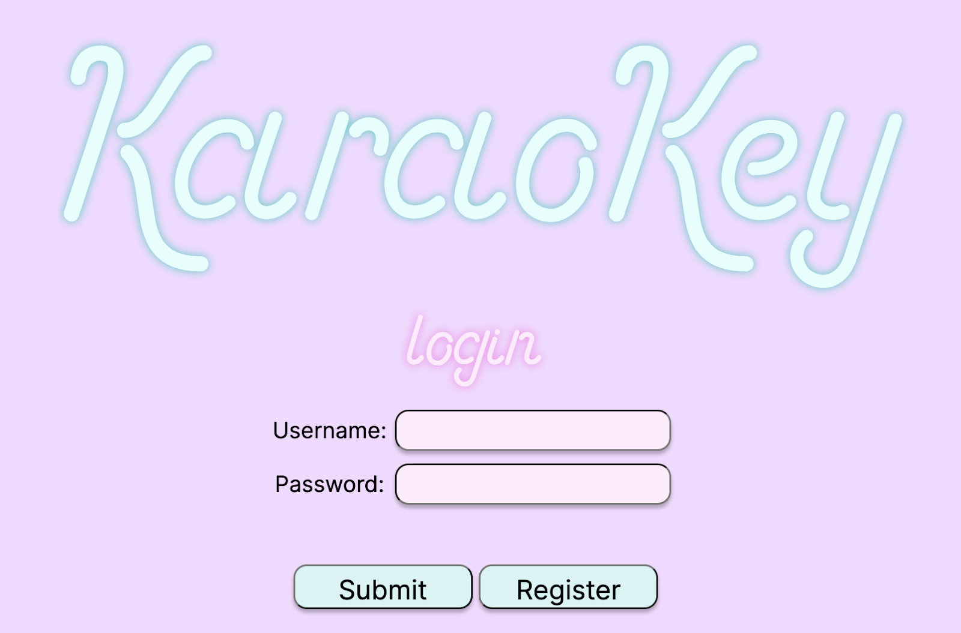
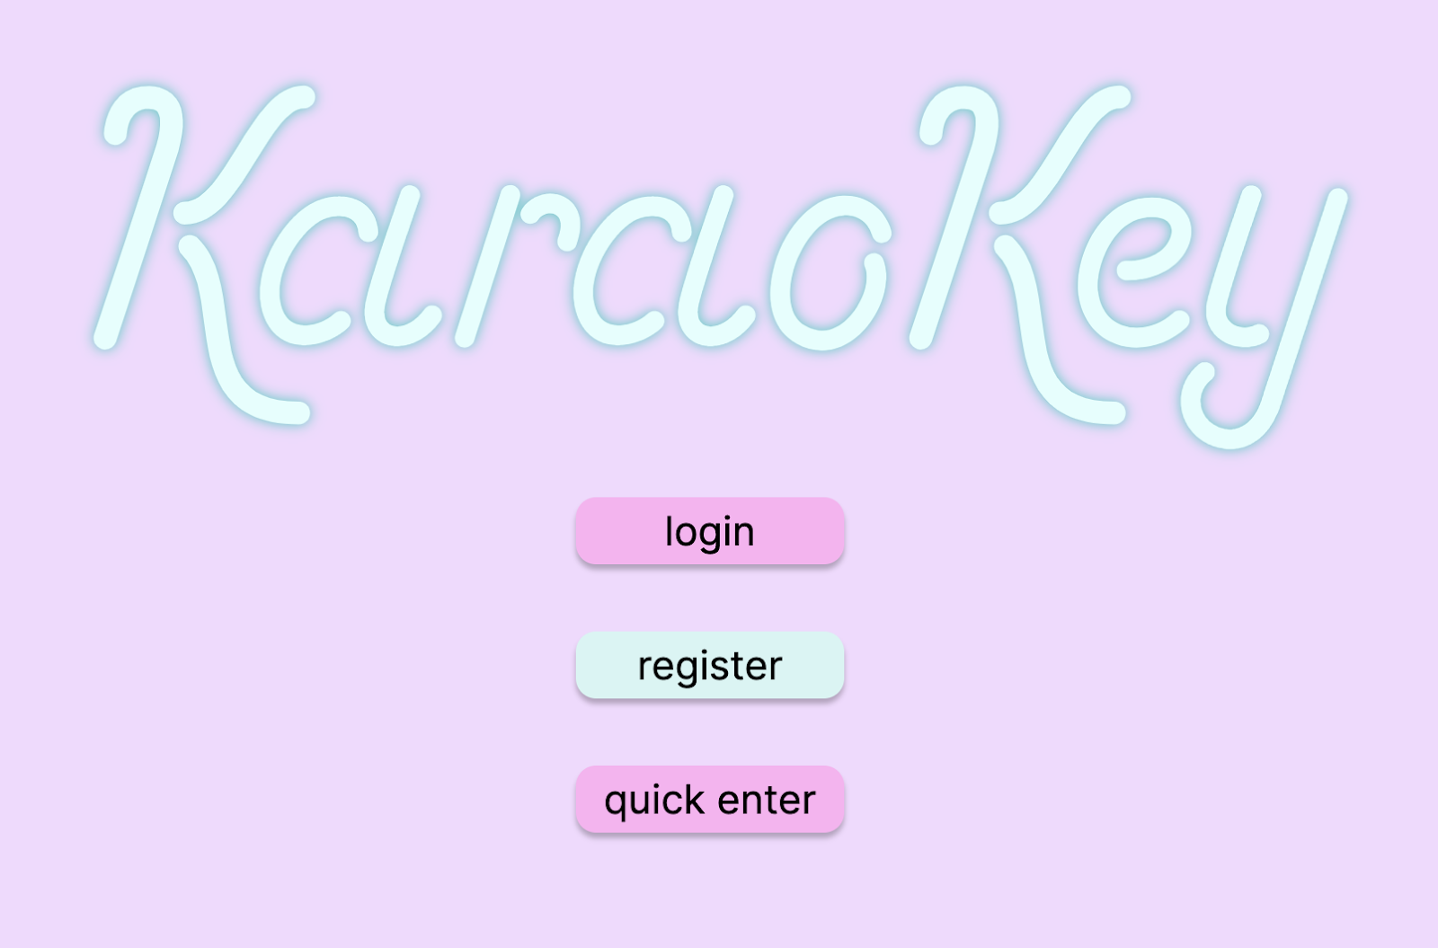
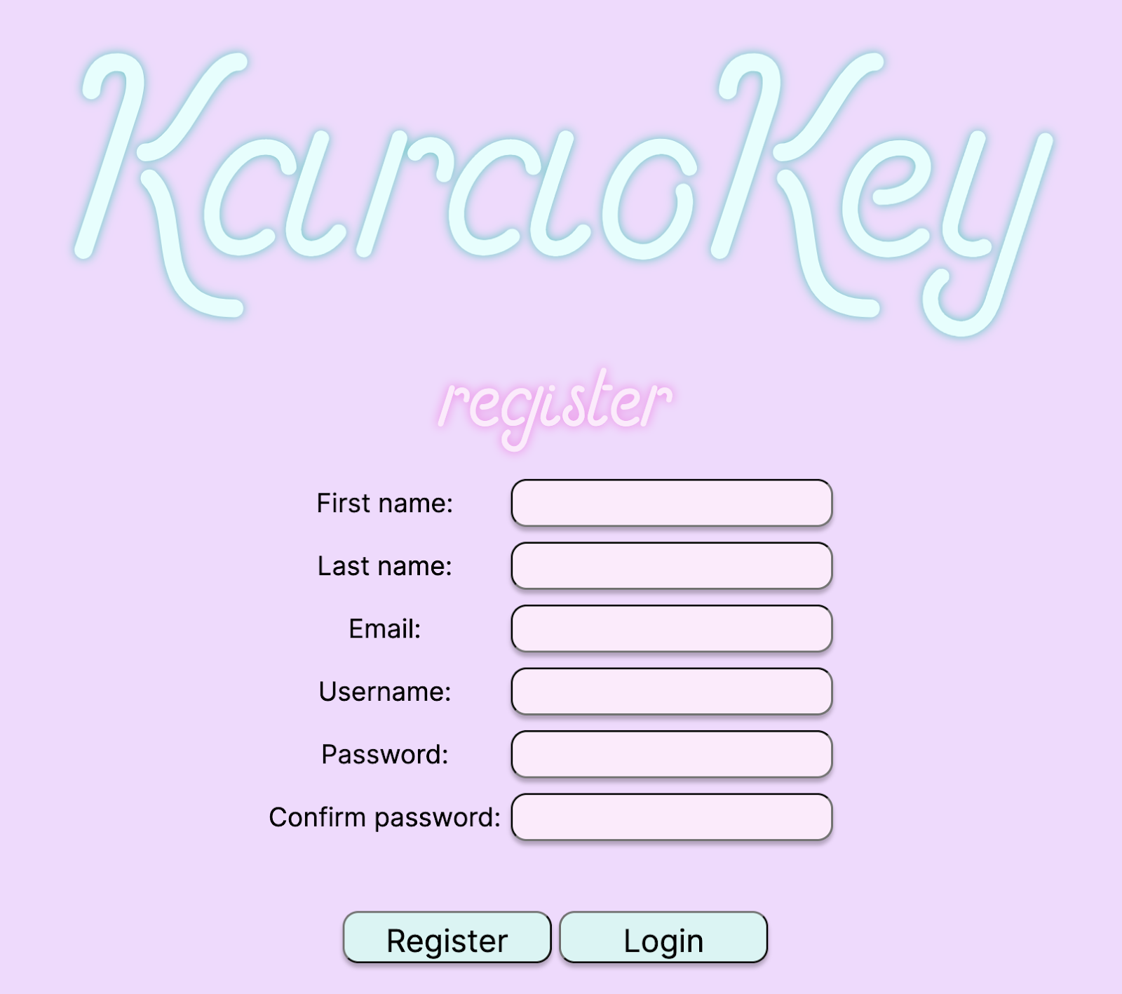
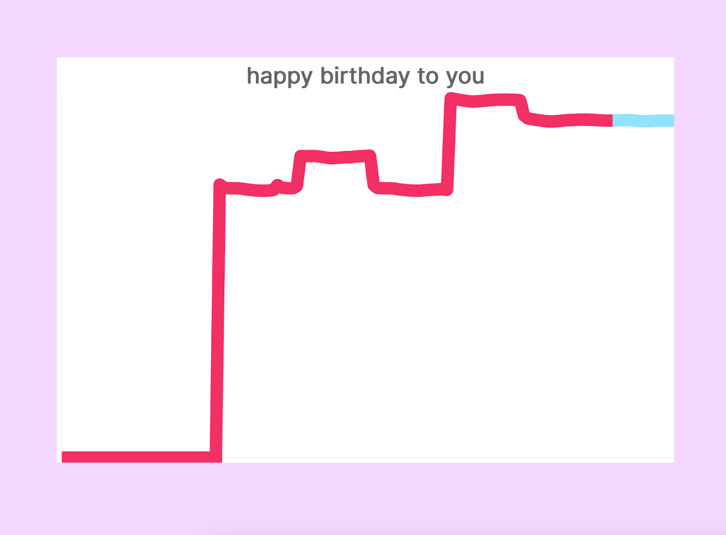
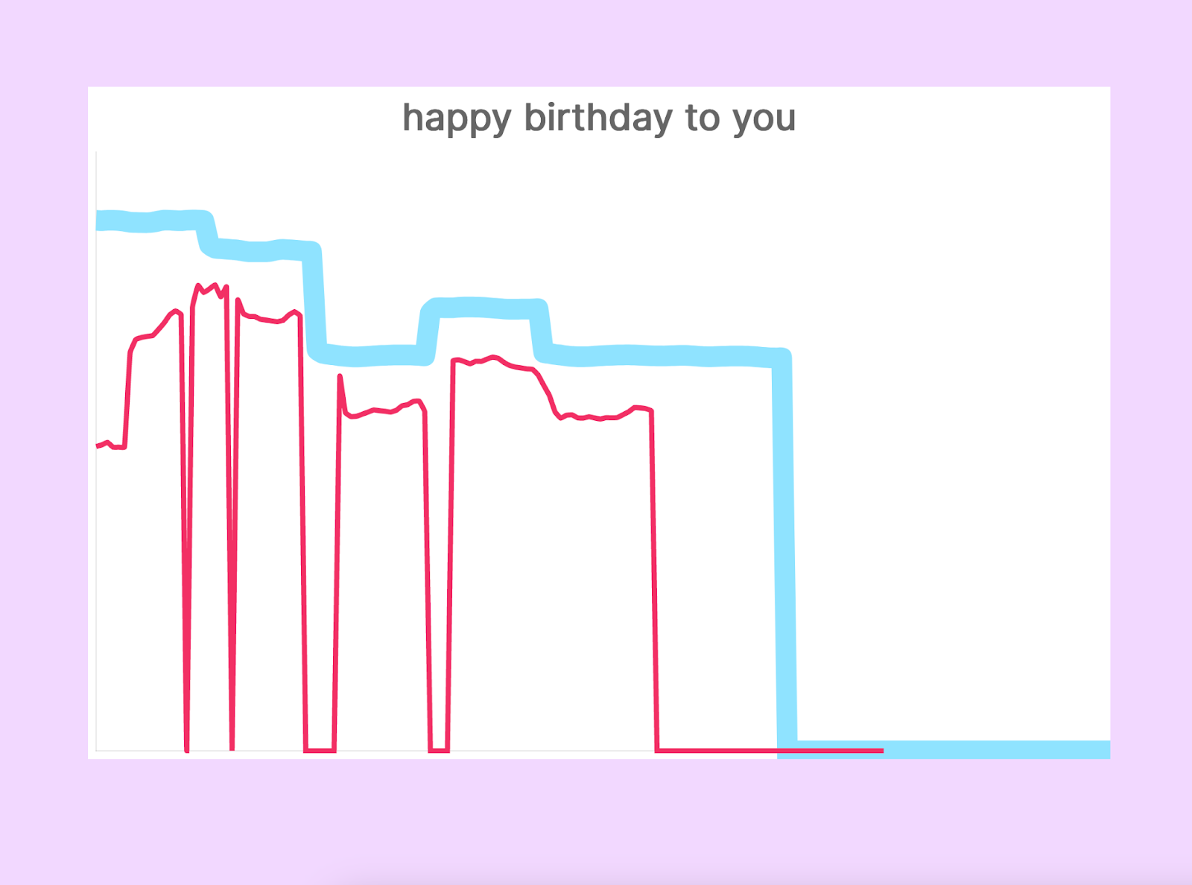
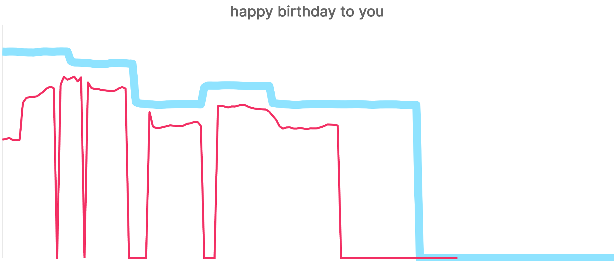
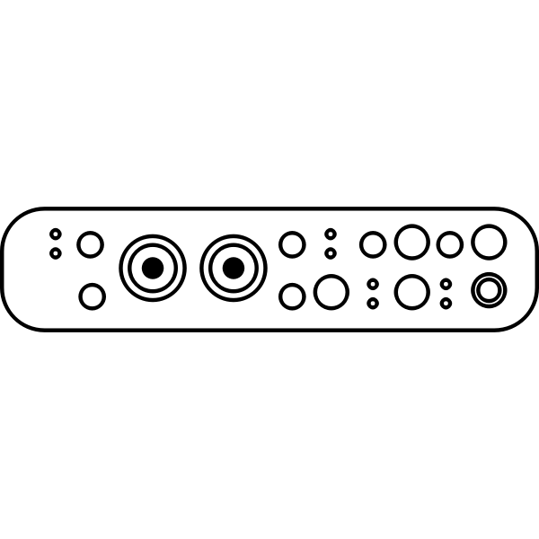
KaraoKey
D0: Kelly Woicik, Anita Ma, Anna Gerchanovsky
18-500 Capstone Design, Spring 2023
Electrical and Computer Engineering Department
Carnegie Mellon University
https://tinyurl.com/teamd0
Product Pitch
System Description
When it comes to reaffirming or growing one’s skills as a casual singer, the options are limited. Vocal coaches are expensive and hard to find. Also, they are often more than what the average singer would need, as vocal coaches target upper echelon singers.
KaraoKey is a free web application that provides asynchronous feedback for casual singers to reaffirm their singing abilities. We are taking a gamified approach inspired by one of the most popular and successful educational apps, Duolingo. Users record themselves singing with the backing track and our web app will provide a visualization, as well as overall feedback of their performance.
Our use case requirements include pitch detection accuracy, latency in inputted song processing, and latency in post-song analysis. Our system meets and exceeds these requirements, with our pitch detection accuracy at 99.4%, latency in inputted song processing at 0.51 seconds, and latency in post-song analysis at 0.26 seconds.
To use KaraoKey, the user signs in (or registers). Next, the user selects a song to perform and performs it, while the backing track plays. The user sees lyrics and target pitch at this time. Afterwards, the user is navigated to see their results, where they view a similar graph, now with their pitch also displayed, and receive numerical feedback on their success.
Login Screen
Home Screen
Song Selection Screen
Sign Up Screen
Recording Screen
Visualization Screen
For demo purposes, we are using KaraoKey in conjunction with a headset microphone and audio interface. This ensures better audio quality, especially in a potentially noisy area. However, these are not necessary for KaraoKey and we have also successfully used it without them.
System Architecture
Django
Downloadable .ogg File
lyrics
AJAX Updates
Frontend UI
target pitch
Local Development
MediaStream
Focusrite Scarlett Solo 3rd Gen
Audio-Technica BPHS1
User
Audio Processing
user pitch
Django
Aubio
Results of user performance vs target pitch displayed via graph
AJAX Updates
Frontend UI
System Evaluation
Local Development
Downloadable .ogg File
Requirement | Result | Quantitative Limit
Latency in real time feedback (AJAX) | 0.05s | Under 0.25s
Latency in inputted song processing | 0.51s | <= 10s
Latency in analysis | 0.26s | < 5s
Pitch accuracy | 99.4%* | >= 90%
User
Conclusions & Additional Information
While we had to pivot our project to include an asynchronous feedback mechanism, we believe that we exceeded our original use case requirements.
We learned that there are tradeoffs in every design decision, and that these tradeoffs must be evaluated for both short and long term impacts. For example, using an already existing PDA module was great for early stages of development, but when it came to system integration, it quickly became a bottleneck.
In the future, we can consider creating our own PDA. This would allow use to have more control over our system integration and allow us to incorporate synchronous, real-time feedback.
*ignores octave errors
To measure latency, automated testing using Python’s time module was used.
To evaluate our system’s pitch detection accuracy, 108 known pitches as well as songs with known pitches were fed into our PDA and the output was compared to the known expected result.

