Slide 1
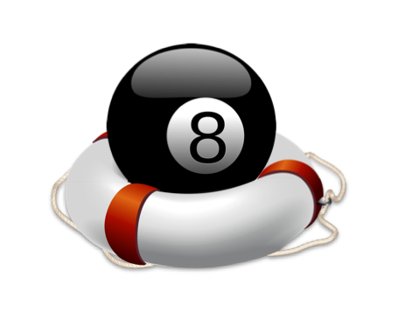
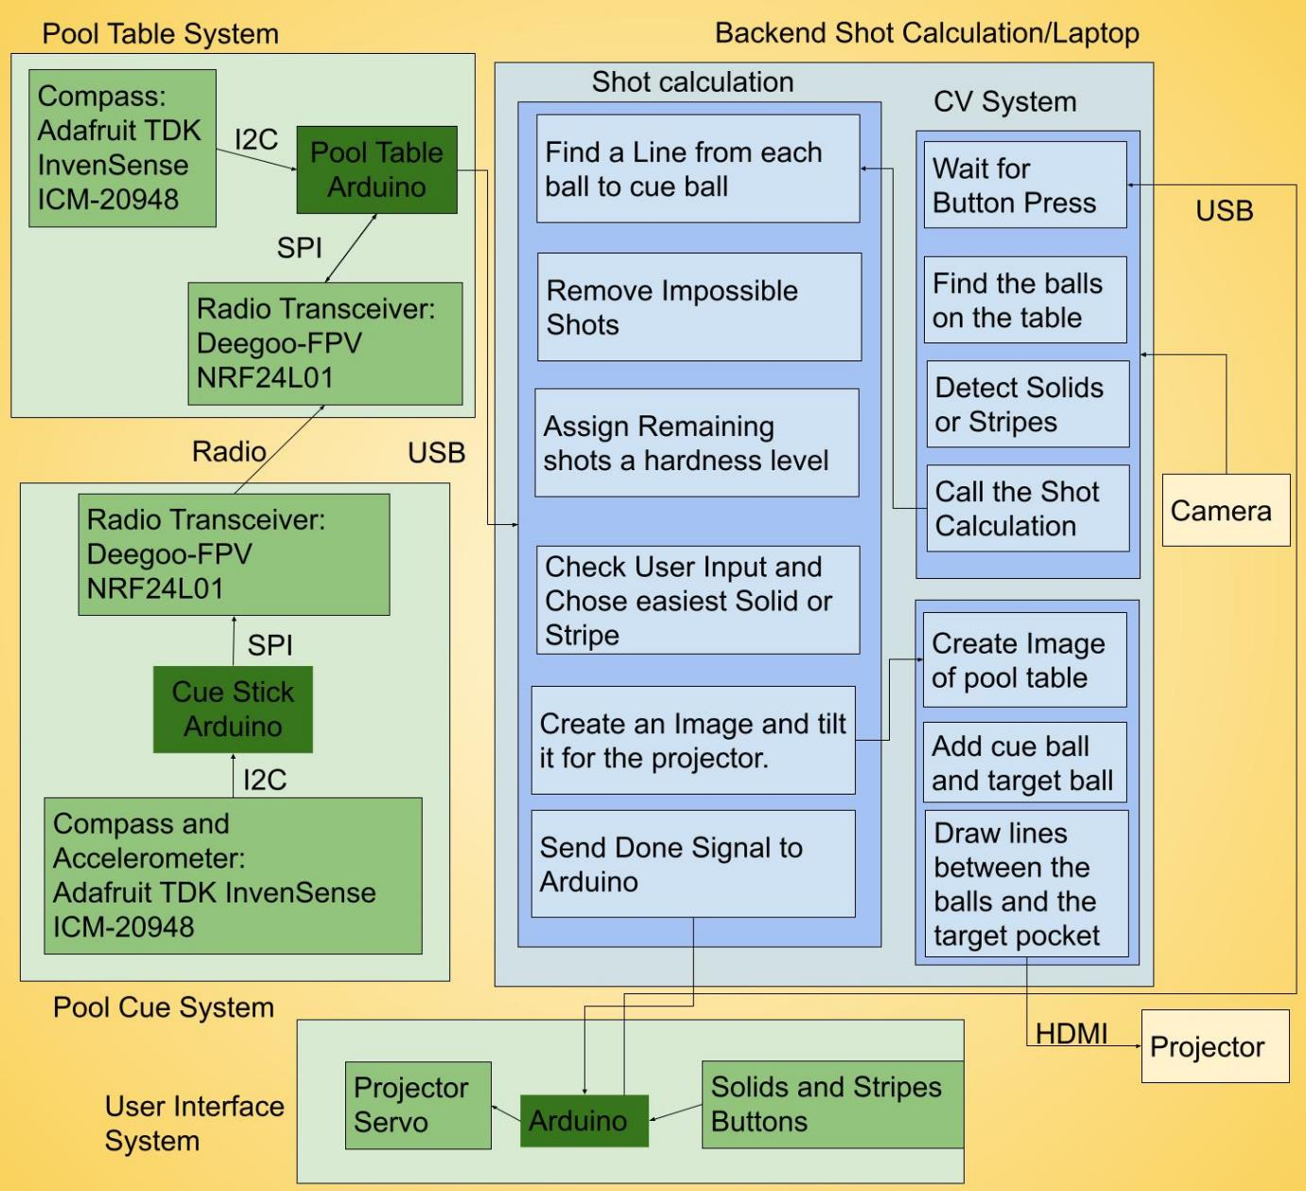
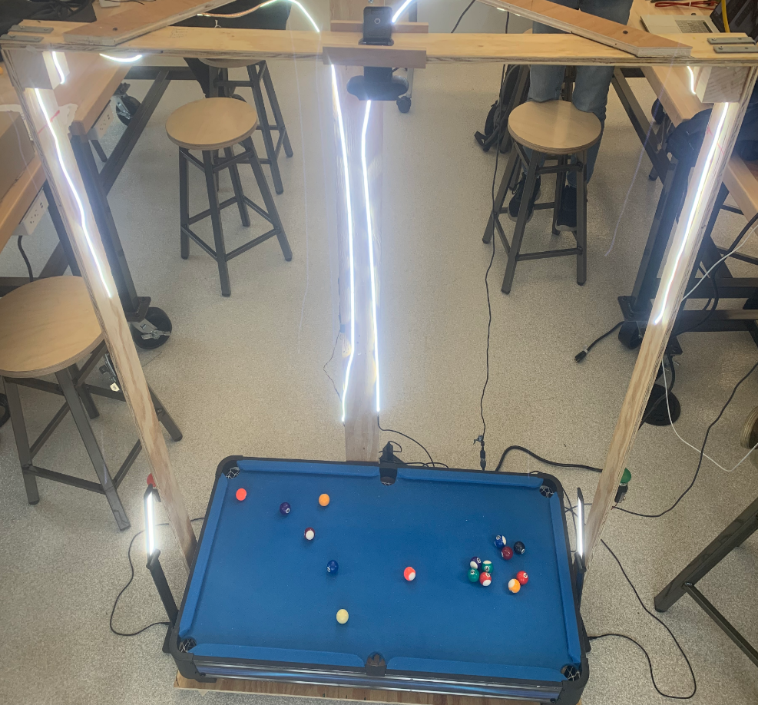
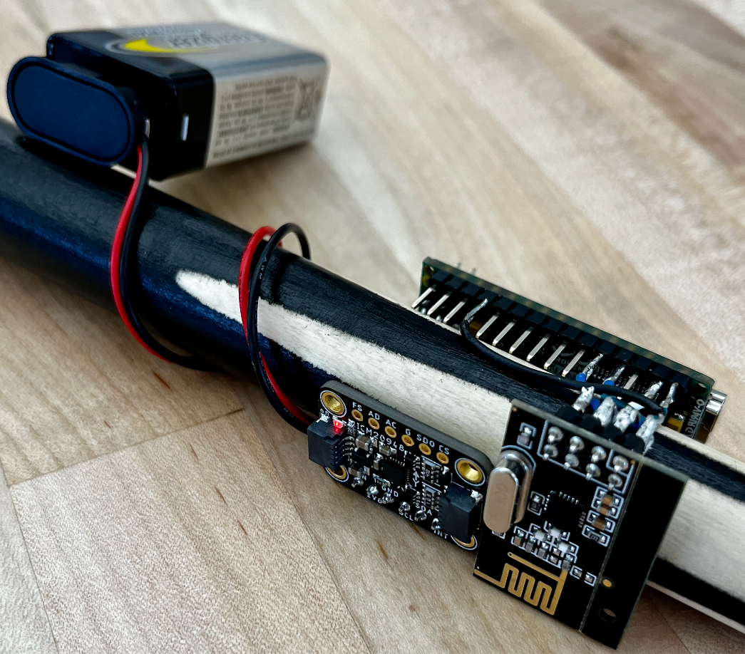
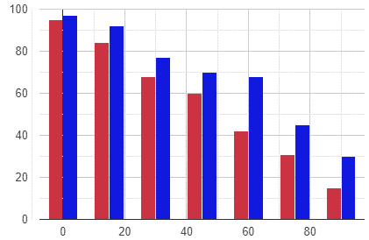
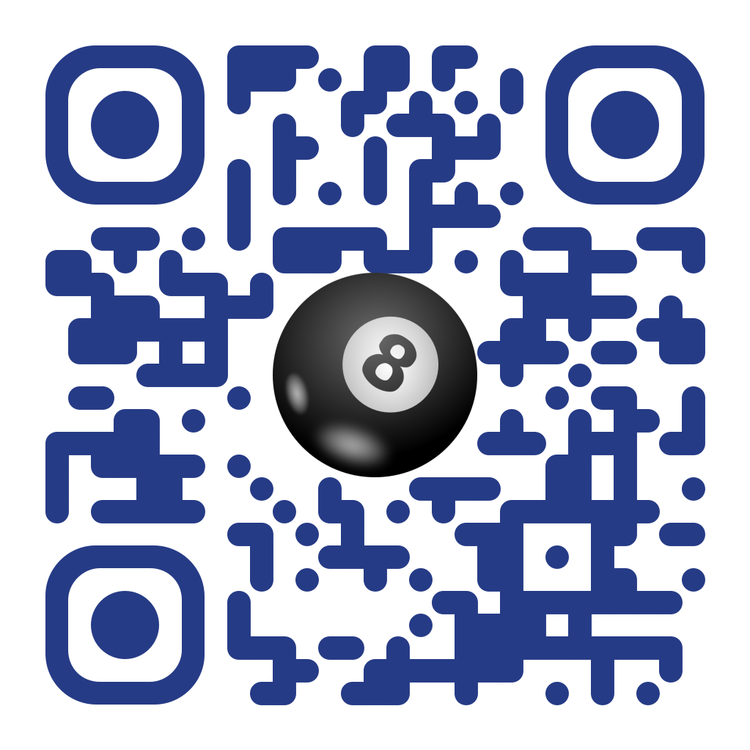
8-Ball Lifeguard
So you don’t drown at the pool table
Team C7: Devank Agarwal, Jimmy Ray, Justin Rager
18-500 Capstone Design, Spring 2023
Electrical and Computer Engineering Department
Carnegie Mellon University
Product Pitch
System Description
Our project serves as a way for beginners to practice and learn 8-ball pool. We project a shot for them to make, and provide feedback once they have made their shot. We want to give a correct shot (<2° margin of error) in an efficient manner (<3 seconds) with accurate feedback (<0.5 m/s²).
8-Ball pool is a hard game to learn. Additionally, in most places, coaching is expensive and inaccessible. The idea behind our project is to show people what the best shot for either a solid or a stripe is at any given game state, help them make this shot, and give feedback about their shot. Our best shot algorithm calculates the simplest shots to make and projects one onto the table. We do this to make it as simple as possible for users to pocket a ball, no matter what the game state is. We then take our collected data and project it onto the table as feedback for the user.
Our system has 5 main Systems:
Computer Vision System
This will take a picture of a the pool table after the user presses a button to signal Solids or Stripes. It will then find the balls by looking for circular objects and calculate which balls are solids or stripes.
Backend Shot Calculation
It will take in the positions of all of the balls and the target (Solids or Stripes) and calculate all possible shots. It then will calculate the easiest shot from the possible shots and send that shot to the projector system.
Projector System
This will take in the best possible shot, create an image of all of the balls on the table, and then draw lines of the best possible shot so the user can follow the lines for their shot. It also will take in feedback for the user from the Pool Table System and project it onto the table.
Pool Stick System
This will measure the direction the pool stick is facing as well as the acceleration of the pool stick. It will then send the data collected back to the Pool Table System
Pool Table System
It takes in the raw data from the Pool Stick System and processes it so that it will determine when a shot has occurred. Once a shot has occurred it will send feedback of the how far off the angle of the user’s shot versus the ideal shot was.
System Architecture
Computer Vision System
Pool Stick System
LED Lighting
Camera
Battery
Arduino Nano
Buttons
Accelerometer and Compass Sensors
Radio Transceiver
System Evaluation and Testing
We had two different testing methods:
Conclusions & Additional Information
System Performance Test Suite.
Over here, we measured the efficiency and correctness of our systems. We ran 5 main tests, the results of which are as follows:
2. User Test Suite: The User test suite compared the performance of users with and without our system.
Through the course of these 13 weeks, we learnt a lot by doing this project. Our team picked up Computer Vision as a topic even though none of us had any experience with the same and we got to a point where we had a working CV system. We did not have a lot of experience with woodworking and were able to build a more reliable frame than we expected. Microcontroller Communication and Game Based Physics and Maths are not topics that anyone of us were an expert in. Due to delays in deliveries and unforeseen complications to the projects there are some aspects we wanted to integrate but did not have the time to, and moving forward the ways we could improve on this project are as follows:
Add more features to shot calculation to calculate bounce and chained shots.
Run a Machine Learning model on game states to better classify a best shot heuristic.
Fine Tune Sensors and remove unwanted noise from the Smart Cue system.
User Performance
Test | Result
End To End Latency (Time taken from press to projection) | 1.5 seconds
Angle Deviation (Actual Shot vs Projected Shot) | 1.5°
Camera Capturing (Percentage of Table Accurately Captured) | Ideal: 95% Not: 65%
Feedback Latency (Time from shot to feedback) | 0.75 seconds
Feedback Correctness (Angle Deviation and Speed Differences) | 2° 0.4m/s²
Without System With System
Percentage of Shots Made
Angle Difference between line connecting Cue Ball to Target Ball and the line connecting Target Ball to Pocket
http://course.ece.cmu.edu/~ece500/projects/s23-teamc7/

