Slide 1
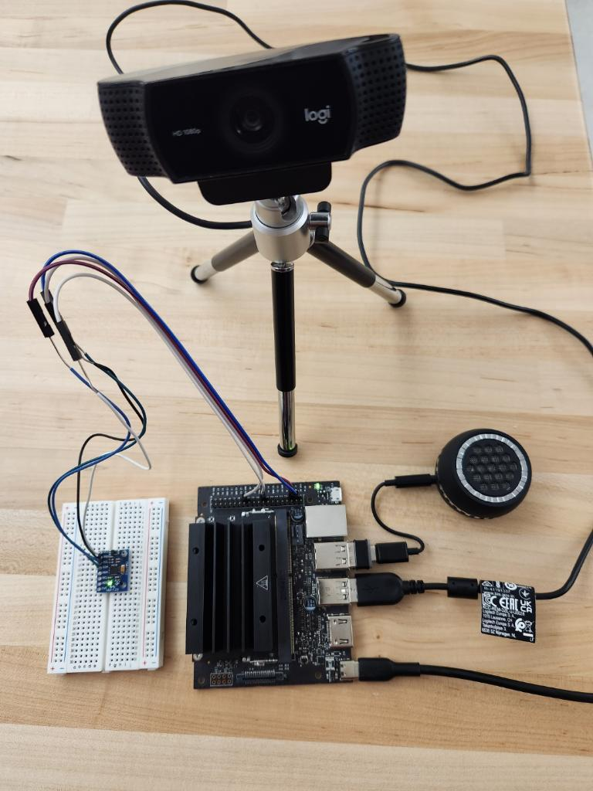
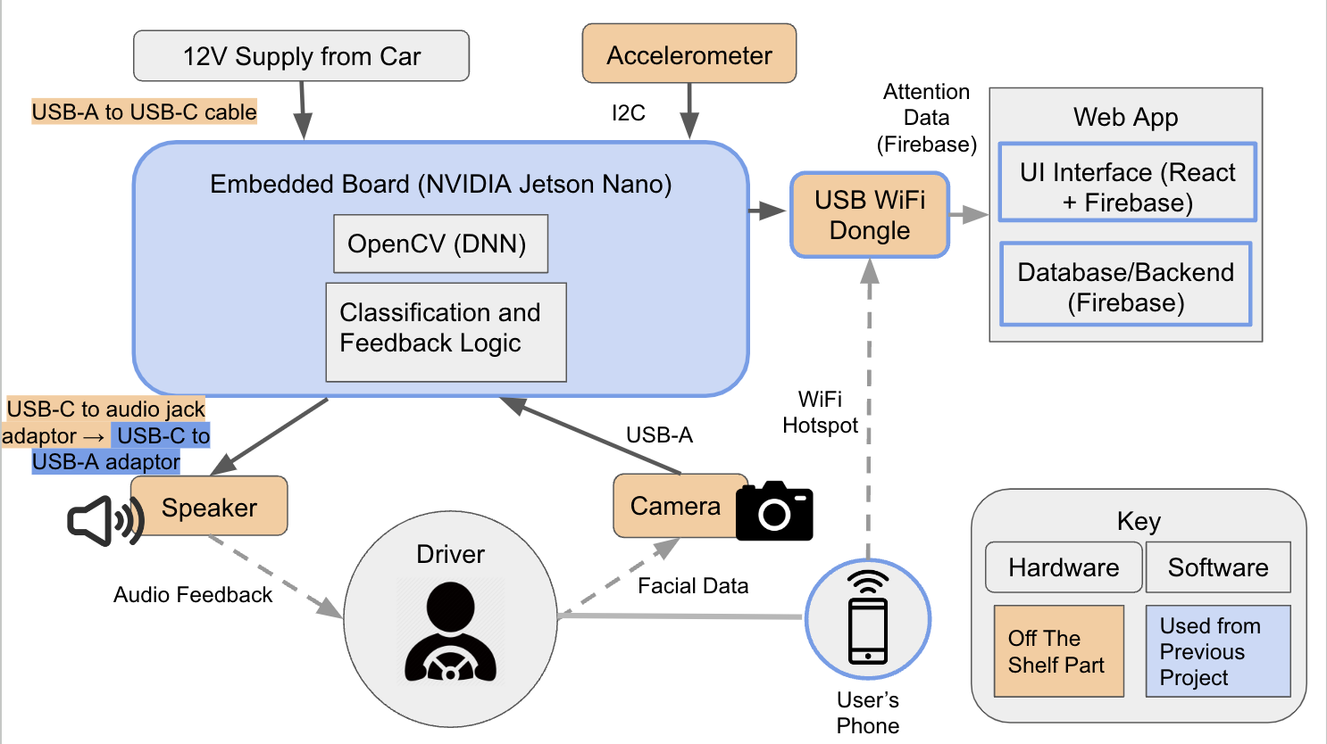
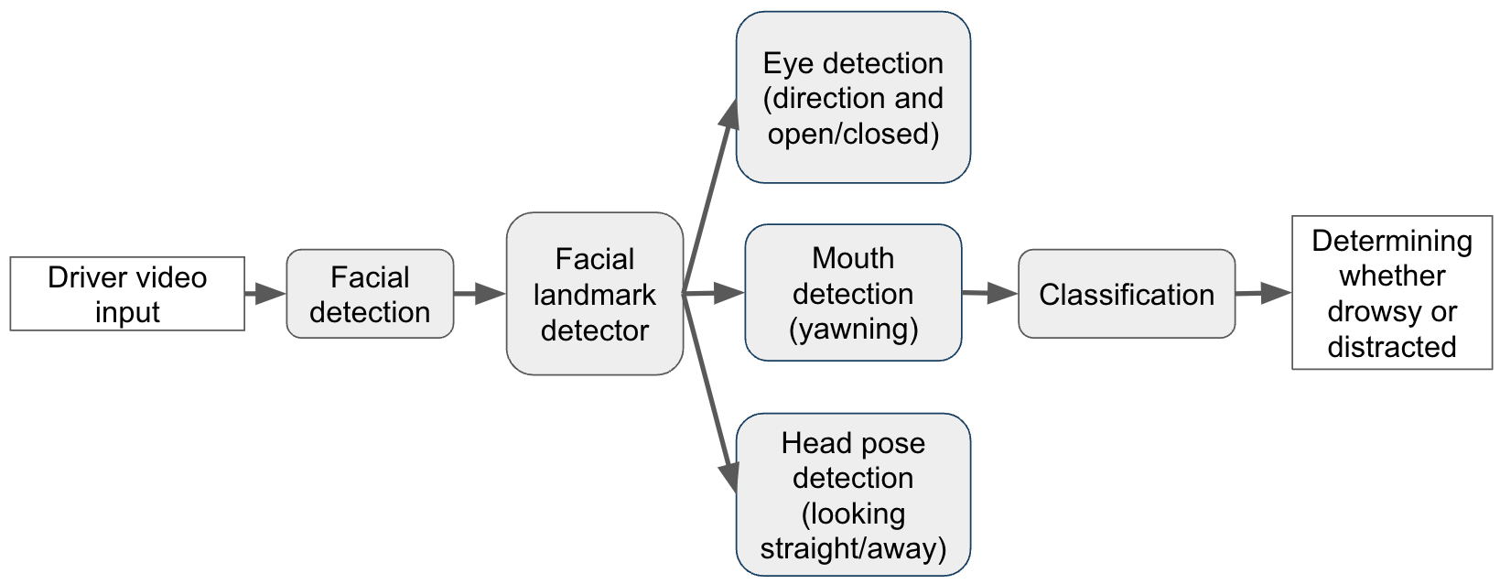
DriveWise
C5: Sirisha Brahmandam, Yasser Corzo, Elinora Stoney
18-500 Capstone Design, Spring 2023
Electrical and Computer Engineering Department
Carnegie Mellon University
Product Pitch
System Description
Many current car safety systems don’t provide drivers feedback regarding their attention to the road. We developed DriveWise as a device that gives users real-time auditory feedback about their levels on inattention and drowsiness when driving through the use of facial detection and eye tracking. With this feedback, users can develop safer driving practices.
The most critical requirements were that the device provided clear and concise feedback for greater than two seconds of inattention, the accuracy is around 90% in ideal conditions, and that the computation time is less than one second. We were able to achieve around a 94% accuracy in ideal conditions and with virtually no latency between classification and giving the feedback.
This project covers the ECE areas of signals and systems along with software.
Our system utilizes a Jetson Nano with a camera, speaker, and accelerometer attached. The camera is used to record a driver’s face to track their eyes, mouth, and head position. Using features such as closed eye detection, yawn detection, and what direction the user’s head is facing, we are able to determine whether or not they are exhibiting signs of drowsiness or inattention. Based on the classification, we output feedback through the speaker so the user can make corrections.
The accelerometer is used to detect if the car is coming to a stop or reversing because we want to turn feedback off in these cases since it is okay for the driver to turn their head.
We also have a web application that tracks the metrics and has feedback logs.
Camera
Wifi Dongle
Speaker
System Architecture
The device is powered by the 12V USB-A port in the user’s car, connected to the Jetson via a USB-A to USB-C adaptor. The Jetson houses all of the machine learning and computer vision capabilities, as well as the classification and feedback logic.
When the car is powered on, the device will immediately turn on and the camera will begin recording a video of the driver’s face. However, feedback will not be enabled until the accelerometer (connected to the Jetson via I2C) detects that the car is moving faster than 5 mph. .
As the Jetson is connected to a live camera feed, frames will be sent to the OpenCV DNN module and its artificial neural network where, along with the landmark detector, will help classify whether a driver is distracted or drowsy through eye and mouth detection. If this is the case, audio feedback will be relayed to the driver through a connected speaker.
Upon triggering feedback, the Jetson will also add classification data to our Firebase Firestore over WiFi (using the WiFi dongle) to our web application for the user to view when they log in. The web application itself will be hosted on Firebase, with the frontend programmed using React.
Accelerometer
Jetson Nano
System Evaluation
To test our system, we had users perform a gesture corresponding the features we implemented and recorded how many classifications were correct.
We also had tests for each of our requirements, and the results are in the table below.
Requirement | Metric | Results
Driver shouldn’t take eyes off of the road for >2 seconds | Eyes looking away for >2 seconds using frontal view | 95% in ideal conditions 80% in non-ideal conditions
Driver shouldn’t fall asleep at the wheel | Changes in yawning and eyes closed | ~100% in ideal conditions 95% in non-ideal conditions
Device accuracy in ideal and non-ideal conditions | Aiming for 90% in ideal conditions and 85% in non-ideal conditions | 94% in ideal conditions 86% in non-ideal conditions
Driver is classified and feedback is given in <1 second | Feedback is given in <1 second so user can react in <2 seconds | ~0 second latency
Some design trade-offs we made were choosing the Jetson Nano over the Jetson Xavier, using DLib over cnn-facial-landmarks, using a wifi dongle over a cellular dongle, and using Firebase over AWS for hosting and storage of the web application.
Fig 1. System Block Diagram
Conclusions & Additional Information
Overall, our system was able to exceed the expectations we had when we evaluated it. It also covered all of our other requirements such as being able to be powered by the car, using Wifi, and remaining at a non-distracting size. For the future, we would like to work on tuning the accuracy even more and add more features to make DriveWise a holistic device.
We learned how challenging computer vision is because its results can change significantly from the tiniest change in lighting. We also gained a lot of experience in the engineering process.
Fig 2. Software Specification Diagram
http://wise.ece.cmu.edu/redmine/projects/safebike/wiki/
Fig 3. Block Diagram for Computer Vision Algorithm
Notes:
Light blue: rgb(113, 178, 246)
Dark blue: rgb(72, 93, 114)

