Slide 1
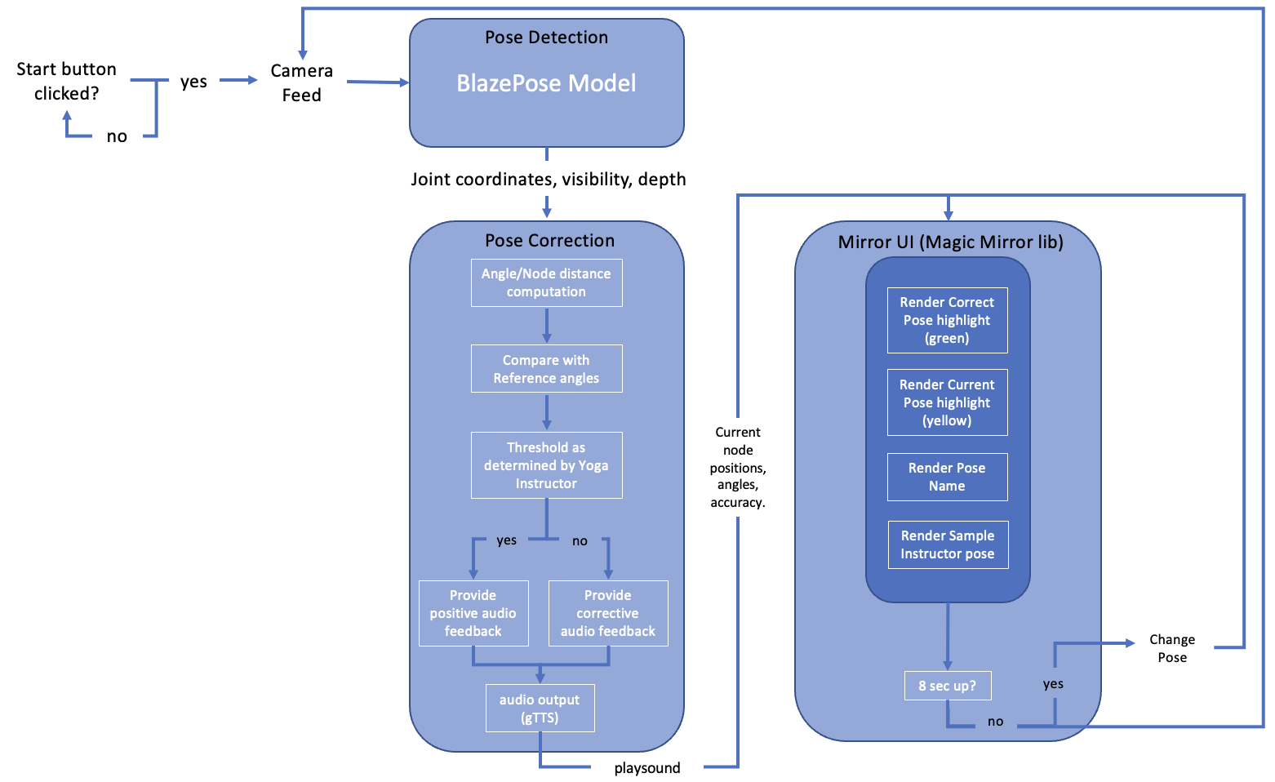
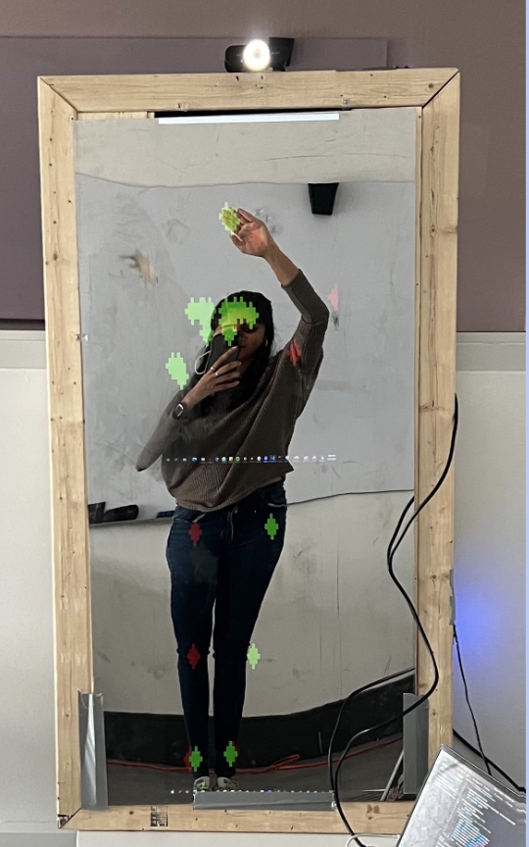
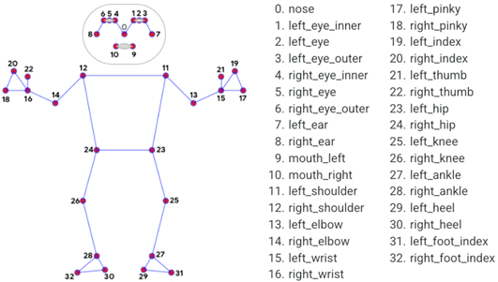
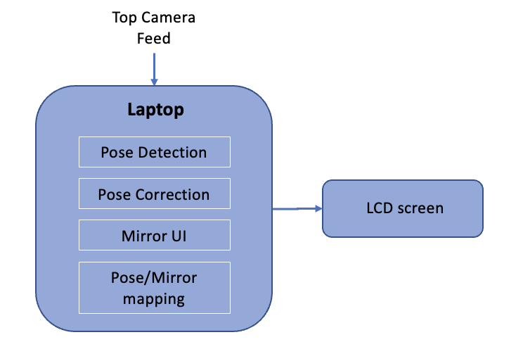
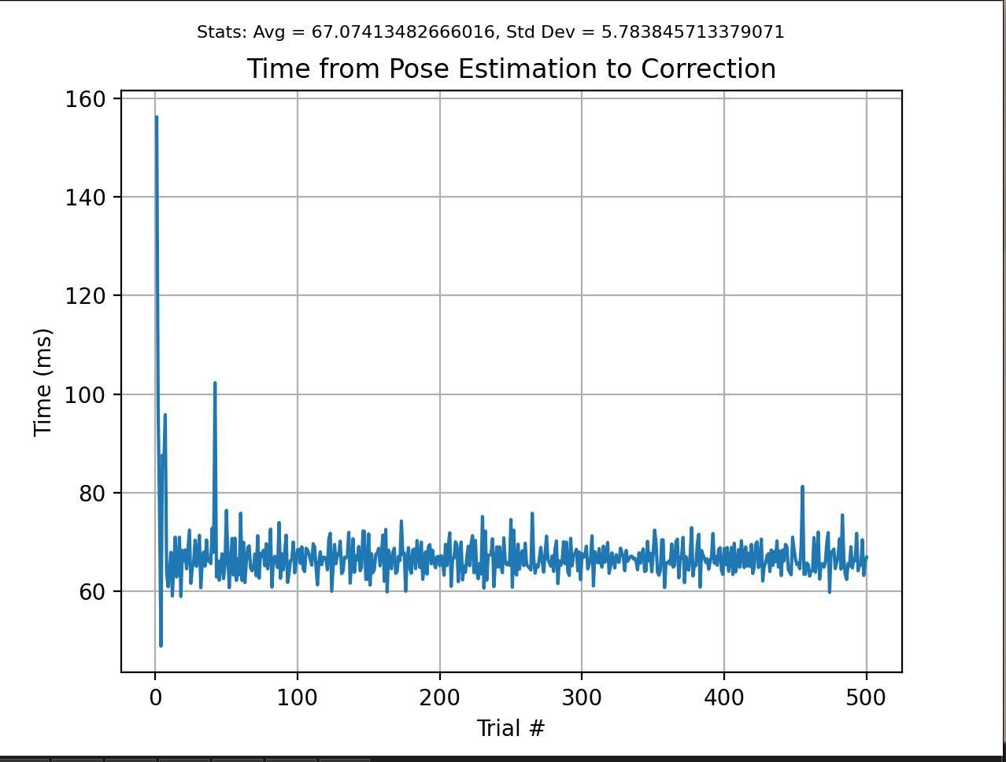
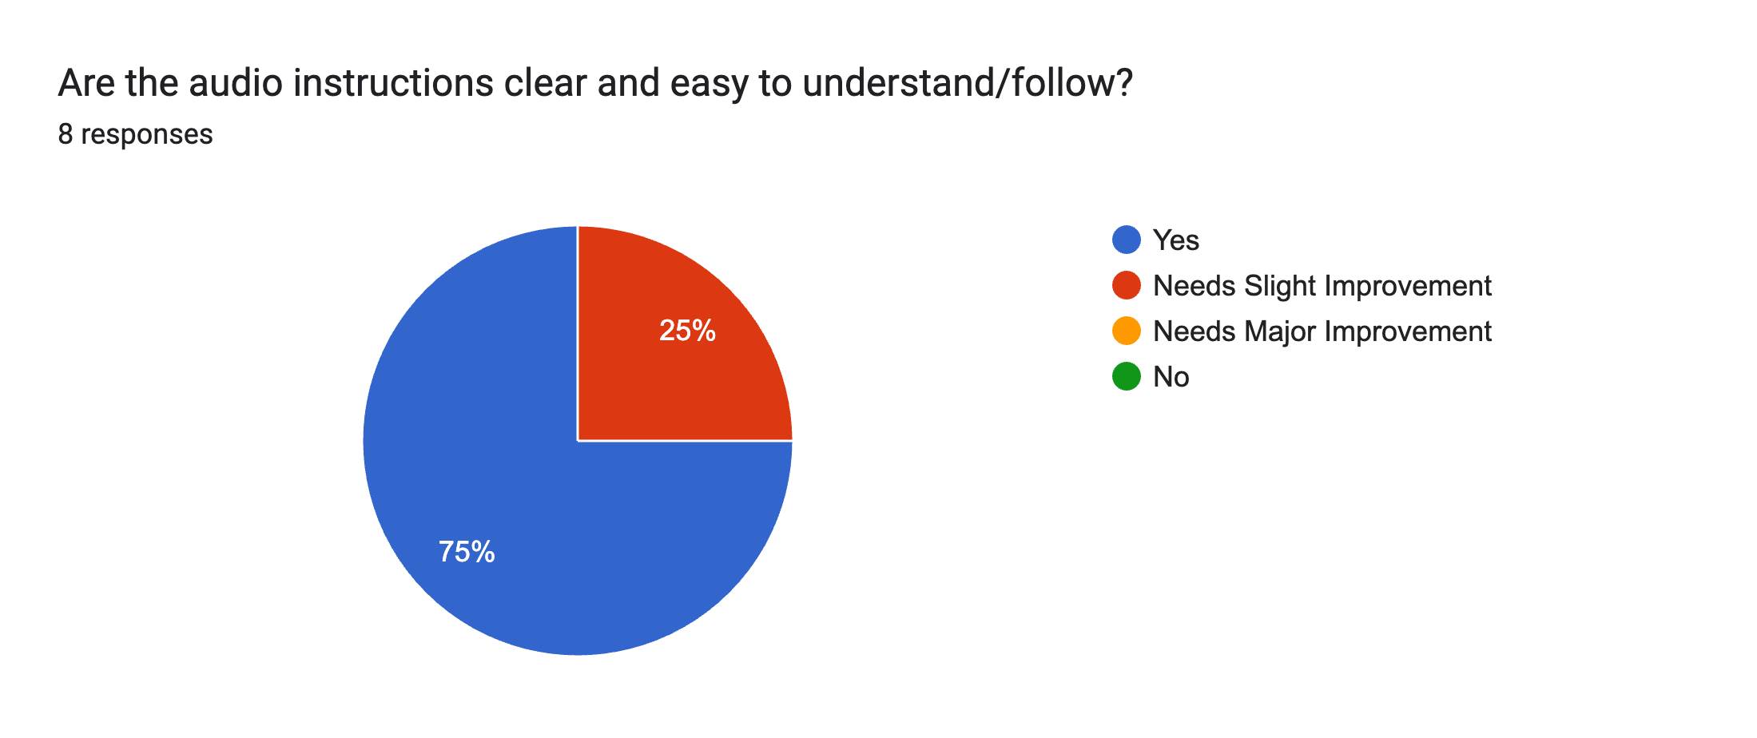
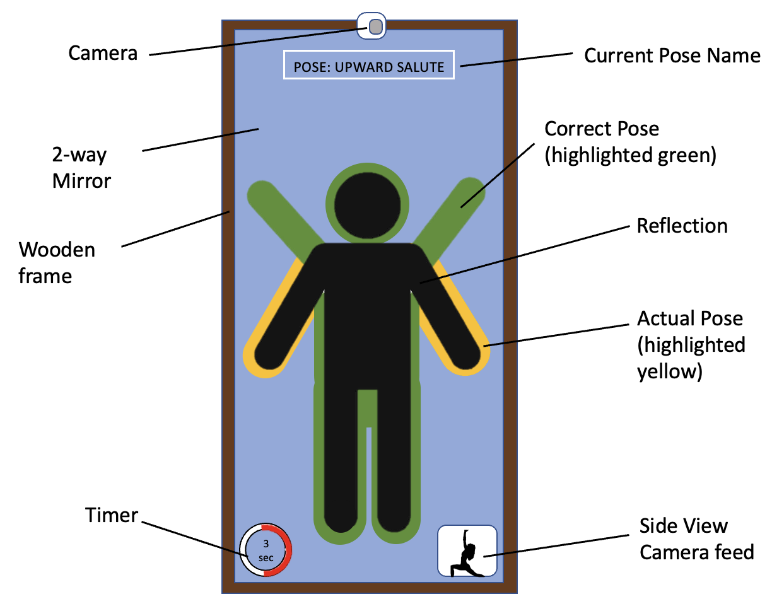
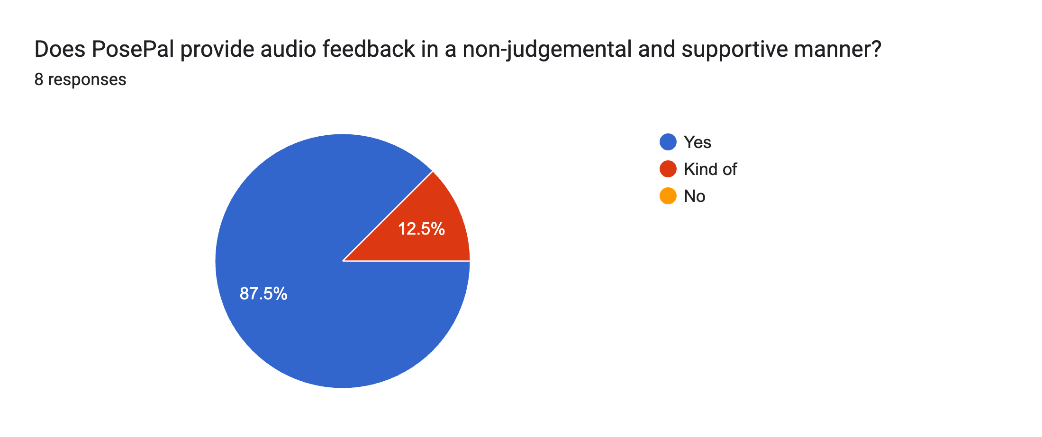
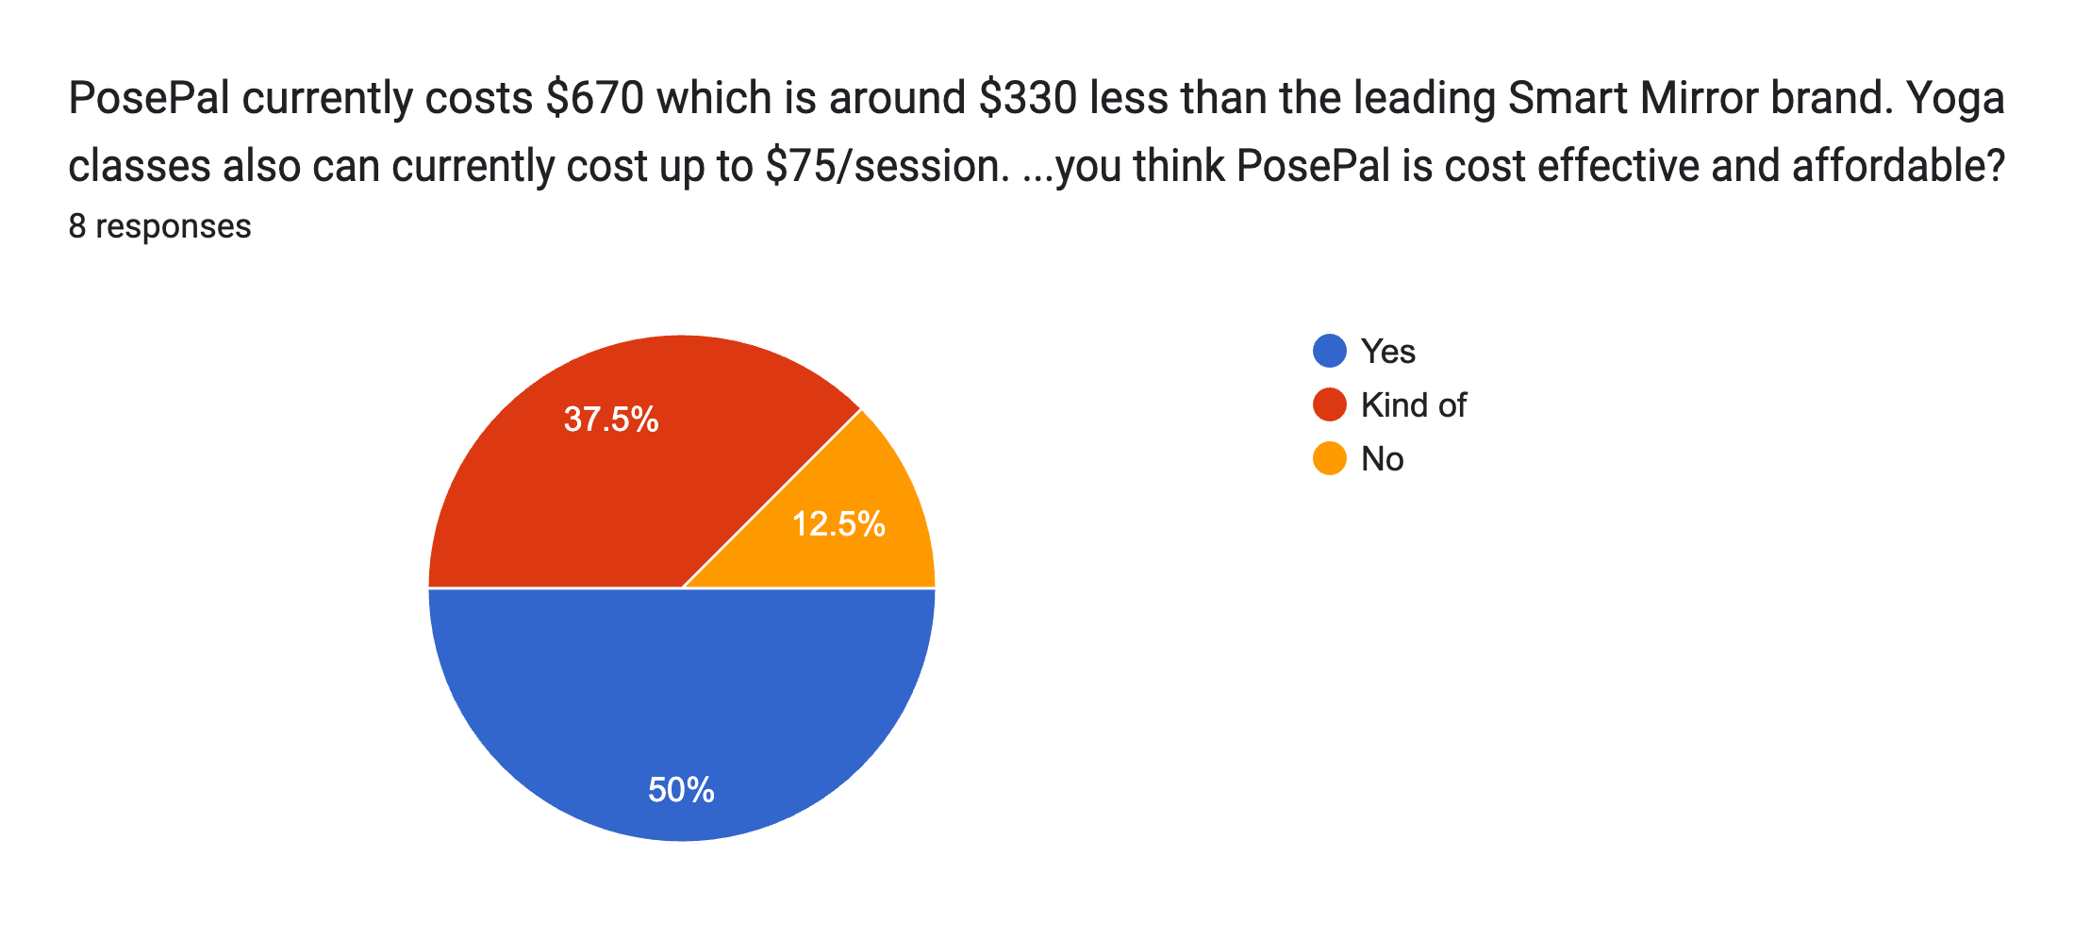
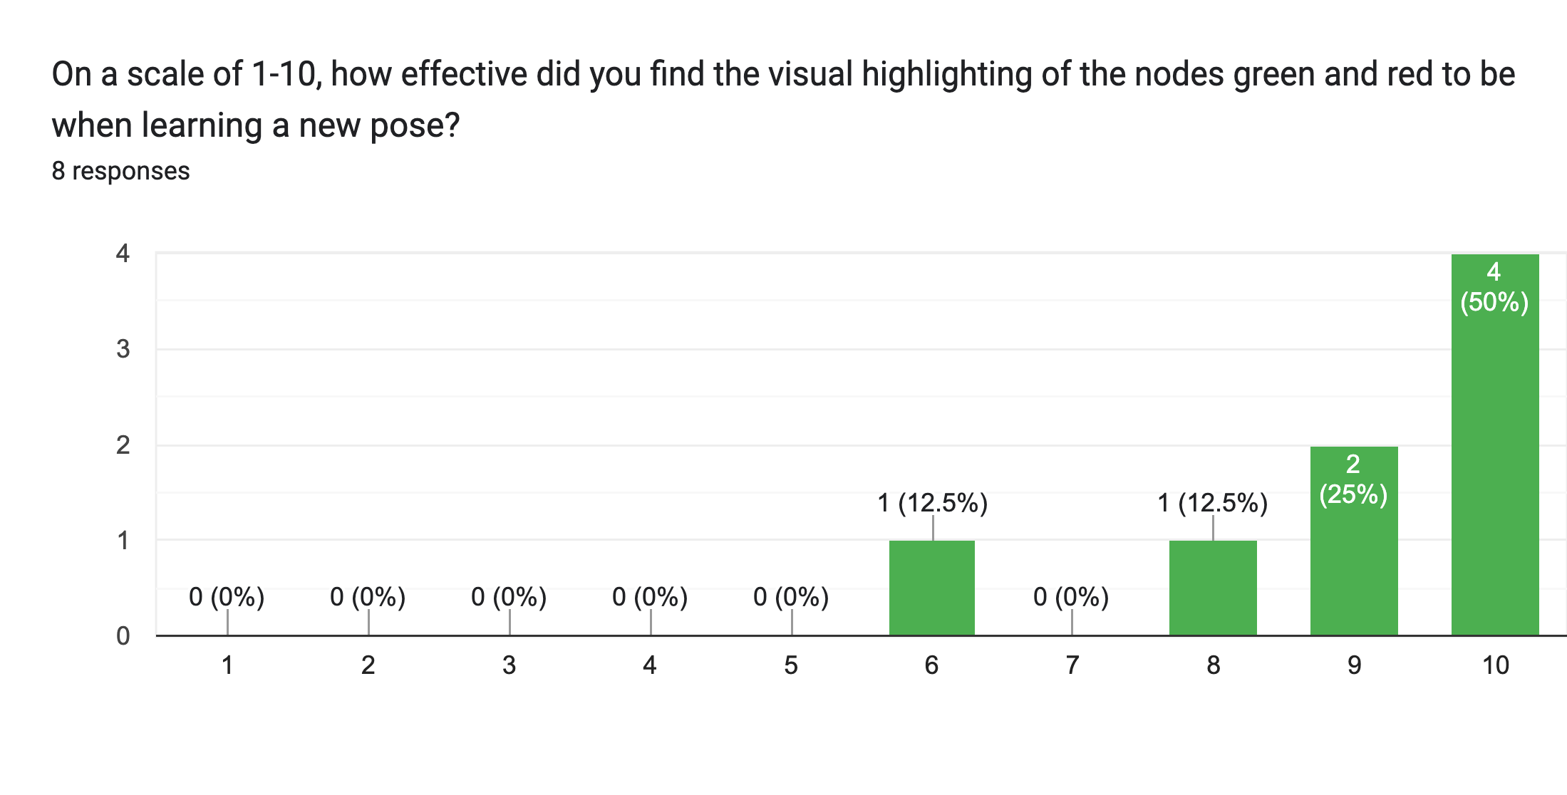
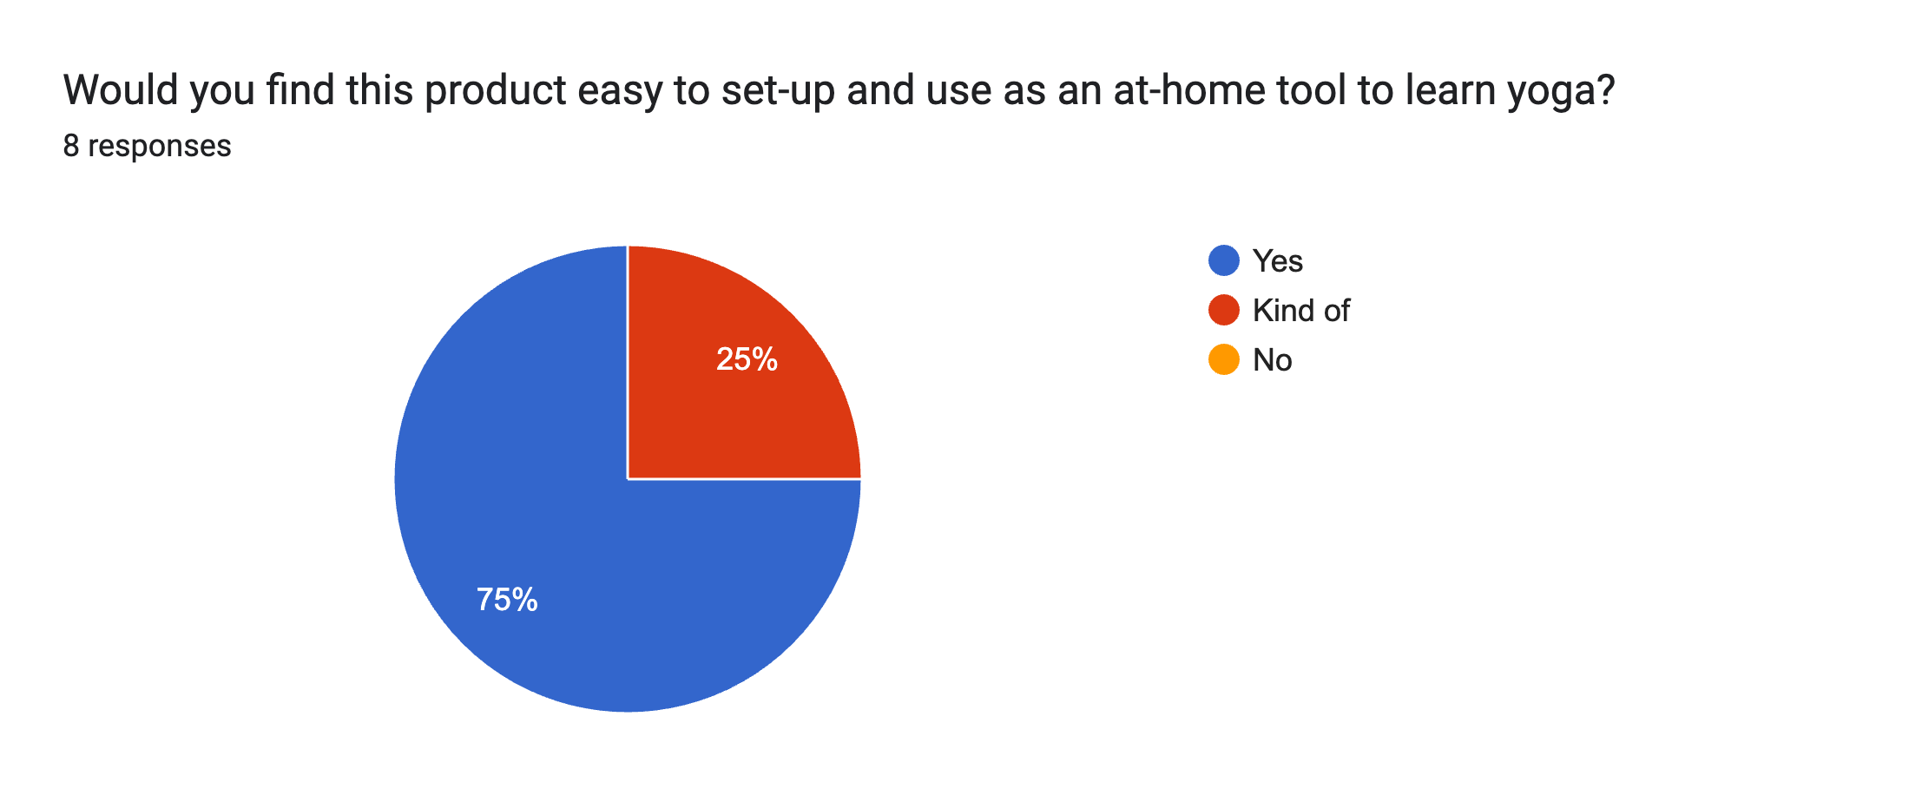
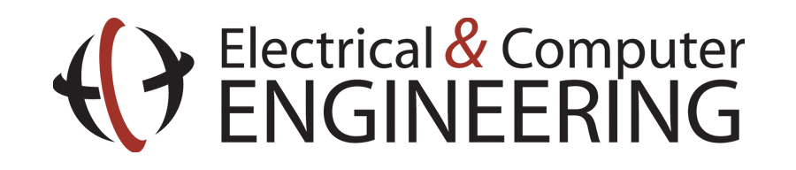
PosePal
Team C4: Ankita Kalkar, Sruti Srinidhi, Youssef Kallel
18-500 Capstone Design, Spring 2023
Electrical and Computer Engineering Department
Carnegie Mellon University
Product Pitch
System Description
Yoga has been linked to tremendous benefits not just physically, but for one’s overall wellbeing. It improves flexibility, helps with stress relief, boosts immunity, improves mental health, and so on. Unfortunately, many beginners find yoga to be difficult citing reasons like yoga postures being physically demanding or the deep breathing technique being unusual. Many beginners may get frustrated when trying to adjust their body all the time and having to maintain a fine balance between strength and flexibility while focusing on mindfulness
Enter PosePal: an easy-to-use, accessible, and cheap solution for any self-starter to teach themselves yoga. PosePal is a smart mirror that has 3 major components: Pose Detection, Pose Correction, and Mirror UI. It provides real-time audio and visual feedback on whether the user is matching the specified pose. Using the BlazePose CNN model for Pose Detection and a custom-built node computation library for Pose Correction, PosePal presents a novel and effective yoga learning experience. Given our stated goals, we focused on the following quantitative benchmarks:
⏰ Live Feedback: From when the image is captured to when the corrections are rendered, the total end-to-end latency of our system is 67.07 ms
✅ Accuracy: We achieved an overall Pose Correction accuracy of 84.5%
🦻🏼Accessibility: After user testing, we were able to average 1 question/user and it took users approx. 3 sec to understand an instruction
In terms of the Software, PosePal primarily consists of the Pose Detection, Pose Correction, Mirror UI, and Audio feedback components.
Pose Detection: The front camera feed is inputted into the BlazePose model which is a Pose Detection model that outputs the (x, y, z) coordinates, visibility, and depth of 33 skeleton key points.
Pose Correction: we calculate key joint angles and node distances which we compare with reference angles we obtained from a yoga instructor. If the accuracy is within the thresholds we specified, we output the corresponding positive audio cue and send the node positions, angles, and accuracy computation to be rendered on the mirror. If the accuracy is not within thresholds, the corresponding suggestions along with the node positions, angles, and accuracy is sent.
Mirror UI: The error rendering subsystem takes the pose inaccuracies that are generated by the pose correction subsystem and renders it on the monitors that are part of the smart mirror. Using python’s tkinter library, yellow highlights are drawn over the inaccurate parts of the pose, while green is drawn at the area where the body should also be. The rest of the background is black so the two-way mirror is as reflective as possible.
Audio feedback: We are using google text to speech (GTTS) to provide audio cues on how to correct the pose. We will either pre-record a set of audio cues and just play the appropriate one, or we will generate the cues in real time, based on the latency of the audio generation.
System Architecture
Software
Hardware
System Evaluation
After conducting user testing with a survey of 11 questions, the results are as follows:
PosePal’s principle of operation is essentially a Pose Detection and Correction feedback loop. The general sequence a user will follow will be as follows:
User clicks “Start Yoga Routine”
A new yoga pose is shown
Wait 5 seconds for user to maintain pose
Show any errors in the pose on the user’s reflection with feedback on how to fix it
Wait until the user holds an accurate pose within thresholds for 8 seconds
Go back to step 2 if there are more poses in the routine
The end-to-end latency of the system is on average 67ms.
Pose | Audio Cues Phrased Incorrectly | Audio Cues in Opposite Direction | Audio Cues with Threshold Incorrect | Time each pose should be held
Upward Salute | 0 | 0 | 0 | 8 sec
Tree Pose | 1 | 0 | 1 | 8 sec
Crescent Moon | 0 | 0 | 2 | 8 sec
Downward Dog | 0 | 0 | 0 | 8 sec
Warrior Pose | 0 | 0 | 0 | 8 sec
Cobra Pose | 0 | 0 | 0 | 8 sec
Conclusions & Additional Information
Overall, PosePal exceeded all of the goals we had initially set for our design requirements. After verification tests with our local Yoga instructor, she claimed that PosePal would provide a formidable alternative for at-home yoga classes and even stated it presents a cost-effective and affordable way for people to practice yoga at home. Through our own user testing, most users were satisfied with our real-time audio and visual feedback and thoroughly enjoyed their experience.
A key lesson we learned is to write software that accounts for all the real-world discrepancies and chaos that wouldn’t typically exist in a binary world. We learned to write durable software that works on all different heights, body types, skill levels, and prioritized making sure it was accessible to everyone.
Future work could include adding an interactive mat that further aids in guiding users to help them correct their pose. Sections of the mat could light up with different colors according to where users put their limbs to visually indicate whether the user is in the correct section of the mat. Additionally, more smart-mirror UI related components could be added to further elevate the user experience.
Blaze Pose Node Detection Accuracy is 93% and 4 audio cues from 64 cues were incorrect, resulting in an overall accuracy of 87.2%

