Slide 1
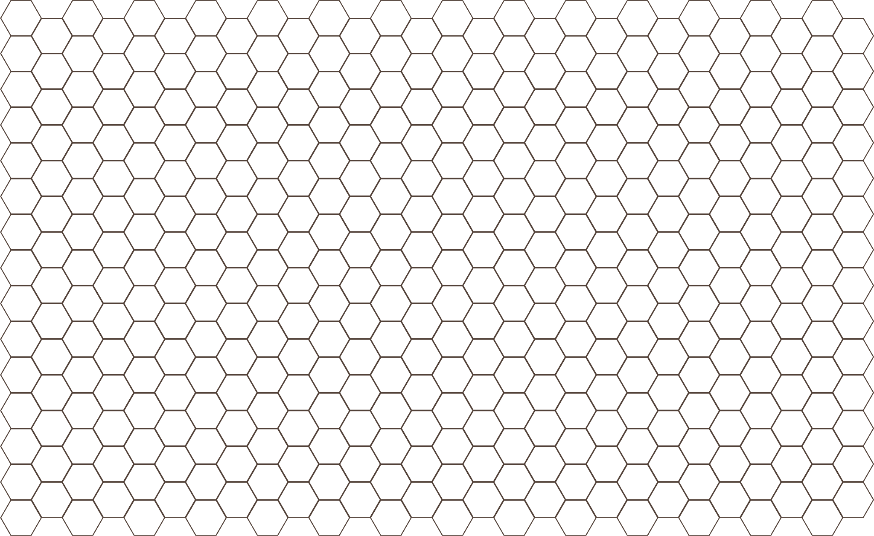
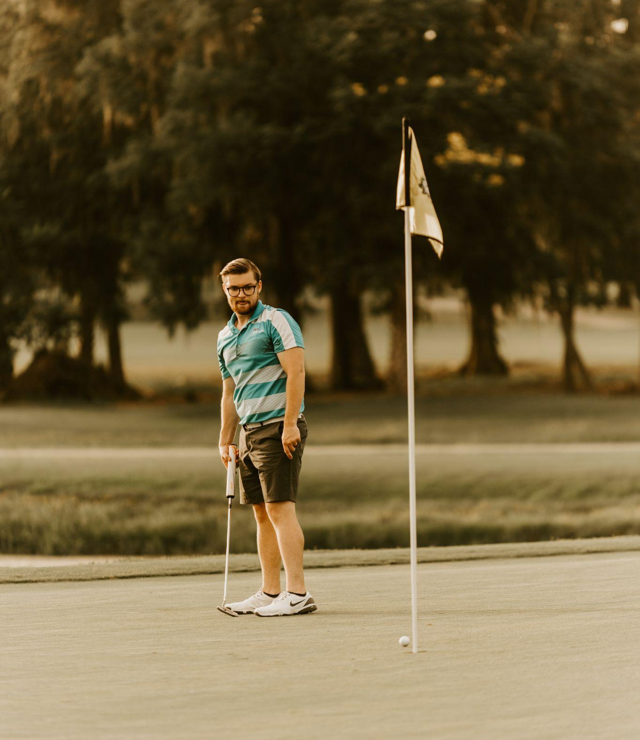
Best Ball
Design Presentation
Christopher Hess, Seaver Dahlgren, Erik Feldmann

Slide 2
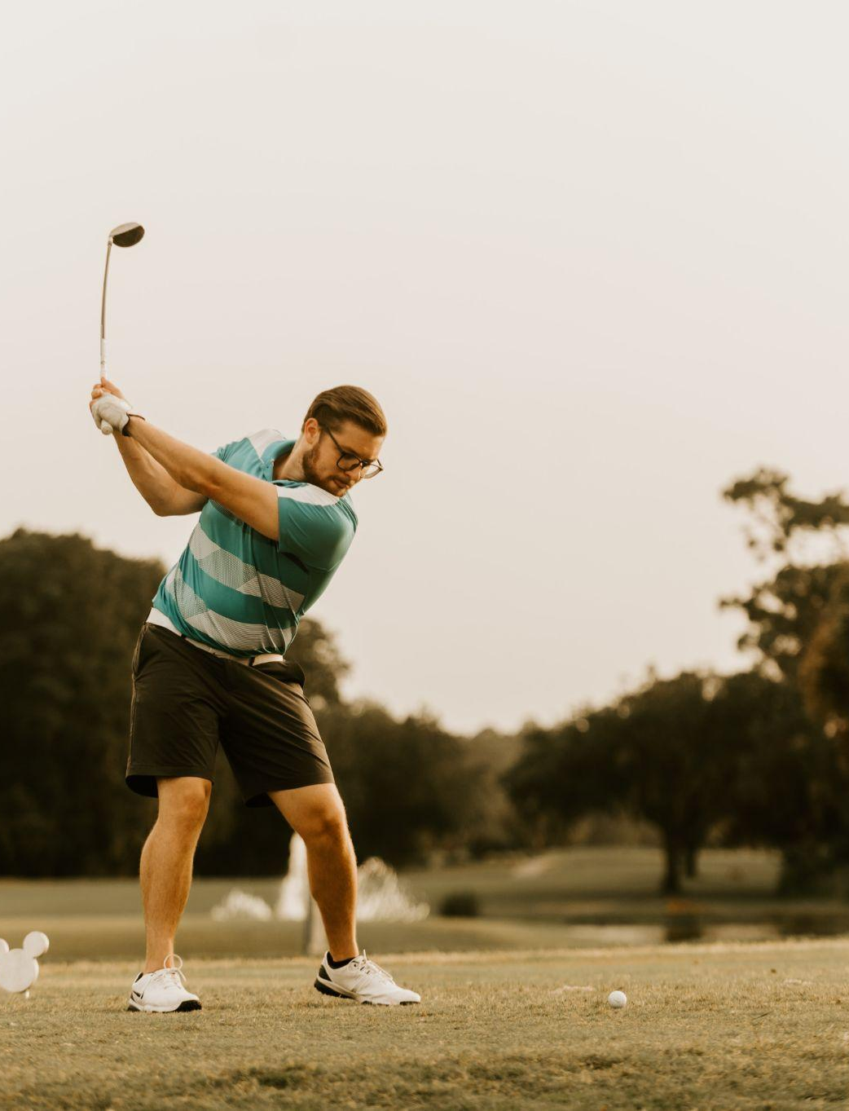
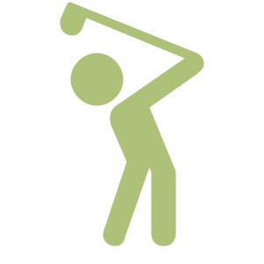
Use Cases: Revised
Case | Details
Real-time hole distance | Users shall be able to know ball distance from hole
Real-time ball and stroke feedback | Users shall be able to know the acceleration of their stroke along with the acceleration and spin of the ball
Enable multiple player connections | Multiple users interacting with a hole shall be able to get feedback concurrently
Portable User Interface | Users shall be able to access course stats from either a desktop tablet or from a mobile device
Reasonable outdoor usability | Users shall be able to use the club and ball pairing for reasonable amount of time. Distance and size of the course should be

Slide 3
Design Requirements
Measurement | Value | Details
Distance Accuracy | Within 3cm of true distance | Users shall know distance from the ball to the hole.
Putt Detection True Positive | 95% accuracy | The system shall be accurate in detecting when a ball is struck.
Putt Make Detection True Positive | 95% accuracy | The system shall be accurate in detecting when a putt is made.
Ball Size | 4.27cm to 6cm diameter | Ball shall be close to the size of a golf ball.
Putter | Standard Golf Putter | Users shall have a normal golf putter to play with.

Slide 4
Design Requirements CONT.
Measurement | Value | Details
End to end latency | 5 seconds | The user shall receive feedback quickly after their putting stroke.
Putt Make Detection True Positive | 95% accuracy | The system shall be accurate in detecting when a putt is made.
Battery Life | >1 hour | The user shall be able to use the system for over an hour.
Ball and putter battery power | Coincell battery | The user shall be able to make quick battery changes.
Green size | 3m x 1.5m | The user shall have large room to practice putting.

Slide 5
Solution Overview:
Sensor Selection:
IMU, Pressure sensors, Lidar, RFID
Bluetooth Communications
BLE protocol between sensors and
RPI
Backend Framework
Receives Sensor information and
aggregates it
Frontend Web App
UI interfaces that uses will be able to
see users stats

Slide 6
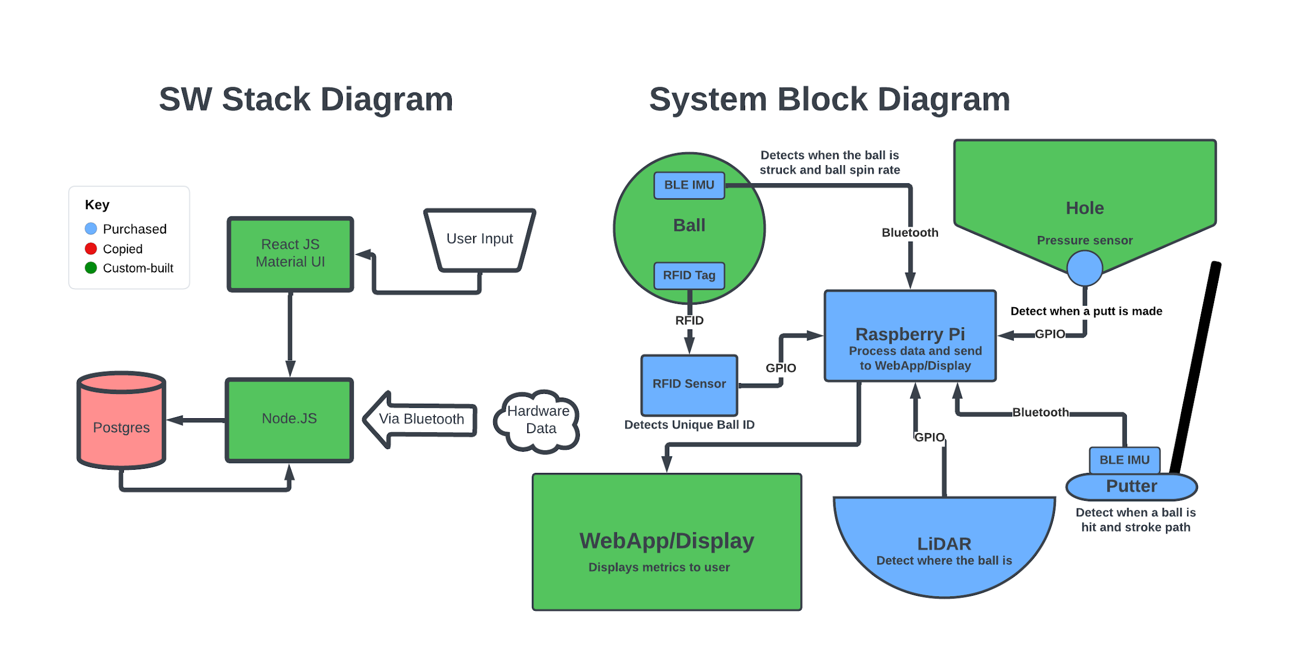
Solution

Slide 7
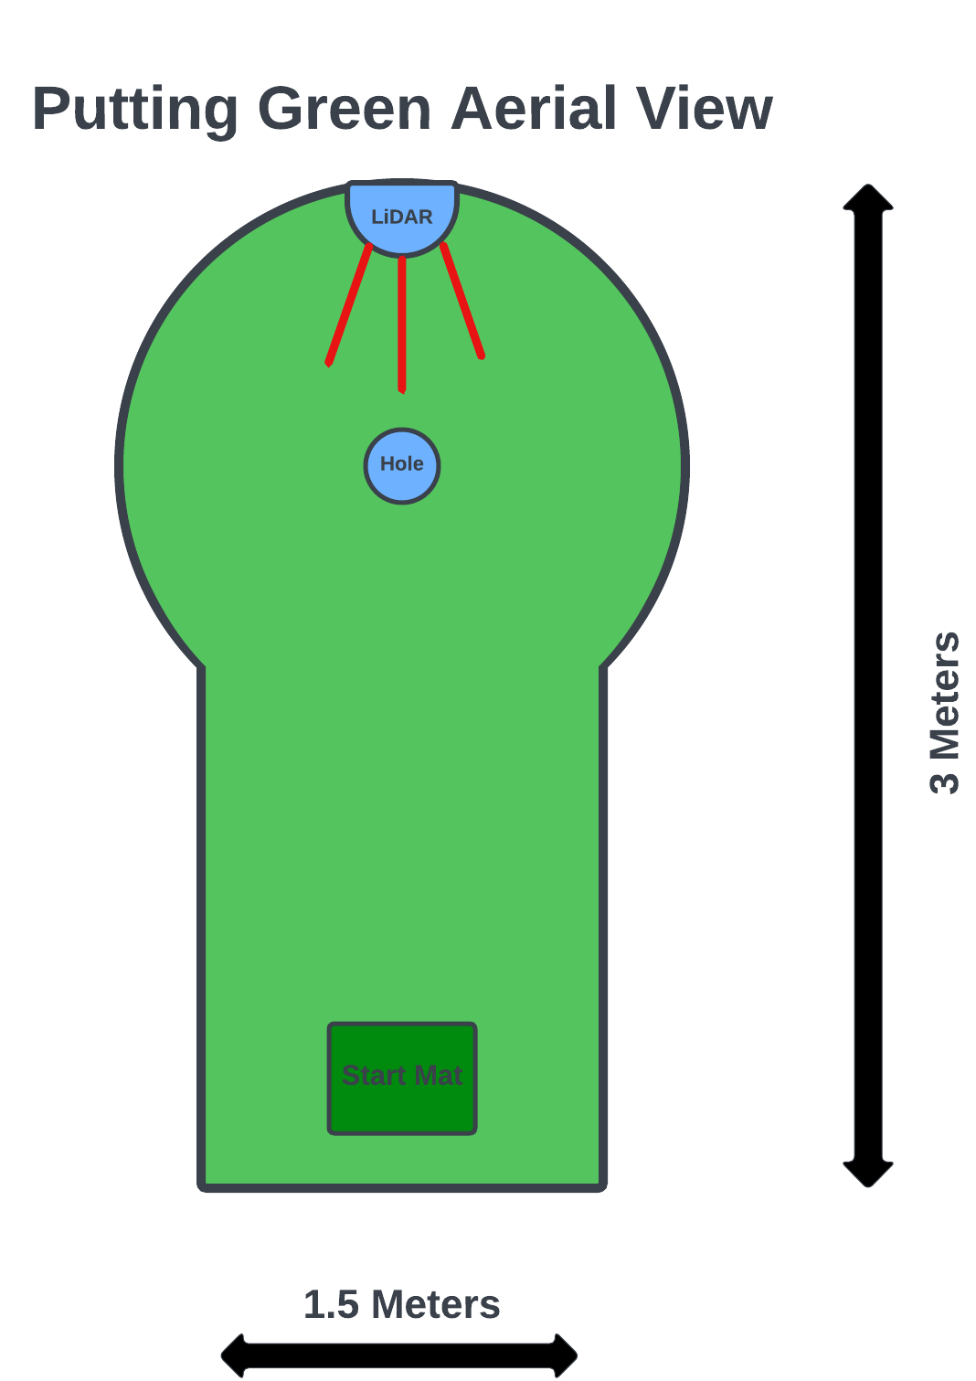
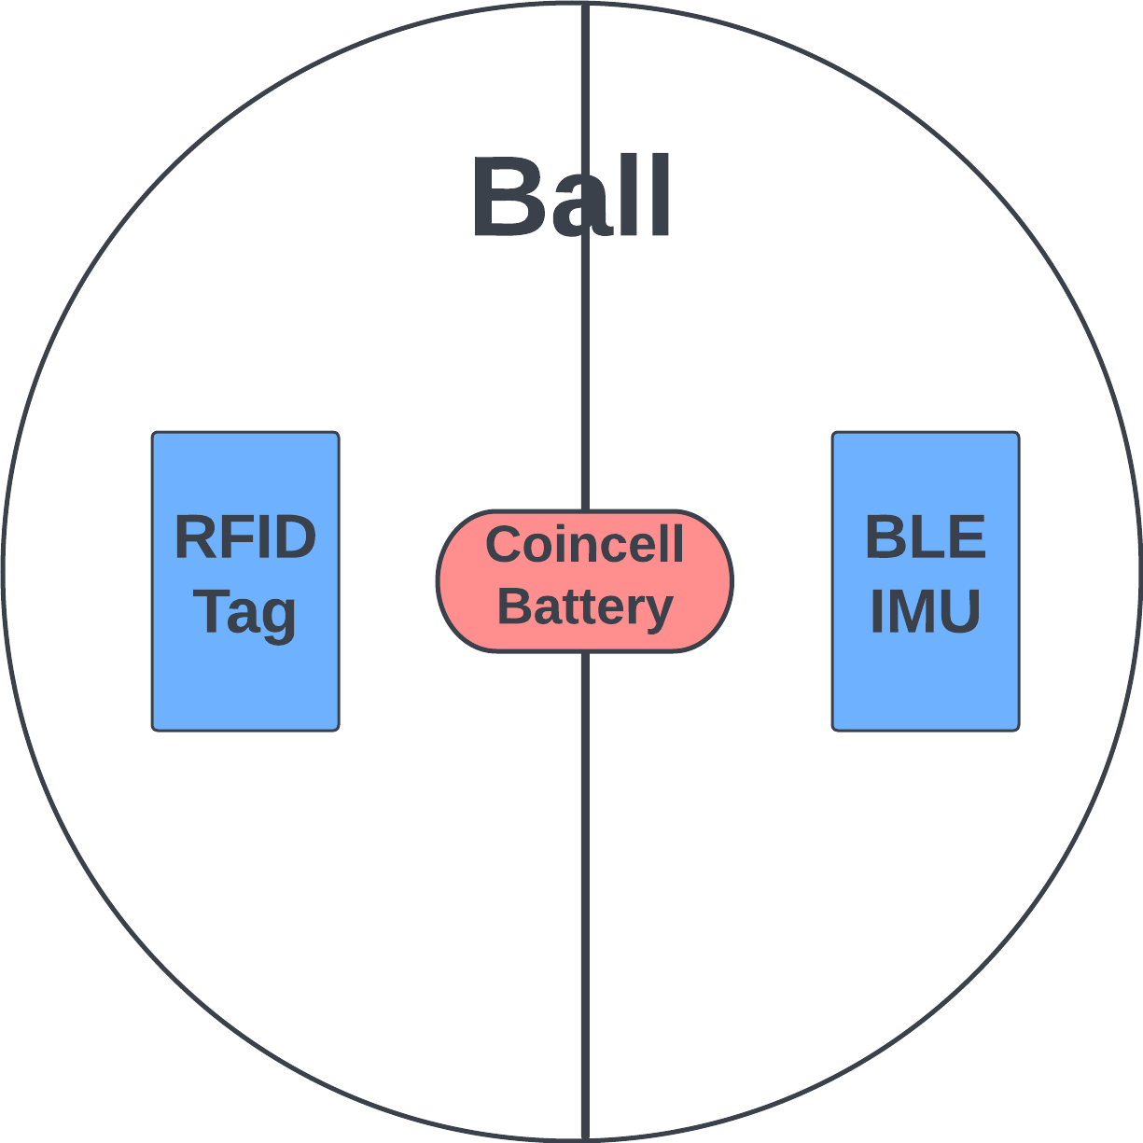
Solution: Green and Ball
Component Block Diagrams

Slide 8
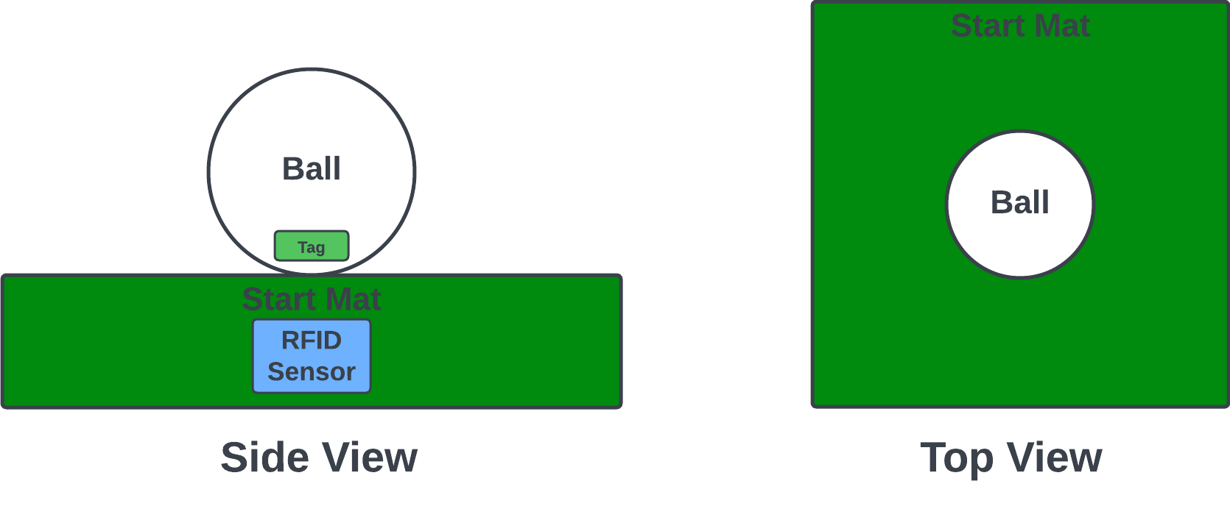
Solution:
Component Block Diagrams

Slide 9
Chosen Components
Sensor | Purpose | Details
SLAMTEC RPLiDAR A1 M8 | Measure distance and location of the ball on the green. | LiDAR sensor with <1 degree resolution and 10m range.
RC522 RFID card reader and tag | Provide each ball with a tag to have a unique ID. | RFID tag reader compatible with RPi and small tag to fit in ball.
Seedstudio MCU w BLE and IMU | Track motion of ball and putter. | IMU with BLE to wirelessly communicate data to RPi.
Thin film pressure sensor | Detect when a putt is made. | Pressure sensor with 20 gram pressure detection.

Slide 10
Testing and Verification
Test | Process
Distance from Hole Test | Place the ball at random location on the “course” ranging in distance. Calculate the distance accuracy.
Club Metrics Test | Swing the club at various accelerations. Use different orientations to do a sanity check on metrics
Ball Metrics Test | Roll ball at different speeds using different angles. Use ball markings to verify angle and roll metrics visually
Durability Test | Hit a single ball multiple times around the hole to test that metrics remain accurate using previous methods.
Multi-User Test | Use multiple balls and clubs at once and perform the Durability test to verify WebApp distinguishes between distinguishes between users. Ensure metric accuracy persists

Slide 11
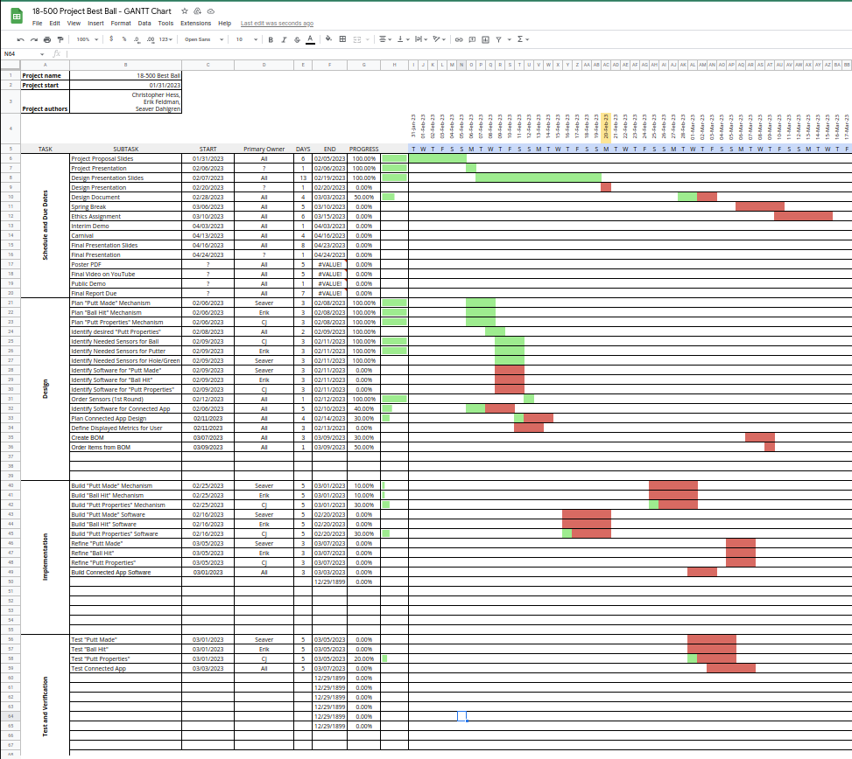
Project Management: Schedule is “on par”

Slide 12
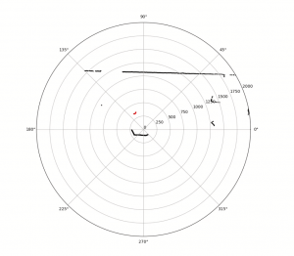
Current Status

