Slide 1
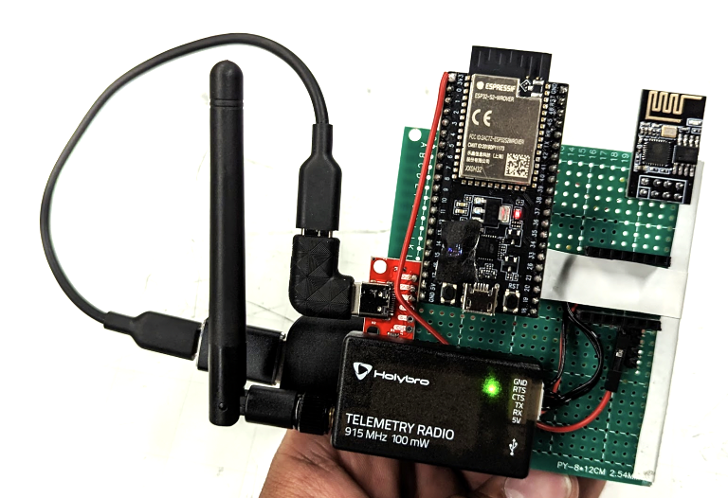
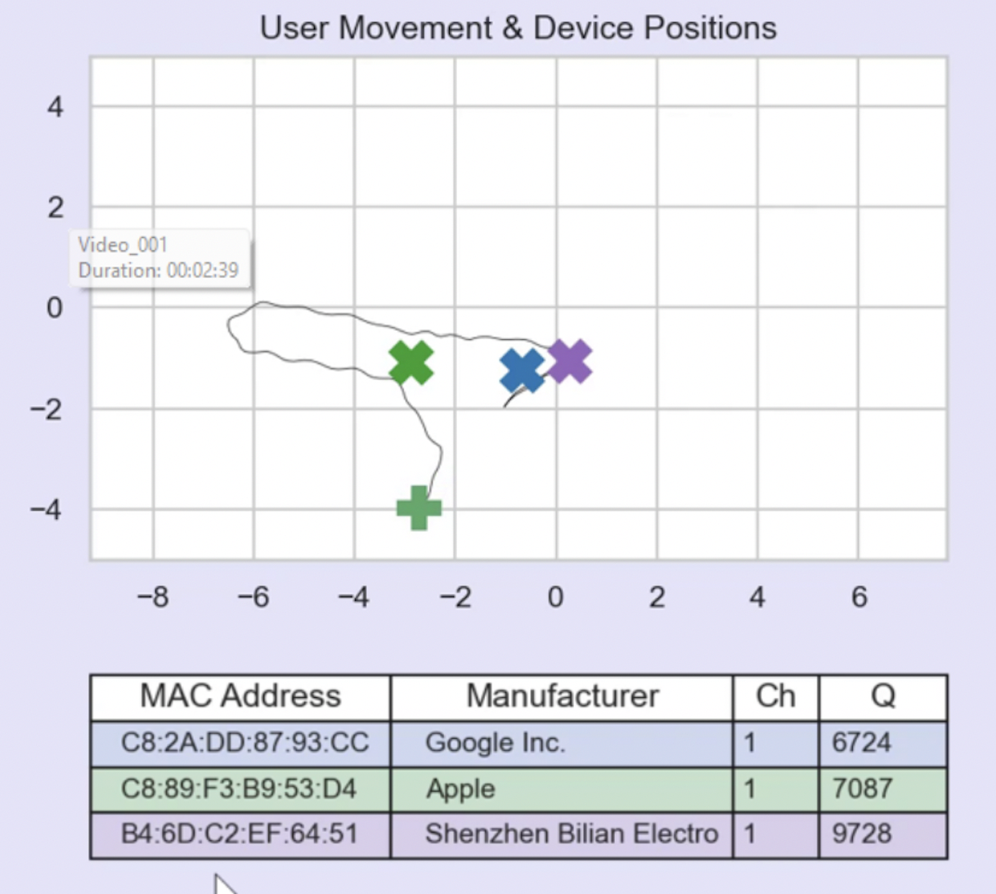
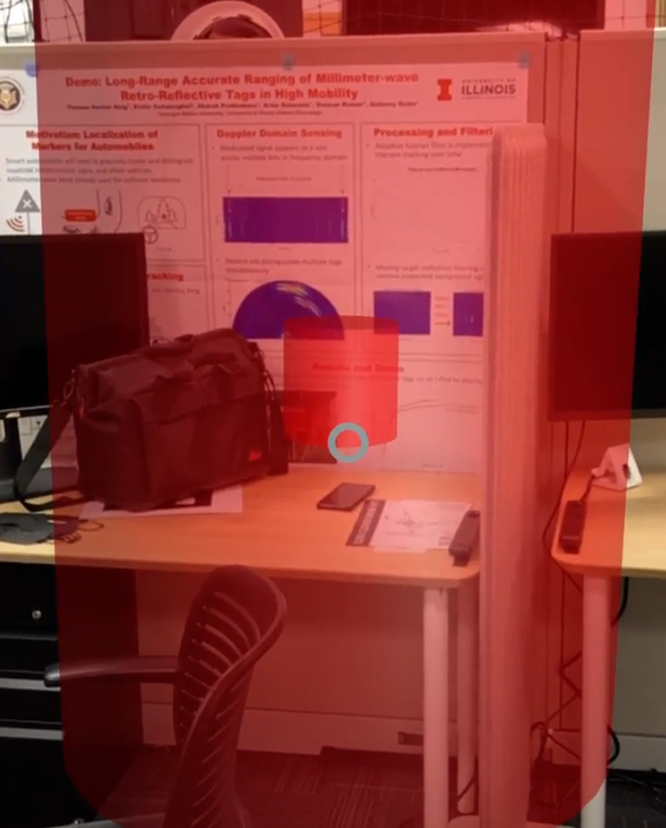
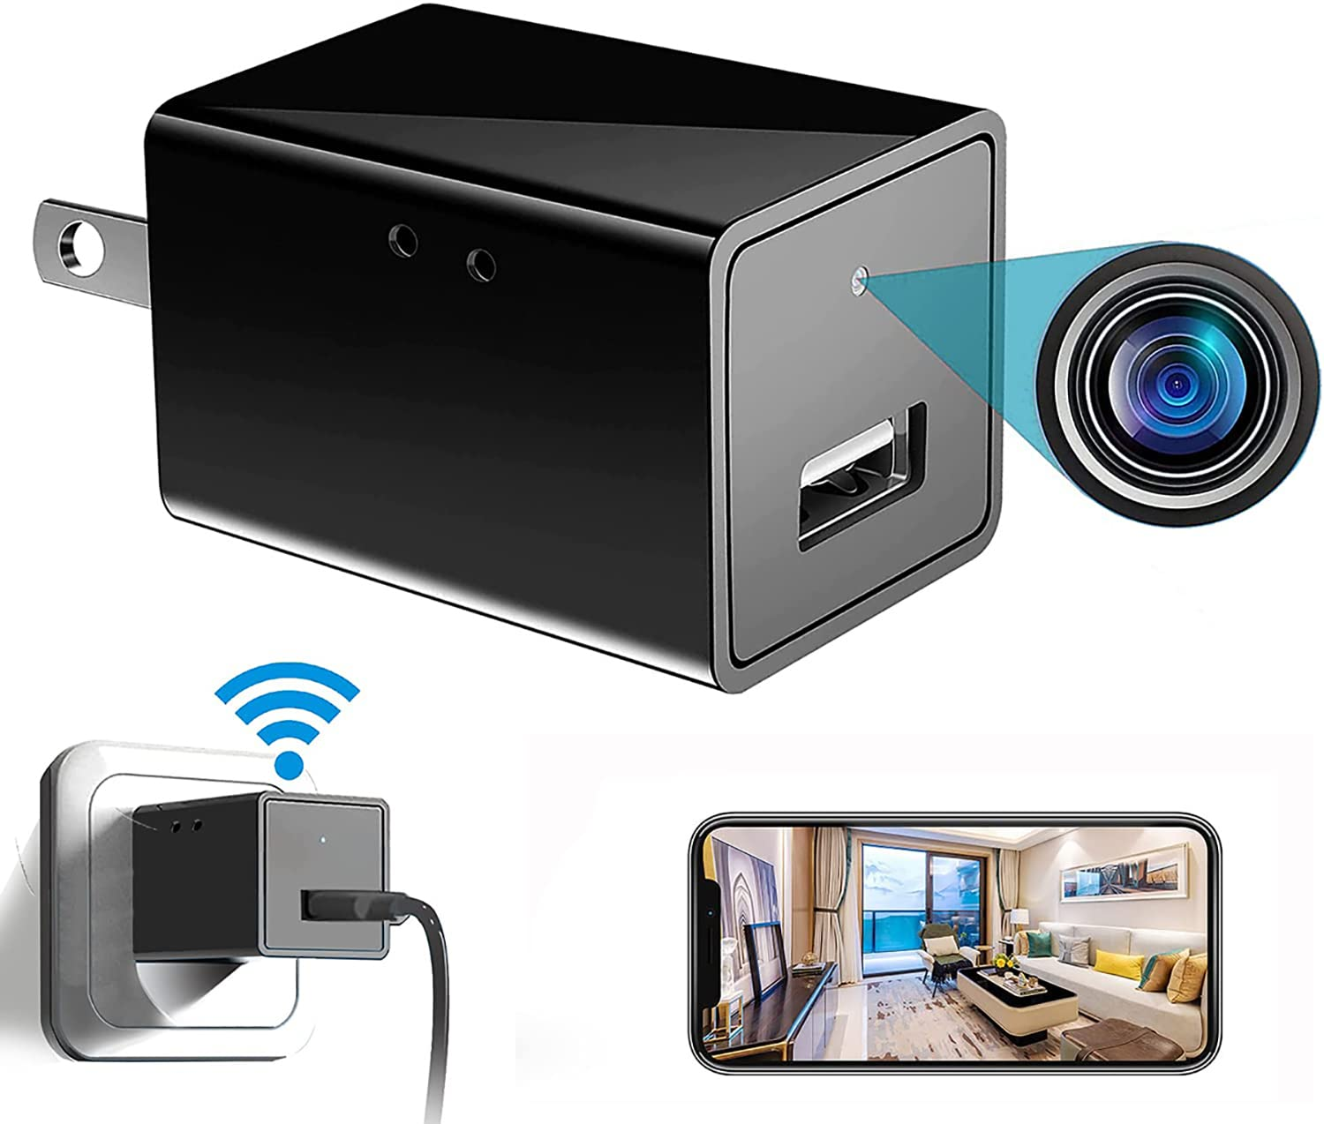
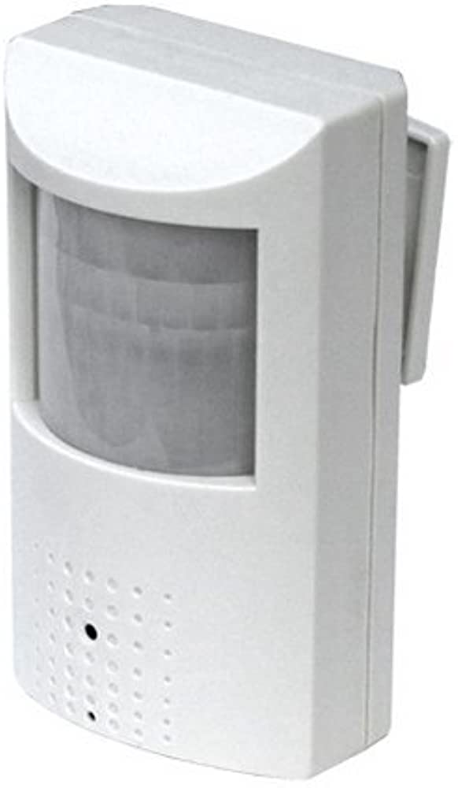
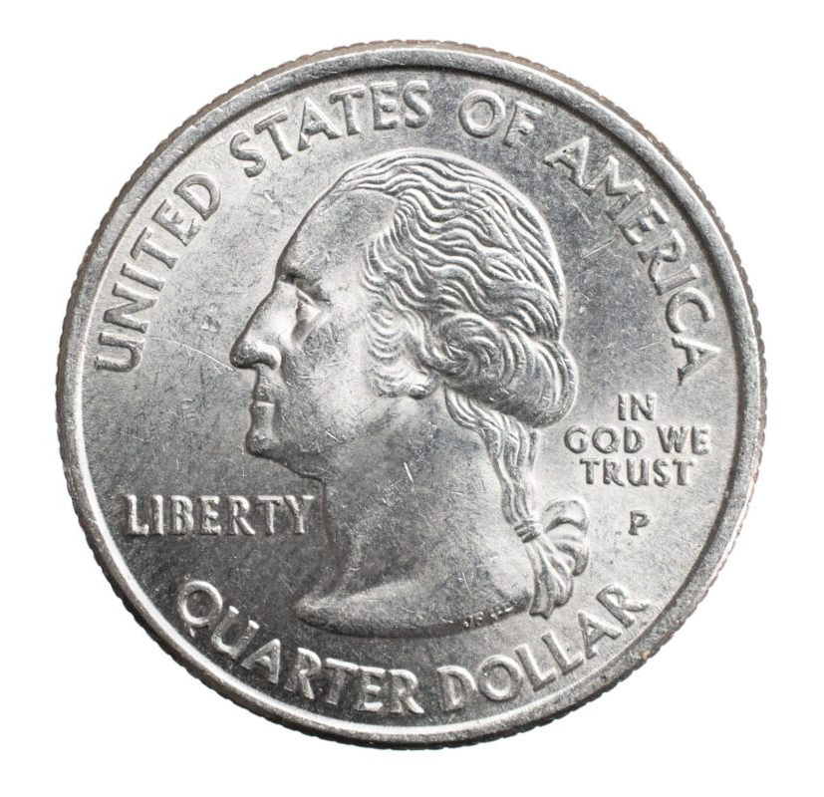
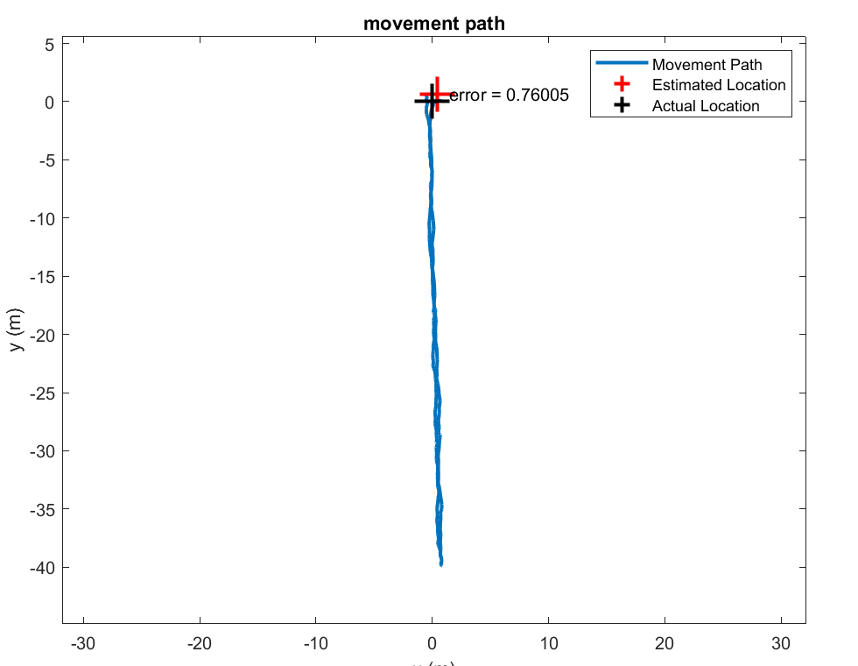
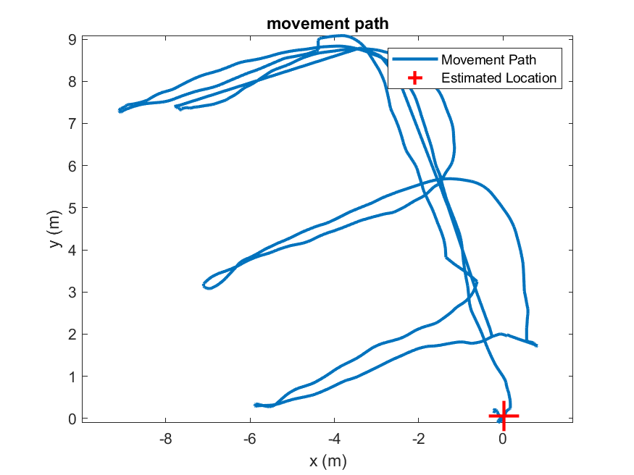
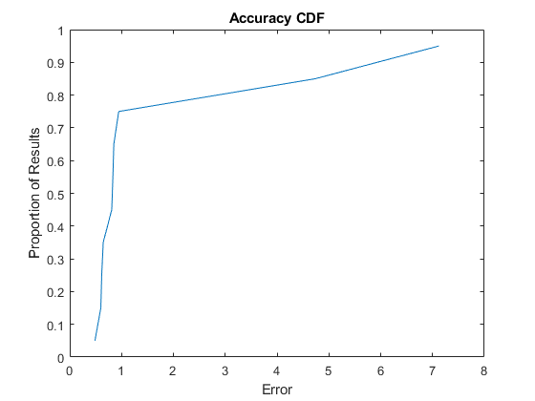
WiSpider
Team C2: Thomas Horton King, Ethan Oh, Anish Singhani
18-500 Capstone Design, Spring 2023
Electrical and Computer Engineering Department, Carnegie Mellon University
Pitch: Finding Covert
Wireless Devices
There has been massive growth in the number of wireless IoT devices in the past 20 years
Hidden or concealed off-the-shelf devices can easily infringe on an individual’s privacy
Users need a way to non-cooperatively find these devices
We developed WiSpider, a product that finds Wi-Fi devices and localizes them with a median of 0.8m accuracy with a total of 40m range
Crucially, WiSpider can operate even if the devices are not connected to the same network
WiSpider visualizes the results on a GUI and an AR app, allowing the user to find the devices in the environment
Hardware Diagram
ESP32
ESP8266
USB
Header
Debug
Header
Wireless
UART Bridge
Software Diagram
.
Target Devices
Computer GUI
AR Interface
Wi-Fi
Devices
Device
information
Architecture: Time-of-Flight sensing with ACK Exploit
Can send fake attack packets which devices respond to even if the transmitting device is unprivileged
Measure the time between transmitting and receiving the spoofed packets
Combine camera self-localization as the user moves
System Evaluation
Move across an entire room for 3 minutes and collect data for 5 minutes, and verify localization accuracy at the end of the trace.
We achieve an overall median accuracy of 0.8m
We verify resolution with targets within 0.2m
Total Cost: $143.60
Detection Range: 40m
Detection Rate: 90%
Hardware Platform
Software Architecture
TX
RX
Pinging ESP8266
Sniffing
ESP32
Custom
Time-of-Flight Measurement Code
USB
Debug
Wireless UART Bridge
Fake Wi-Fi
Packet Generator
Data Cleaning and Interpolation
Laptop
MATLAB MLE Device Localization
Desktop GUI
iPad Pro
AR Visualization
ARKit
Vision-based
self-localization
Acknowledgements
We would like to thank the works before us that made our project possible: Polite Wi-Fi (2020), ARENA (2021), Wi-Peep (2002), and Lumos (2022)
Thank you to Professor Hyung Kim and Omkar Savkur for their feedback and guidance
New
Off-the-shelf

