Slide 1
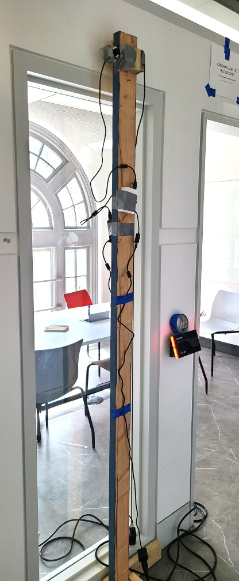
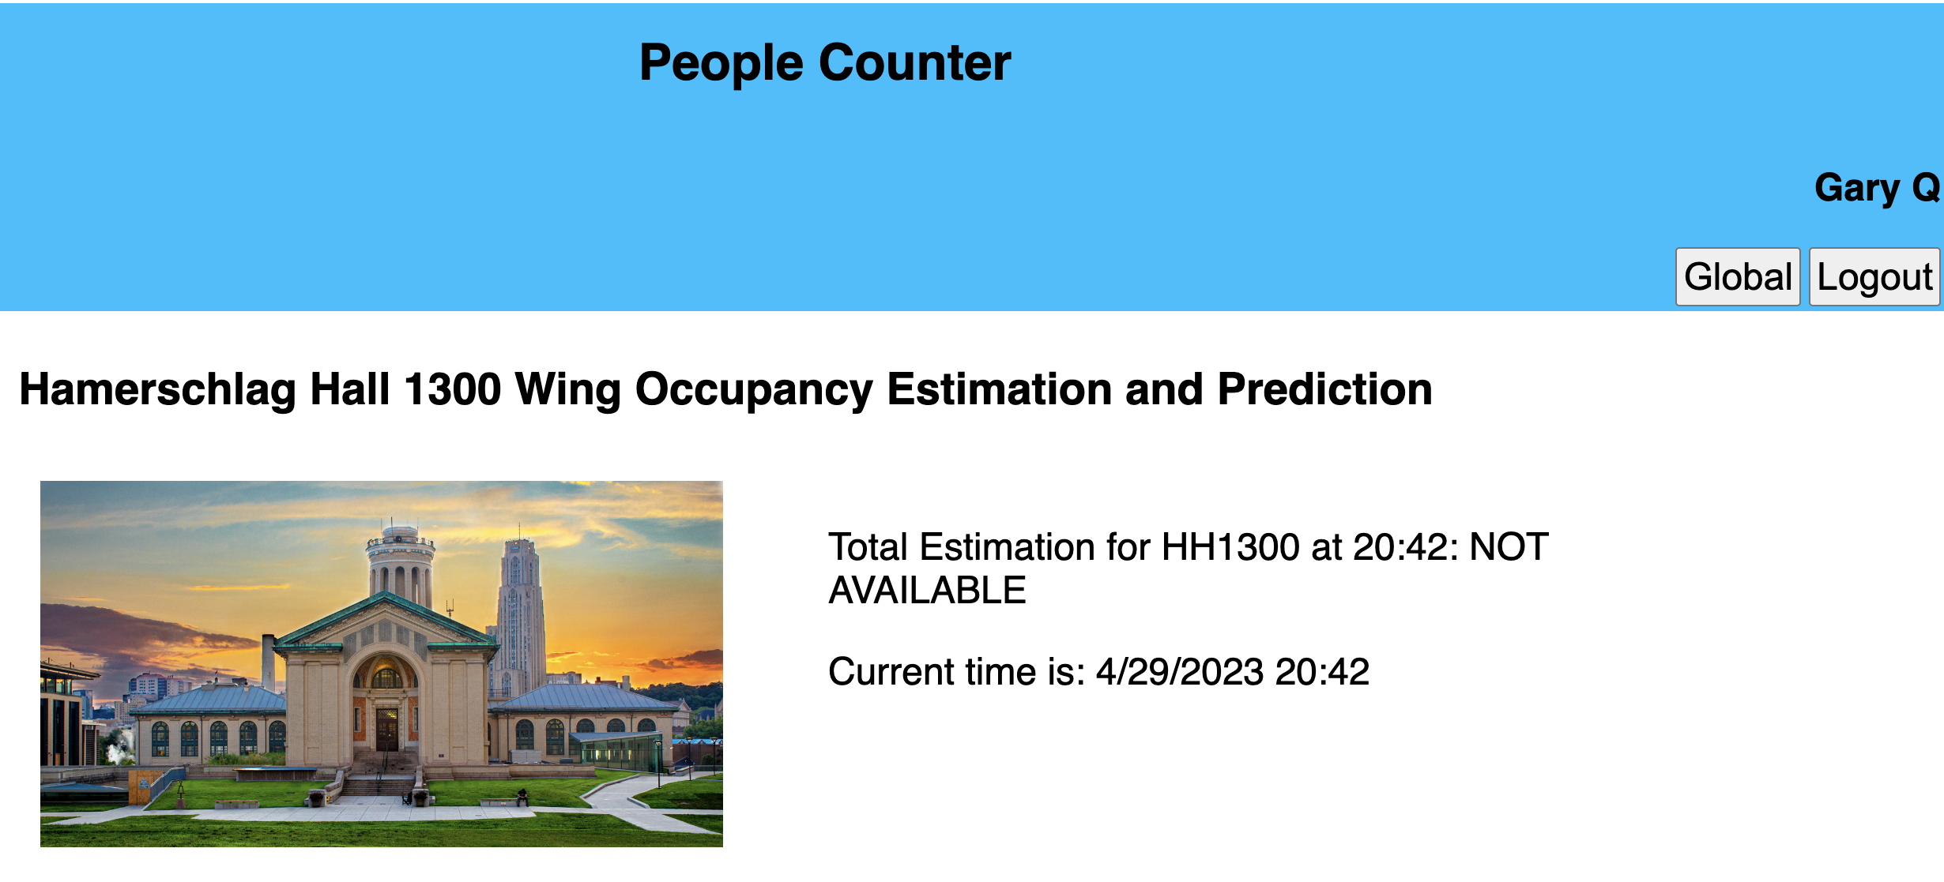
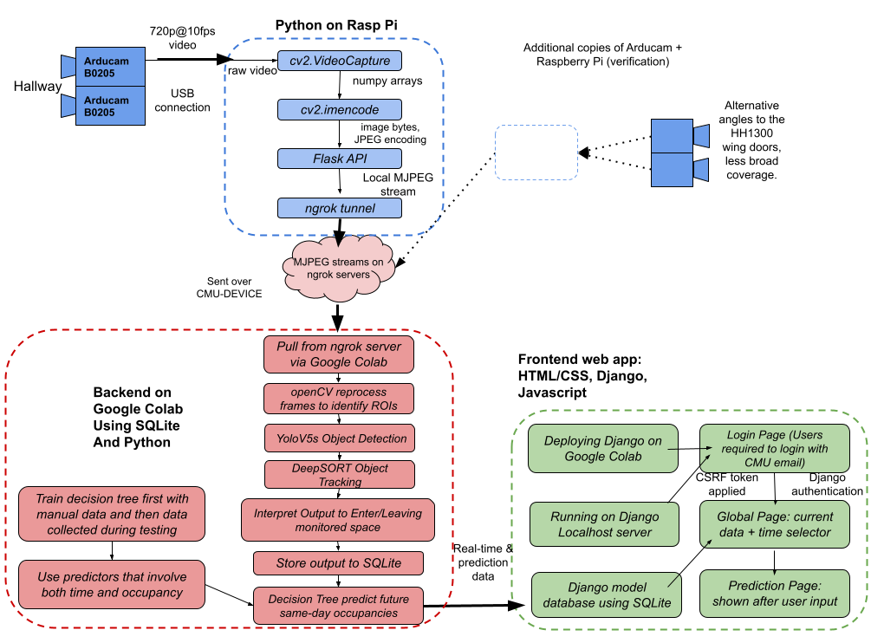
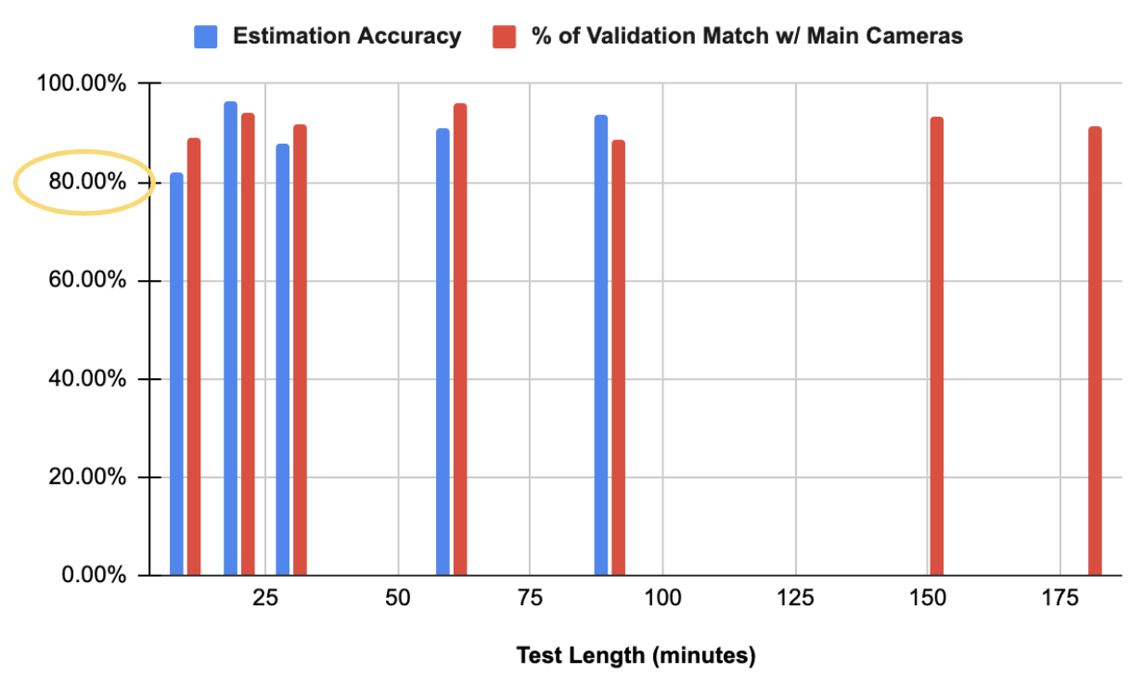
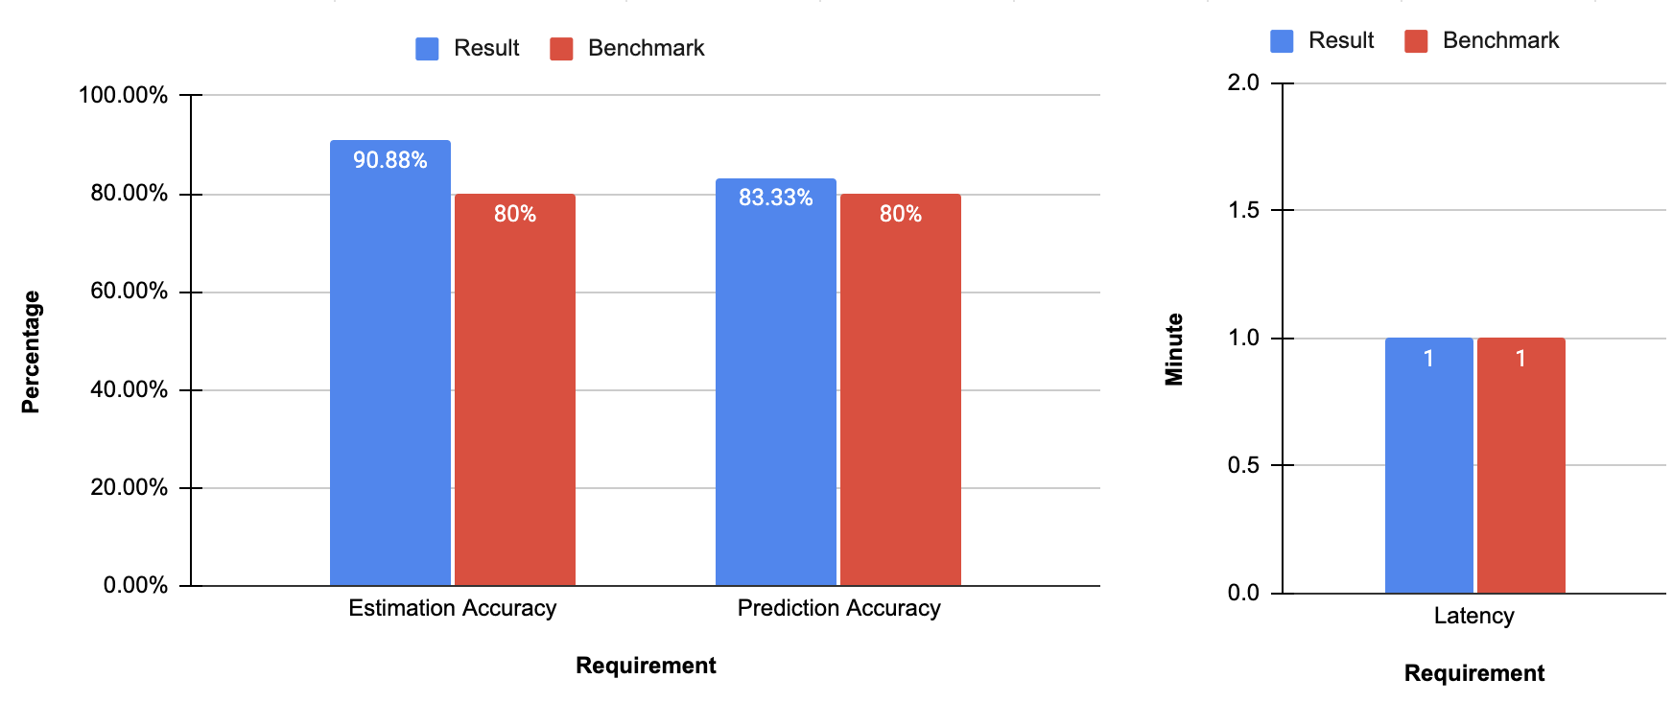
People Counter: Occupancy Estimation & Prediction
Team C0: David Feng, Tianzhuo Li, Gary Qin
18-500 Capstone Design, Spring 2023
Electrical and Computer Engineering Department
Carnegie Mellon University
Product Pitch
System Description
Have you ever walked across the entire campus to your favorite study spot only to find a packed room? People Counter is an integrated system that allow users to view real-time data of the number of people in a room (tested in HH1300 wing) as well as the predicted occupancy category up to 1 hour in advance. The critical use-case requirements include an over 80% estimation accuracy, a less-than-1-minute data transmission latency from hardware to frontend, and an above 80% prediction category benchmark. After a 6-week testing period, People Counter has achieved all 3 requirements, posting on average a 91% estimation accuracy, an 83% prediction accuracy, and a 60-second latency. With People Counter, you can now get a sense of how crowded a study space is before deciding whether to make the trip there.
The picture shown on the right is the main hardware system of People Counter. Facing the doors in the HH1300 hallway are the main cameras that send data through the CMU Device wireless network and are connected to the Google Colab backend through Ngrok tunnels. The cameras are mounted with roughly 15-degree angle from being parallel with the wood pole. For validation, we installed 2 extra cameras each on its own wood pole in order to provide the system with alternative camera angles to ensure overall accuracy of the system.
Main cameras placed on supporting wood pole
2 main cameras
System Architecture
HH1300 wing
People Counter is a full stack system that computes real-time occupancy through a series of Arducam cameras that sends data to the backend that keeps track of the count of people who enter/exit a room through a door. The processed data is updated once per minute in the ElephantSQL database and displayed on a secure web application that runs on Django.
Web application that displays real-time occupancy
2x Raspberry Pi 4
power extension cords
System Evaluation
Given that the system is time-sensitive and frequent changes were made daily on our algorithm, we tested the system’s accuracy in intervals. After final changes were made, all tests show our main cameras surpassing the 80% accuracy benchmark and validation cameras having an above-90% match with the main cameras’ outputs. One of the most significant tradeoffs we made was to run our backend through Google Colab rather than locally to ensure the videos do not lag frequently, which can cause a ~10% decrease in accuracy.
Main and validation test results in HH1300 hallway
Conclusions & Additional Information
People Counter meeting and/or surpassing all use-case requirements
The team faced numerous challenges over the course of the period of development, including having to change the design of our system multiple times due to unforeseen regulations and circumstances. We learned that testing and validating an integrated system always take up a major chunk of time and require a quantitative method to measure the results. In the future, we would definitely want to expand the use case in terms of locations, as we firmly believe in the potential of People Counter in being a feasible solution to helping students on campus make informed decisions about where to relax or study.

