Slide 1
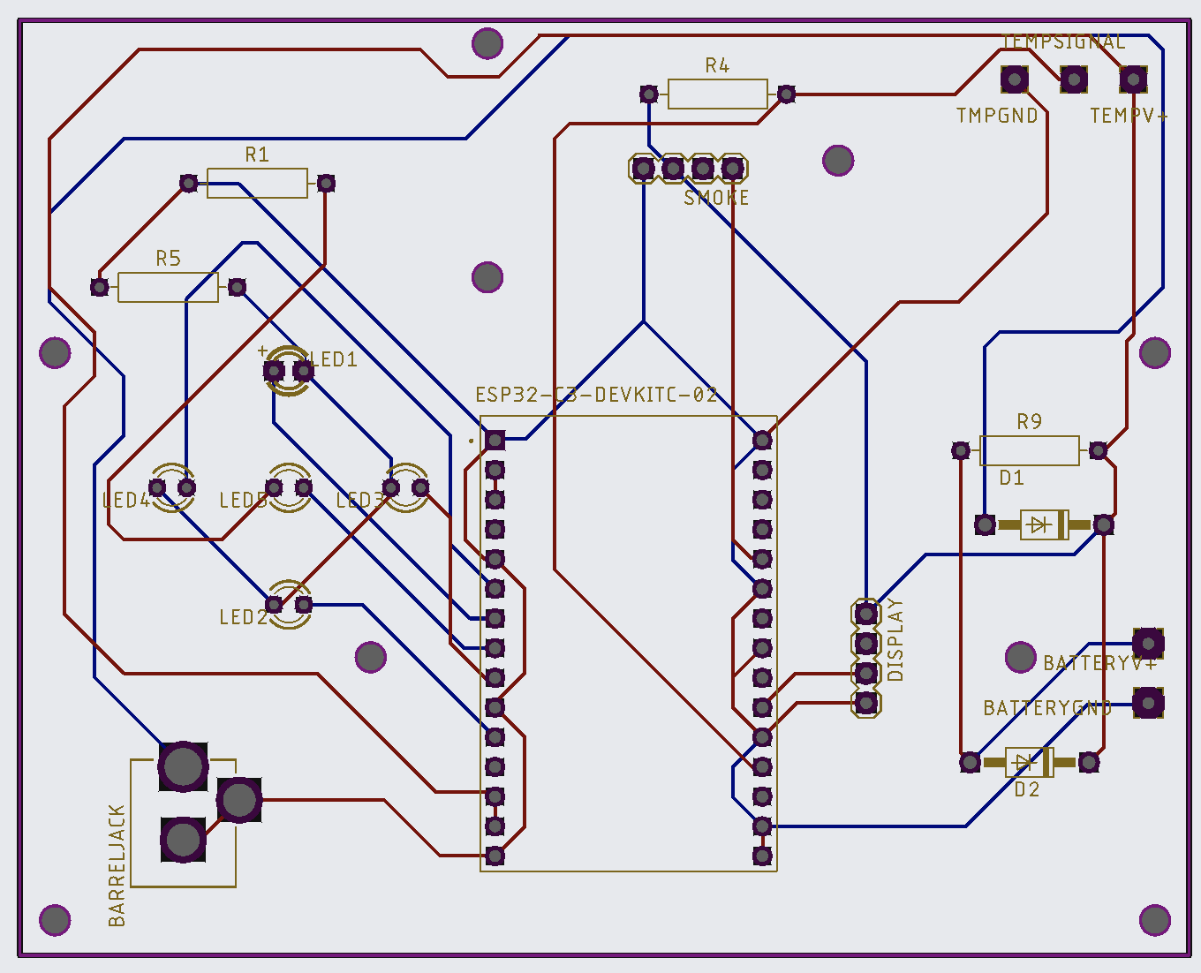
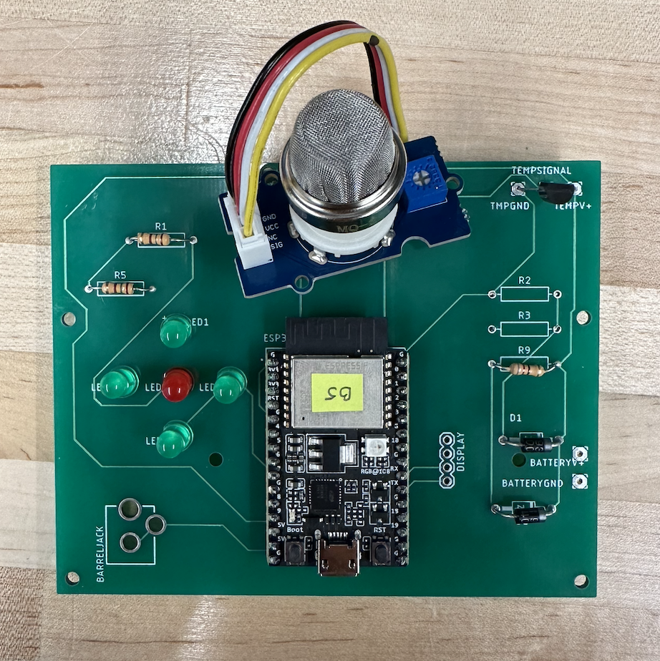
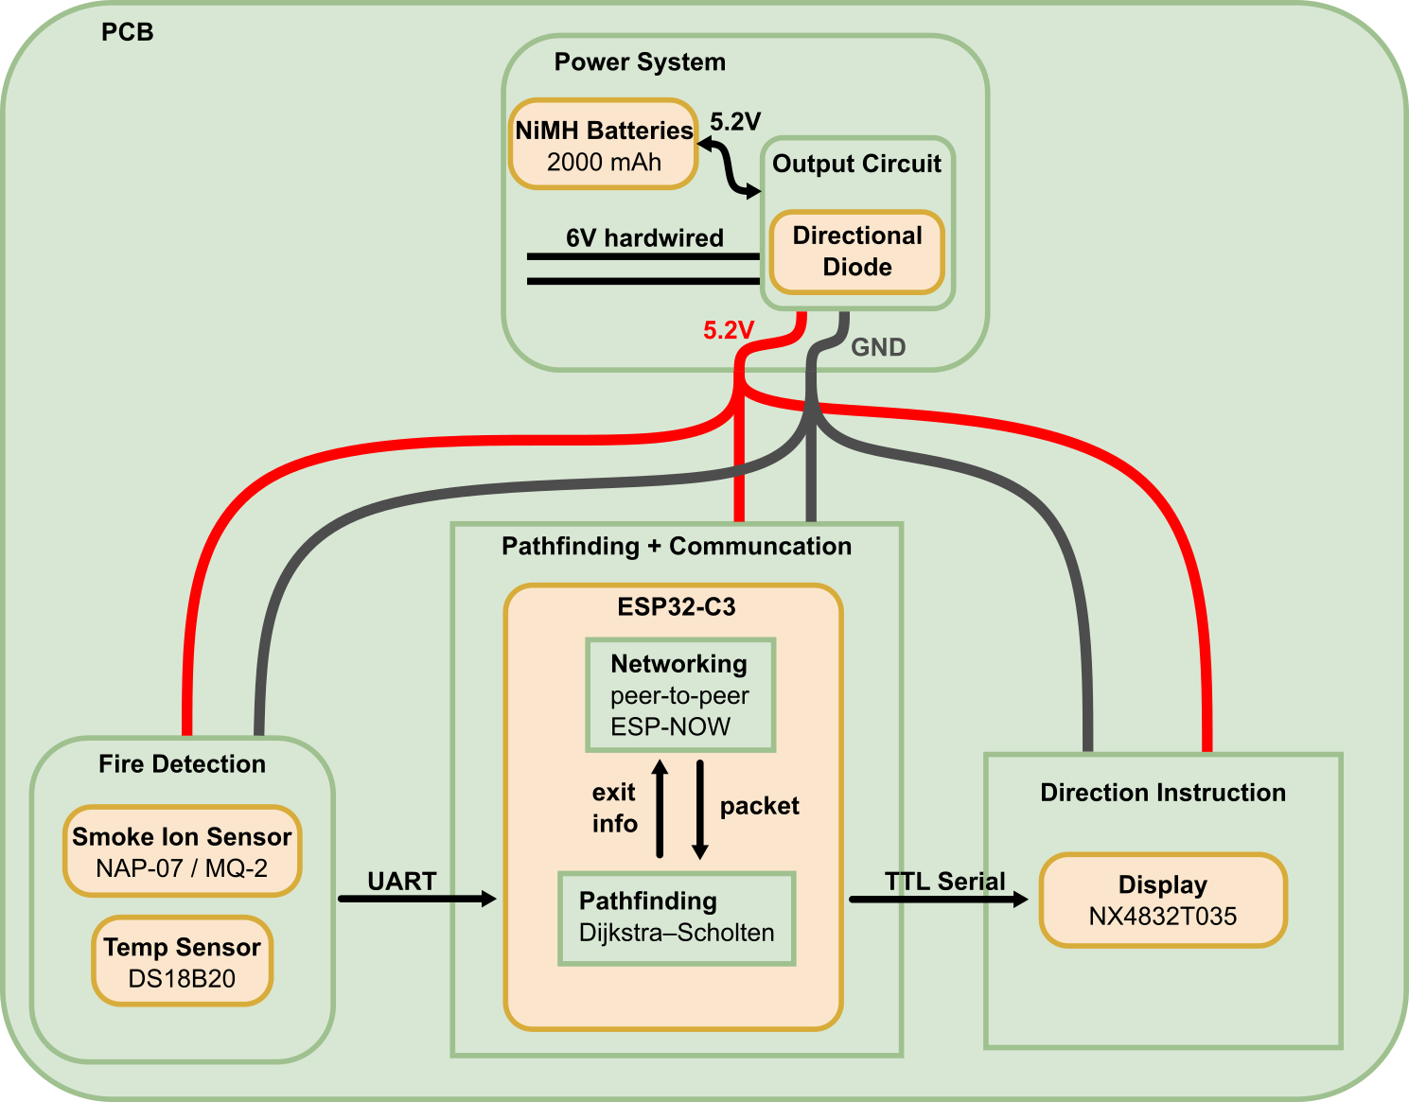
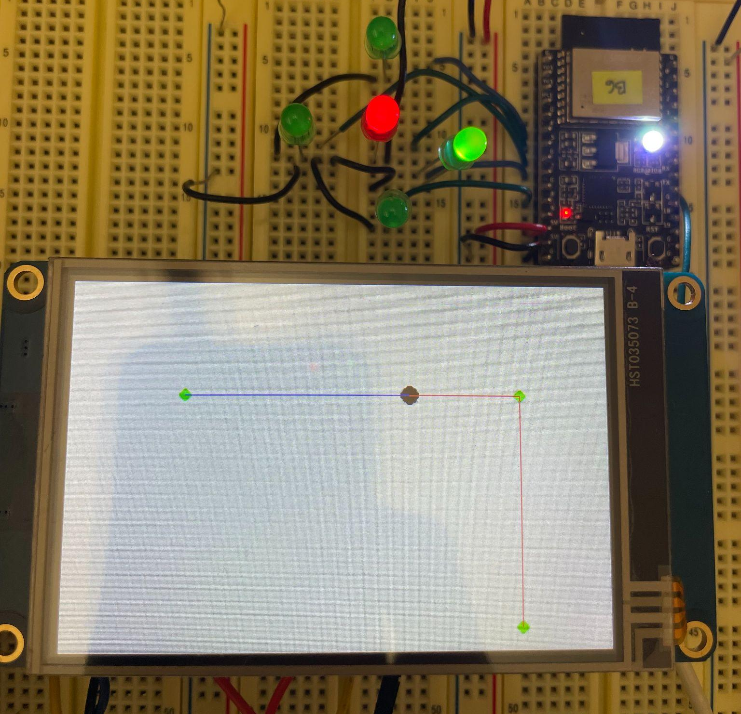
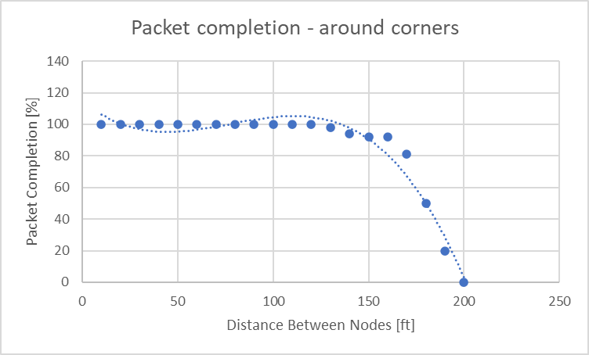
FireEscape
B8: Aidan Wagner, Jason Ledon, Neha Tarakad
18-500 Capstone Design, Spring 2023
Electrical and Computer Engineering Department
Carnegie Mellon University
Product Pitch
System Description
Our product aims to guide occupants to the safest path out of a burning building through a distributed system of fire detecting nodes. Currently, the existing solutions include evacuation maps in key areas based on strictly the closest exit. However, this does not take into consideration the potential threats that those paths could have. Our solution eliminates the risk of directing occupants towards fire hazards when trying to escape the building and prioritizes the safety of users.
The nodes are able to dynamically plan the safest and most optimal path out depending on distance, temperature and smoke data, reacting in real-time to threats of fire throughout a building. Our system is able to display directions in < 600ms taking into account packet reception, command computation, serial data transfer, and display time. Within our test scenarios, nodes have a 100% detection rate and the planned paths are optimal and correct based on a given floor plan for a building.
Our system is comprised of individual nodes that are broken up into two categories. The distinguishing factor between the two types of nodes is that one is comprised of LEDs while the other is comprised of an LCD screen. The LED nodes provide the relative direction to the next node in the optimal path. The LCD nodes provide in-depth information and highlight the optimal path out of a building based on the floor plan. Both categories of nodes have an ESP32 microcontroller which allow for communication over ESP-NOW; pathfinding out of the building is done using a form of distributed Dijkstra’s, where each node is only in communication with its neighbor. They also each include temperature and smoke sensors for fire detection. Currently, our nodes make use of wall power through a 6V barrel jack input into our PCB. However, in the event of a power outage, we include a backup battery circuit for each node which includes a blocking diode to prevent the battery from leaking into power supply and a resistor to prevent overcharging.
System Architecture
LED Display
Smoke Sensor
Temperature Sensor
Interfacing between all our components is our PCB. Power enters through our power system, which is configured to charge the batteries and power the rest of the board, but switch over to battery power in the event of an outage. Our ESP then requests the latest information from the sensors to construct a packet to send to all other nodes; this packet also includes information about the current shortest path to an exit that can be reached from that node, which is received from the peer-to-peer ESP-NOW network between nodes. Based on this information, and the status of whether a fire is detected or not, a shortest path is generated that avoids any detected fires. Based on this path, users are guided to the exit through our LEDs and LCD displays.
Power Jack
LCD Display
Backup Battery
System Evaluation
After we had our pathfinding, LEDs, LCD displays, and temperature sensors working, we wanted to ensure that we are able to integrate these subsystems on an example graph. This integration was successful, and the directions and escape routes were presented correctly.
Examples of directions displayed on LEDs and LCD screen
Conclusions & Additional Information
As we hope our system will be able to scale up to larger buildings, we performed testing to get an approximation of how far the nodes can be spaced apart in an indoor setting, while still being able to communicate.
Link to our website:
We believe that our design provides a solution to a problem unsolved by current fire alarm systems. By informing occupants of real-time exit strategies, we are giving users the a better chance to avoid fires while they exit a burning building. We hope to be able to scale our project upwards to fit the fire code and evacuation standards of large scale buildings and implement our system to prioritize the safety of the public.
https://course.ece.cmu.edu/~ece500/projects/s23-teamb8/
Notes:
NOdes currently have a 100% fire detection rate

