Slide 1
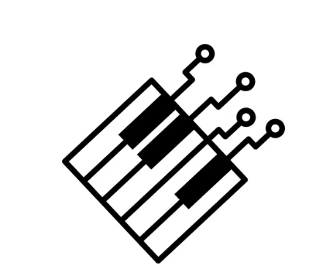
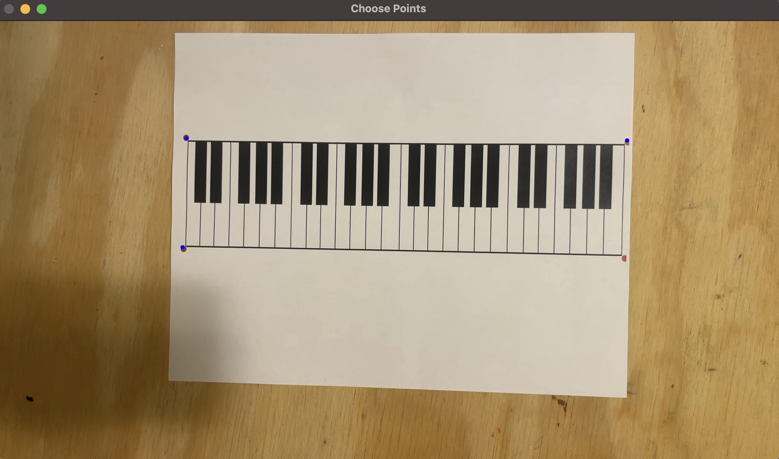
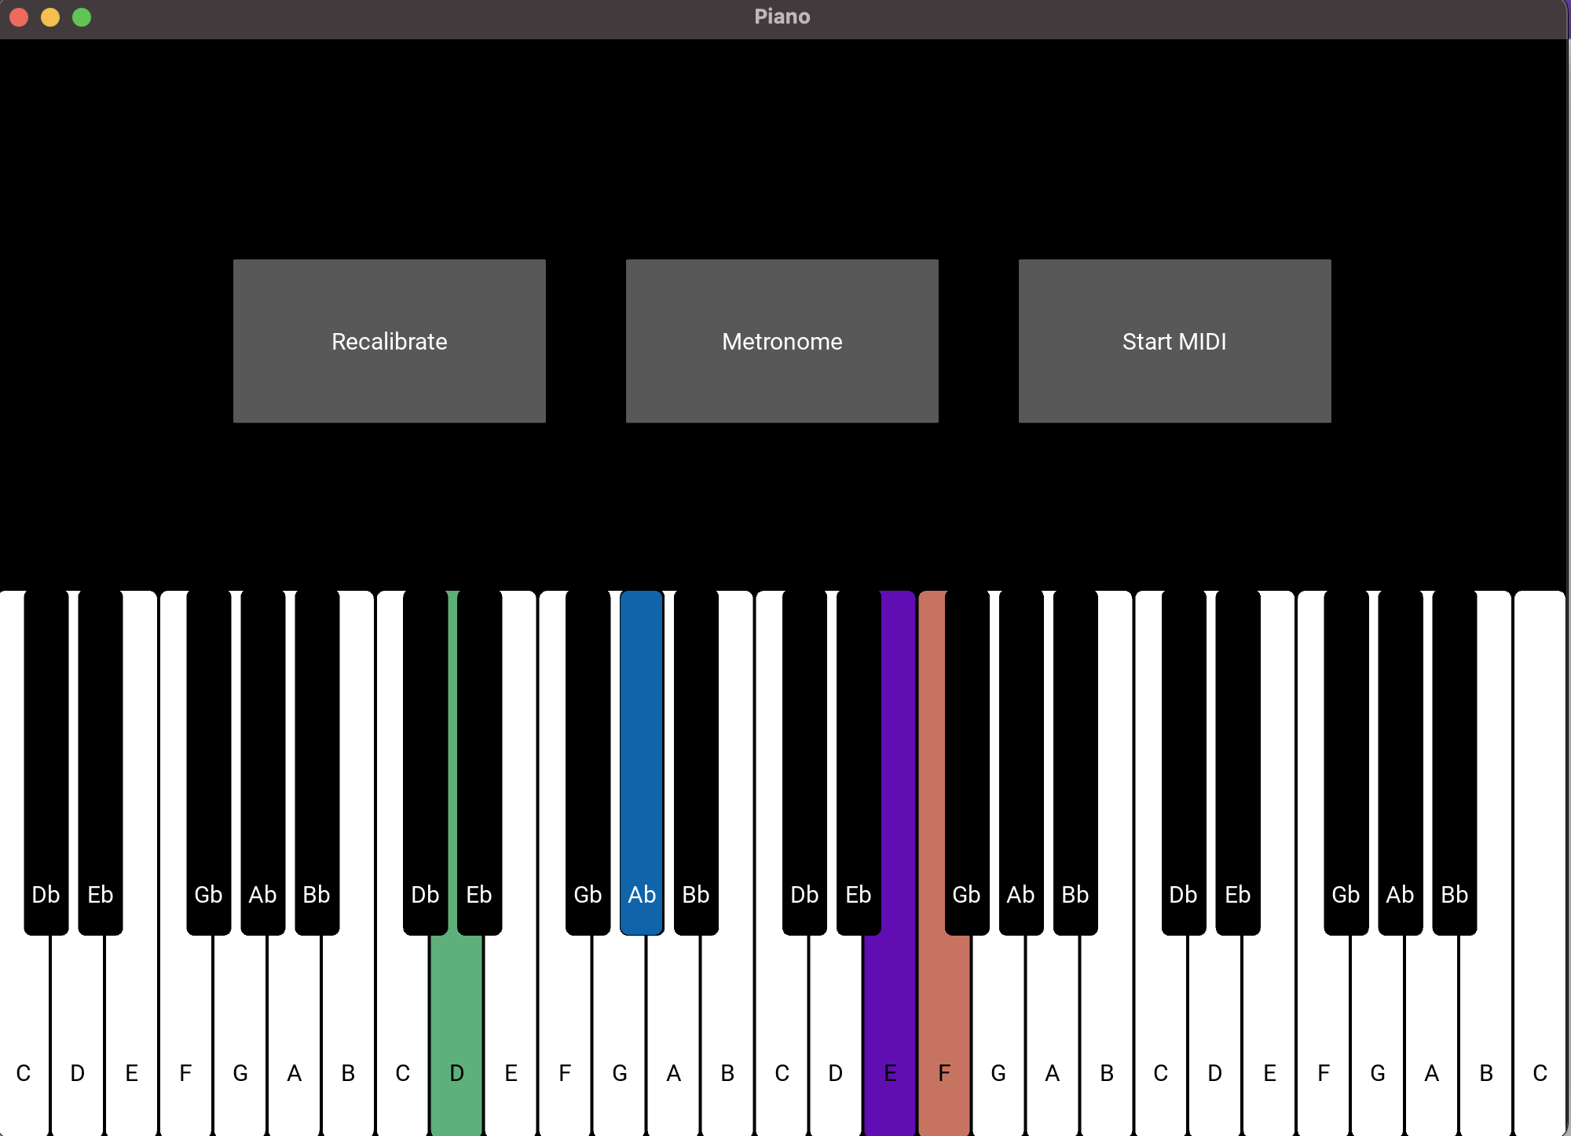
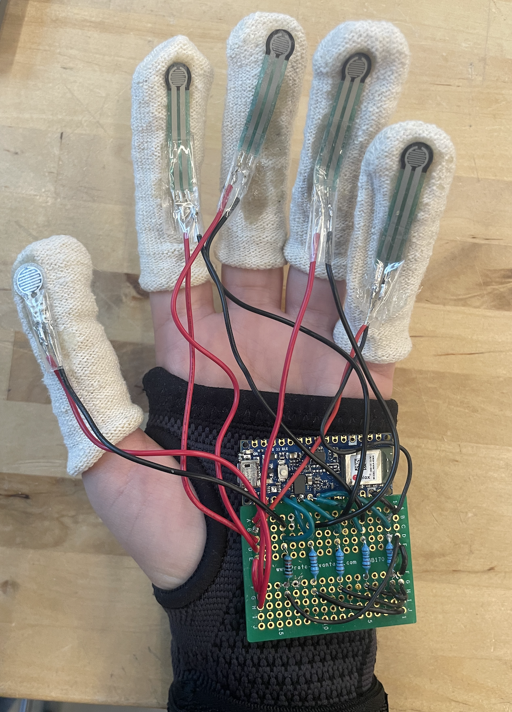
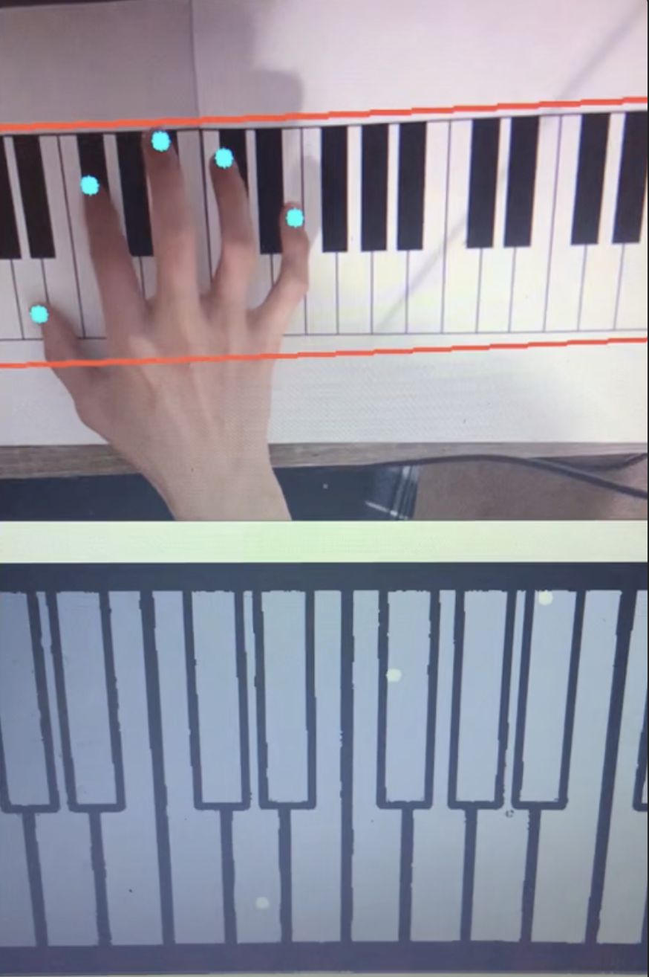
Anywhere Piano
Team B6: Lee Poirier, Nish Nilakantan, Caroline Liu
18-500 Capstone Design, Spring 2023
Electrical and Computer Engineering Department
Carnegie Mellon University
Product Pitch
System Description
Problem
Music composition and arrangement requires using a piano (not portable & lacks accessibility). Online synthesizers are not user-friendly & robust, and lack pressure-controlled volume.
Solution
User will wear a glove of sensors, play notes on a printed piano key layout, use phone camera CV to detect notes, and desktop for UI.
Calibration screen, Camera view of Keyboard
Interface Subsystem
System Architecture
Left Hand:
Arduino BLE Nano
5x MD 30-60 Pressure Sensor
3x AA Batteries
Gloves Subsystem
Mount to hold phone directly above user
Right Hand:
Arduino BLE Nano
5xMD 30-60 Pressure Sensor
3x AA Batteries
Fig 1: Phone+ Camera
Computer Vision Subsystem
49 Keys
System Evaluation
Test | Method | Goal | Result
Warp Consistency | 25 Test Images | 95% | 80%
Key Segmentation | 25 Test Images, with successful warp | 95% | 84%
Key Identification | 25 Test Images, with successful warp | 100% | 84%
Multi-Note Volume Comparison | Play 48 successive notes and compare decibel output <1-2 dB difference | 9/10 notes -> 90% accuracy | 100%
Multi-Note Volume Threshold | Play 48 “loud” notes and check they don’t overpower the speaker (go above 70 dB) | 9/10 notes -> 90% accuracy | 100%
Note Accuracy | Play all notes and compare with tuner | 48/49 notes -> 98% accuracy | 100%
Edge Cases | Use one finger to play between two notes 10 times to make sure ties are correctly broken | 9/10 notes -> 90% accuracy | 100%
Fig 2: Gloves
Fig 3: Paper Keyboard
Contour Detection
Warp Homography
Manual Points
Accesses stream from phone camera
Key Identification
Thresholding
Edge Detection
Segmentation
Bluetooth information
Send and receive information
Finger Identification
Localization
Media Pipe
Multiple notes through speaker output
Table 1: Tests, verification, validation + results
Fig 4: Computer Vision
Fig 5: App Interface
Design Tradeoff | Before | After | Rationale
Resistors | 68K Ohm | 10K Ohm | Wider range of volume outputs
Microcontroller | STM32 + HC-05 | Arduino BLE Nano | Bluetooth already integrated
App UI | Phone | Desktop PC | Can’t see user interface from phone. No need to convert code to C++ for apple phones.
Finger Identification | Colored Fiducials | Mediapipe | Faster, effective, and more reliable
Camera Angle | 45 degrees | Top-Down view | Easier for warping and ring light more stable
Conclusions & Additional Information
Further Design Extensions
Synth Engine
MIDI Capabilities
More Volume Levels
Increase thresholding accuracy
Interface
Pedal capabilities
More accurate resonance for loud + soft notes
http://course.ece.cmu.edu/~ece500/projects/s23-teamb6/
Table 2: Design Trade-offs

