Slide 1
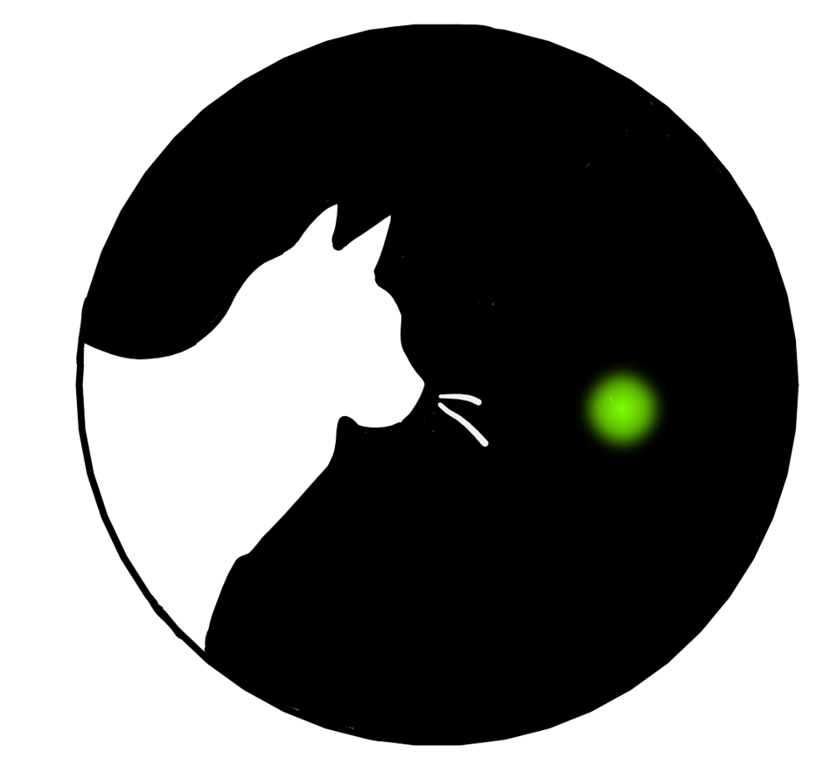
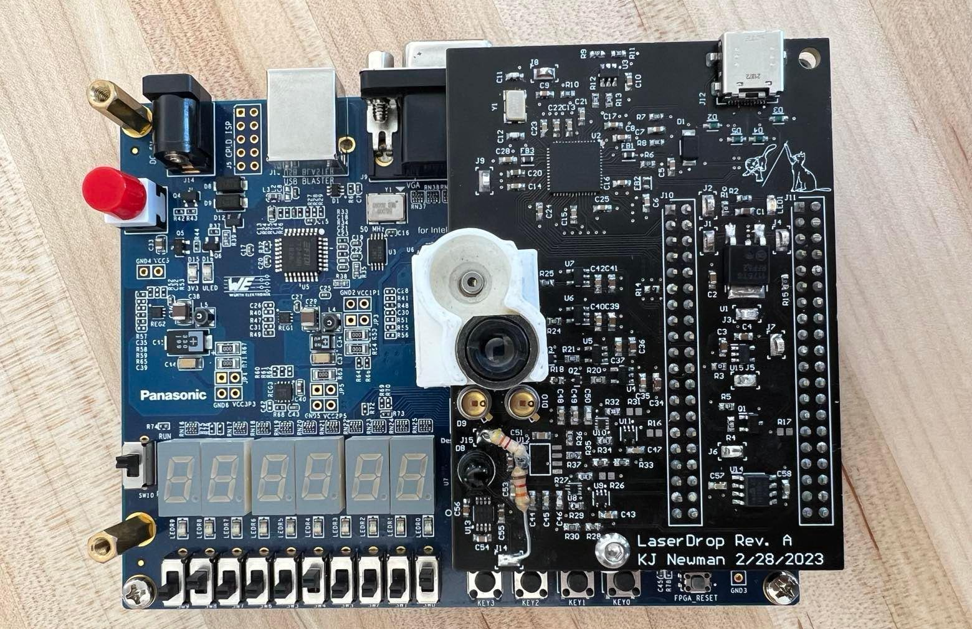
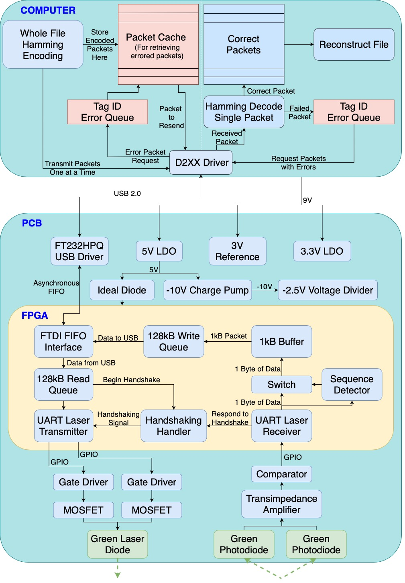
LaserDrop
B5: Anju Ito, Roger Lacson, KJ Newman
18-500 Capstone Design, Spring 2023
Electrical and Computer Engineering Department
Carnegie Mellon University
Product Pitch
System Description
Common transmission protocols such as Wifi, Bluetooth, and Internet, are not secure. RF communication creates a signature that can easily be detected and intercepted. Thus, these are poor methods for undercover agents to exfiltrate data, and so it is most often done with dead drops. Our project provides a better solution to transmit sensitive data discretely and securely using lasers. This provides a solution for transferring data without any physical contact, physical evidence, or detectable RF signature. LaserDrop is a USB device that consists of a circuit board, FPGA, and software that allows users to transmit data from one device to another through lasers.
Our project’s requirements are to transmit data at a range of 1 meter at speeds above 1 Mbps. We more than double both of these requirements. We also require that the system is able to correct for up to 2 bit errors within a 16 byte period and allows users to misalign lasers by 0.1 degrees. The laser power must be under 5 mW to be safe for public use without damaging bystanders’ eyes.
Hardware Components:
Software Components:
FPGA: USB-laser interface including handshaking, UART encoding and decoding, and packet padding
Software: Hamming encoding, packet creation and file reconstruction, and controlling the overall protocol
USB-C Port
Adjustable Lens Housing
FPGA Board
Green Laser + Lens
Laser Receivers
System Architecture
System Evaluation
System Block Diagram:
Data Encoding:
Encoding data as shown above requires a speed reduction but allows for ambient light filtering for operation in varying lighting.
Test Results
Usable Data Transfer Rate | 2.1 Mbps
Raw Data Transfer Rate | 4.2 Mbps
Operational Distance | 2 m
Max Laser Power | 5 mW
Allowable Angular Error | +/- 0.13 Degrees
Error Detection | Correct 1 Bit, Detect 2 Bits
Conclusions & Additional Information
Our device successfully provides a proof of concept for a high-speed, discrete, and safe laser communication system. With more time, budget, and resources, we anticipate that this device could be integrated into consumer devices and use non-visible lasers for better secrecy in operational use.
More Information at:
http://course.ece.cmu.edu/~ece500/projects/s23-teamb5/

