Slide 1
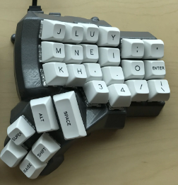
Use Case RECAP
People who want to invest in a Custom Keyboard usually do so for the comfort and customizability it offers.
PROBLEM: Finding the keyboard that is perfect for you and all the things you use your keyboard for can be difficult and require multiple keyboards and thousands of dollars. Specifically, often times, different applications require different layouts aka different keyboards to work best.
Applications: Gaming, Video Editing, Programming, Streaming
Notes:
Use Case/Application: Remind us of the problem you are solving. Don't spend too much time
here, as you can assume your audience can remember your previous presentation. Of course, if
you've made big changes, you need to explain them.
For those who want an easily customizable ergonomic experience
For those who want to minimize cable clutter on their desk
For those who want to try new layouts without buying an entirely new keyboard

Slide 2
Use Case Requirements
Low Latency | <50 ms | Users such as gamers need fast response times (COMFORT)
Battery Life | >2 Days | Battery sufficient for the longest feasible use sessions (CONVENIENCE)
Keyboard Layout Freedom | ∞ | Any keyboard layout imaginable (that fits on the baseplate) can be created (CUSTOMIZABILITY)
Cheaper than multiple keyboards | <$300 | Less than the price of buying 2 decent custom keyboards. (COST)
Stability | < 1mm | No noticeable wobble while typing (COMFORT)
Portability | <1 kg | Maximize usefulness, reference avg weight
Notes:
Quantitative Use-Case Requirements: What requirements are driven by the use case ? Include
numbers and units. This can be merged with the use case/application slide as this too was the
focus of the last presentation. However all teams must have a list of quantitative requirements
(and perhaps some qualitative requirements) listed.
GOALS (the why): retain COMFORT, improve CUSTOMIZABILITY, reduce COSTS (less than multiple keyboards)

Slide 3
Solution Approach
What we will show
Fully Customizable Wireless Macro Keyboard (Layout, Keymap, Switches)
Infinite Keyboard Layouts for any use case users want
Help reduce strain on hands (Health!)
Less keyboards = Less waste
Changes: BLE to microcontroller but USB-C to PC
Full set of 16 wireless keys!
Inductive charging station for 1 key
Web app for key configuration
3D housing for keys
Baseplate to attach keys to
Notes:
Solution Approach:
This was the focus of the Design Review, so you don't want to spend much
time here either.
Instead, just remind us of your approach and highlight any changes from the
original approach. Include your block diagram and highlight any differences in the "as-built"
version from the Design Review version.
Please emphasize any considerations of public health,
safety, and welfare, as well as global, cultural, social, environmental, and economic factors in
how you formulated a solution approach to meet your use-case requirements.
Explain how
your thinking and solution has evolved since the proposal presentation.

Slide 4
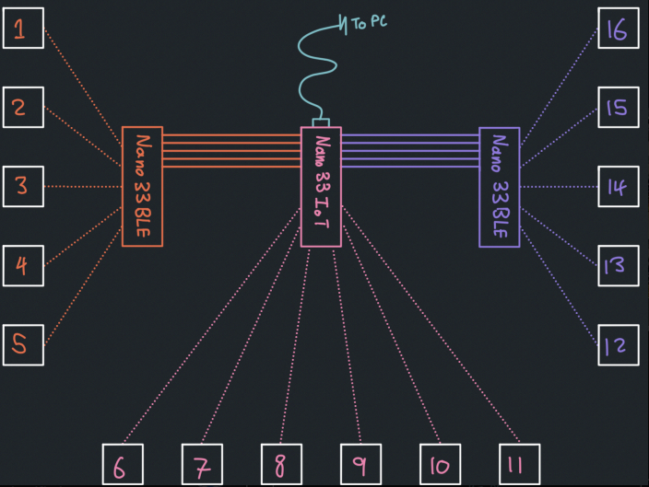
Block Diagrams
Key:
█ 3D printed █ Off the Shelf Parts
█ Program █ Custom Design
Keyswitch Enclosure
Cherry MX LP Switch
Seeed XIAO BLE
BMS Code
BLE Code
Power System
100 mAh
LIPO
Rectifier Board
Inductive coil
Notes:
Changes:
LIPO location in stack

Slide 5
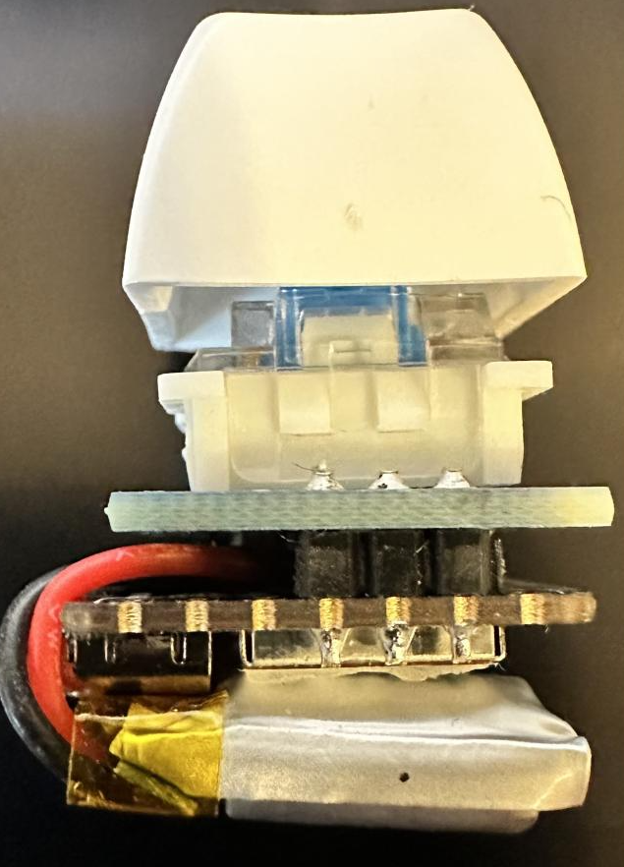
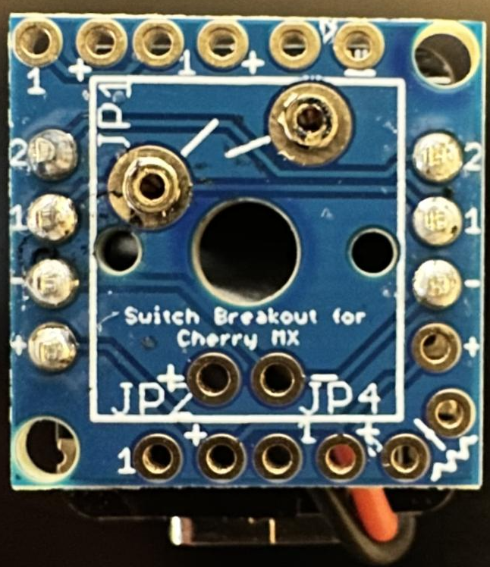
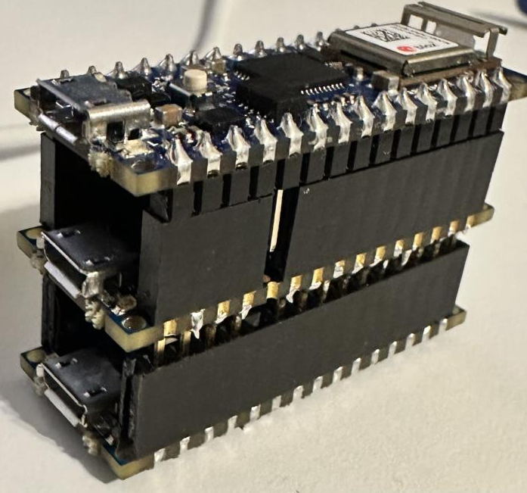
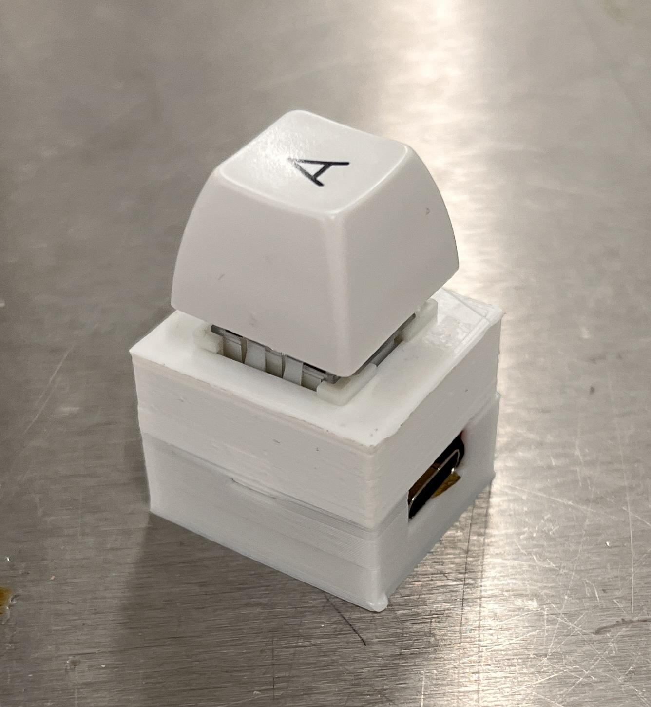
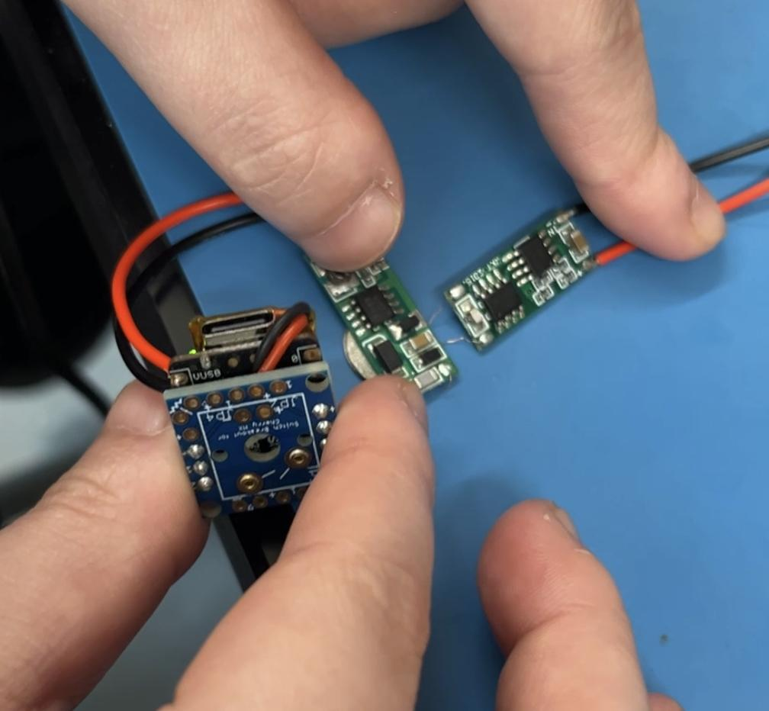
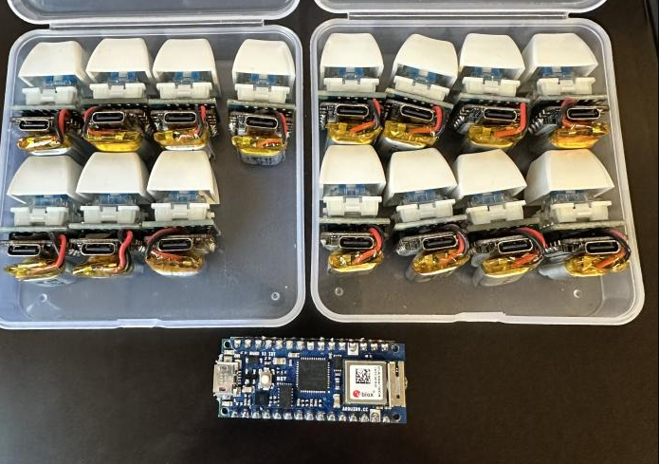
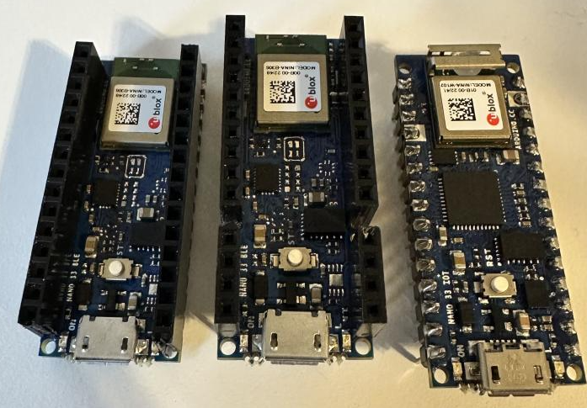
Complete Solution
Notes:
Complete Solution: Discuss what you will show in the public demonstration.

Slide 6
Testing: Design
Metric + Value | Method | Input | Success Output
Key Size | Calipers | Key Housing | Footprint < 25mm x 25mm
Stability | Camera | Typing | Wobble < 1mm (not noticeable)
Wireless Charging Coil Size | Product Specification | Charging Coil | < 22mm in Diameter
Key Reliability | Pressing Keys | 10 fast key presses | Exactly 10 letters typed
Hot Swappable Switches | Change Switches | Key & 2 switches | Key works after changing switch
Wireless Connectivity | Measuring Tape | Typing | Key remains connected within ~1m of receiver
Notes:
Remind us of what you've said before regarding the test plans: QUANTITATIVE
measurements of the goodness / functionality of your design? We want to hear about both
the verification of design requirements and the validation of use-case requirements. Test
inputs? What constitutes a passing test?

Slide 7
Testing Results: Design
Metric + Value | Success Output | Result
Key Size | Footprint < 25mm x 25mm | Housing is 23mmx24.8mmx20mm (WxLxH)
Stability | Wobble < 1mm (not noticeable) | 0mm ~ No perceivable wobble
Wireless Charging Coil Size | < 22mm in Diameter | 8.5mm < 22mm
Key Reliability | Exactly 10 letters typed | 10 letters received and typed
Hot Swappable Switches | Key works after changing switch | Key works after switch swap
Wireless Connectivity | Key works within ~1m of receiver | Key remained connected 15m away with line of sight
Notes:
Results: How well did your implementation perform?
Table of Specs and Performance

Slide 8
Testing: Use Case
Metric + Value | Method | Input | Success Output
Latency | SlowMo Video | Type | Letter Appears < 50ms later
Wireless Charging | Ammeter | Current In | > 12.5 mA current measured
Battery Life | Ammeter | Current Draw | 10h(mA on) + 38h(mA off) < 100 mAh
Cost | Sum of Parts | Spreadsheet | <$300
Portability | Scale | Whole keyboard | <1 kg for 16 keys + baseplate
Layout Freedom | Degrees of Freedom | Reposition Keys | Keyboard functions correctly regardless of switch location
Notes:
Remind us of what you've said before regarding the test plans: QUANTITATIVE
measurements of the goodness / functionality of your design? We want to hear about both
the verification of design requirements and the validation of use-case requirements. Test
inputs? What constitutes a passing test?

Slide 9
Testing Results: Use Case
Metric + Value | Success Output | Result
Latency | Response < 50 ms | 37.5ms (9 frames @ 240fps)
Wireless Charging | > 12.5 mA current in | 17mA current in measured
Battery Life | 10h(mA on) + 38h(mA off) < 100 mAh | 6.5 mA on, 0.7 mA off measured
Cost | <$300 for 16 Keys | $17 per wired charging key($272 total), $26 per inductive charging key ($416) Mass Production Costs: $15.57 per key ($249.19)
Stability | No wobble in video | No detectable wobble
Portability | <1 kg | 372g total weight
Layout Freedom | Keyboard functions correctly regardless of switch location | 16 switches remained connected and responsive independent of layout
Notes:
Results: How well did your implementation perform?
Table of Specs and Performance

Slide 10
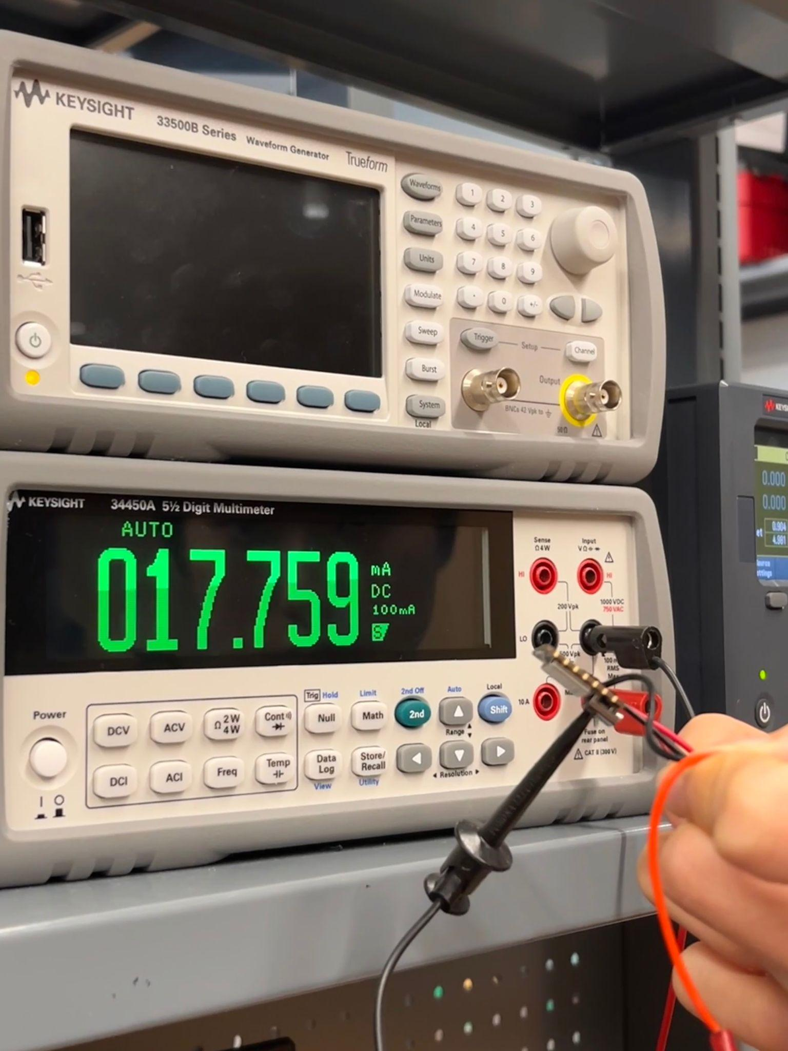
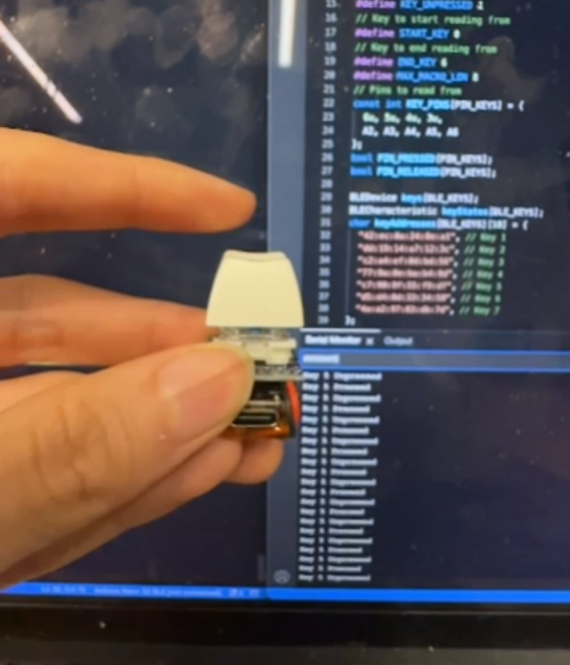
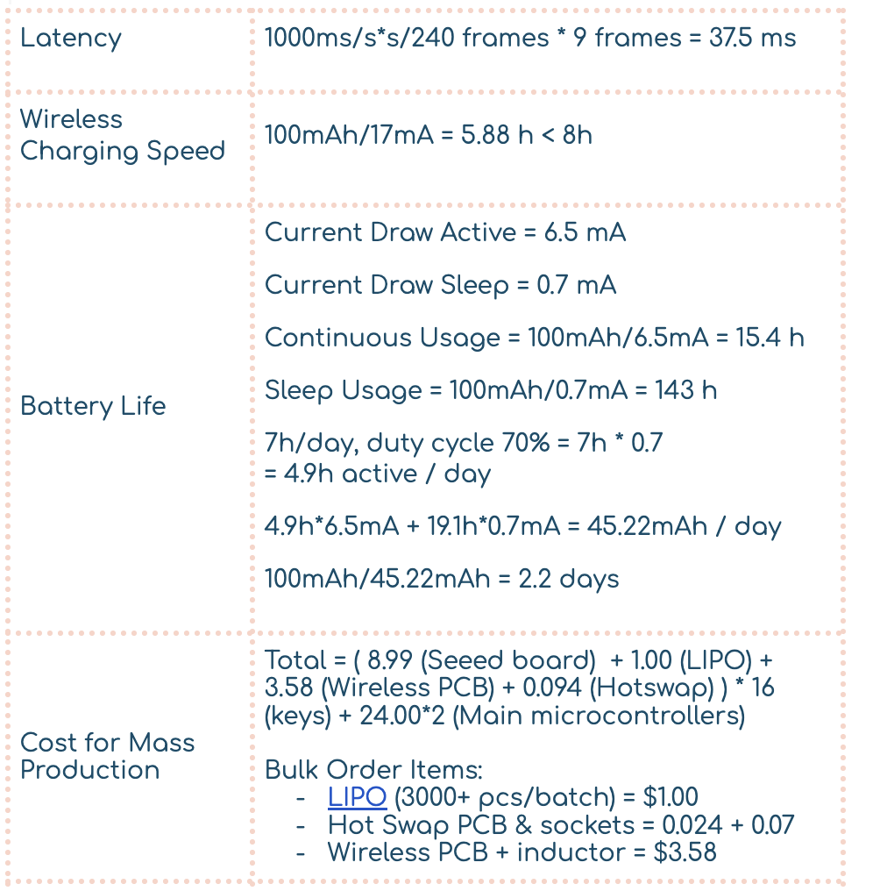
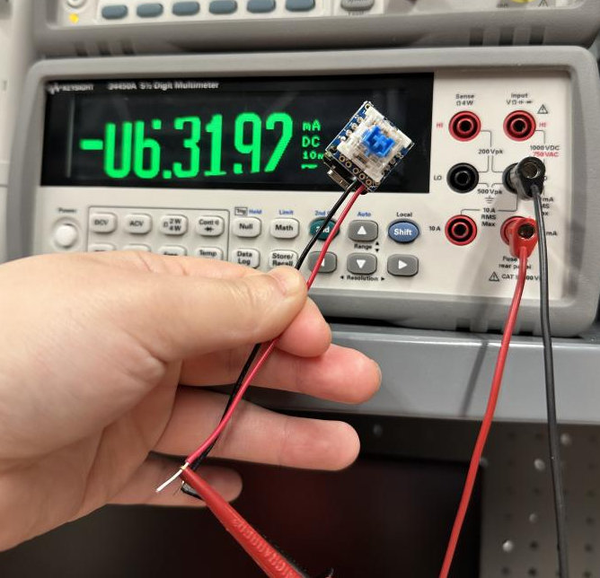
Testing Images + Calculations
Power Transfer in Charging
Latency Test with iPhone Slo-mo camera
Current draw while clicking

Slide 11
Trade Offs
Battery Life vs Physical Size
20mm x 7mm x 14mm @ 100mAh
23mm x 15mm x 5.5mm @ 120mAh
26mm x 16mm x 6.6mm @ 150mAh
Availability
Latency vs Battery Life
100ms reconnection latency vs 0.7mA constant power draw
Charging Convenience vs Cost
More wireless charging coils = more heat and cost
Convenience vs Physical Size (height)
Hot swap sockets add another 1mm of height to overall assembly
Battery connectors add another 2mm
Inductor PCB adds another 1mm height + length borders 25mm limit, (can be resolved with some more layout optimizations)
Notes:
Highlight design trade-offs you made. Engineering is often the process of choosing
(making decisions about) different approaches to a problem. We would like to see those
areas where this was done in your project.
We also want to see the QUANTITATIVE trade-offs in your implementation if you were able to gather this from the testing.
Specifically between the specifications you listed as the most important based on your
application area. This is called a Pareto trade-off.

Slide 12
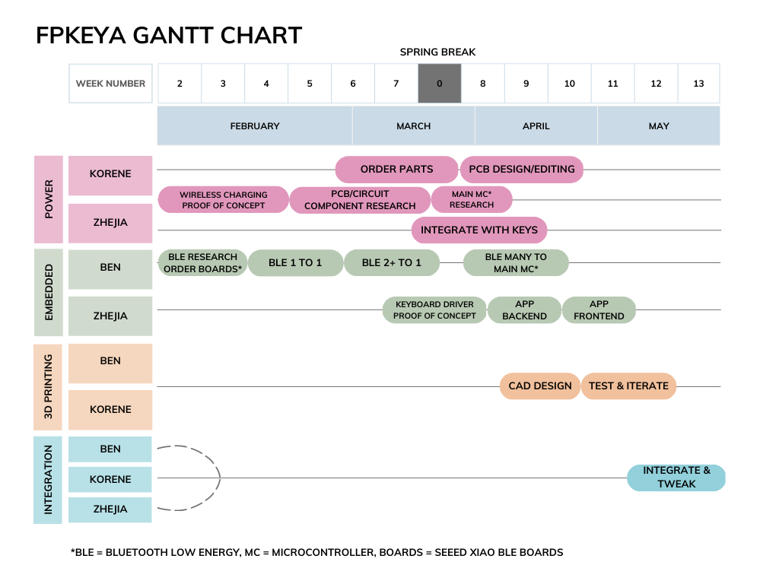
Edits:
App Backend Details swap order Frontend
PCB Transmitter board time longer than expected
Work Remaining:
Packaging
Charger Assembly
Key housing Assembly for all keys
Key Baseplate
Notes:
Show and discuss your schedule. Again, focus on what changed. Highlight any work that
remains before the public demo. Take care to make sure this slide is readable. An example
schedule was provided in the Design Review Presentation and Report guidance.

