Slide 1
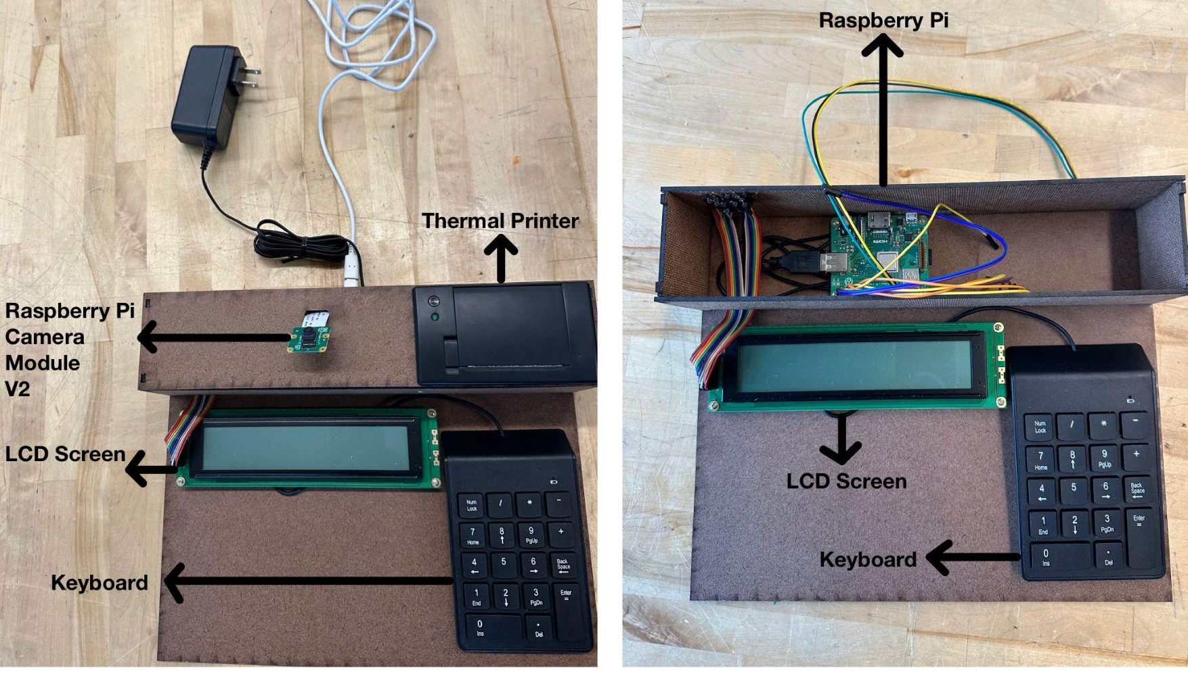
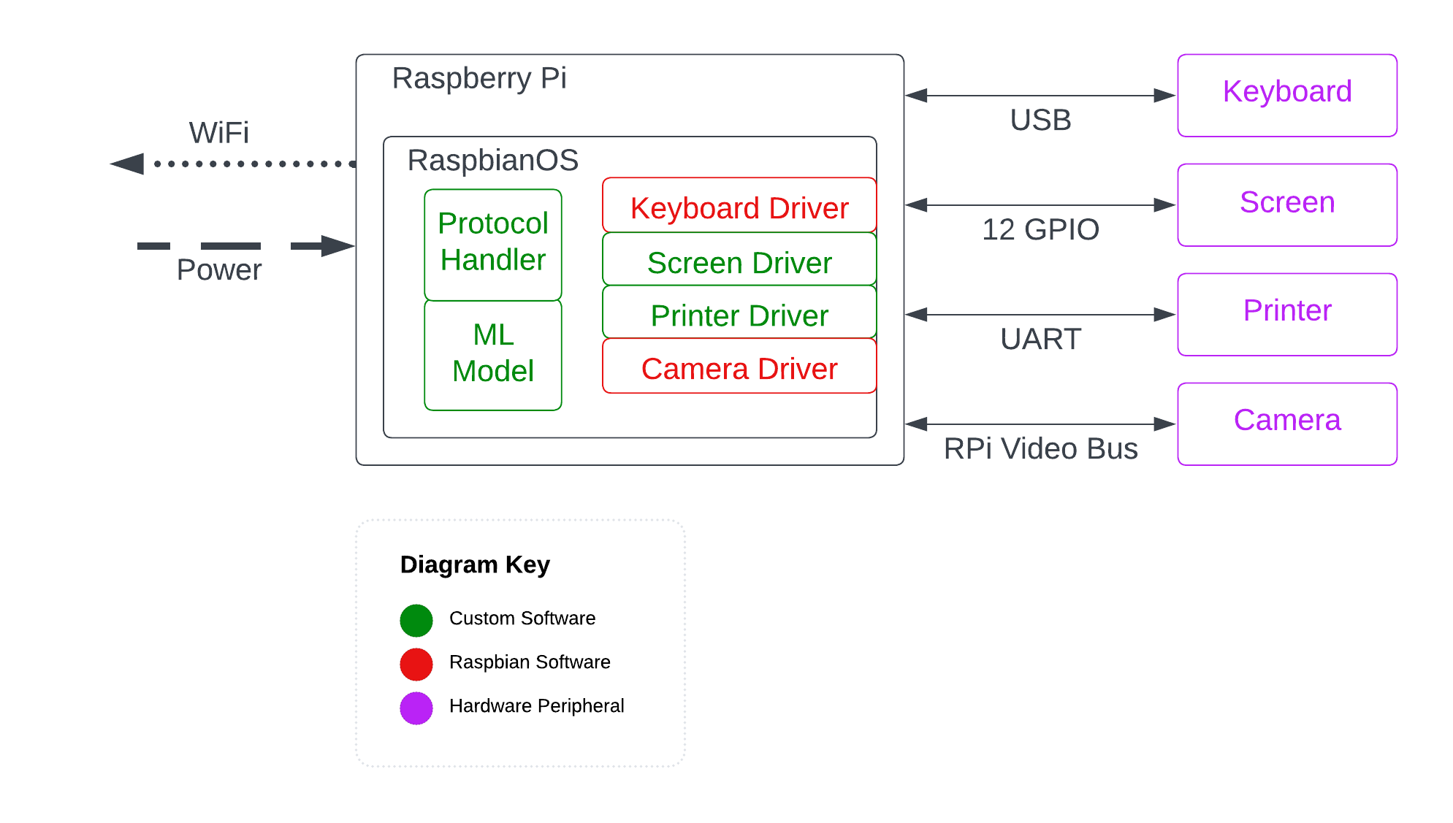
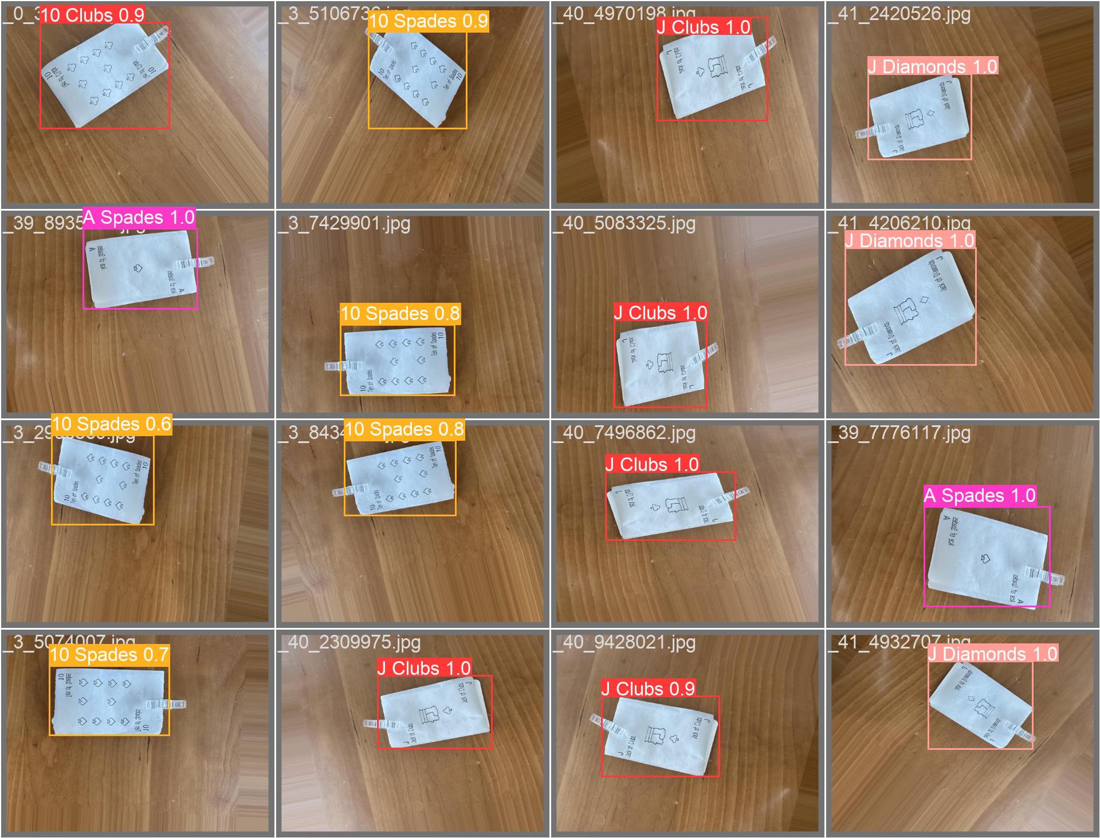
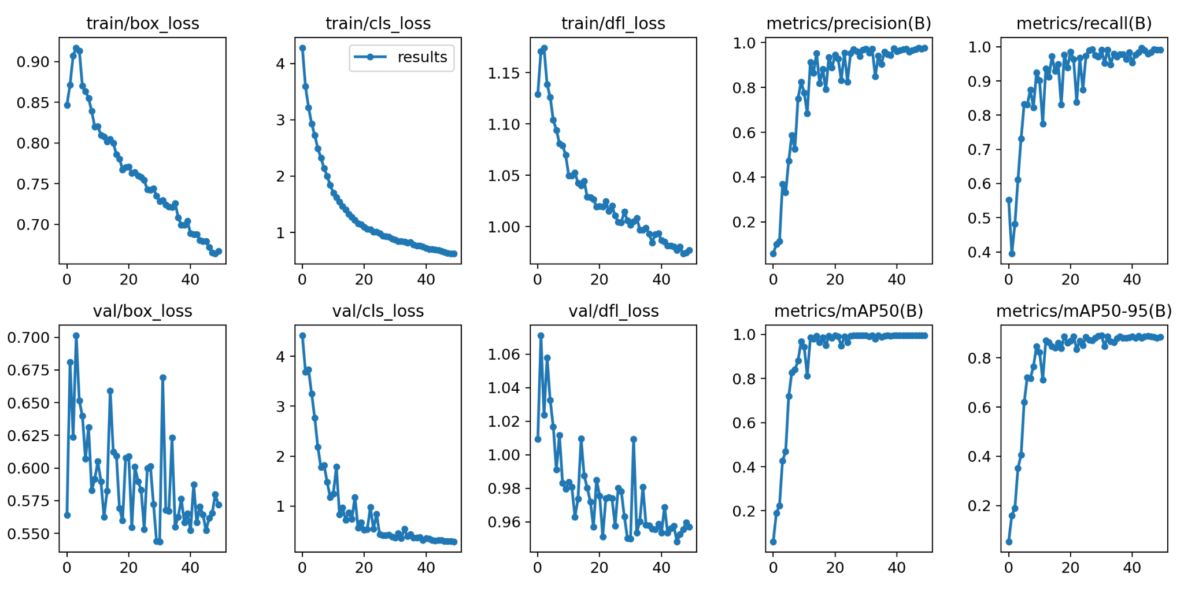
Jack of All Trades
Team A7: Miya Higuchi, Mason Loyet, Rachel Ratnam
18-500 Capstone Design, Spring 2023
Electrical and Computer Engineering Department
Carnegie Mellon University
Product Pitch
System Description
Our project lets people play games with physical cards remotely from different parts of the world! The current alternatives for remote gameplay are purely virtual, consisting of online sites and applications that lose the authentic feeling of holding and placing cards. Requiring only a 12” x 24” playing space, an outlet, and connection to WIFI, our portable system handles all the card game setup for players to play games such as Go Fish.
Our system will deal cards to the players with the thermal printer. Information about the current game state and any potential action items will be displayed on the LCD screen for the user. For games that require input, we will have a keyboard so that users can enter in information such as card suits, numbers, and more. Finally, to “play” a card, the user can place their card in the playing space under the camera which will be fed into our server which will then detect the card and update the game state.
The use case requirements are to be able to have concurrent games with multiple players and be able to play Go Fish. Our current system implementation meets the user requirements with a 99.5% card detection accuracy, 23 millisecond detection latency, 4-7 second card printing speed and no visible lag between the keyboard and LCD screen.
The physical components of our system can be organized into input, output, and dealing devices. The keyboard helps progress the game where user input is needed. The server needs to be able to know what the request is, in order to relay the information to the opponent and progress the game state. The camera module input device captures the cards the user “plays” and uploads the information to the server, updating the game state. The output device is the LCD screen, which displays the current game state and items of action to the user. For instance, the screen may indicate the move the opponent has just made. Lastly, for the scope of this project, the dealing device will be a thermal printer instead of a mechanical sorting machine. The thermal printer, connected to the Raspberry Pi, will print out the cards as a means of dealing. Cards will be printed out on receipt paper and supplemented with cardstock.
Raspberry Pi Model 4
Label B
System Architecture
User Input
Game State
System Evaluation
Card Dealing
Card Detection:
99.5% accuracy
User Input
Trade offs:
Dealing speed/Detection latency vs. Design complexity
Single vs Multiple card detection
The Raspberry Pi serves as the central hub, connecting all of our peripheral devices (keyboard, LCD screen, printer, and camera) and communicating with the server.
Accuracy and Loss Graphs for the CV Card Detection Algorithm
Conclusions & Additional Information
For future development, the card dealing system could have a more mechatronic implementation in place of the thermal printer.
For more information on our development process, scan the QR code!
http://http://course.ece.cmu.edu/~ece500/projects/s23-teama7/
*x-axis = # of epoch (# of iterations where the entire dataset passes through the algorithm for one cycle)

