Slide 1
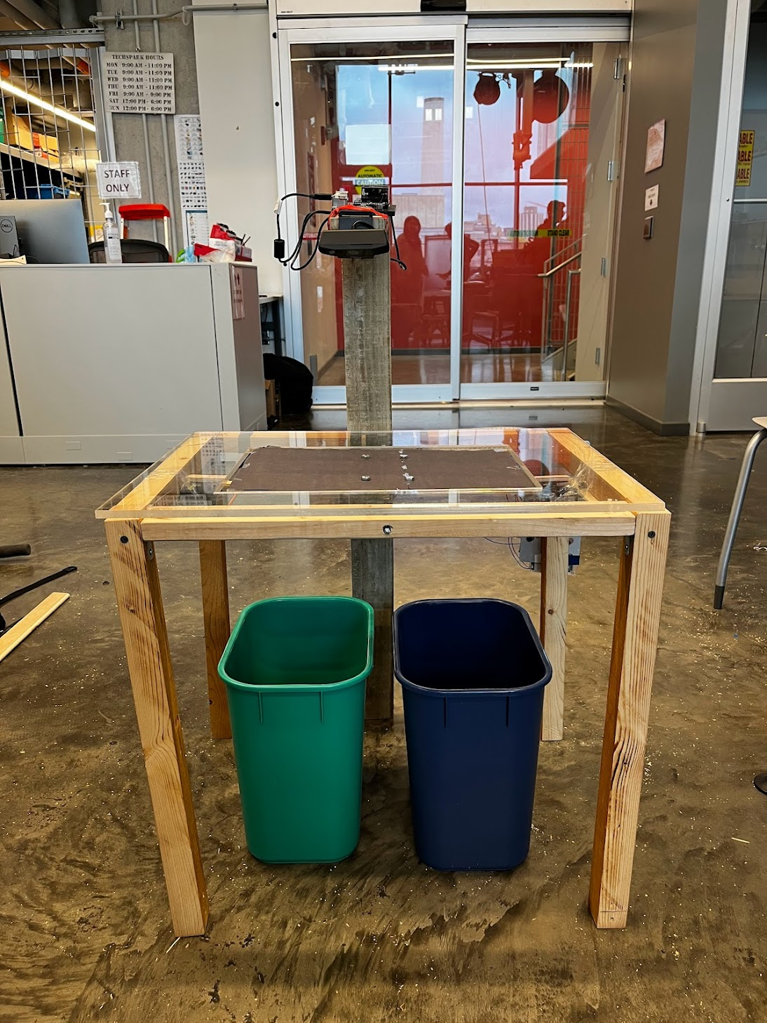
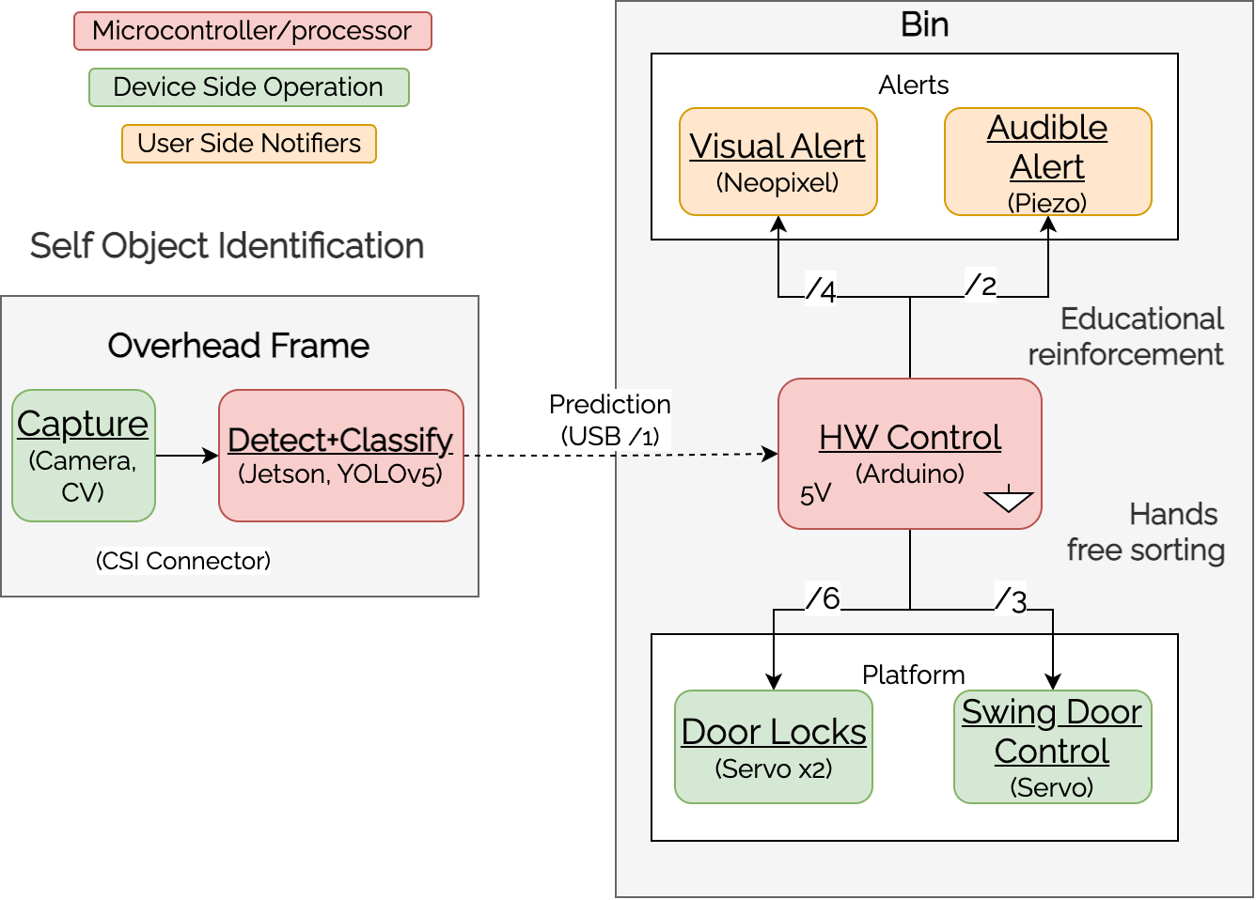
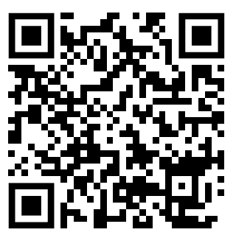
Dr. Green
A05: Tinghua Hsu, Vasudha Srinivasan, Aichen Yao
18-500 Capstone Design, Spring 2023
Electrical and Computer Engineering Department
Carnegie Mellon University
Product Pitch
System Description
Dr. Green is a smart recycling device for schools designed to educate users on the recycling rules of Pittsburgh while reducing recycling contamination. It uses a vision-based recycling classifier to automatically sort waste items and generate real time visual and audible feedback alerts. Since schools are a learning-based community with existing large scale waste organization infrastructures, schools and their students are Dr. Green’s targeted users.
To reach ideal operation, Dr. Green’s classification accuracy should be 90% to prevent recycling contamination and reduce manual sorting at waste plants. Dr. Green’s prototype is fully integrated with accuracy around 70% and total operation time around 15 seconds.
The mechanics are fully automated with 100% accuracy to ensure ease of use, safety, and sanitation for younger users. The alert system has 100% accuracy and less than 2 second operation time for prompt feedback.
Camera
Jetson
Platform (Door)
Arduino & Alert
System Architecture
Trash
Recycling
Dr. Green consists of three main subsystems:
Object Identification: Detect and classify objects on platform. CV looks for two consecutive platform changes to trigger YOLO classification of object to be sorted.
Hardware Control: Uses output from model to control alerts and door systems.
Mechanics: Physical structure of device, consists of a camera frame to hold up the camera, lid frame holding up the alerts and a swing door above the bins to sort the waste into.
System Evaluation
We tested our system for accuracy and speed, initially testing each unit, then combined operation. Our testing and evaluation process was as follows:
Object Image Capture: Confirmed continuous capture of whole platform
Detection: Verified detection of new items placed
Classification: Run YOLO classification on multi-object image (Tradeoff: model confidence vs accuracy)
Jetson to Arduino Communication: Verify output classification result to Arduino (via USB) from Jetson (Tradeoff: Latency vs Accuracy)
Hardware Circuit: Verified operation of each component (Neopixels, speaker, and servos) based on a given input.
Mechanics: Checked door and frame for stability and operation when connected to HW with different weighted waste (tradeoff: door weight vs stability)
Subsystem | Goal |  | Current State
 | Accuracy | Op Time | Accuracy | Op Time
Camera capture & object detection | 100% detection | <1 sec | 100% accuracy | ~4 sec
YOLO multi-object classification | 90% (recyclable vs. trash) | <2 sec | 70% | ~ 2 sec op 12 sec boot
Alert system (Neopixel, Piezo) | 100% | < 1 sec start < 1 op | 100% (12/12 unit + integration) | 1 sec op
Swing Door mechanics (servo) | 100% operation, 80° platform turn | <1 sec start <3 op | 100% 12/12, TBD with door attachment | ~2 sec start ~ 5.5 sec op
Overall Operation | 85% | <5 sec | 70% | ~ 10-12 sec
Conclusions & Additional Information
Overall, our team did well in meeting our set use case requirements and goals. We especially exceeded in integrating early and making significant progress in the development of each of our subsystems. We learned a lot about the engineering design process and more general development related lessons such as how implementation can very often turn out to be different than the imagined and planning ahead with slack time is crucial as things always take longer than expected.
http://course.ece.cmu.edu/~ece500/projects/s23-teama5/

