Slide 1
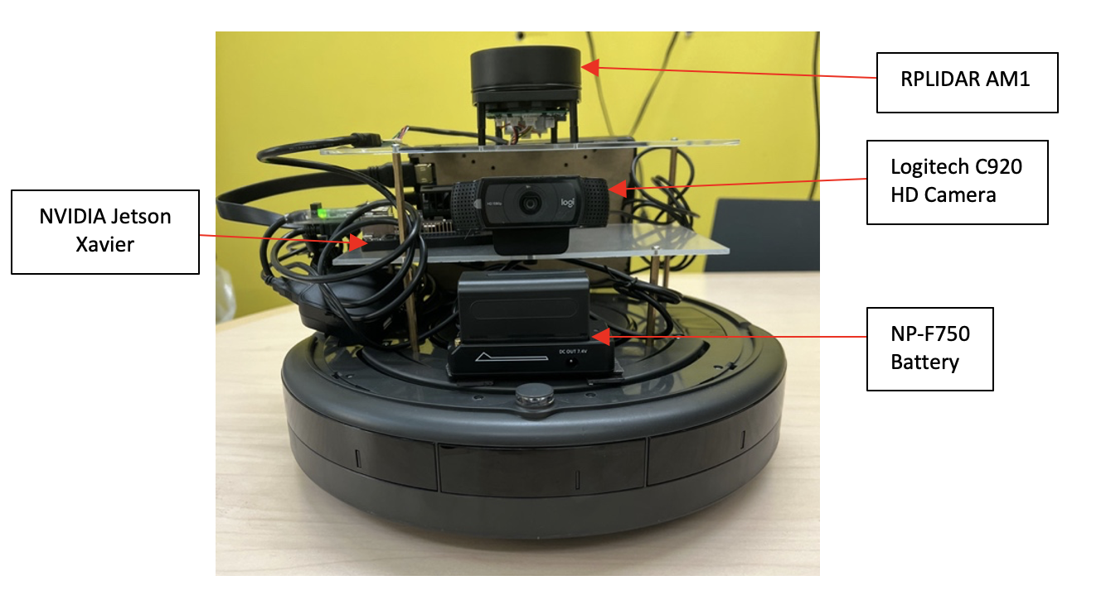
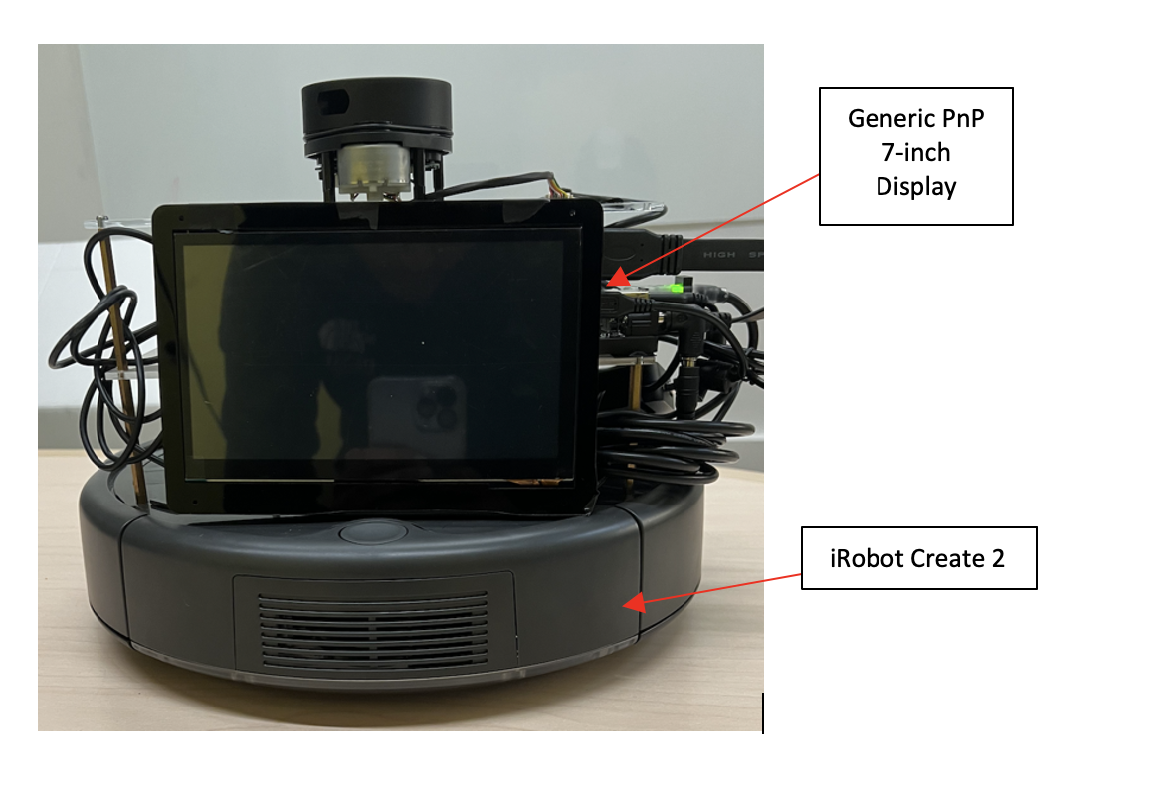
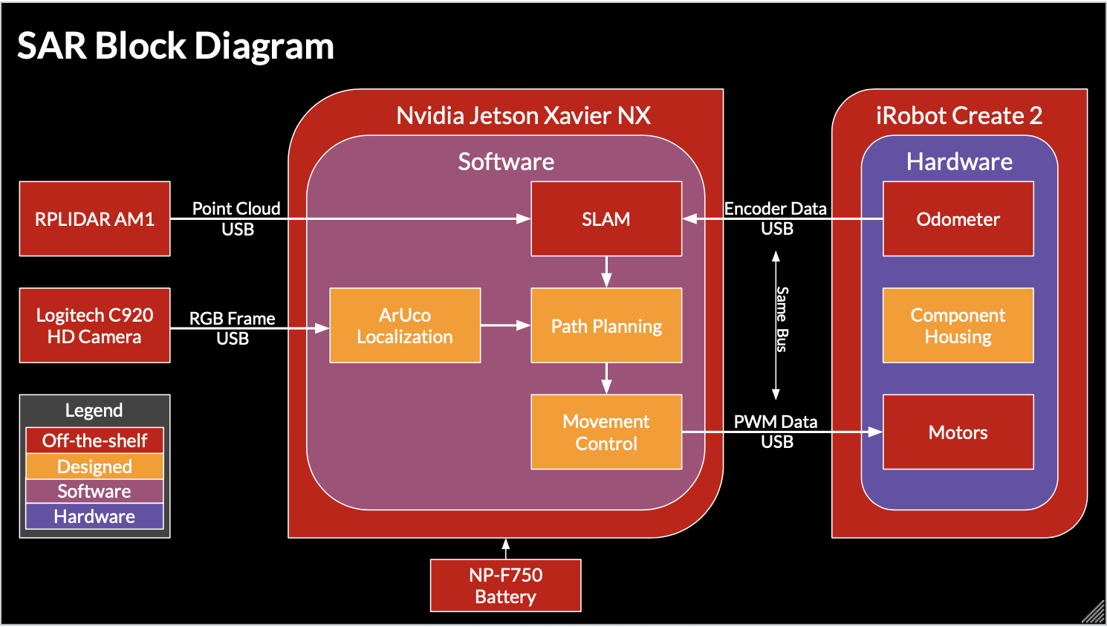
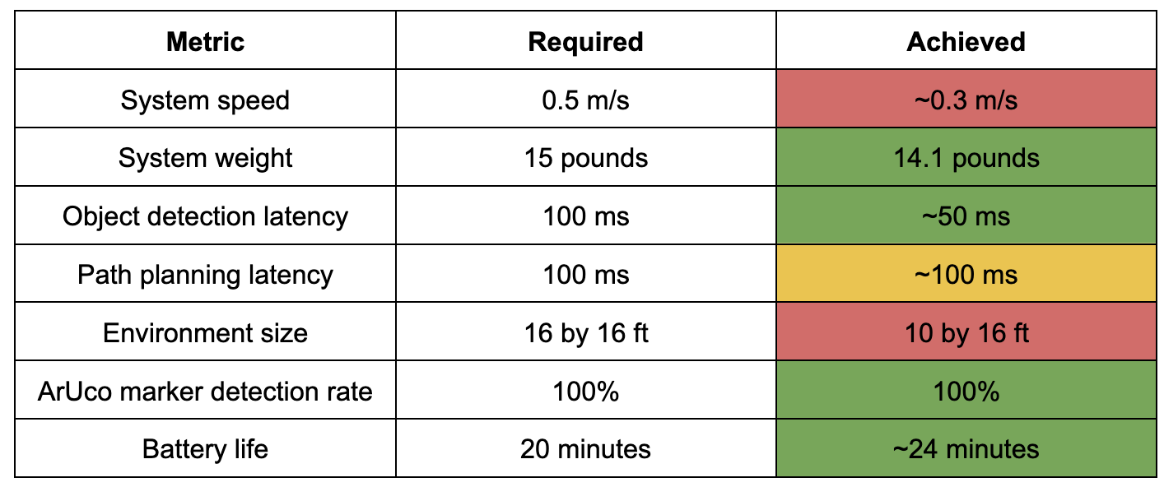
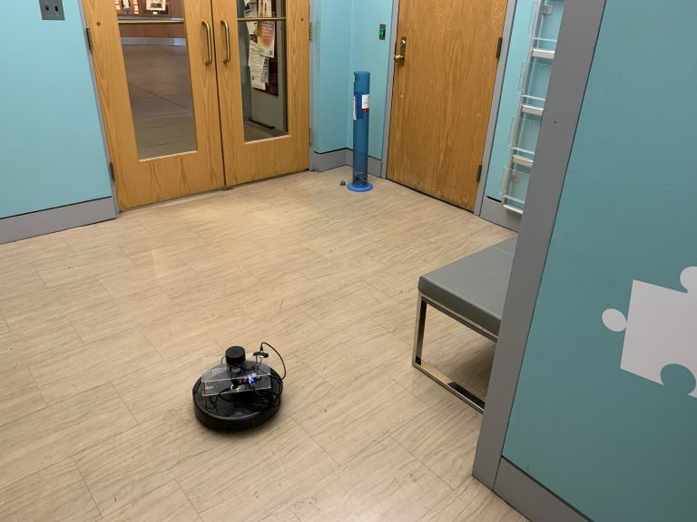
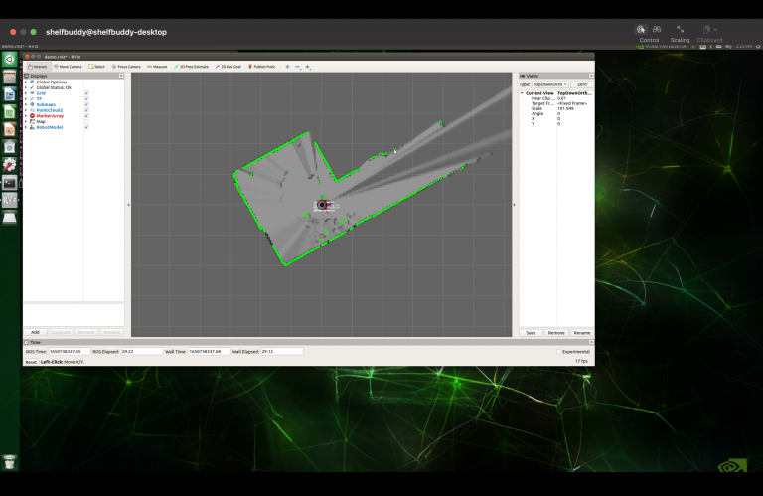
SAR: Search and Rescue Robot
E2: Keshav Sangam, Jai Madisetty, Raymond Xiao
18-500 Capstone Design, Spring 2022
Electrical and Computer Engineering Department
Carnegie Mellon University
Product Pitch
System Description
Firefighting is a dangerous profession, and a lot of research and data show the profession’s contributions to chronic illnesses, such as cancer and heart disease, and in behavioral health issues that may end in suicide. In addition to these long-term health issues, firefighters face serious risks on the scene of a fire as there is exposure to various combustion products. It appears that reducing the amount of time spent in these dangerous environments would improve the well being of those who put their lives on the line.
SAR is a completely autonomous robot that can quickly navigate unexplored rooms and relay human presence to a third party in real time. Such a robot would facilitate searching empty rooms or floors, potentially reducing the amount of time firefighters would spend in these dangerous environments. Firefighters would be able to deploy a number of these robots throughout a burning building and have the robots scout ahead and provide valuable real time information.
Our system is comprised of four main components: the NVIDIA Jetson, the iRobot Create 2, the LIDAR sensor, and webcam. The Jetson interfaces with the LIDAR and webcam and utilizes the collected data as input to our Hector SLAM algorithm. The mapping created via Hector SLAM is then used by our DWA/A* path planning algorithm. We also include a generic PnP 7-inch display to provide a low latency display for more efficient debugging and visualization.
Front view of SAR
System Architecture
Back view of SAR
System Evaluation
Table: Required and Achieved System Metrics
Conclusions & Additional Information
Overall, our system met almost all of our use case requirements. We achieved most of the major milestones that we set out to complete. Lessons that we learned include testing throughout any design process to catch difficult to locate bugs as well as capitalizing on each team members strengths and weaknesses. In addition, we learned that extra time should be allocated for a project schedule in case something arises. In the future, we hope that our project will be improved upon by adding more capabilities to the robot (navigating in water, rescuing humans) as well as providing more information (temperature, humidity, etc).
Shown above: Evaluating our system’s SLAM algorithm and corresponding visualization
For more information, please visit our website using the QR code.
http://course.ece.cmu.edu/~ece500/projects/s22-teame2/

