Slide 1
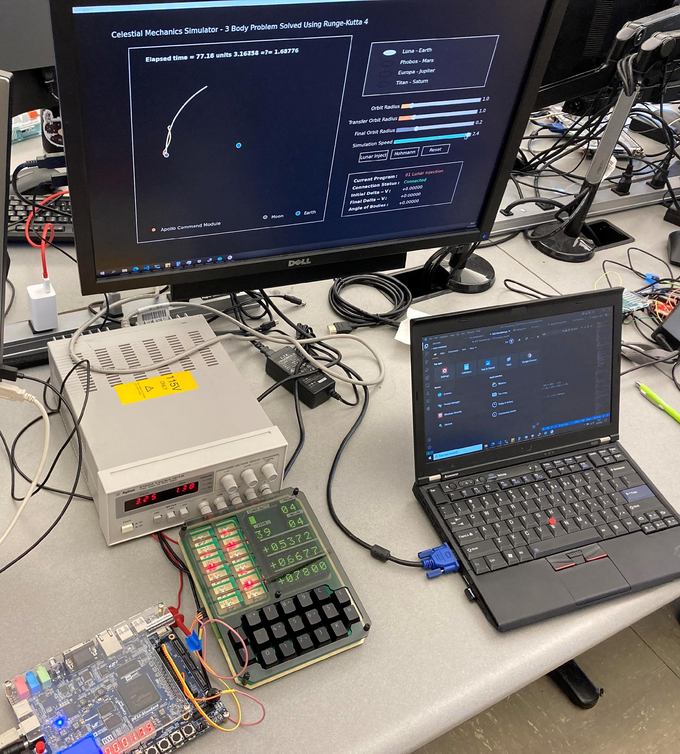
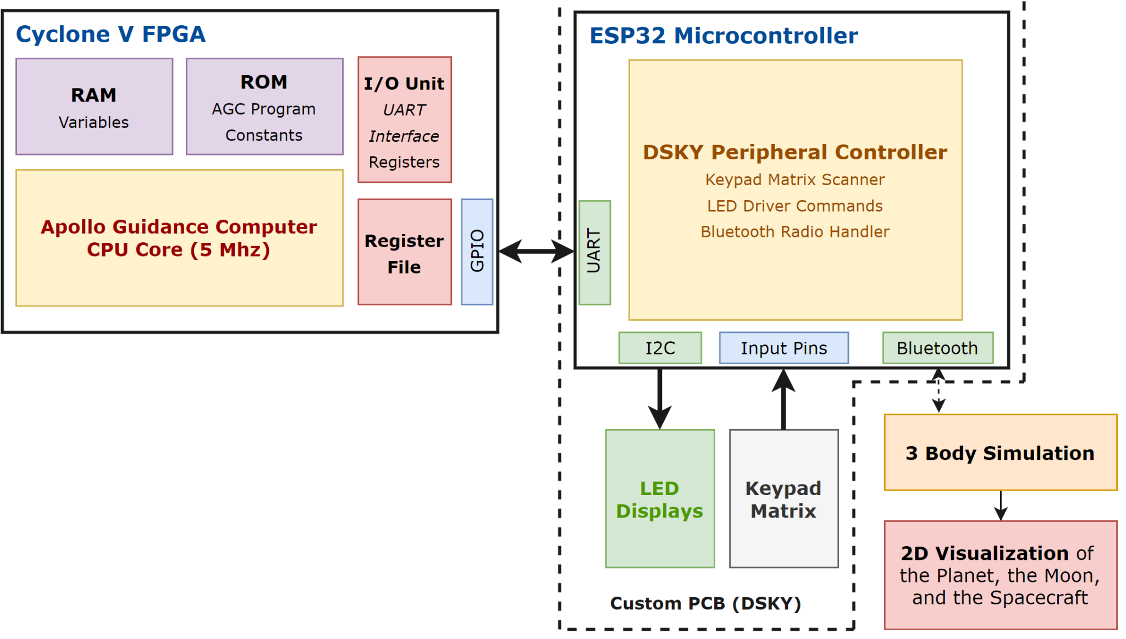
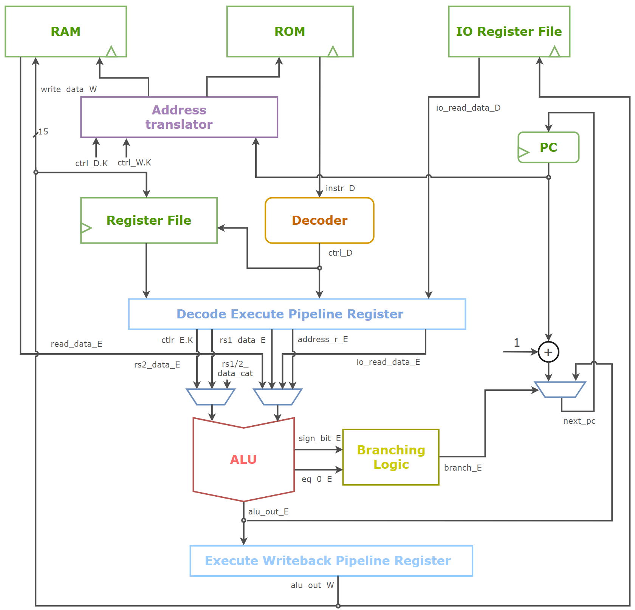
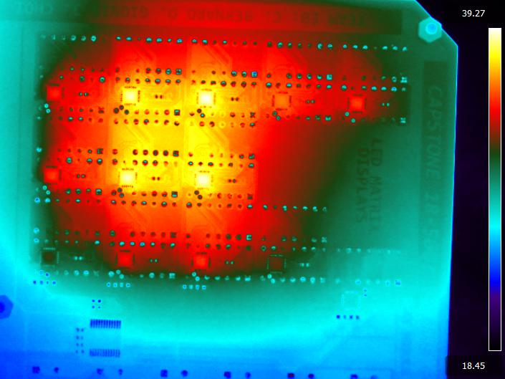
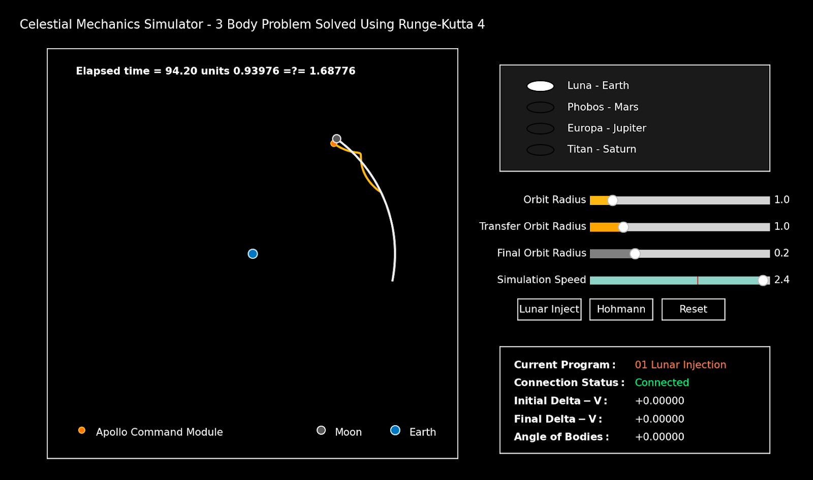
To the 60s and Back
E0: Christopher Bernard, Jae Choi, Donavon Gionis
18-500 Capstone Design, Spring 2022
Electrical and Computer Engineering Department
Carnegie Mellon University
Product Pitch
System Description
An implementation of the Apollo Guidance Computer (AGC) developed as an educational exhibition piece.
A custom AGC architecture running on an FPGA.
A custom PCB implementation of the original AGC’s Display Keyboard (DSKY) user interface.
An interactive simulation that responds to user inputs and provides orbital mechanics/lunar injection demonstrations.
A light and portable hardware that is under 3.5 pounds.
A fast-responding AGC CPU implementation (5 Mhz).
The system composes of a custom designed AGC architecture CPU instantiated on a DE10 Cyclone-V FPGA.
The AGC CPU core communicates with the ESP32 microcontroller over UART.
The ESP32 controls the LED lights using the I2C Bus and receives input from the keypad.
The ESP32 then communicates with a laptop running the simulation script over Bluetooth.
The Python simulation is a 3-Body simulation with 4th Order Runge-Kutta ODE Solver.
System Architecture
Simulation
Monitor
The Python 3-body simulation script sends positions and velocities of orbiting bodies to the ESP32 via Bluetooth.
The DSKY Peripheral Controller (ESP32) sends the received data and program number to the AGC.
The AGC CPU runs the programs and updates the DSKY, and simulation displays orbital transfers of the spacecraft.
Power
Supply
Simulation
DSKY
AGC
The Entire System
System Evaluation
Our system evaluation included:
Functional correctness verification of the AGC (34/34 Instructions Verified)
Performance validation of the AGC (±0.5% Error for calculations)
Operating temperature validation of the DSKY PCB (Max. 45°C)
Full stack verification with Lunar injection program.
Conclusions & Additional Information
Scan to see more information about our project!
Video, Documentations, and Project Logs

