Slide 1
Team D6 - EyeHear
Stella Getz, Larry Geng, Charlie Li
Add your 12 slides after this slide… [remember, 12 min talk + 3 min Q/A]
For more information about formatting or importing slides see: https://gsuite.google.com/learning-center/products/slides/get-started/
Make sure to cover
(refer to the Final Presentation Guidance):
Use Case / Application and Primary (Quantitative) Requirements (i.e. A reminder from prior presentations)
Solution Approach – a reminder (include updates from Design Review presentation if changed)
System Implementation – your complete solution
Testing, Verification and Validation – with quantitative Metrics and target values to compare with experiment
What tests did you run ? How many tests ? What were the results ?
Graphs, tables, quantitative results (compare with the metric targets & ultimately use-case requirements)
Project Management – Tasks, division of labor, and schedule
Lessons Learned
Consider that this slide already works as a introduction slide so use your first slide wisely

Slide 2
Use Case
Real-time video with captions for each speaker.
Visually match speakers with what they say.
Enhance live meetings and recordings with better captions.
Can you believe it?
No
Notes:
Google STT has “speaker diarization”.

Slide 3
Use Case Requirements
Metric | Requirement | What we achieved
Accuracy of speech to text output | Word Error Rate <= 20%, Microsoft standard | [results discussed later]
Minimum number of speakers | 2 | Achieved
Delay: Video+audio capture to captioned video display | < 2s delay, Zoom live captions | No longer pursuing real-time: Requirement changed to < 1min processing time (Achieved)
Quality of video played for user | 720p (HD) 30fps, suitable for live streaming | Achieved
Range of audio capture by microphones | 75 Hz to 4kHz, range of human voice | Achieved
Size and weight of device | Can fit on conference table, < 4.0lb | Can fit comfortably on conference table (photo later)
Notes:
https://docs.microsoft.com/en-us/azure/cognitive-services/speech-service/how-to-custom-speech-evaluate-data#:~:text=A%20WER%20of%
205%2D10,and%20requires%20customization%20and%20training. https://support.zoom.us/hc/en-us/articles/202920719-Accessing-meeting-and-phone-statistics

Slide 4
Final Solution Approach
Camera identifies location of speakers for positioning of captions
Deep learning algorithm uses stereo audio recording to separate speakers
Beamforming concepts help determine which speaker is left and which is right
Audio is fed to NLP model to produce captions
Captions overlaid over final video
Camera (eyes)
Microphones (ears)
Processing
Output Video
Notes:
Explain why we moved away from the beamforming, but we still used concepts from beamforming in the deep learning approach
Concept: beamforming separates speech based on the difference in time of arrival of different speakers to the microphones
Potential question: Looking to Listen: Audio-Visual Speech Separation (bad for pandemic)

Slide 5
System Diagram
Website:
Jetson TX2 Camera
User Laptop
speechbrain Speech Separation

Slide 6
Testing, Verification, and Validation
Metric | Target Value | Test
Accuracy of speech to text output | Word Error Rate (WER) <= 20%
Minimum number of speakers | Acceptable WER for 2 speakers | Measure WER degradation when adding additional speakers.
Quality of video played for user | 1280 x 720 pixels | On laptop end, check output resolution and fps
Processing time | < 1min | Measure time from end of recording to when the captioned video is ready
Original Script
Raw Speech
Speech-to-Text
Word Error Rate (WER)
Separated Speech
Speech-to-Text
Word Error Rate (WER)

Slide 7
Speech Separation: Signal Processing vs. Deep Learning
Raw Audio |  | SSF + PDCW |  | Deep Learning Approach
Speaker Left WER | Speaker Right WER | Speaker Left WER | Speaker Right WER | Speaker Left WER | Speaker Right WER
97.1 | 127.3 | - | 66.7 | 41.2 | 54.5
→ Conclusion: Proceed with deep learning
Notes:
Remind that deep learning approach led to significantly better performance as compared to deep learning

Slide 8
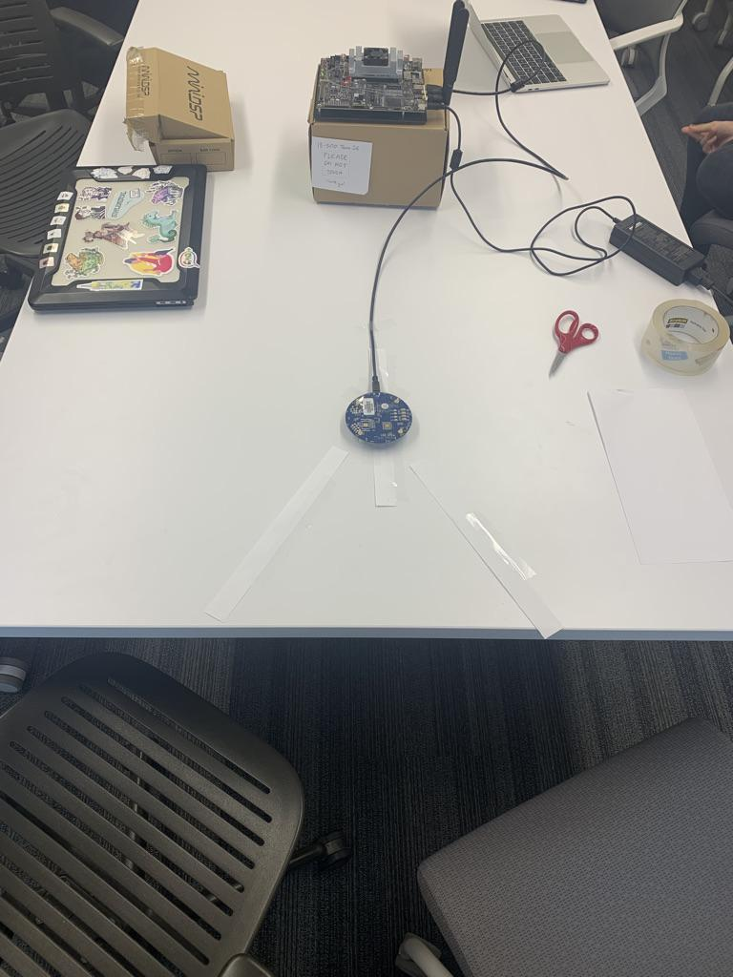
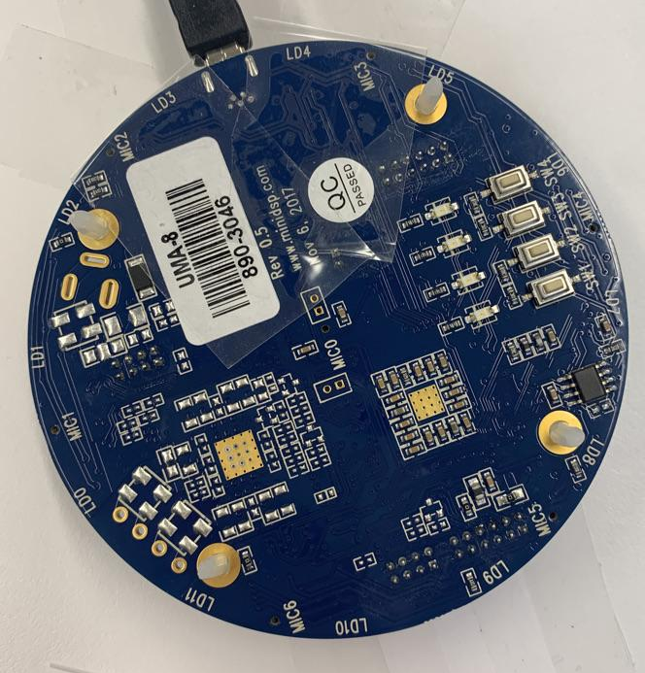
System Implementation & Testing Setup
Jetson TX2
Mic1
Mic4
Mic array
Speaker A
Speaker B

Slide 9
Testing Results - Accuracy of speech to text output
 | Raw Signal |  |  |  | Deep Learning Approach
 | conference room |  | CUC loggia |  | conference room |  | CUC loggia
Metric | Speaker Left WER | Speaker Right WER | Speaker Left WER | Speaker Right WER | Speaker Left WER | Speaker Right WER | Speaker Left WER | Speaker Right WER
Speaker Left | 33.3 | - | 29.6 | - | 6.7 | - | 23.3 | -
Speaker Right | - | 39.4 | - | 84.4 | - | 43.2 | - | 67.6
Speaker Right interrupted by Speaker Left | - | 87.5 | - | 71.8 | - | 40.5 | - | 59.5
Speaker Left partially overlapped by Speaker Right | 62.2 | 84.4 | 65.2 | 87.0 | 36.7 | 51.4 | 36.7 | 54.1
Speaker Left completely overlapped by Speaker Right | 93.8 | 109.4 | 97.7 | 88.6 | 43.3 | 73.0 | 70.0 | 73.0
Notes:
Remind that deep learning approach led to significantly better performance as compared to raw signal

Slide 10
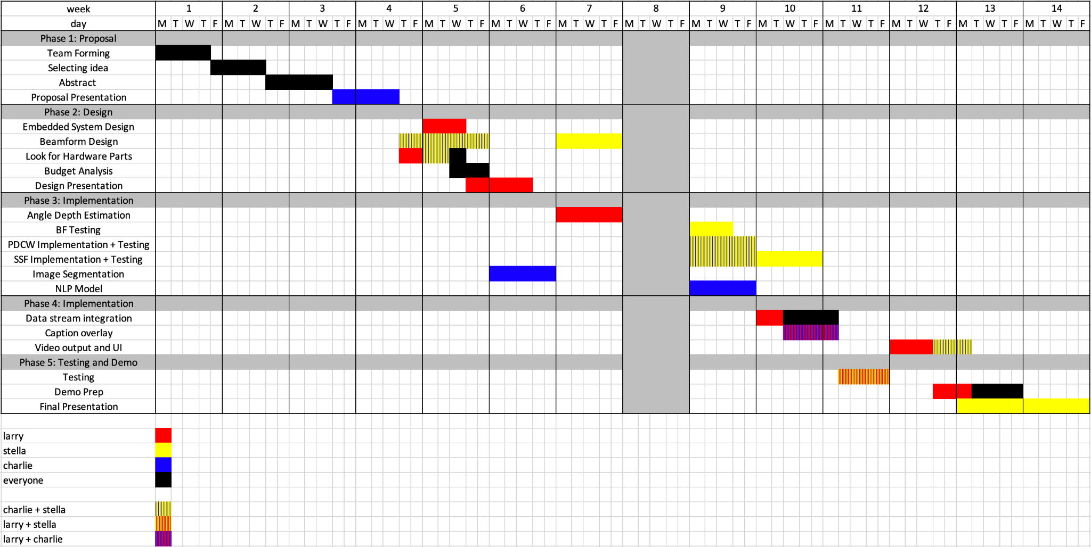
Schedule and Work Distribution

Slide 11
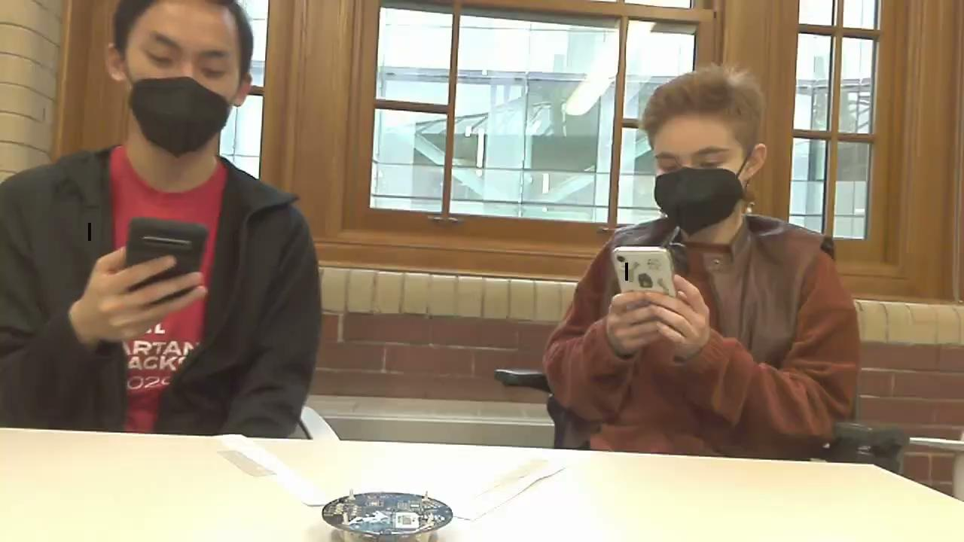
Final Product

Slide 12
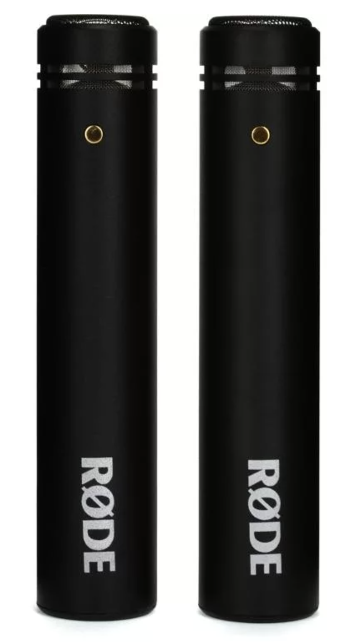
Next Steps
Try SSF + PDCW pre-processing
Calculate new WERs when using better mic setup

