Slide 1
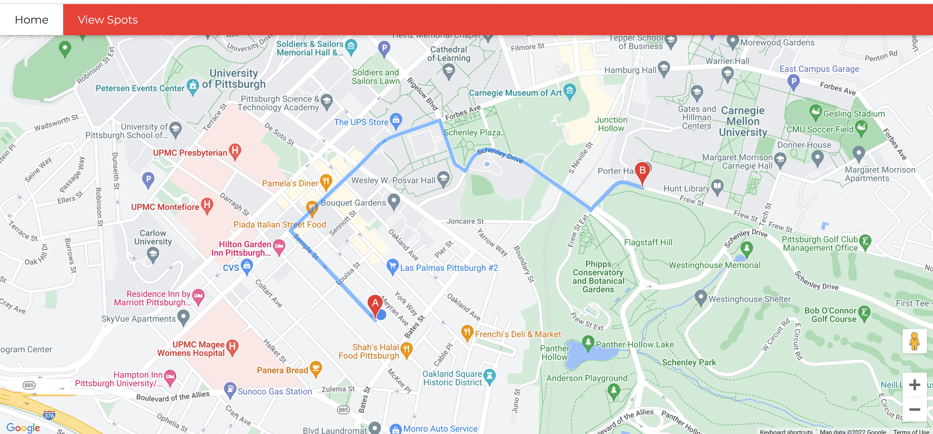
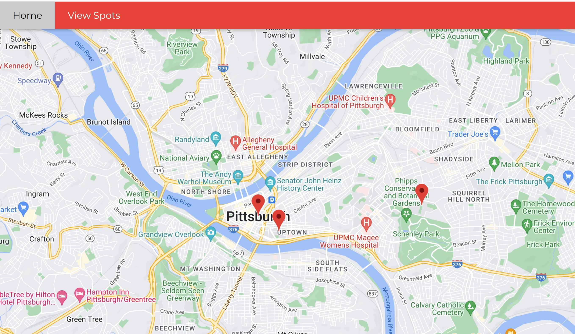
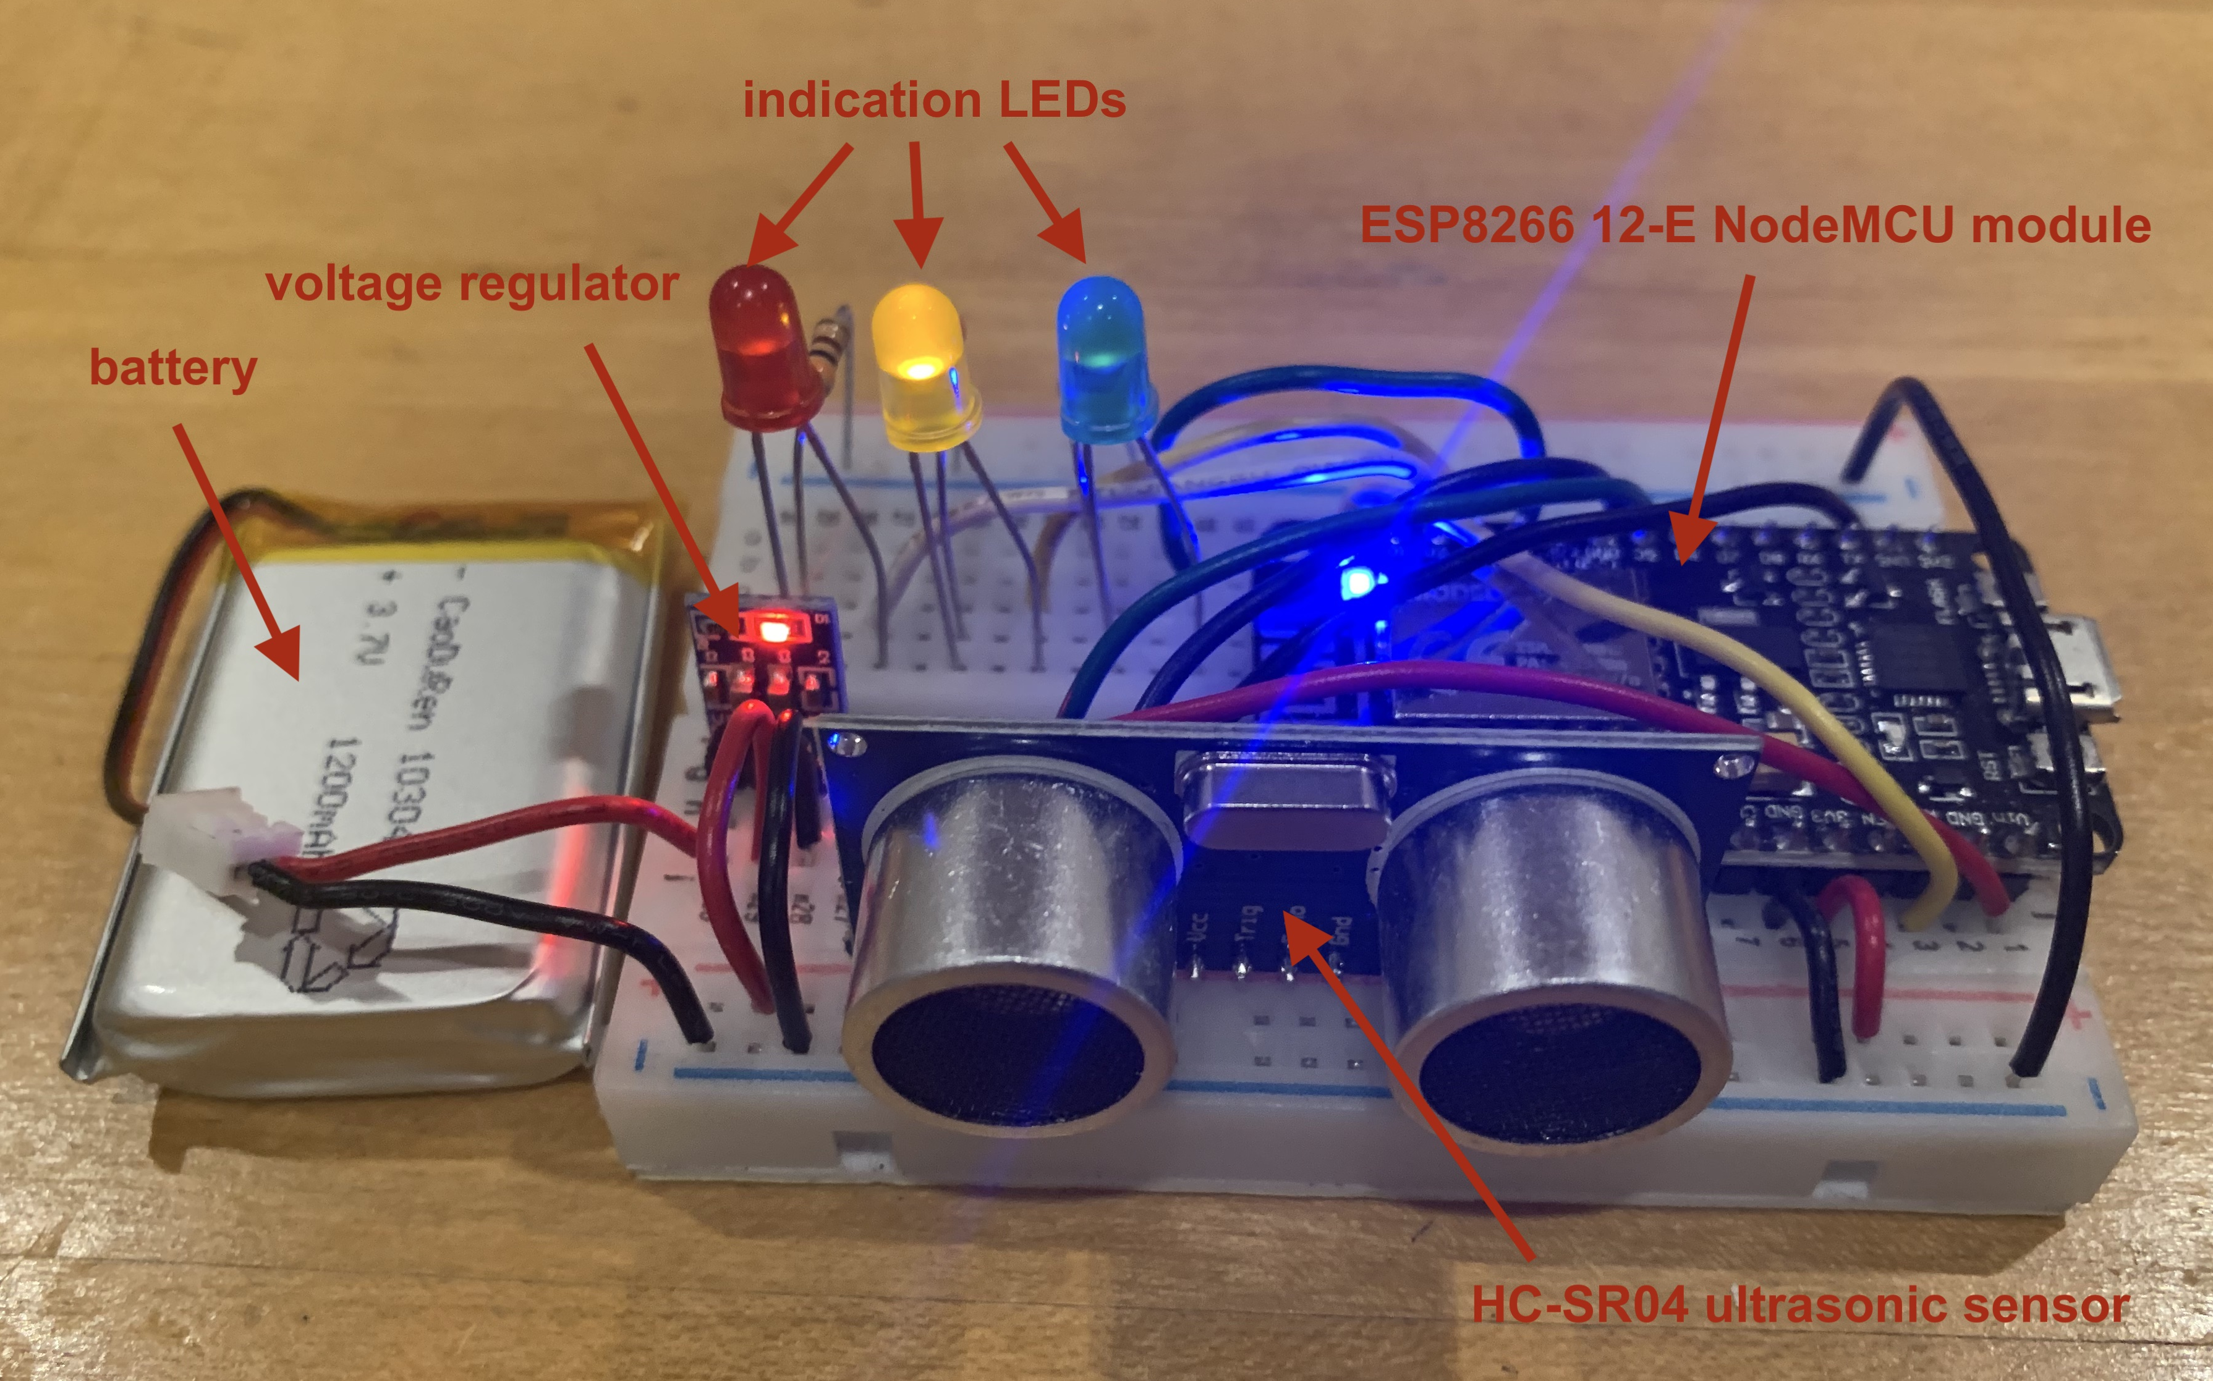
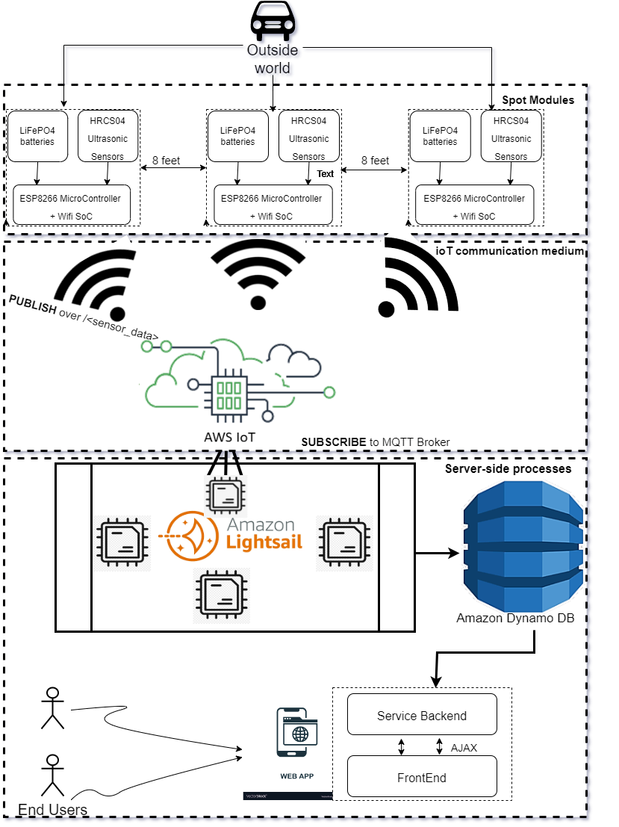
Team C1: Neville Chima, Mrinmayee Mandal, Kanvi Shah
18-500 Capstone Design, Spring 2022
Electrical and Computer Engineering Department
Carnegie Mellon University
your curbside parking buddy
System Description
The overall system has three key components: sensing IoT hardware installed on the curbside (called spot modules), an information warehouse stored on the cloud, and the user interface web application.
Kerby has two modes: requesting a spot and viewing all spots.
Product Pitch
Kerby is an innovative smart city solution meant to tap into the benefit of parking as it exists in our current civil infrastructure by bringing it online. The network built through Kerby’s non-invasive and scalable technology makes an easy-to-install tool available to cities and their residents for modernized parking management.
As your curbside parking buddy, Kerby was designed to be useful by most drivers on the road; since the average car measures 14.7 feet long, our final system points to open spots for vehicles measuring under 16 feet in length. Similarly, Kerby is usable by anyone as our web application is accessible on any platform and has a user-tested interactive design. User satisfaction through high location accuracy was met through use of the reliable Google Maps API. Burden on current infrastructure was avoided by making modules not requiring battery changes for six months as well as keeping a focus on future scalability through modules costing less than $60 per spot.
Viewing: In this mode, the user is able to view Kerby’s spot modules (locations and availability) on an interactive map.
Request: In this mode, the user can request Kerby to give them directions to a curbside parking spot near their destination.
Spot Modules: Kerby’s Hardware
System Architecture
Kerby’s spot modules are placed on the curbside, distanced at 8 feet apart. When 3 sensors are detected as free, then an open spot is determined and displayed on the web page.
System Evaluation
Table 1: Testing Results
Requirements | Measurements | Goals | Results
Accurate parking location | Distance between provided location and actual parking spot in real world | < 30ft | < 10ft
Relatively cheap for scalability | Compare to cost of regular parking meters | < $50 per spot module | Per sensor < $20 Per spot module < $60 on average
Easy-to-use web app | Usability Testing | > 3.5/5 stars on average | 4/5 stars on average
Reliable & long-lasting sensor modules | Battery Life (h) = Battery Capacity (Ah) / Load Current (A) | ~ approx. 6 months | ** scan QR code for latest results
“Real-Time” Representation | Request E2E Latency | < 5 min | < 2 min
Table 2: Design trade-offs in choice of detection, computing, and transmission devices
Conclusions & Additional Information
Computing Device + Sensing Device | Total Cost
Jetson Nano with Camera | $120 + $26 = $146
Raspberry Pi Zero W Camera Pack | $45
NodeMCU ESP8266 with HC-SR04 Ultrasonic sensor | $6 + $2 = $8
Kerby, our small-scale proof of concept for the online management of smart city parking systems is very promising threefold:
i) cost savings ii) real-time data sharing iii) algorithmic solutions for traffic control.
For future efforts, we would like to see our implementation expanded to test more features on a larger scale, including but not limited to:
Sensor coverage over a local municipality or state to test network robustness
Implementation in rural communities to explore non-WiFi connectivity (e.g LoRAWAN)
Exploring other dynamic parking allocation algorithms and their cost analysis
In addition to the design trade-off exploration between computing and sensing devices, building Kerby required discussion of trade-offs between power sources, computing algorithms, and types of sensors. On the testing side, trade-offs between different sleep/wake-up times for the ESP8266 12-E modules were explored. Additionally, the spacing between modules was varied in order to conclude that 8 feet was the best distance for our use-case of vehicles under 16 feet in length while still returning the most accurate number of spots available where our sensors were positioned. Interactive results are available on our website (scan the QR code).
http://course.ece.cmu.edu/~ece500/projects/s22-teamc1/

