Slide 1
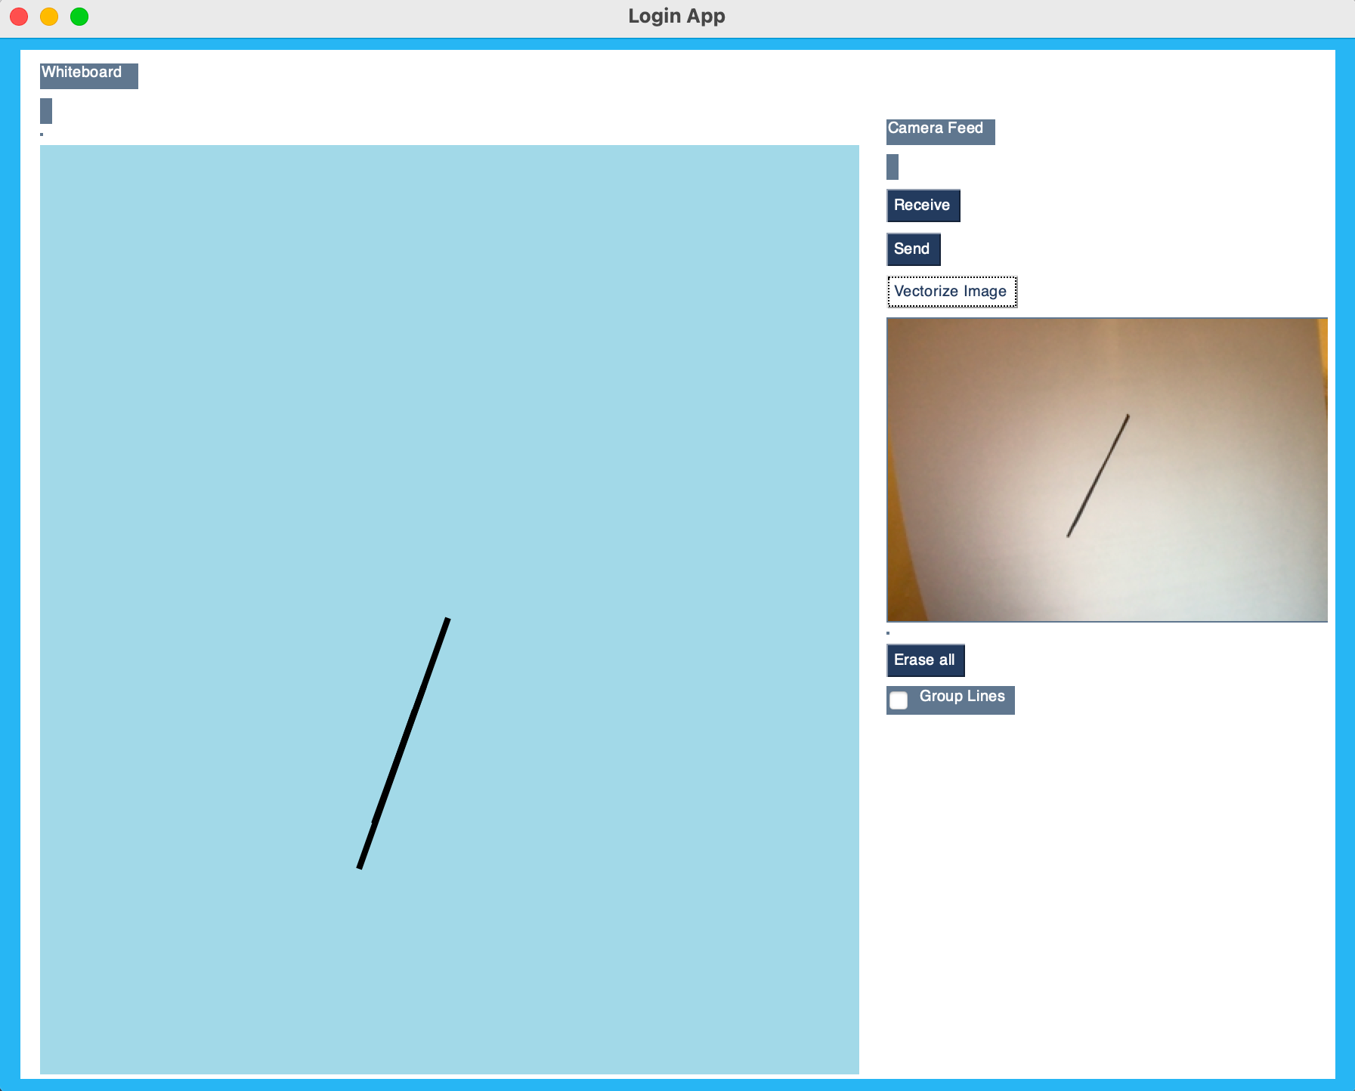
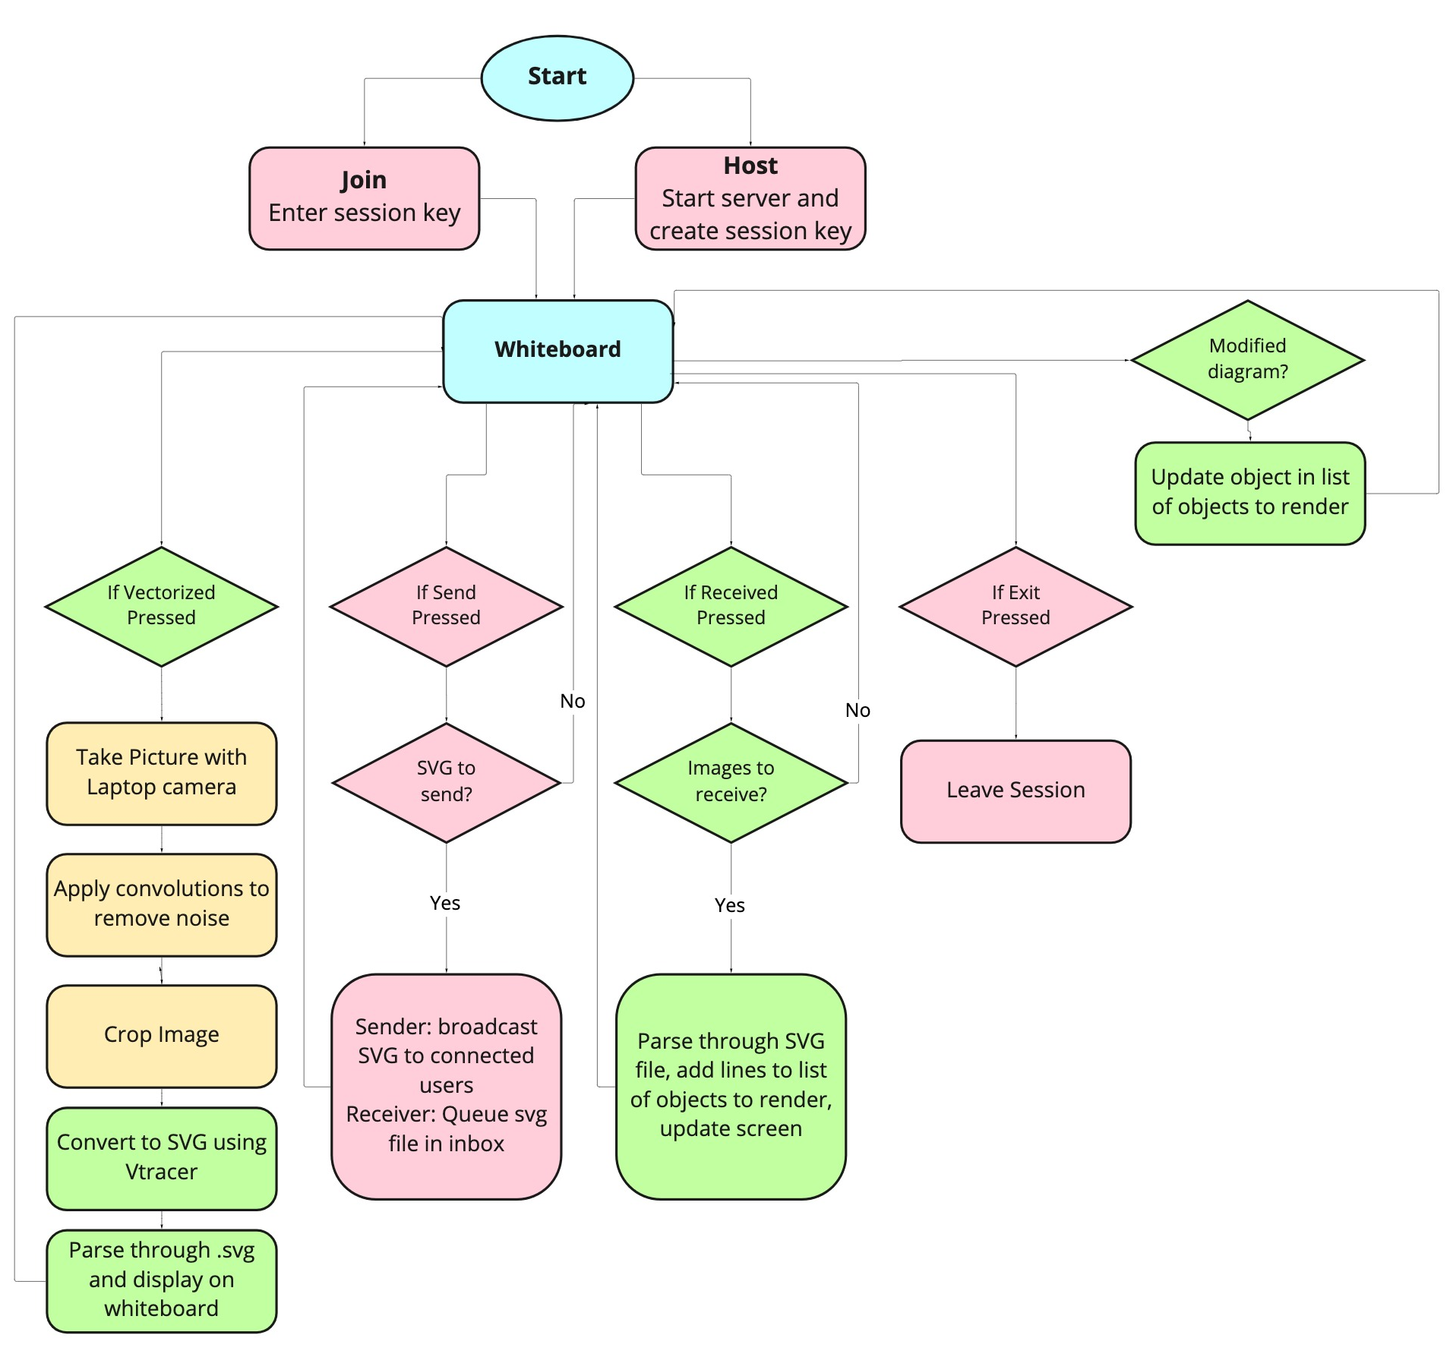
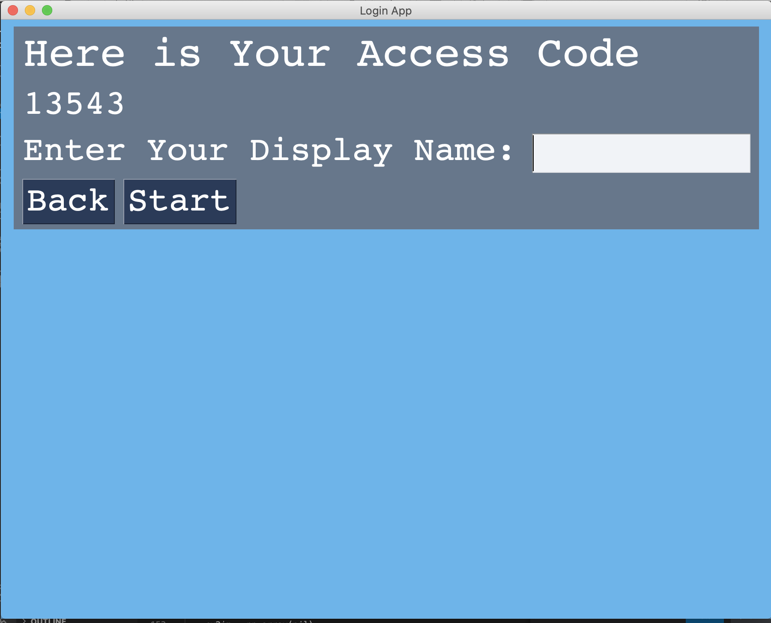
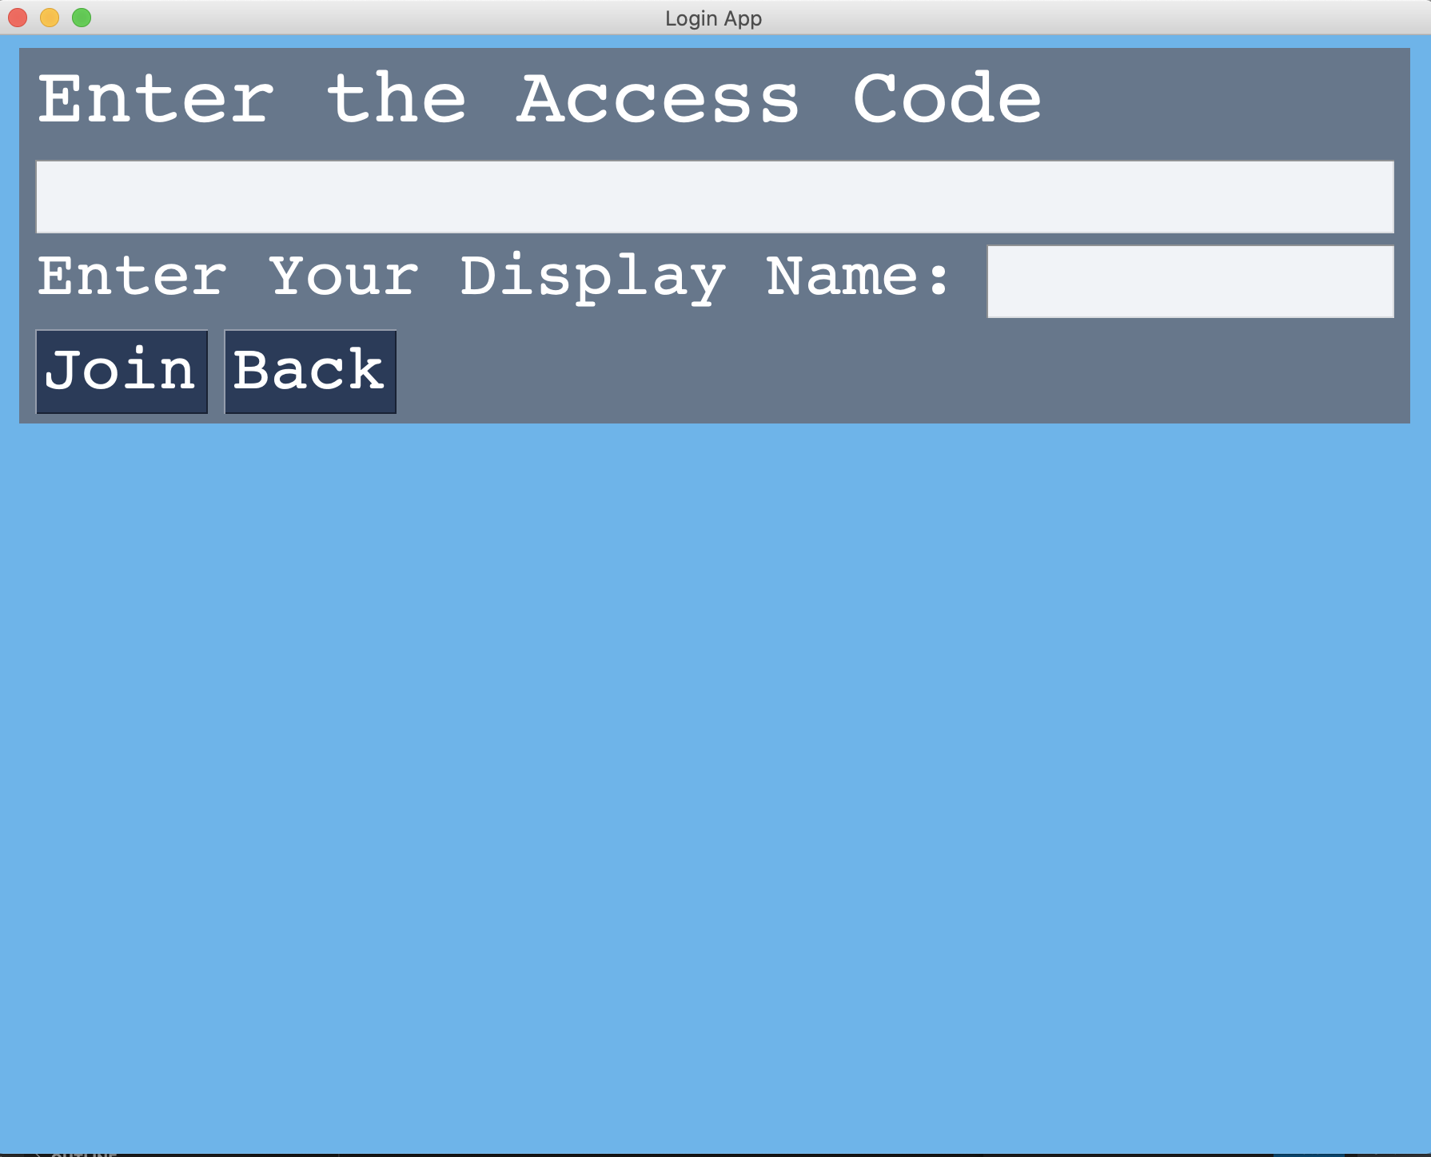
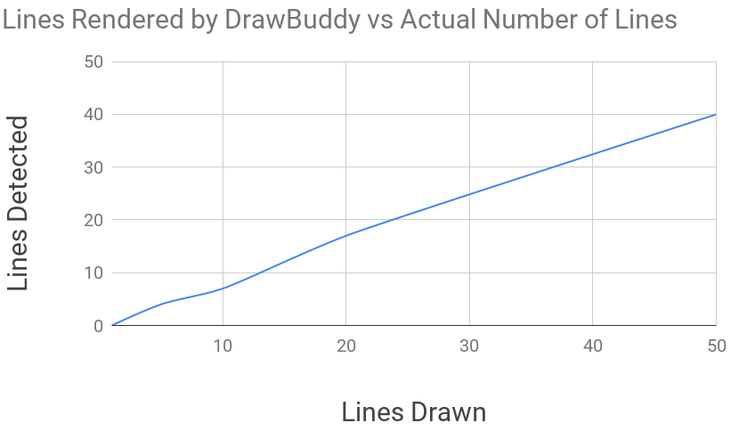
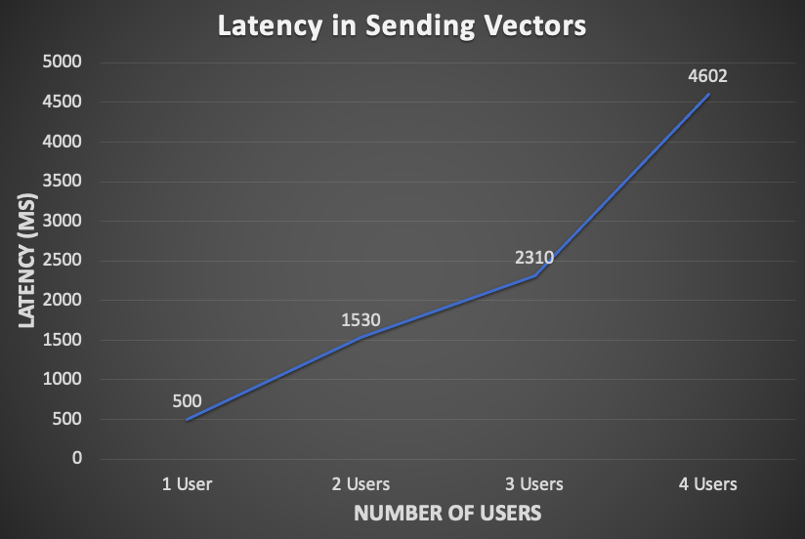
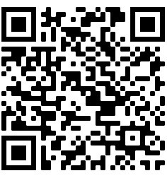
DrawBuddy
B2: Lisa Mishra, Ronald Gonzalez, Denise Yang
18-500 Capstone Design, Spring 2022
Electrical and Computer Engineering Department
Carnegie Mellon University
Product Pitch
System Description
While virtual platforms like Zoom are useful tools for remote lectures they are not as adept for group work that involve drawing diagrams especially with only a mouse/mousepad. Cue DrawBuddy, a more accessible and natural web app that can convert black and white hand drawn images to SVG files that cam be displayed, modified and sent to peers in a shared session.
DrawBuddy should be able to render diagrams drawn with black ink with line thicknesses of 0.4mm-1mm on white letter sized paper held anywhere from 1-3 feet from the camera within 120s. Any modifications and broadcasts should be reflected within 100ms and 500ms respectively. We aimed for users to rate the rendered image 9/10 with 10 being the highest.
Our system is able to convert diagrams in 100 ms, reflect updates in 15ms and has varied results with .svg broadcasts. Users rated our system 5.3/10.
Drawbuddy relies on the laptop camera to capture the image and then performs image processing (reducing noise, detecting lines, masking/cropping image) via OpenCV. DrawBuddy will convert the initial .jpeg into a .svg via Vtracer. Then our system will extract the objects in the .svg file with a parser that we wrote in Python and displayed on a web app made with PySimpleGui. Diagrams can be modified and then later exported as .svg files using our parser.
Interactive whiteboard space
Receive/display new images
Broadcast to users
Convert to .svg button
Camera feed
Erase all lines
System Architecture
Group lines together
Figure 1. DrawBuddy Flowchart: Our architecture can be broken down into image processing (yellow), converting to and from .svg files (green), and socket communication (red). There are 4 main states: Start, Join, Host, and Whiteboard indicated in bold.
Figure 2.1 Whiteboard Screen
To create and join sessions DrawBuddy uses PySocket to start servers and register users as clients. .svg files can be sent over these sockets.
Figure 2.2 Welcome Screen
Figure 2.3 Start Server Screen
Figure 2.4Join Screen
System Evaluation
To quantify the quality of our diagrams we compared the number of lines rendered with the true number of lines. We tested with 1, 5, 10, 20, and 50 lines. Ideally we would see a 1:1 ratio, but as the number of lines increase, we render less lines. As a result of these inaccuracies we fell short of our user rating goal.
Figure 3.1 Comparison of number of lines rendered vs lines drawn. Our behavior is relatively linear however as we begin to lose quality as the amount of lines drawn increases
To test our communication use case we measured the time it takes to send a compressed and encoded .svg file with 30 vectors from one user to a varied number of users. The latency increases somewhat exponentially as the number of users increase.
Conclusions & Additional Information
Find out more:
We implemented our MVP of converting hand drawn lines into an .svg file that can be moved around the screen and resized/rotated before being sent to peers. Although the quality of the .svg rendering of the diagram can be improved with algorithms to remove similar lines that overlap, and line detection algorithms. Overall DrawBuddy taught us the importance of collaboration and communication not only as we considered how to quantify improvements to collaboration but also during the integration of our individual parts.
Figure 3.2 Comparison of sending 30 vectors latency to varied number of users.
http://course.ece.cmu.edu/~ece500/projects/s22-teamb2/

