Slide 1
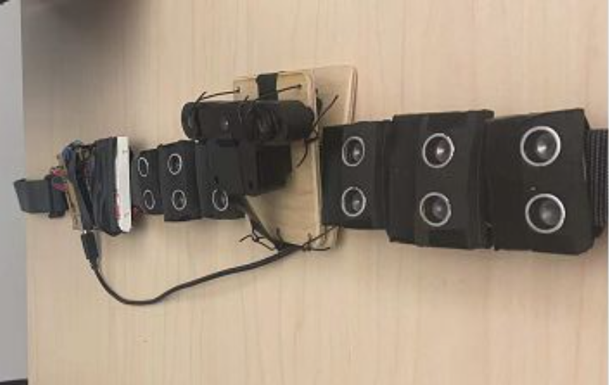
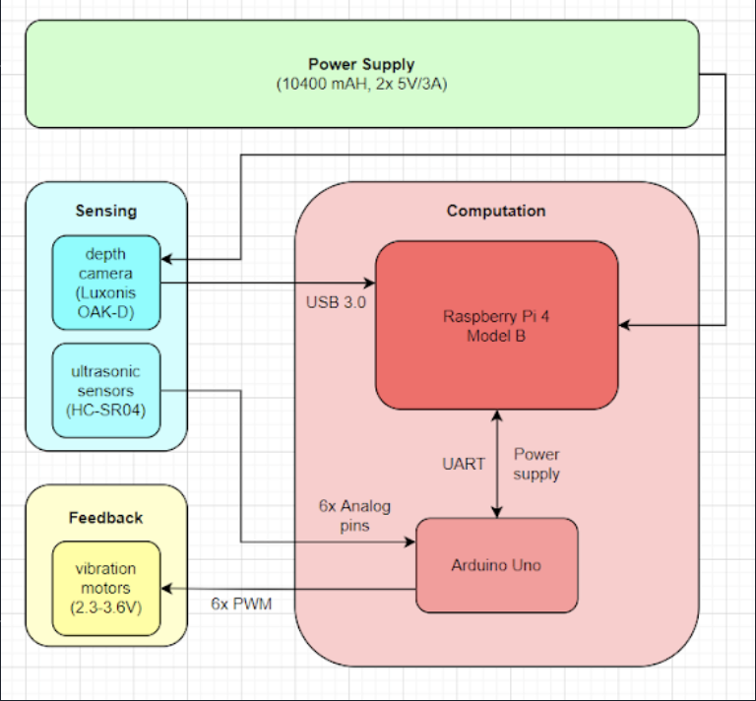
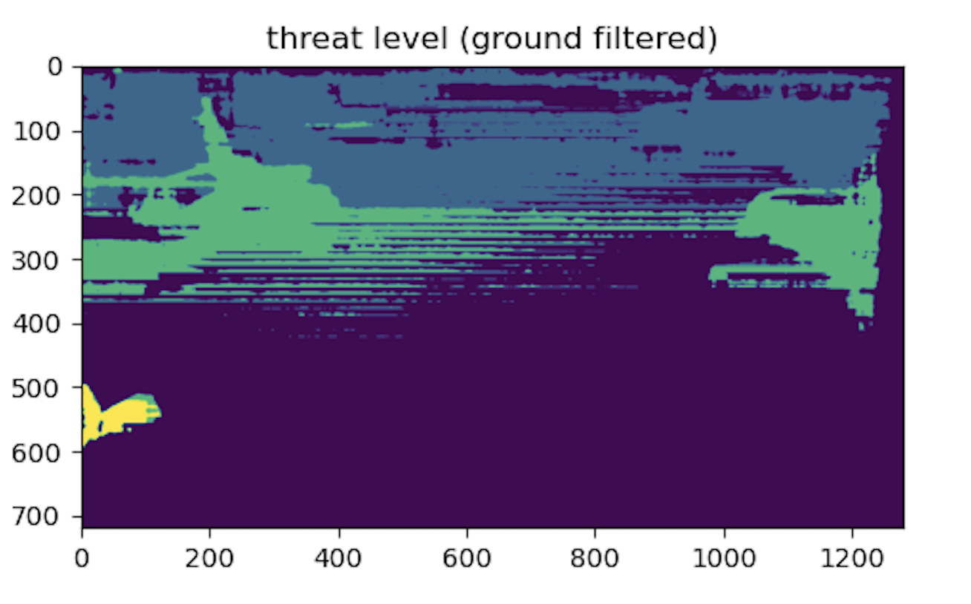
The Bat Belt
Team A2: Kelton Zhang, Ning Cao, Xiaoran Lin
18-500 Capstone Design, Spring 2022
Electrical and Computer Engineering Department
Carnegie Mellon University
Product Pitch
System Description
The Bat Belt is a smart sensing and feedback wearable device designed to help the visually impaired to move around obstacles. The appeal of this product is to achieve a better affordability and functionality balance comparing to the cane and guide dog. Specifically, the lightweight wearable belt provides both ground-level and waist-level detection through a depth camera and ultrasonic sensor array with intuitively actionable haptic feedback. Our product dramatically outperforms the typical white cane in perceiving the user’s environment, while being much more low-maintenance and affordable than the guide dog.
In terms of hardware, the system is built on a off-the-shelf belt bundled with Oak-D depth camera and an array of 6 ultrasonic sensors for sensing, a set of 6 vibration coin motors for haptic feedback, Raspberry Pi 4 and Arduino Uno boards to drive computation. Sensors and vibrators are padded with foams for protection and precise vibration feedback.
In terms of software, a communication interface is customized for control and data messages between Raspberry Pi 4 and Arduino Uno. And the machine learning model of linear regression is used during calibration to form a baseline of a clear ground to compare with incoming frames.
System Architecture
Arduino Uno &
Raspberry Pi 4
Depth Camera
Sensing: 6 ultrasonic sensors & depth camera
30° per ultrasonic sensor, group of 6 to cover user’s front 150°
69° x 49° depth camera to classify ground-level risks
Computation: Raspberry Pi 4 & Arduino Uno
Collect analog signals from ultrasonic sensors and calculate distance and speed
Identify obstacles based on feedback from Arduino Uno and depth camera
Rate “threat level” of each identified obstacle based on distance and speed
Activate vibration system accordingly
Feedback: Vibrating Coin Motor
An array of 6 vibration units around the belt
Vibration direction and intensity based on the obstacle’s position and rated “threat level”
Belt
Vibrators
Ultrasonic Sensor
Hardware components
System Evaluation
Light-weight : 1.025kg
Affordable : < $500
Battery life : 5.5 hour
Reliable detection
False positive <10%
False negative < 5%
Sufficient range
Waist-level : 4.5m, 150°
Ground-level : 5.5m
Actionable latency
Depth mode : 0.181s
Ultra only : 0.131s
While depth camera offers ground level
detection, it slows the sense-feedback
loop down significantly. This presents a
tradeoff between functionality and smooth
user experience.
Conclusions & Additional Information
Demo of alert in a floor with obstacles
Comparing to our aspirations, the system is 1. a little overweight (by 2.5%); 2. a little slow (by 0.5s); 3. reliable enough; 4. covers an ideal range (1m); 5. Intuitively actionable (95% users move in the right direction upon feedback).
Many practical lessons are learned regarding syncing data communication between multiple microcontrollers and sensors. The system has the potential to complement the cane and be lighter, faster, smarter with more optimizations.
http://course.ece.cmu.edu/~ece500/projects/s22-teama2/

