Slide 1
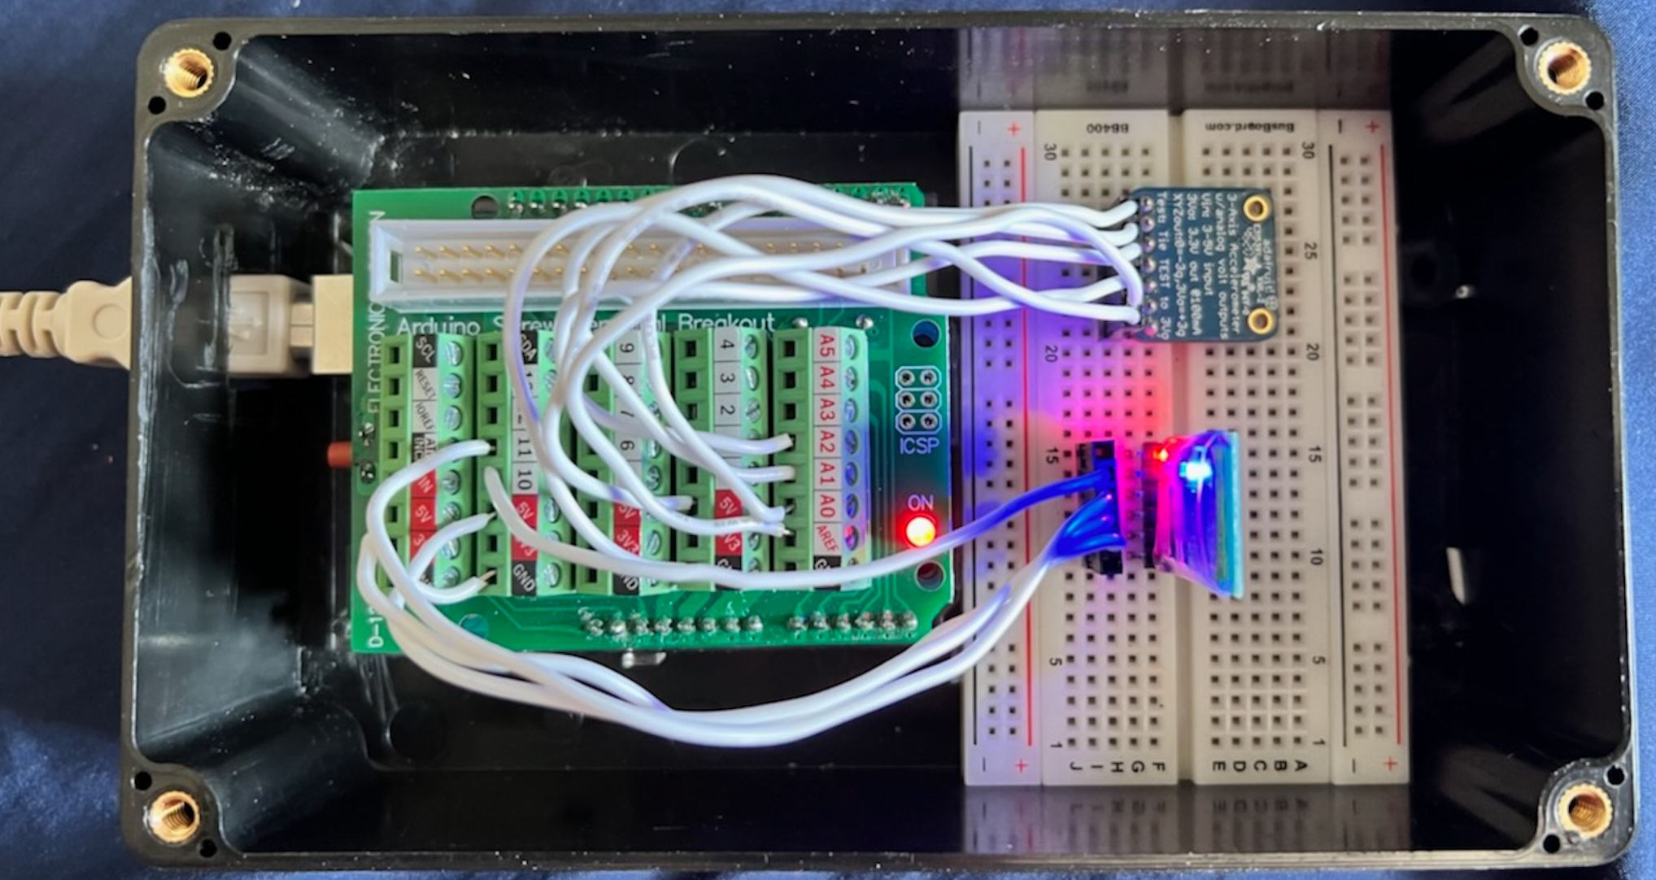
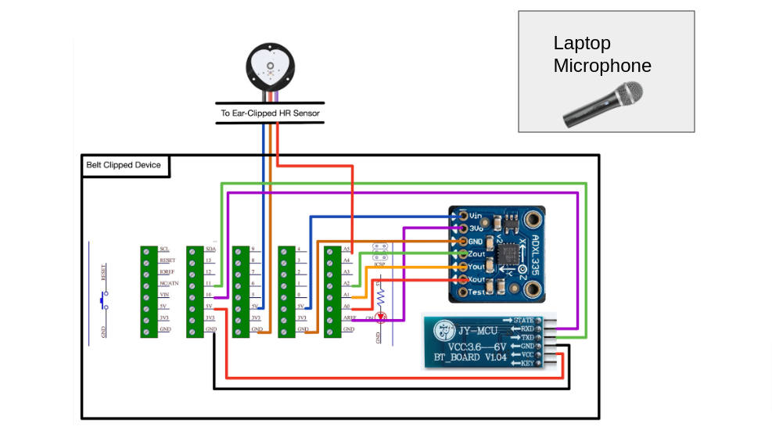
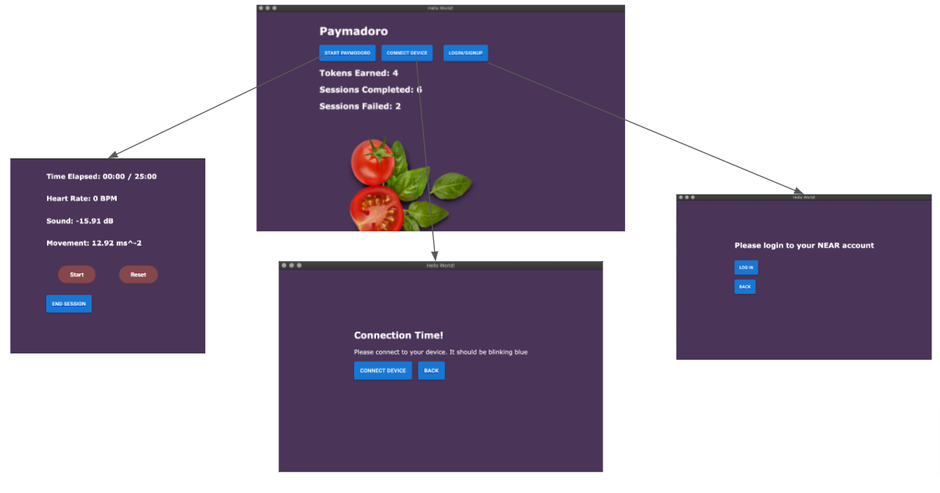
Paymadoro
A1: Austin Lin, David Wang, Lev Stambler
18-500 Capstone Design, Spring 2022
Electrical and Computer Engineering Department
Carnegie Mellon University
Product Pitch
System Description
Paymadoro is a system which gamifies Pomodoro (a technique for focused work sessions: 25 minutes intense work followed by 5 minute breaks). Paymadoro monitors environmental inputs (sound levels, movement, and heart rate) to determine whether the player was in a state conducive to deep focus. If they are, they get a randomized payout from a blockchain program (via cryptocurrency). If they fail to meet requirements, they are penalized 0.1 Near Tokens (~$1).
We specify criteria failure as > 5 dB increase in volume from base (95% of failures detected), magnitude of change in acceleration being > 1.96 m/s³ (90% of failures detected), >40% increase in HR (30% of failures detected). Two or more criteria failures for 30+ seconds is a session failure. One criteria failure for > 6.25 minutes is a session failure.
Desktop app: Electron JS and React JS.
Blockchain: Near protocol (similar to Ethereum) to handle the reward payouts. Rust.
Microcontroller: Arduino to handle measurements. C.
Communication: Bluetooth
Open Box View of Belt Clip Device
Accelerometer
System Architecture
Hardware
Arduino
Bluetooth Connection
The wires for the heart rate sensor, switch, and battery are not pictured since they were not implemented at the time this picture was taken.
System Evaluation
Test | Performance | Reasons
Start/End Session Latency | < 8 seconds to start and stop a session | When BT connection is started, communication with the Arduino and the blockchain take < 5 seconds
Criteria failure: Sound Level | 95% success rate after adjusting dB increase to 5dB from baseline | The laptop’s microphone is quite consistent with its readouts of sound levels
Criteria failure: Movement | 90% success rate after changing measurement to difference in acceleration measurements | We were able to remove the effects of gravity and constant conditions by re-adjusting for difference
Criteria failure: Heart Rate | 30% success rate after changing to attaching to the ear | We had to use an optical HR sensor instead of an ECG monitor. For an accurate measurement, the HR monitor has to be attached precisely
User agreement with result (self testing) | 15% false positives 12% false negatives | The inaccuracy in the HR measurements resulted in increased false negatives.
Software Flow
Conclusions & Additional Information
We were able to successfully implement both the software and hardware that we aspired to create. We learned that supply chain management and agile development is important in team projects as we have to be able to work around unforeseen challenges.
We had issues with an inaccurate HR sensor. Through this hurdle, we learned that supply chain management is an important part product design (our original ECG sensor was delayed due to the Ukraine war).
http://course.ece.cmu.edu/~
ece500/projects/s22-teama1

