Slide 1
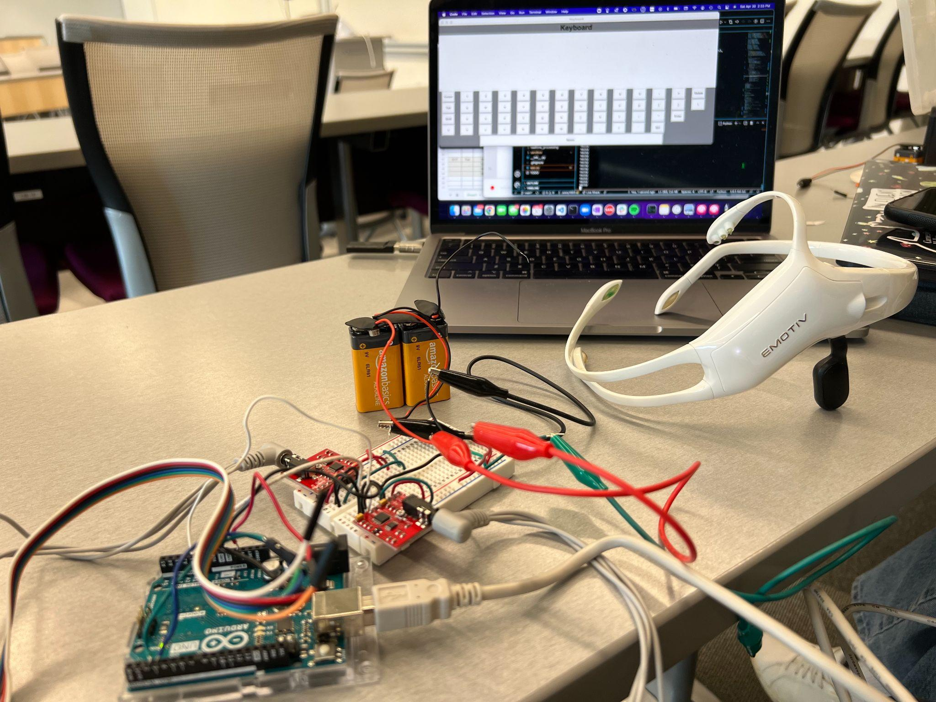
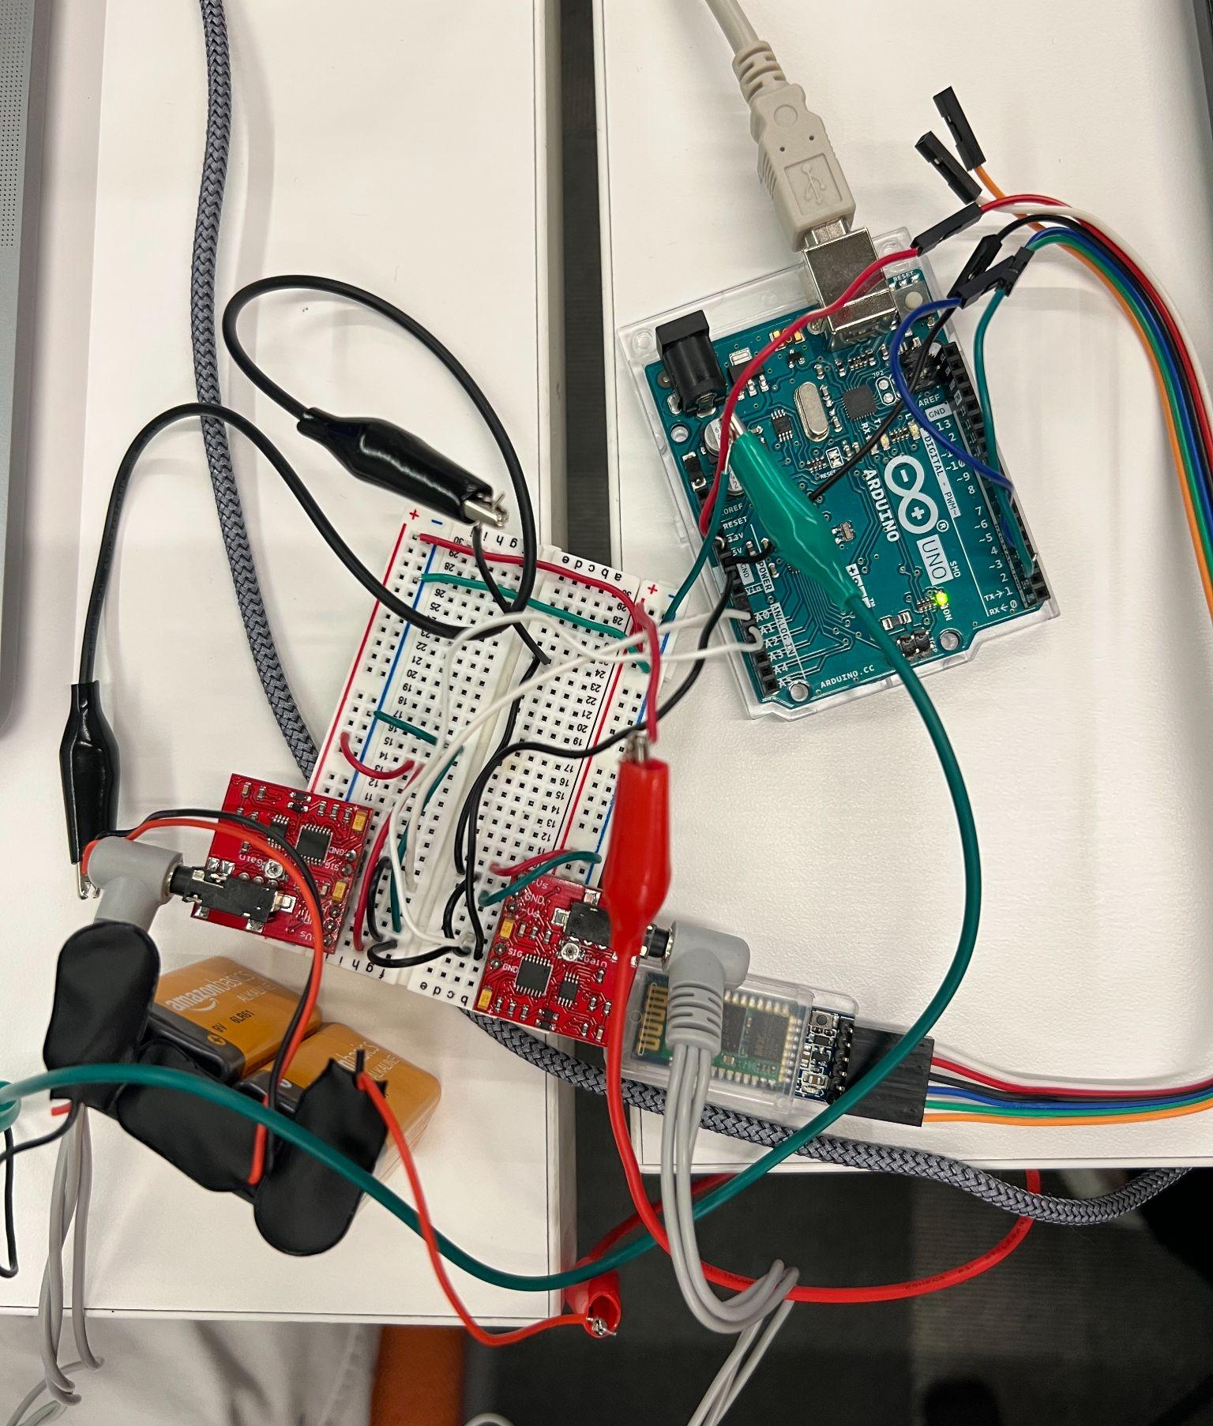
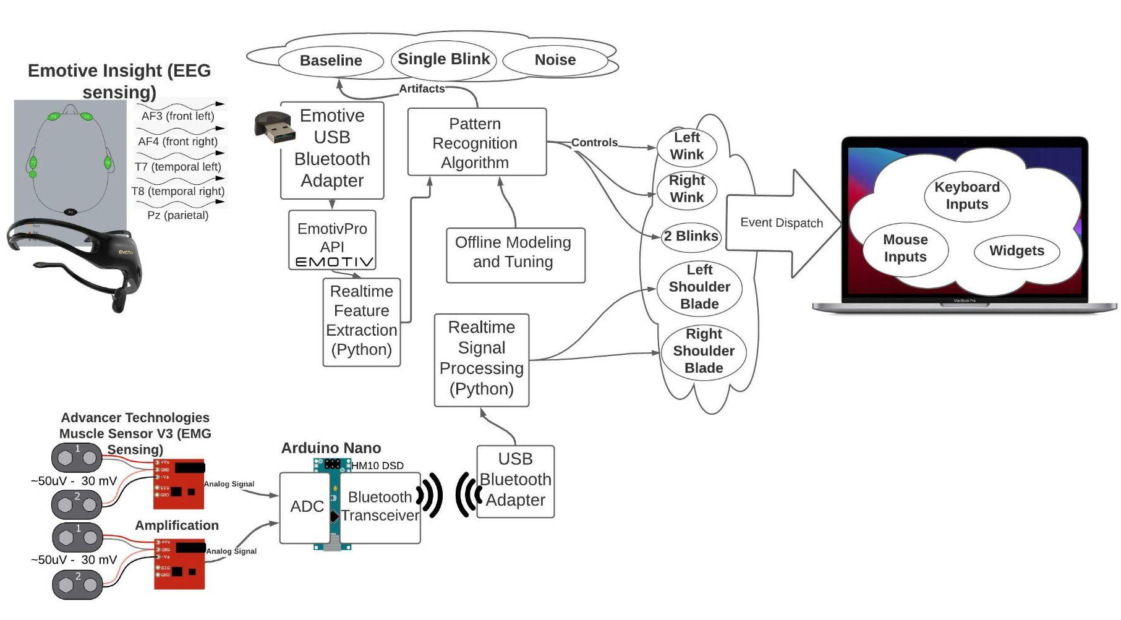
NeuroController
Team A0: Jonathan Ke, Wendy Mo, Jean Udompanyawit
18-500 Capstone Design, Spring 2022
Electrical and Computer Engineering Department
Carnegie Mellon University
Product Pitch
System Description
The traditional mouse and keyboard is a staple tool for interacting with computing devices; however it may not be an effective access method for some with limited mobility. NeuroController is an alternative platform for users to control a desktop computer through neural signal acquisition, specifically through electroencephalogram (EEG) and electromyography (EMG) signals. The interface rethinks the classical approach to computer accessibility by optimizing for a low latency, ease-of-access, and accurate device for controlling a computer interface without ever lifting a finger.
Our project consists of 3 subsystems, namely a backend EEG signal processing subsystem, an EMG circuit setup, and the frontend interface.
EEG is used for processing single control signals from the eye and converting them into clicking and mode changes on the desktop. An ensemble of machine learning methods composed of random forests and logistic regression models are used to detect combinations of blinking and winking from a live EEG signal stream.
The EMG subsystem includes two EMG sensors, an Arduino, and a Bluetooth module. The EMG sensors detect muscle movements and sends the data to Arduino. The Arduino digitalizes, parses, and transfers the data wirelessly to the computer program for event triggers. Because EMG allows continuous detection of muscle potential, the signal produced is used for cursor movement. The events produced by EEG and EMG are integrated as controls in the frontend.
System Architecture
Data is collected from the user in two ways: one through EMG sensors, which are placed on the user’s left and right shoulders and the other through EEG sensing, through an Emotiv headset. The two different ways of capturing signals are fed through our signal processing algorithm. When a user performs a certain action like double-blinking or right winking, our backend will parse that signal and the detect if an action occurred through ML classification. This will trigger the event on our frontend. Our desktop application includes many features, including the keyboard, cursor, and scrolling.
Overall System
EMG Subsystem
Frontend
interface
Arduino
EEG subsystem
EMG sensors
System Block Diagram
EMG subsystem
Power supply (9V)
Bluetooth Module
System Evaluation
Frontend Interface
Live EEG Ensemble Classifier Error
(% of false positives, mispredictions, and false negatives recorded while repeating each eyelid action 20 times)
Left Wink | Right Wink | Double Blink
10% | 15% | 30%
ML Classifier (Individual classifiers used in ensemble classifier) | Validation Error (%)
Sensor is moving/detached (Logistic Regression) | 1%
Eyelid event occurred (Logistic Regression) | 6.31%
Blink Occured (Logistic Regression) | 2.53%
Right Wink Occured (Logistics Regression) | 2.61%
Left Wink Occured (Random Forest) | 20%
Double Blink Occured (Random Forest) | 9.5%
Left Wink or Right Wink (Logistic Regression) | 0%
Two consecutive blinks in a row on an EEG
EMG Subsystem
Conclusions & Additional Information
Left wink on an EEG
With enough patience and practice, the NeuroController can be an effective tool for interacting with a desktop monitor without ever using your hands. However, to accomplish this, the system requires a lot of non-generalizable accuracy tuning and multiple intrusive sensors placed on the body.
Our team experienced the difficulty of building and configuring reliable, interactive, and efficient IoT devices alongside effective project management, especially system integration planning.
Future improvements can be made to the system to increase the efficacy of the device such that it is intuitive to use to anyone without prior experience while decreasing the intrusiveness of the device. This includes rethinking an effective user interface and improved accuracy and generalizability of reading a smaller subset of sensor inputs.
Right wink on an EEG
Our device operates in real-time, and three important considerations for our system are latency, accuracy, and user experience. The table below shows the tests and results obtained from test users.
Requirement | Testing Strategy | Quantitative Metric | Results
User Latency | Human benchmark test | Register the time the user takes to click in reaction to a display stimulus in 500 ms | Average reaction time is 1780 ms
User Accuracy & Speed | Point and click test | User can click 3 randomly spaced static targets within 60 seconds | Average time is 74.5 seconds
Overall Intention Accuracy | Task test | 75% of users can open Chrome browser within 60 seconds | Achieved in 42 seconds
http://course.ece.cmu.edu/~ece500/projects/s22-teama0/

