Slide 1
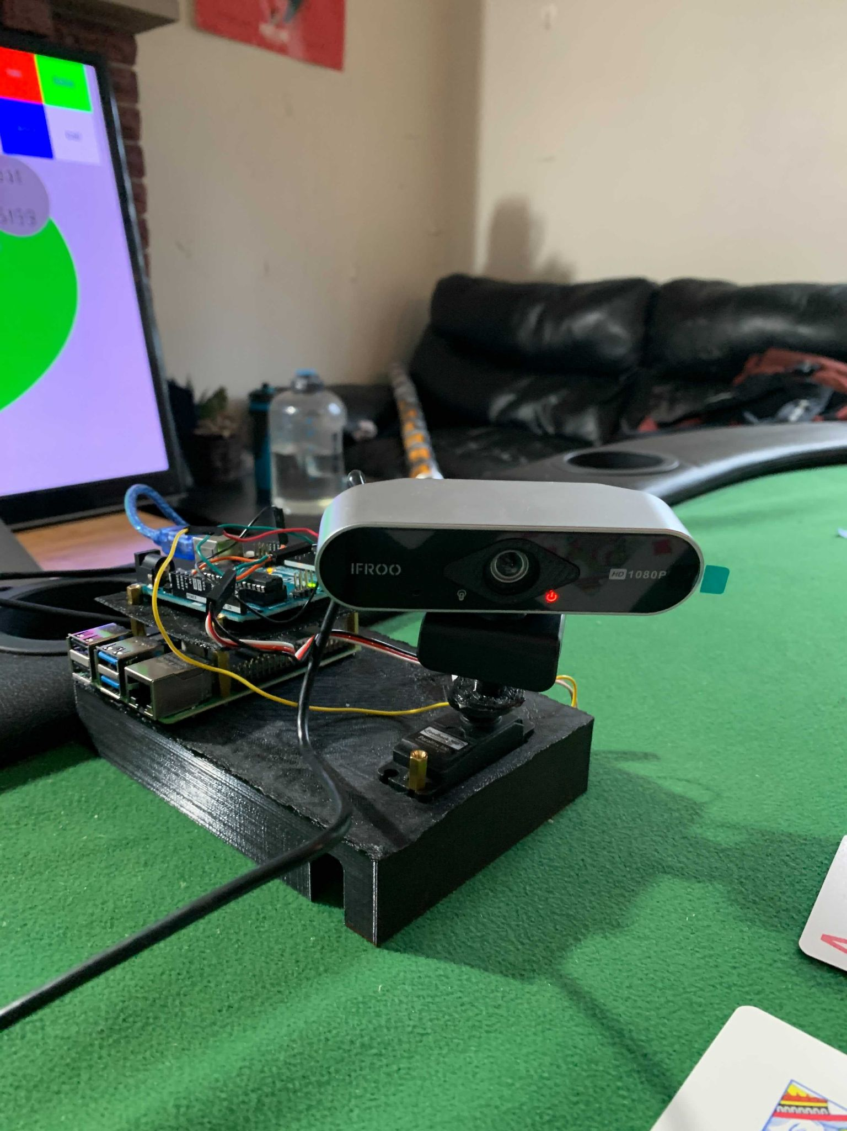
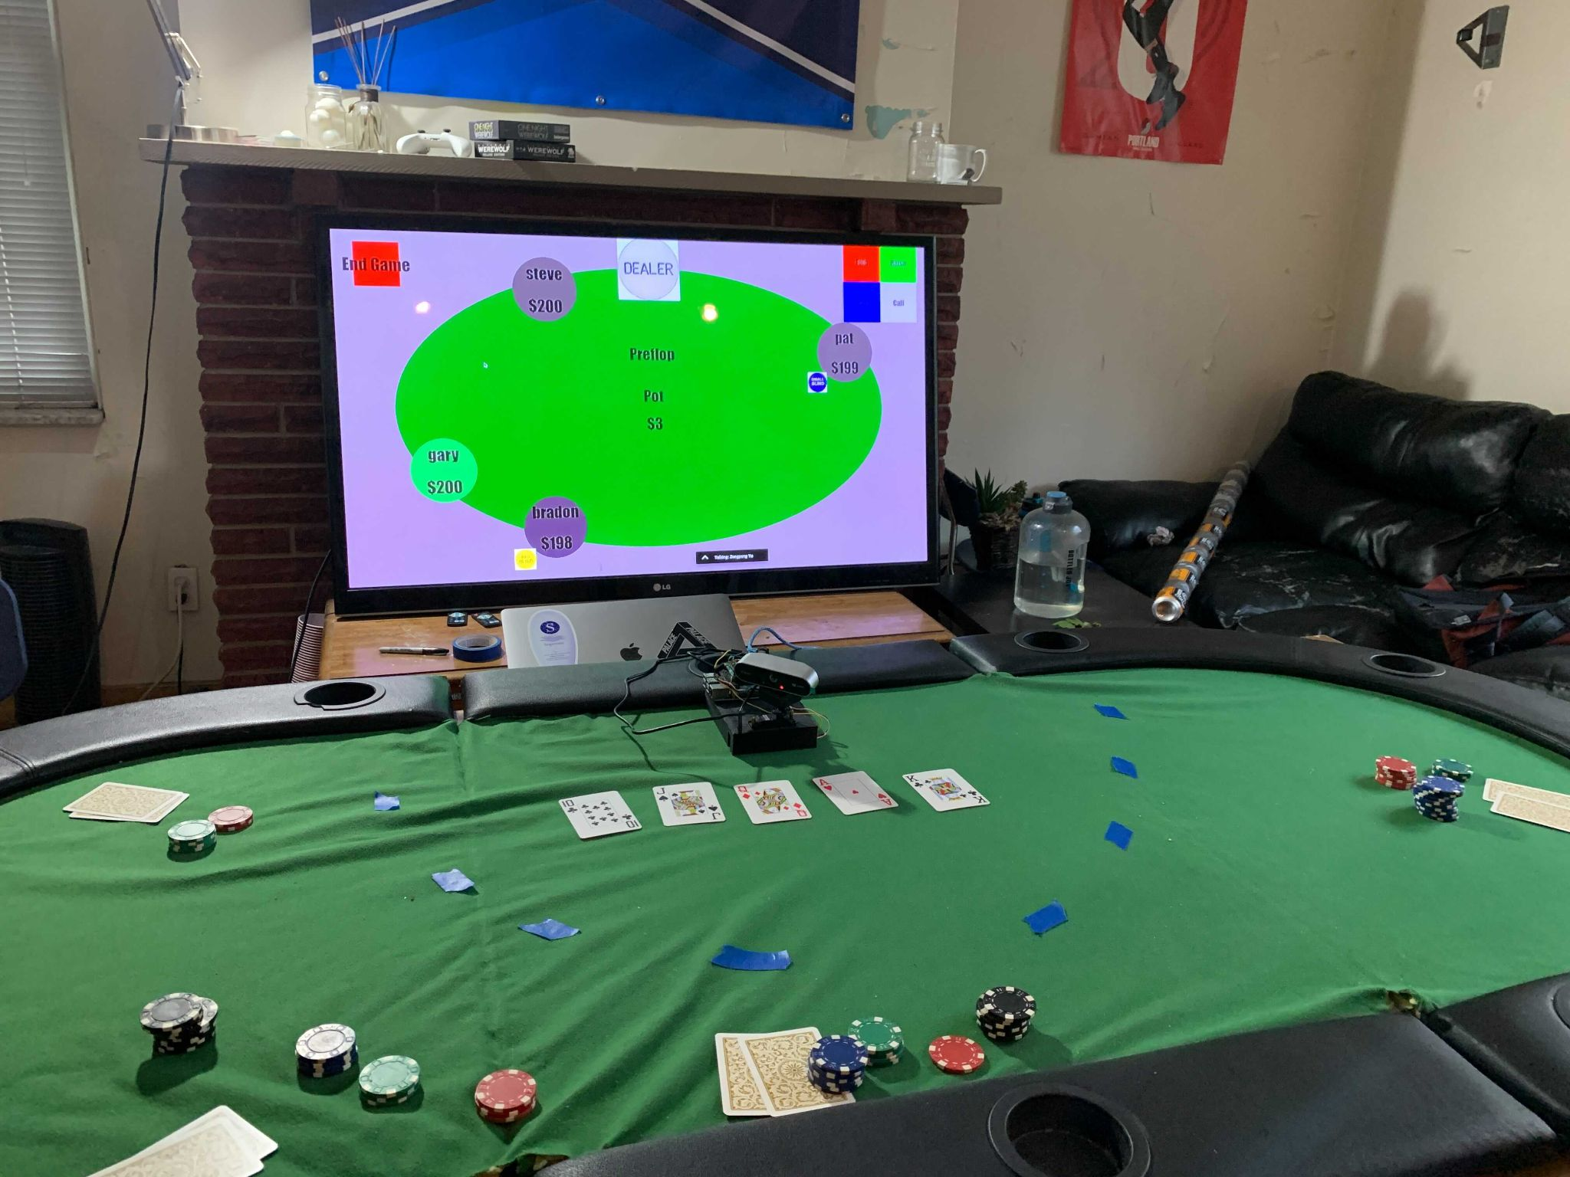
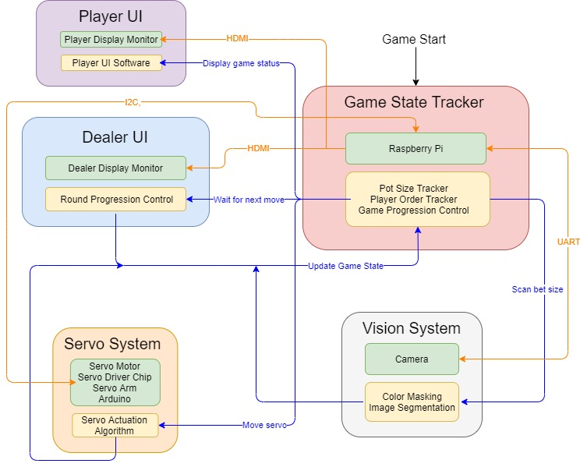
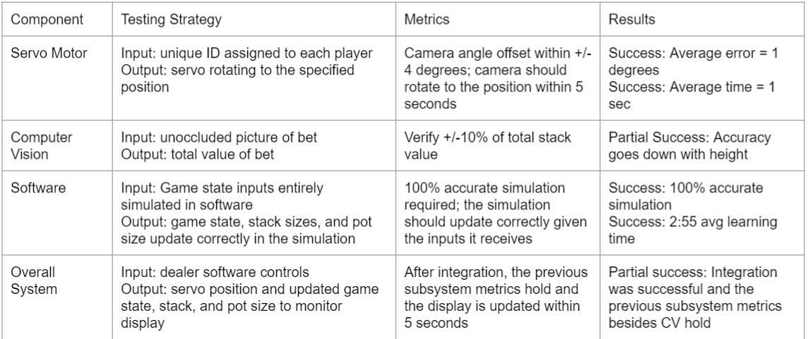
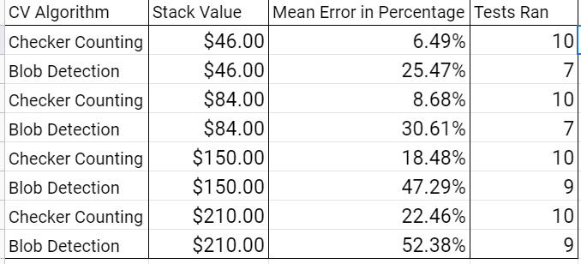
Smart Poker Table
Team E8: Steve Yu, Brandon Hung, Patrick Kollman
Product Pitch
System Description
As online poker games grow in popularity and convenience, live poker practices feel increasingly out of date. WIthout the information being in front of their faces, serious players constantly query their dealer for answers. This causes the players’ attention to drift away from the most integral part of the game: decision making. Smart Poker Table is a way to provide a speedy real-time estimation of game data accessible for all players to access through an intuitive user interface. Designed for casinos and hobbyists alike, Smart Poker Table fulfills its purpose as an easy to use device for both players and dealers that automatically tracks and displays the pot and bet sizes that simulates the convenience of an online poker game in real life.
Camera, Servo, and Electronics
Full setup, on poker table
Camera and Raspberry Pi
Dealer and Player UI
Camera
Raspberry Pi
Servo
Player seats
System Architecture
Arduino
Overall System Architecture
Markings for stack placement
System Evaluation
Summary of Testing, Metrics and Validation
Trade Off Performance

