Slide 1
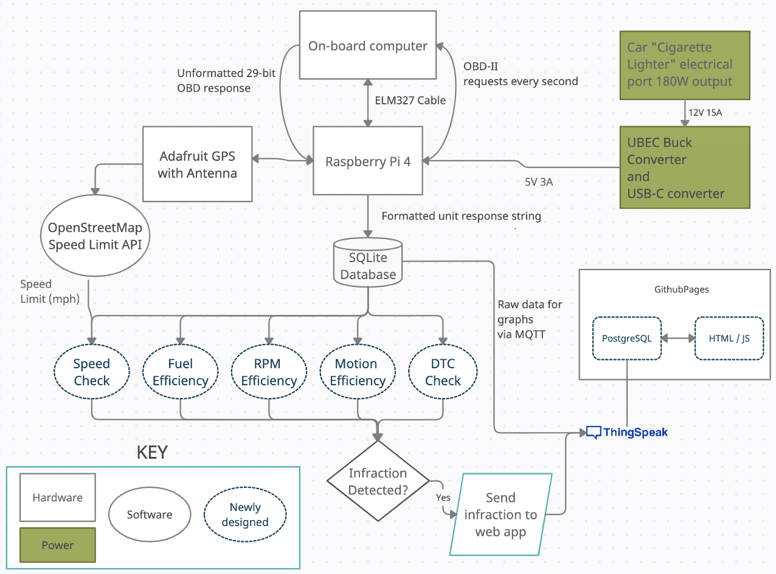
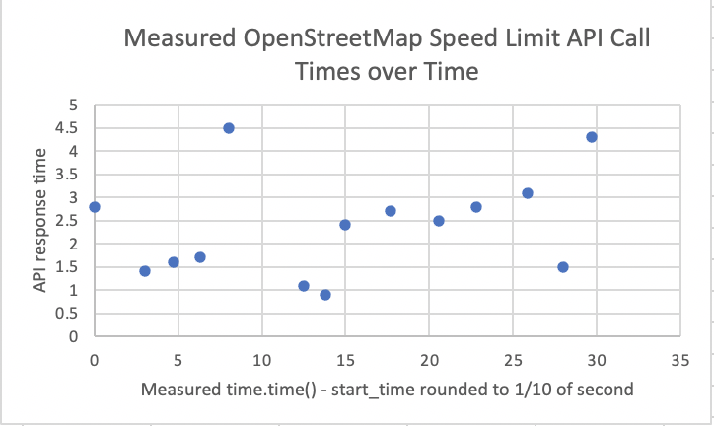
DRIVAID
Team E1: Samraj Kalkat, Ryan Vimba, Reid Yesson
Product Pitch
System Description
Drivaid is a vehicle monitoring system which passively identifies poor driving habits and provides real time driving infraction notifications and logs to the user. Drivaid is targeted toward individuals who want to improve the driving, as well as companies looking to increase the safety of their employees and customers. The purpose of Drivaid is to collect and analyze car data in real time because the best way for a drier to fix their mistakes is to make them aware while they are happening. Our product analyzes fuel usage, acceleration patterns, vehicle speed, engine RPM’s, and throttle to provide insights into driving efficiency as well as safety. To test our product, we did a number of driving tests that exposed our system to various speed limits, RPM levels, and accelerations in order to validate our infraction detection system.
Antenna: Improves reliability of GPS. This allows us to store the actual GPS safely in the box
Vehicle Power Outlet Plug: Provides power to the raspberry pi
ELM327 Cable: Provides OBD-II connection to vehicle under the steering wheel. This is how we collect data from the vehicle’s on board computer
Raspberry Pi 4: Where all data storage and computation occurs. Data is received from the car and sent to the web application from here.
System Architecture
Container to protect the Raspberry Pi and GPS, improve portability, and provide cable management
Drivaid System Block Diagram
System Evaluation
Requirement | Testing / Metrics/ Verification | Results
Speed Limit Check Accuracy | Test latitude and longitude points with speed limits of 25, 35, and 55 mph | Success, all locations returned correct speed limits
Fuel Efficiency accuracy | Go for a 10 minute drive and compare fuel efficiency calculated to the car’s fuel efficiency | Success, result was within 5 miles of fuel efficiency displayed from the car
RPM Efficiency accuracy | Run RPM check on data set with 100 points that bring the RPM above 6500 | Success, check found exactly 100 infractions
Motion Efficiency accuracy | Run motion efficiency check on data set with 100 points that bring acceleration above 1.5 m/s² or below -1.5m/s² | Success, check found exactly 100 infractions
Arduino receives 5V 3A from UBEC Converter | Multimeter recording verification | No current recordings above 3A, voltage steady at 5.2V, power steady at 15W regardless
Figure above: in a test drive, we measured how long the API response from OpenStreetMap took and found it was longer than we thought after switching to 2 API calls/ latlong point. This motivated us to keep Speed Limit calls in a separate thread as not to slow down the OBD-II database reads.
Pl

