Slide 1
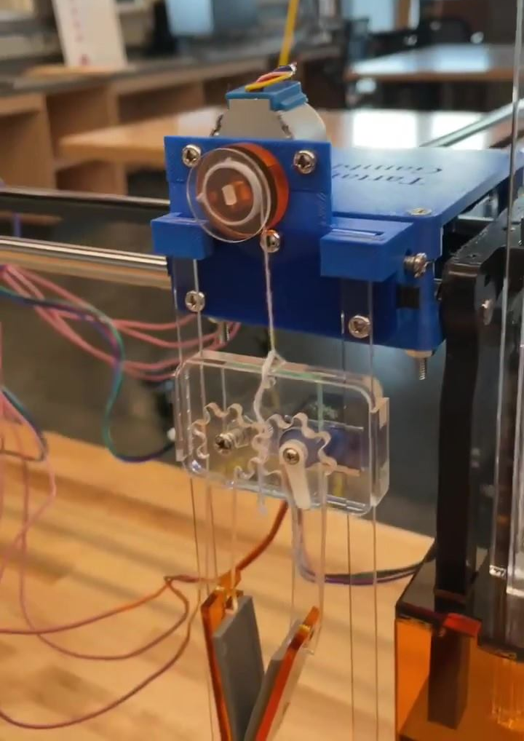
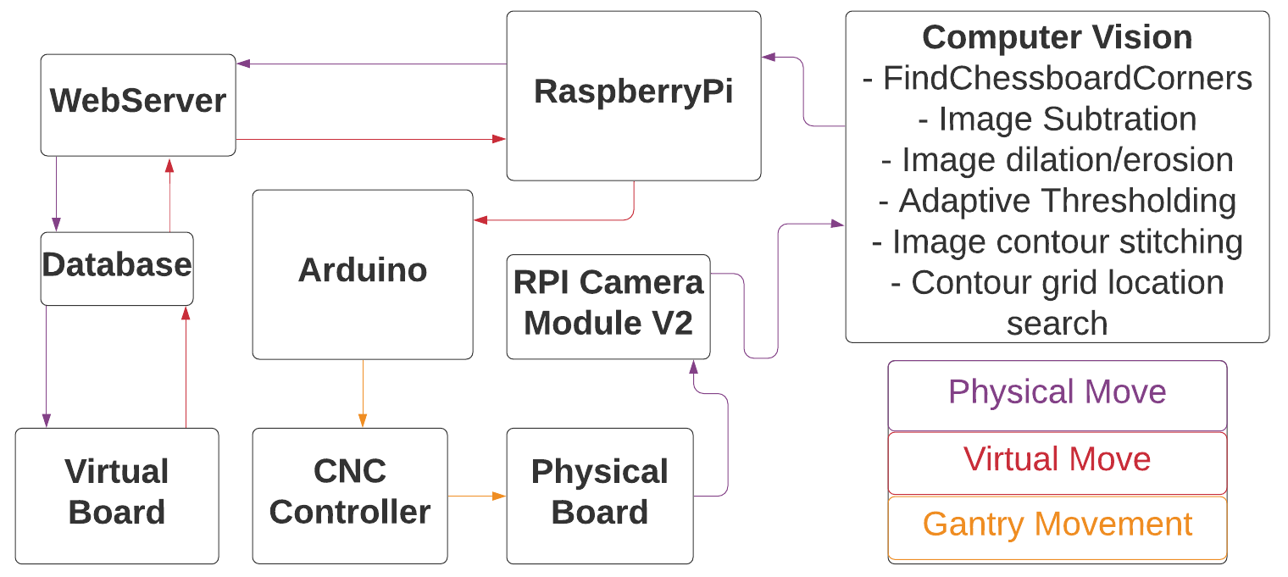
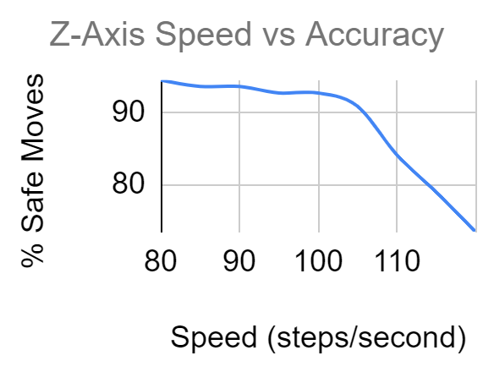
Tartan’s Gambit
Team E0: Lillie Widmayer, Luis Ortega, Juan Cortes
Product Pitch
System Description
Tartan’s Gambit is an integrated software and hardware system that enables a user to play a physical game of chess with a remote opponent via a web application. Due to the pandemic, it can be difficult to see people in person, and an in-person game of chess cannot be played while maintaining 6-feet of social distance. Hence, we have created Tartan’s Gambit. One player makes moves via a web application while the other player makes moves on a physical chessboard with actual pieces. The moves made in the real world are detected using computer vision and are translated to be reflected on the web application. The moves made by the web player are communicated to the gantry system which performs the web player’s move on the physical board world.
Elevator Gripper Close Up
Front View of Entire System
5V Stepper
Arduino
Elevator
Camera
Pulley
Raspberry Pi
Yarn
Servo
Free Gear
Servo
5V Stepper
Claw
Guide
Rails
System Architecture
12V Steppers
Software Flow Diagram
Grip Pads
Claw
Height Stands
Chessboard
System Evaluation
Requirements Met
Accuracy Test Chart
Requirements | How it is Met
Remote play | Physical and virtual boards communicate via http requests and sockets.
Synchronous board states | Webserver synchronised with the physical board every 5 seconds
Low false positives from move detection | OpenCV pauses calculations while movement is occurring within its field of view
Gantry does not interfere with other pieces | Each piece is lifted above the height of the tallest piece (King) before commencing any XY movement
High accuracy of move detection | OpenCV bases the location of the moves on where the center of the pieces lie, minimizing edge cases
No turns detected if player decides not to place a moved piece | The OpenCV will not report and forward moves to the webserver if only one square is calculated to have been involved
Hardware Block Diagram
Arduino
CNC Shield
5V Input Voltage + GND
A4988 Driver
A4988 Driver
USB Serial
Raspberry Pi
12V Stepper
12V Stepper
12V Input Voltage + GND
A4988 Driver
9g Servo
Camera
5V Stepper
Coolant EN Pin
GND 5V Input Voltage
Legend
Claw
X-Y Gantry

