Slide 1
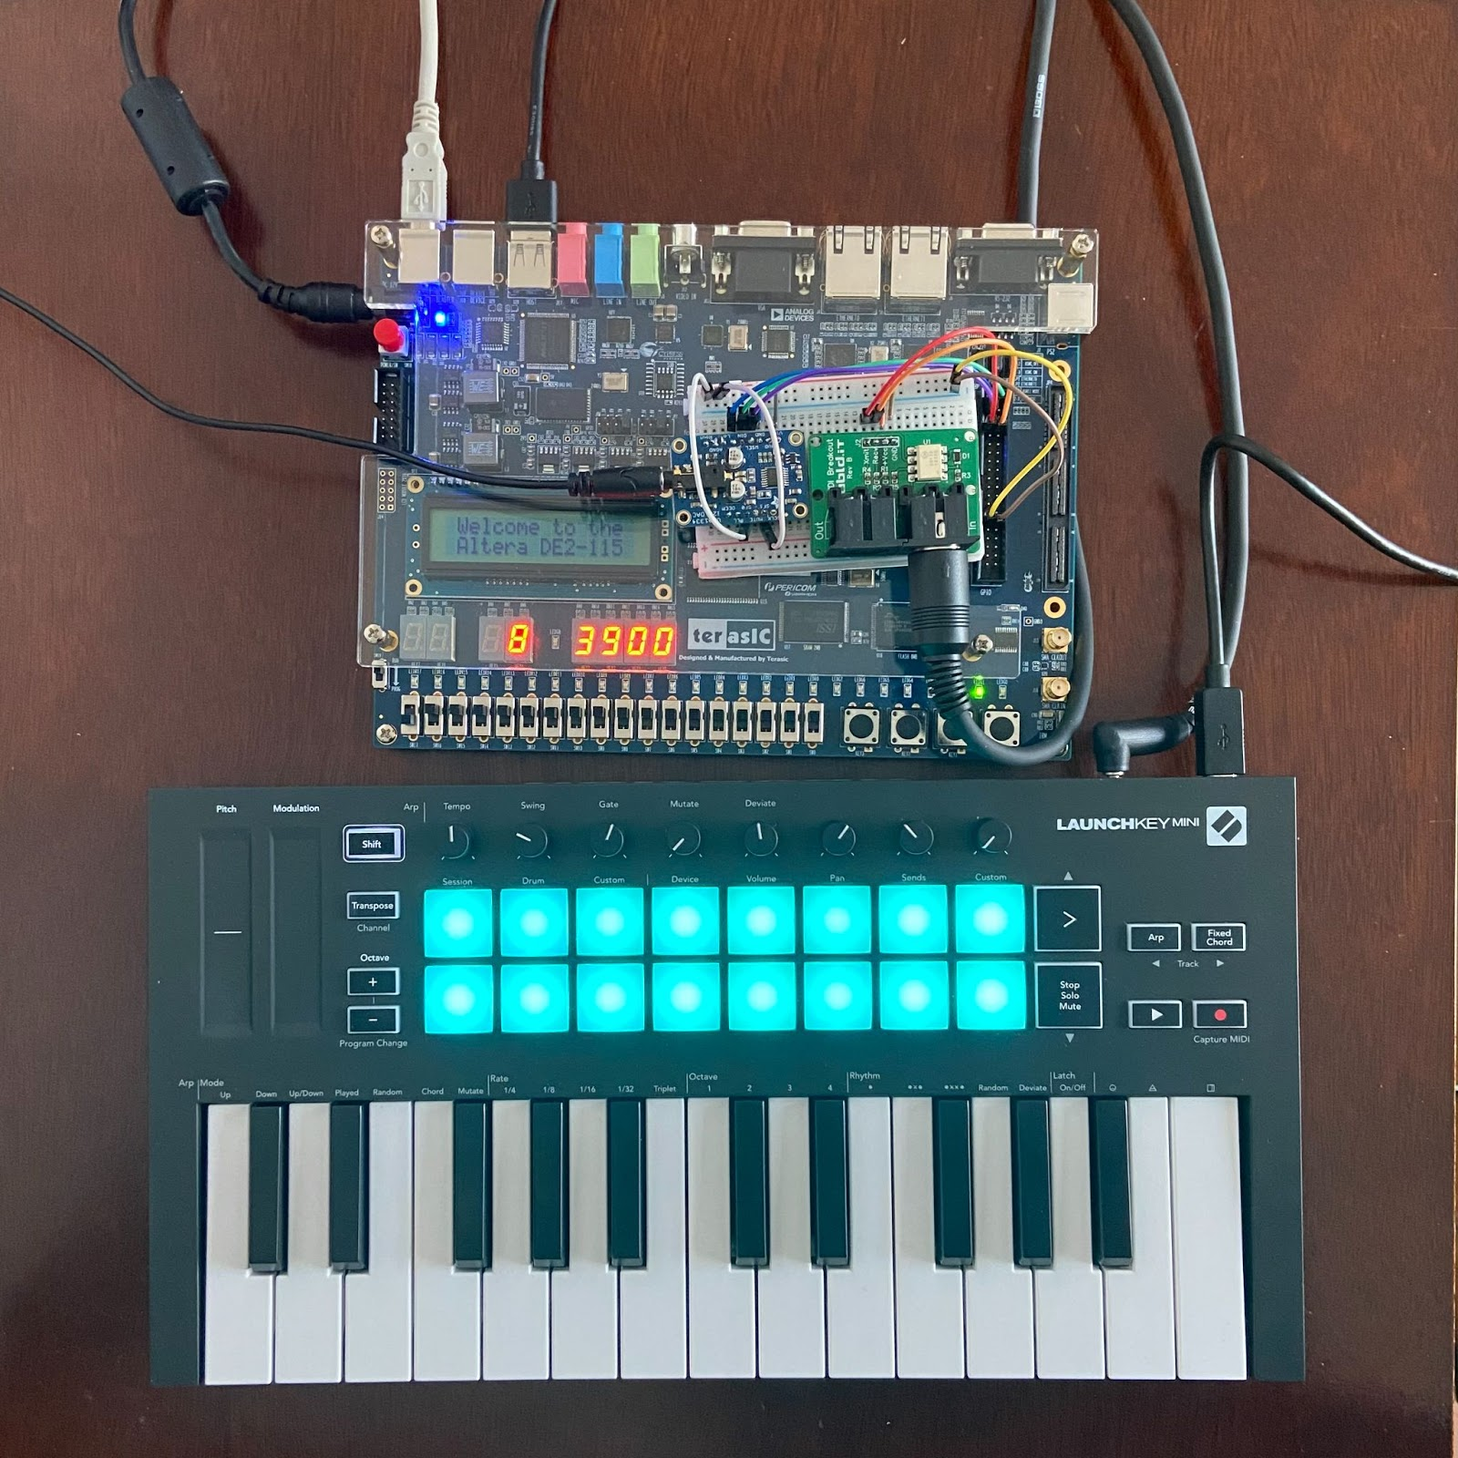
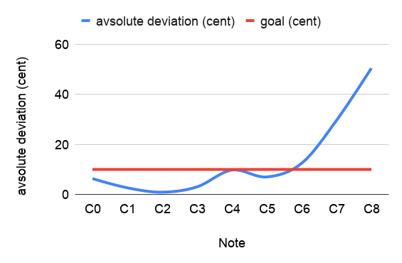
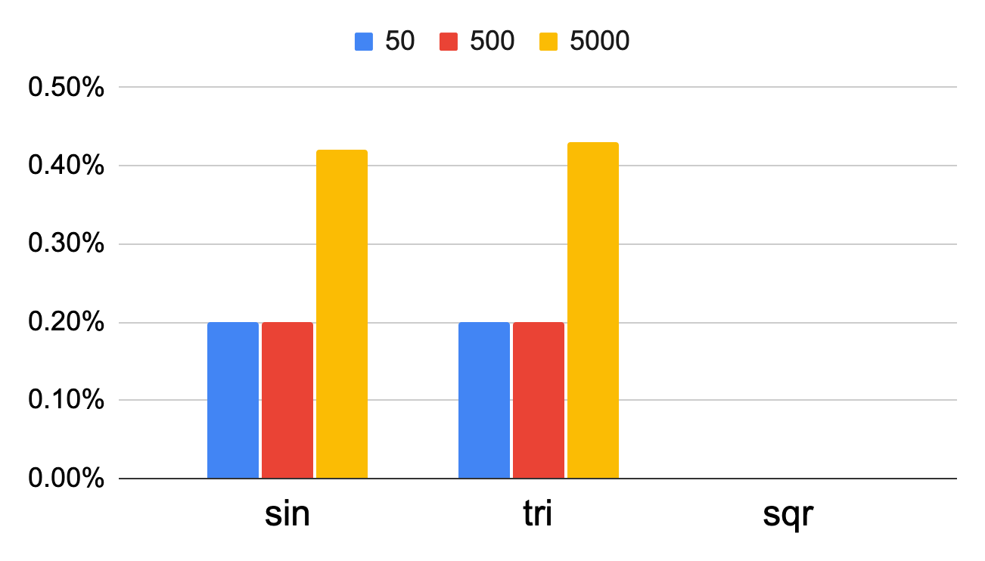
conFFTi — FPGA music synthesizer
Team D8: Michelle Chang, Hongrun Zhou, Jiuling Zhou
Product Pitch
System Description
conFFTi is a digital music synthesizer implemented on an FPGA.
It accepts real-time input from a MIDI keyboard, generates and processes audio signals, and outputs 44.1kHz, 16-bit, 2 channel signals through an audio DAC.
conFFTi has a very low latency of 3.3ms, minimal shape distortion of less than 1%, and low frequency distortion of less than 10 cents across notes from C0 to C6.
4-note polyphony
Play up to 4 musical notes at the same time!
8 waveforms to select from the FPGA switches
Basic waveforms: square, triangle, sine
Special wavetables: violin, viola, cello, trumpet, french horn
ADSR
Adjust attack, decay, release and sustain levels via keyboard knobs
Pulse width modulation (PWM)
Adjust waveform duty cycle via keyboard knob
Unison detune
Thicken the sound by adjusting keyboard knob
Record and cycle
Hold down the record key, play up to 4 notes
Press play button to loop the recording
DE2-115 Cyclone IV FPGA
UDA1334
I2S DAC
ubld.it MIDI breakout board
System Architecture
Launchkey Novation MINI MkIII
System Evaluation
Latency (including DAC) | 3.30ms
Latency (except DAC) | 940us
Fig. A. Latency from MIDI to DAC is below the 10ms requirement and is undetectable by human ears
Fig. C. Pitch deviation across all octaves measured in cents; Notes above C6 are not meeting the requirement of less than 10 cents
Fig. B. Shape distortion for signals of different periods;
1% deviation requirement met for all signals

