Slide 1
Team D7
Funmbi Jaiyeola, Sai Chandana Korivi, Carlos Taveras
Add your 12 slides after this slide… [remember, 12 min talk + 3 min Q/A]
For more information about formatting or importing slides see: https://gsuite.google.com/learning-center/products/slides/get-started/
Make sure to cover:
- Use Case
- Requirements
- Technical Challenges
- Solution Approach
- Testing, Verification and Metrics
- Tasks and Division of Labor
- Schedule

Slide 2
TEAM: D7
Funmbi Jaiyeola, Sai Korivi, Carlos Taveras

Slide 3
Application Area
Problem Area:
High cost and inaccessibility of singing lessons taught by vocal coaches for people interested in introductory vocal lessons
Solution:
A free web application that provides novice singers with exercises focused on improving their pitch control and rhythm identification, as well as music theory lessons that can provide a fundamental understanding of music elements

Slide 4
USER INPUTS
PITCH DETECTION
VOCAL RECORDING
Pitch detection algorithm
Note Segmentation
Post
processing
Extract metrics
VOICE RANGE EVALUATION
PITCH EXERCISES
CLAPS RECORDING
Calculate relative pitch differences
Exercise Template
RHYTHM EXERCISE
TEXT INPUT
USER INFO
MUSIC THEORY QUIZZES
RHYTHM DETECTION
APPLICATION OUTPUT
Clap Detection
Algorithm
Exercise Template
VISUAL FEEDBACK
VOICE RANGE ON PIANO
AudioSynth.js
PITCH FEEDBACK
Compare Timing
USER’S RHYTHM - Accuracy %
Charts.js
VERBAL FEEDBACK
VOICE RANGE DESCRIPTION
Notes:
Replaced Web Audio API with AudioSynth.js to play piano notes for vocal range feedback + pitch exercises - will discuss more in detail in design trade offs slide
Replaced highcharts with charts.js to display pitch and rhythm feedback- will discuss more in detail in design trade offs slide

Slide 5
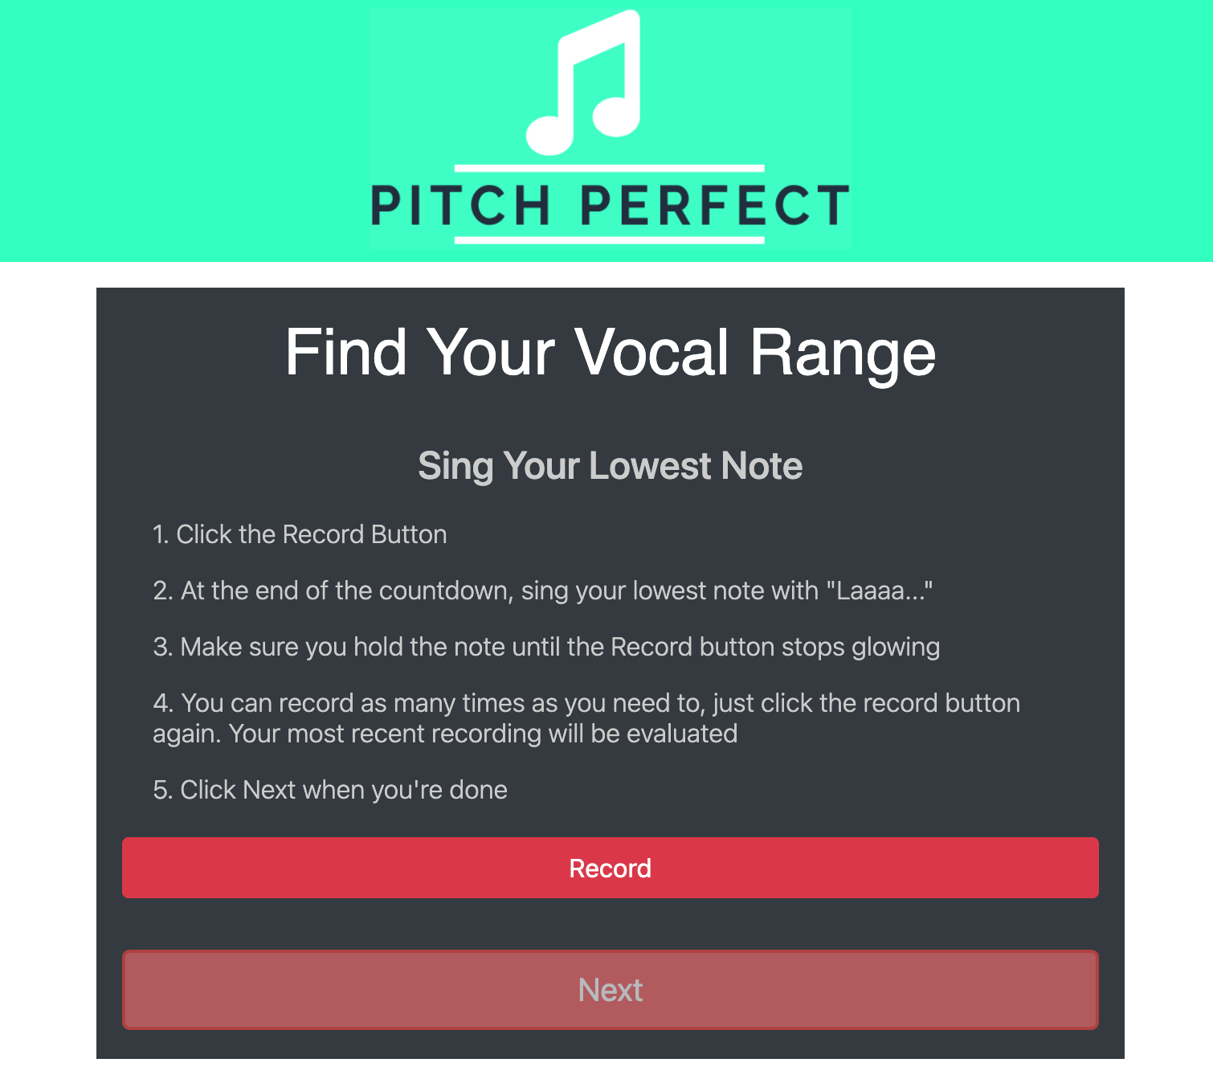
Complete Solution: Pitch Exercise + Vocal Range Evaluation
Notes:
Video: Pitch Exercise for scale practice - User will use headset with headphones+microphone for pitch exercises.They can listen to how scale sounds on piano with headphones, record themselves singing along with the mic while listening to the scale play, and then submit the recording for feedback. Still need to integrate feedback generation with frontend.
Vocal Range: When the user registers for the web site, they will be directed to find their vocal range. They record their lowest note + highest note so that their range can be used to personalize their pitch exercises to accommodate that range. This range can be updated at any time.

Slide 6
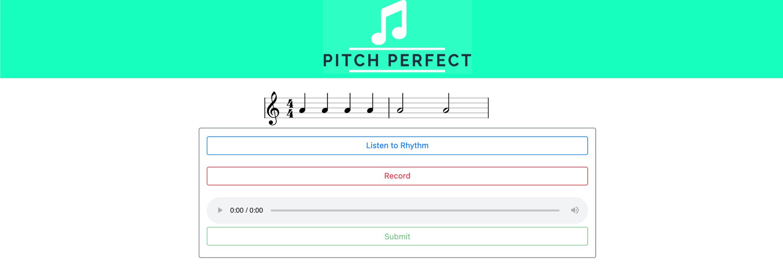
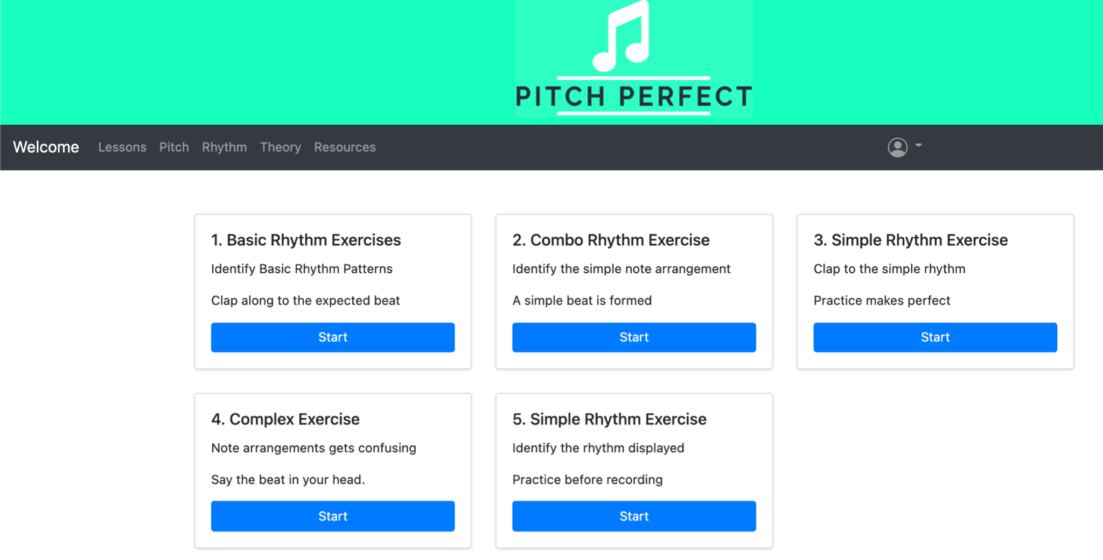
Complete Solution: Rhythm Exercises
Notes:
(Middle-left) → Dashboard page to navigate between exercises
(Top-right) → Rhythm/Clap exercise page - listen to rhythm button allows you to listen to the rhythm displayed with the music notes
(Bottom-right) → feedback page , see what you got right and wrong as well as the percentage you scored on specific exercises

Slide 7
Testing, Metrics, and Validation
Requirement | Test Input | Expected Test Output | Actual Output
95% PDA accuracy per note | 10,000 randomly generated pure tones with added white noise and modulation | PDA able to accurately classify 95% pitch to notes on test set | 100% note segmentation accuracy on pure tones, but too simple of a test example to generalize to speech
95% clap detection accuracy | Audio clips of a single person clapping | Clap detector able to accurately detect 95% of claps in clip | Able to detect claps, spaced out at least 10 ms, on 100% of test examples
Intuitive and User-friendly Interface | Comment and suggestions on experiences and possible improvement / Overall satisfaction | Overall positive experiences + minor fix suggestions 5/5 Satisfaction Rating | 100% of test users gave 4/5 satisfaction rating
Notes:
All of the test users gave a overall ⅘ rating for the website.

Slide 8
User Experience Survey Responses
“Dashboard tabs should never disappear
Clicking on logo should take you to home page”
“Maybe add dropdown menu or buttons. Also add a hyperlink back to the appropriate theory lesson, I think the clef theory page was missing”
“try to put more instructions on what to do on every page”
“There’s a lot of tabs on the dashboard so it’s a little difficult to know what’s where. Maybe when you hover over a tab, there could be a drop down of all the exercises in each tab”
“the descriptions were missing for the exercises. As a beginner, I was low-key lost. Don't know how to sing a scale at all, like am I supposed to say random words or the do re mis. Maybe add an example recording”
Notes:
After testing the current state of our application with the users this is some of the feedback received,
Our app still has some tweaks that need to be made to allow for ease of usability.
Overall the comments suggest that adding very thorough instructions for each lesson, having navigation buttons to exit from the lesson to the dashboard, and making the dashboard tabs more intuitive, will improve the user experience greatly.
Currently 4 stars with hopes that after final testing it would rise to 5 stars for usability.

Slide 9
Design Trade-offs (User Interface)
Pitch Lessons:
AudioSynth.js vs Web Audio API
Solfege Bars vs. Music Notation
Solfege bars more intuitive for beginner level singers
Pitch Accuracy Feedback:
Percentages vs. Relative Pitch Representation (Graph)
Feedback Software
Highcharts vs Chart
Notes:
AudioSynth vs Web Audio API: Was initially going to use Web Audio API to play scales and rhythm with piano notes for the user to listen, but the sounds produced with web audio api were too robotic sounding, and required us to filter and modify it ourselves to make it sound more realistic. AudioSynth.js library was really easy to use and produced very realistic piano sounds. Traded HighCharts for Charts as Charts is simple to use and navigate and the extent to which we would be using charts is basic and not in need of a more complex platform like HighCharts.

Slide 10
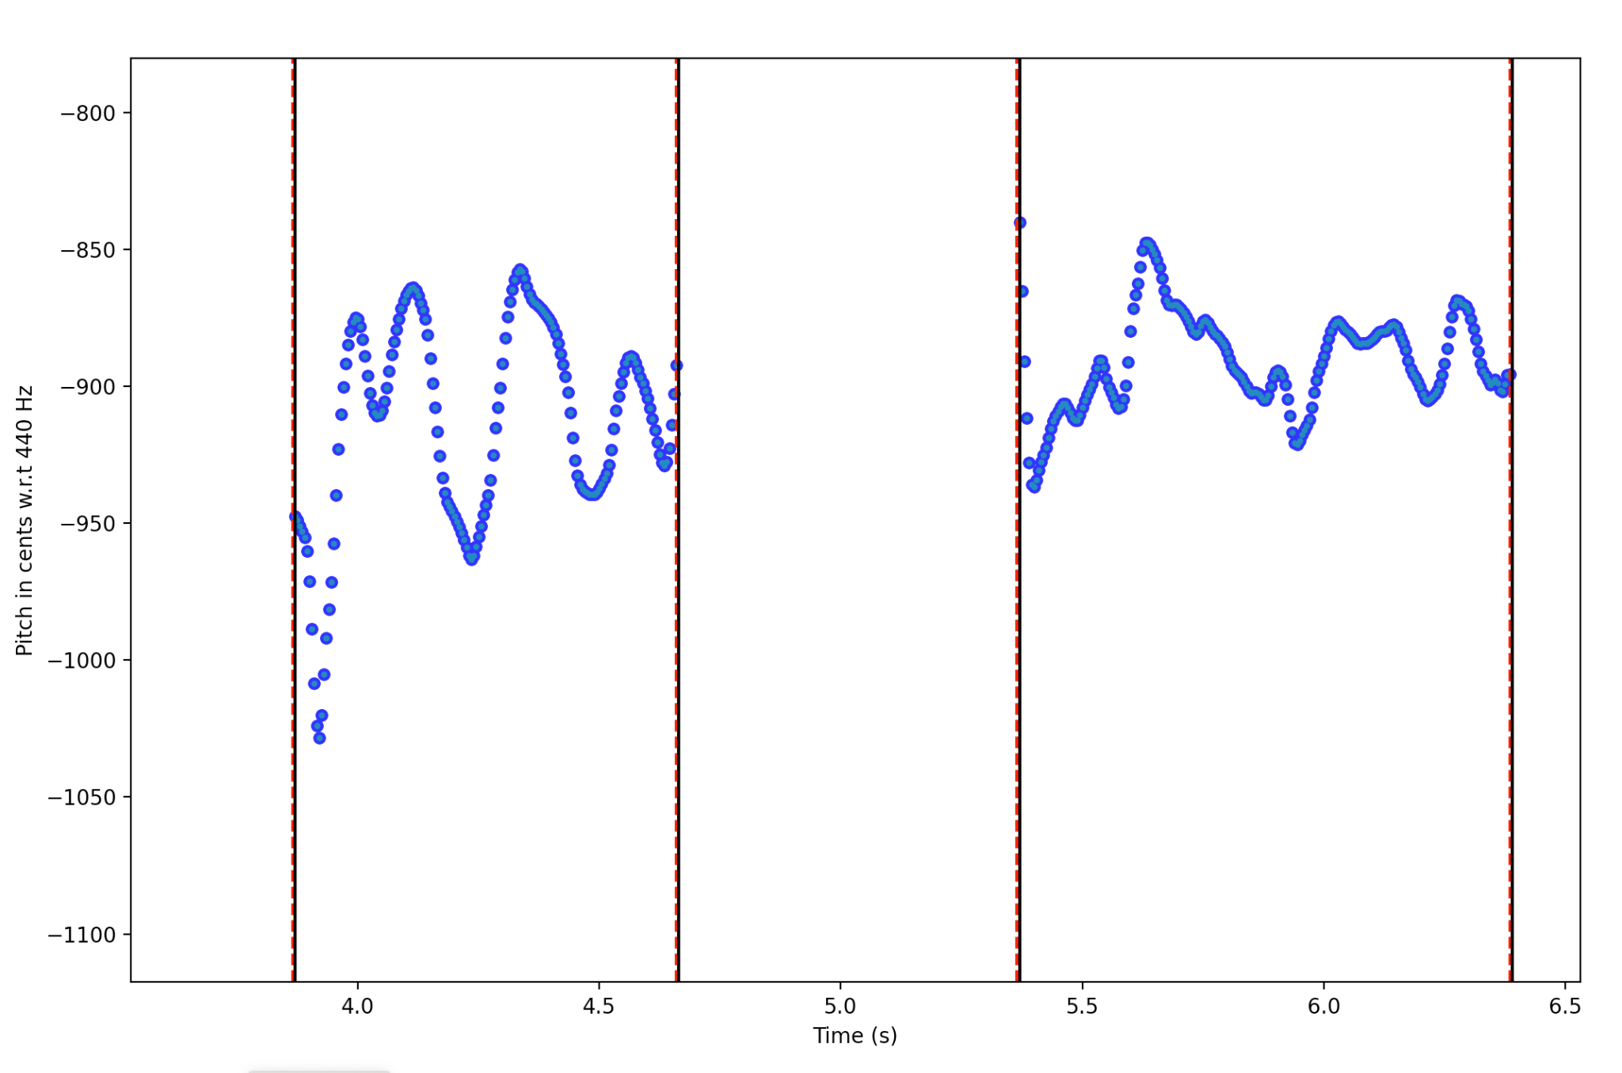
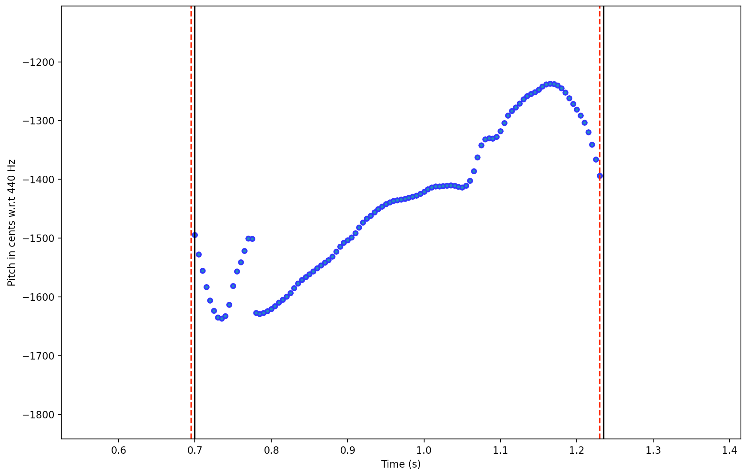
Design Trade-offs (Pitch Exercises)
Pitch detection algorithm selection
Parselmouth Python library was more user-friendly, and its pitch detection algorithm was more accurate than the third party Yin implementation
Absolute vs. Relative Pitch
Absolute pitch simplifies performance comparison, but it assumes users have perfect pitch which is most likely not the case
Continuous tone transition v.s. breaks between notes
There is more opportunity for extracting metrics if users are allowed to transition between notes, but note segmentation is difficult due to the common occurrence of pitch drifting
Selecting metrics that indicate singing quality
Metrics indicative of ‘good’ singing are difficult to extract within the given time constraints, so instead we focused on collecting more concrete metrics

Slide 11
Risk Factors / Unknowns
Risk | Actual Mitigation
External Noise in Vocal Recording/Clap Recording | Noise-cancelling microphone; test in noisy environments
Recorded audio contains artifacts that do not contribute to what exercise is testing (high frequency noise, elongated non-vowel sounds) | Post process pitch to account for these cases
Data needed to evaluate pitch algorithms was not readily available due to added processing constraints (added breaks between notes) | Test product against as many recorded examples as possible
Compatibility issues of audio format recorded in frontend (.webm) with audio format required for audio processing (.wav) | Used ffmpeg open source command line tool to convert audio file format
Notes:
Compatibility issues of audio format: When audio recordings from the user got sent back to server and were saved locally, we realized that the audio files couldn’t be opened as wav files, and therefore couldn’t be processed by the pitch detection algorithm, since they were being saved as webm files which was the only format compatible with our media recorder api. To mitigate this, we found a open source command line tool called ffmpeg to convert the webm files to wav files, which ended up being successful in producing wav files.

Slide 12
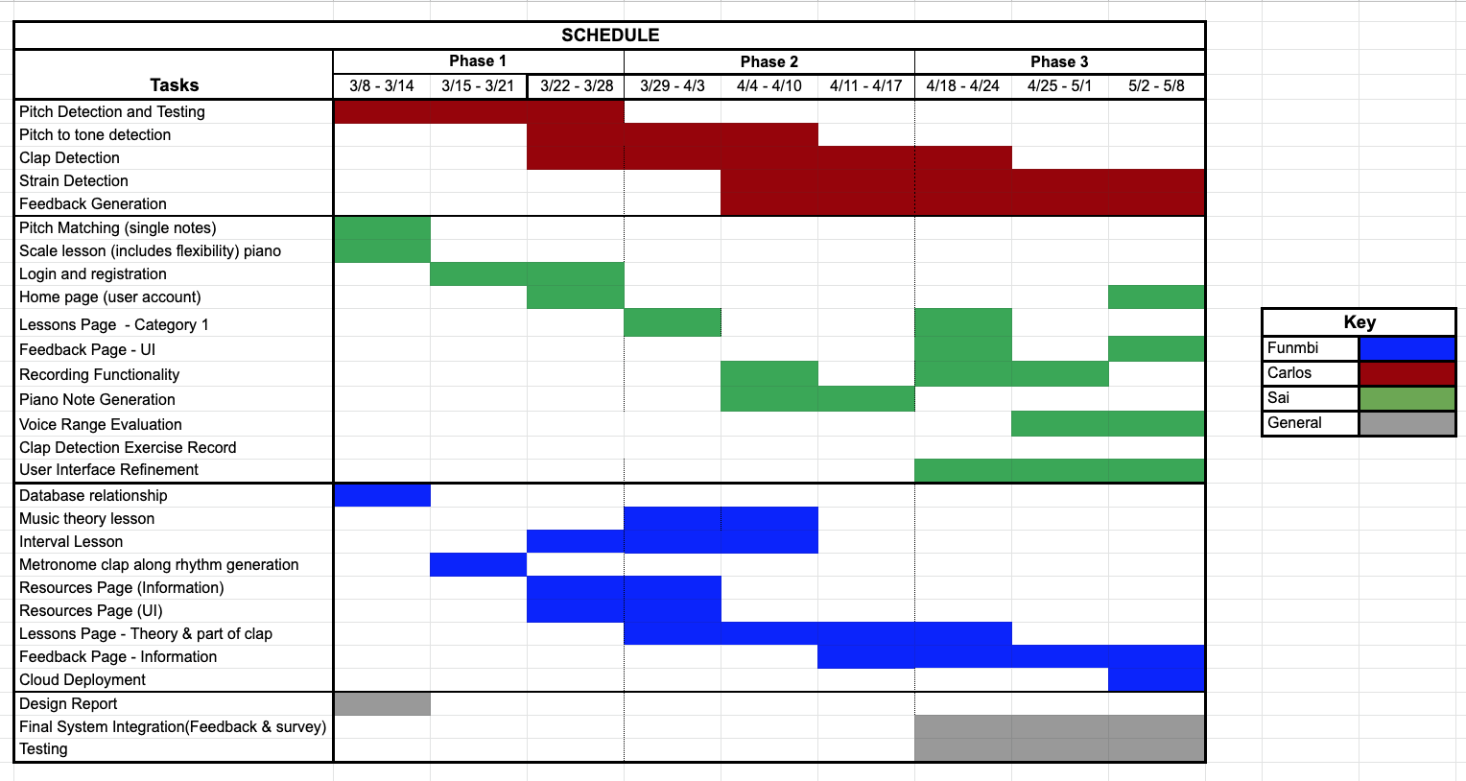
Project Management
Notes:
Working on the lessons using VexFlow, integrating the javascript with the python aspect of the project took more time than anticipated which affected the time left to render the feedback page
Sai: Working on the Recording functionality and figuring out how to send it back to the audio processing took some more time than expected since file formats became an unexpected issue after thinking it was take care of.

Slide 13
Lessons Learned
Incorporating APIs ensures checking compatibility with browsers and software
Functionality should get most priority over aesthetics during initial stages
While, to some degree, pure tones can be used to approximate human singing, they cannot capture the nuances of a real speech/signing signal
While there is an abundance of singing data readily available online, it can be difficult to find a dataset that is usable for your application
Characterizing singing quality is an open research question, and providing actionable feedback on advanced singing features is a difficult task
Notes:
Functionality priority: A lot of time was wasted at the beginning in trying to figure out how to make the web app pages look good, but ran into several issues such as audio file format and sending the audio file back to server when functionality was addressed towards the end, and this delayed the integration of the web app with the audio processing.
Real-world signals often require significant post-processing, and understanding of the signal’s production to extract meaningful data

