Slide 1
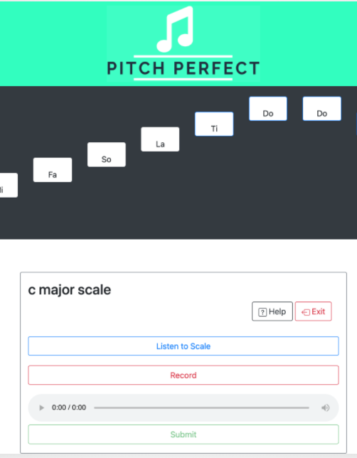
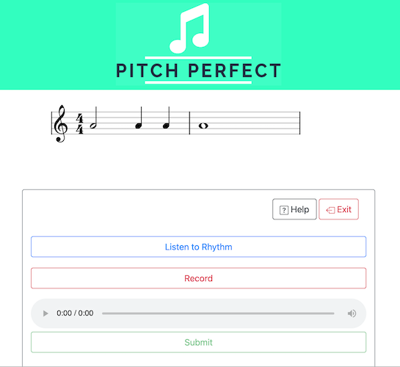
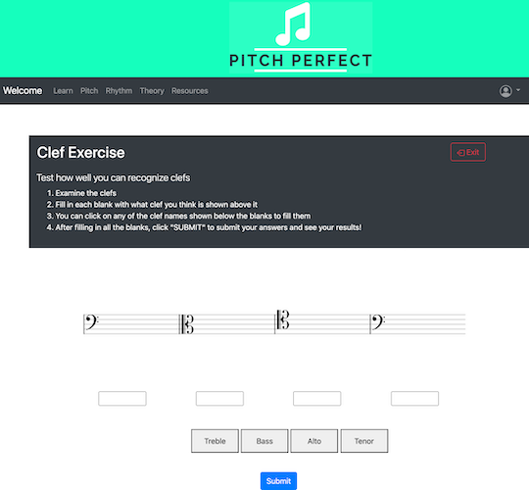
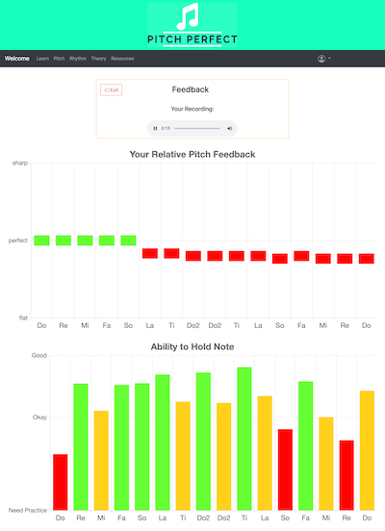
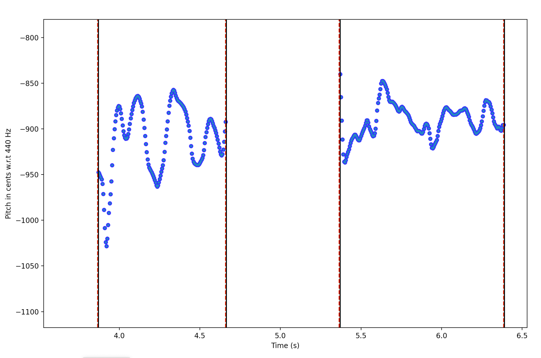
Pitch Perfect
Team D7: Funmbi Jaiyeola , Sai Korivi, Carlos Taveras
System Description
Product Pitch
Pitch Exercise Page
Rhythm Exercise Page
Theory Exercise Page
Pitch Feedback Page
A free web application that provides novice singers with exercises focused on improving their pitch control and rhythm identification, as well as music theory lessons that can provide a fundamental understanding of music elements.
The exercises hosted by this web application provide accurate feedback to users on their intonation, ability to clap a rhythm, and music knowledge. The overall web application is designed to be user-friendly and easy to navigate.
Music Notes
Navigation Bar
Solfege Bars
Instructions
Instructions Button
Playback
Listen Button
Exercise Name
Playback widget
Clefs
System Architecture
Record Button
System Diagram
Media Recorder API
AudioSynth.js
Submit Button
Fill in the Blanks
Feedback Charts
USER INPUTS
PITCH DETECTION
VOCAL RECORDING
Pitch detection algorithm
Note Segmentation
Post
processing
Extract metrics
System Evaluation
RANGE EVALUATION
PITCH EXERCISES
Pitch Detection Contour Lines
UX Survey Results
CLAPS RECORDING
Calculate relative pitch differences
Average User Rating of Overall User Experience and Ease of Use | 100% of Test Users Gave 4/5 stars rating
User Comments and Suggestions | “try to put more instructions on what to do on every page” “color scheme and layout are visually pleasing and intuitive” “I liked the the showing of the different type of scales”
RHYTHM EXERCISE
Exercise Template
TEXT INPUT
USER INFO
RHYTHM DETECTION
THEORY QUIZZES
APPLICATION OUTPUT
Clap Detection
Algorithm
Exercise Template
VISUAL FEEDBACK
PITCH FEEDBACK
RHYTHM - Accuracy %
Compare Timing
VERBAL FEEDBACK
Vexflow
VOICE RANGE
Chart.js
THEORY QUIZ RESULT
Algorithm used to segment pitch contours to musical notes

