Slide 1
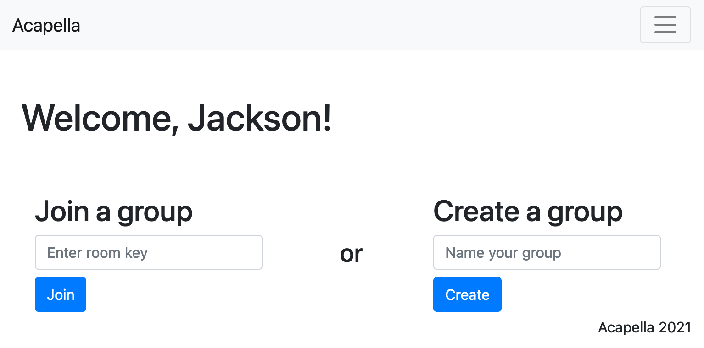
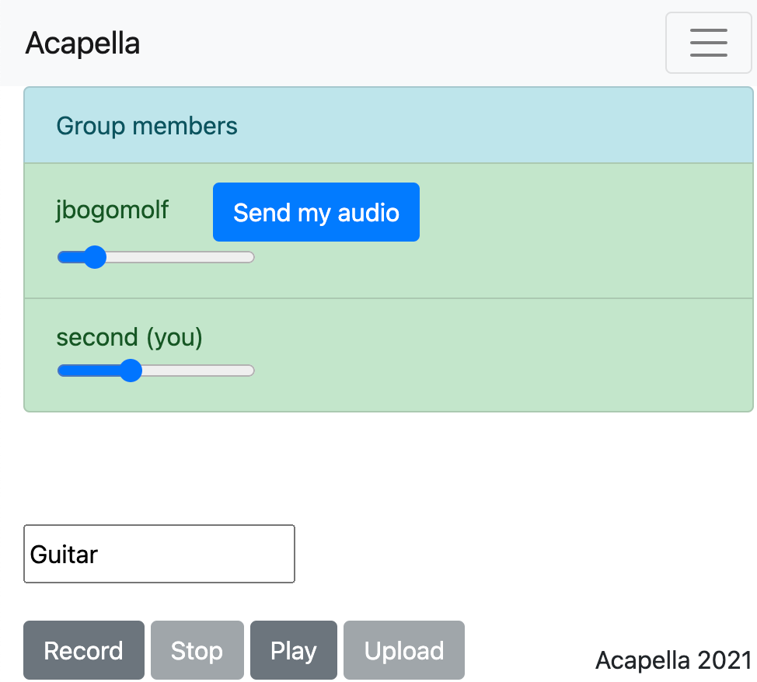
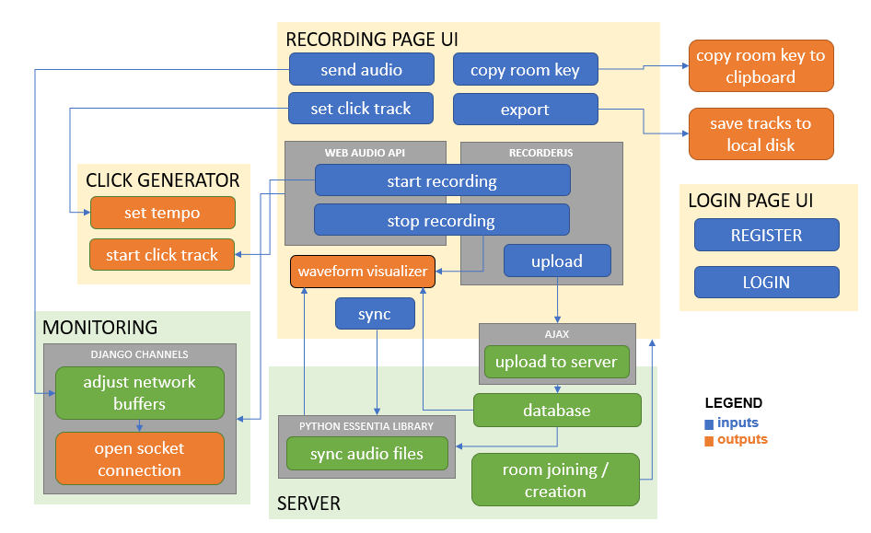
Acapella
Team D5: Jackson Bogomolny, Ivy Ye, Christy Lee
Product Pitch
System Description
Acapella is a free, collaborative digital audio workstation that works entirely in your browser. Think of it like a Google Docs for audio recording: supporting real-time monitoring with an end-to-end latency under 100 milliseconds, the web app empowers ensembles of up to 4 musicians to create professional quality multitrack audio recordings remotely. After the session, Acapella will automatically synchronize users' recorded tracks and allow for them to be downloaded off the web server.
Home Page User Interface
Group Page User Interface
Click to start p2p monitoring
System Architecture
Software block diagram
From the home page, users can either join an existing group...
Name your track
...or create a new group
System Evaluation
Metrics & Validation Table
 | Validation Method | Requirement | Performance
End-to-End Latency | Send UTC time with TX, compare to UTC time on RX | < 100 milliseconds (always) | < 5 ms locally, TBD after cloud deployment
Audio Quality | # lost packets ━━━━━━━━ # sent packets | < 5% (average) | Virtually 0% locally, TBD after cloud deployment
UI Intuitiveness | Ask users to perform basic tasks and time them | < 5 seconds (average) | TBD after cloud deployment

