Slide 1
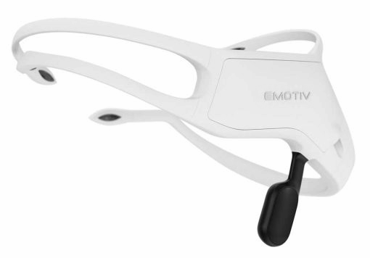
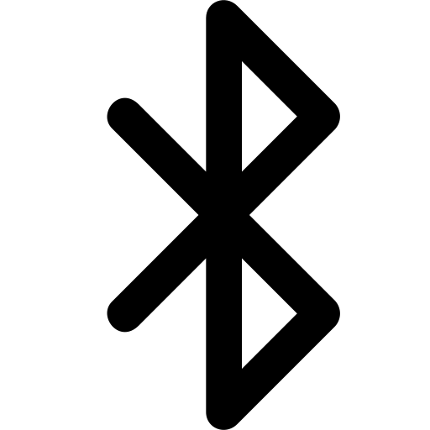
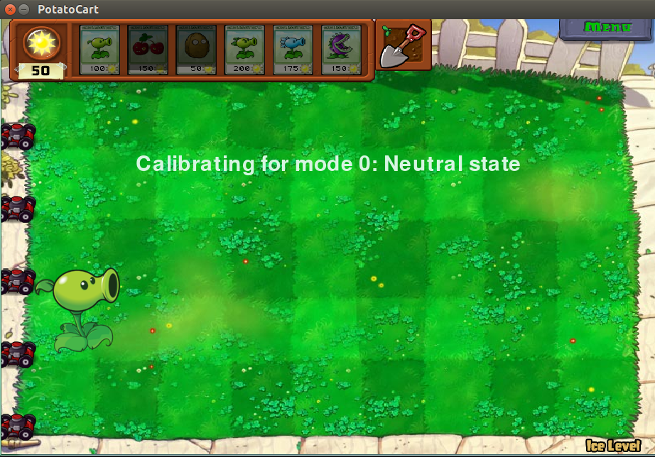
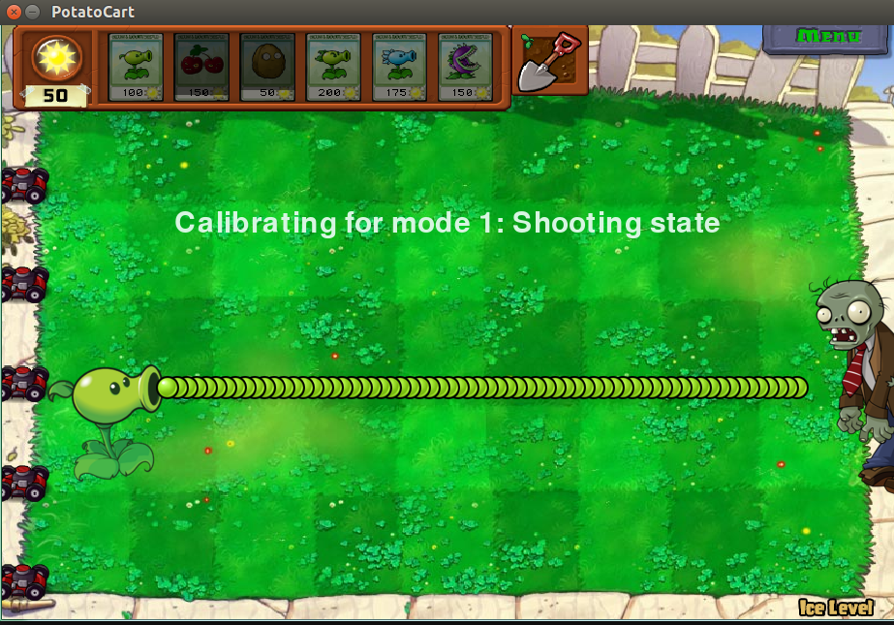
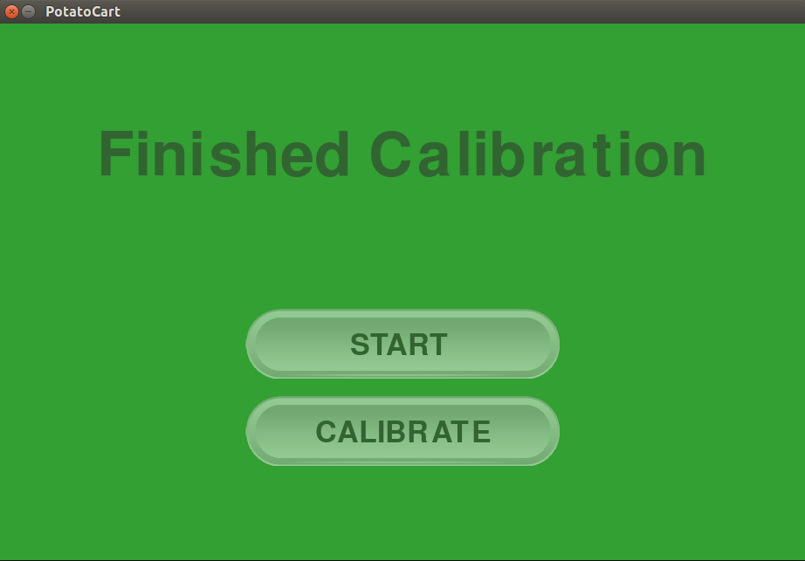
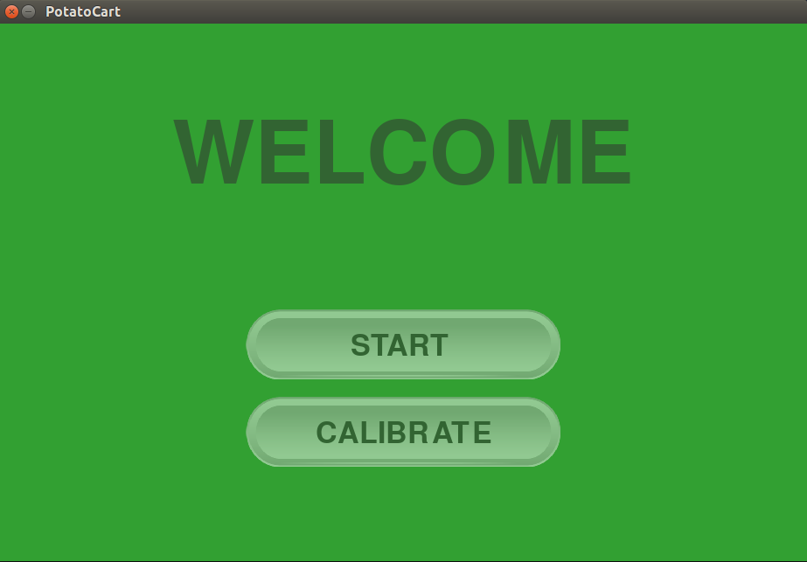
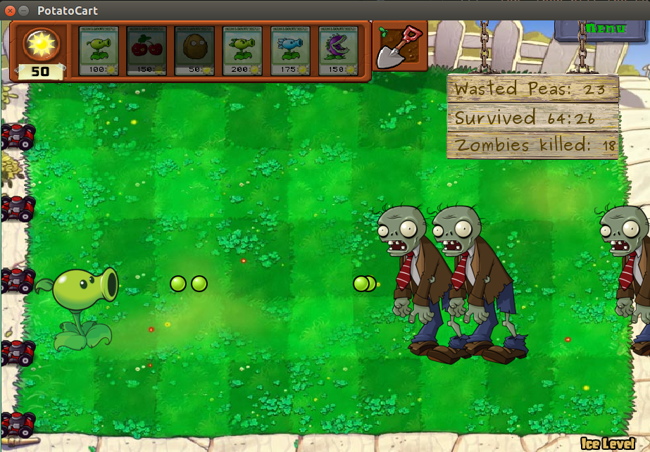
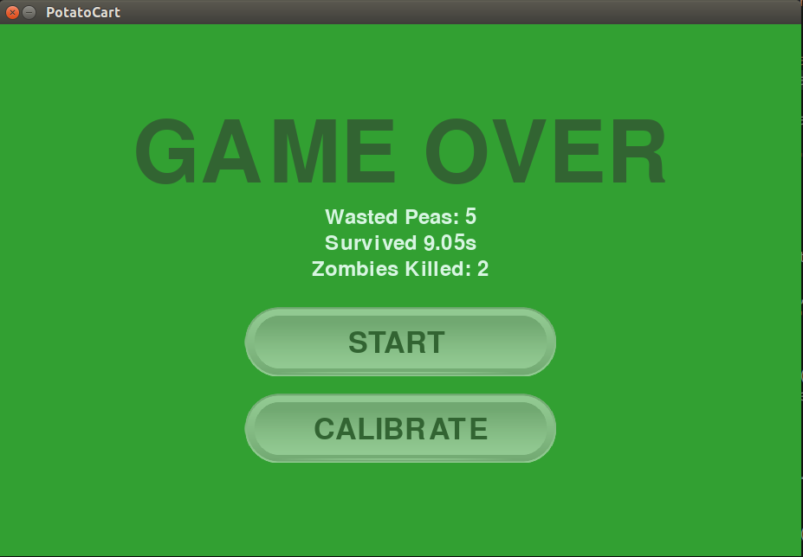
Traveling Mind: EEG Controlled Game
Team D4: Chris Liu, Lavender Jiang, Eryn Qian
Product Pitch
System Description
Our team develops a mind controlled game, where users fight waves of zombies as the lone peashooter. The system reads user’s brainwave signals via a EEG headset and identifies the control intentions - shoot or hold - from the signal patterns. The software stack could be used in other scenarios too, e.g. enabling people with locomotor disabilities to seamlessly command the compute agents.
Our system is thoroughly tested by 3 different users and after some training, 2 of them are able to survive the game for more than 20s and effectively assert their control intentions for more than 3s.
Raw EEG data
Processing Computer
Green: UI workflow
Black: Data flow
EEG Headset
Calibration
Calibration
data
System Architecture
Real-time
control directives
Starting Screen
Neural Network
User Interface
Start Game
Emotiv Brainware
Layer n, n in {1,2,3,4}
Calibrate
Bluetooth
Temporal Conv2D for n=1
System Evaluation
Emotiv App
Start
Table 1: System Test
Test Category | Test Name | Result / Criterion | Pass
Denoising | Ocular Effect Removal | Blinking Spikes Look Attenuated | Y
Denoising | Fidelity of Cleaned Signal | 0.83 / > 0.65 | Y
Denoising | Latency | 0.0035s / <0.01s | Y
Neural Network | Max Binary Classification Accuracy | ~80% / >70% | Y
Neural Network | Latency | 0.05s / <0.1s | Y
UI Rendering | Latency | 0.012s / <0.1s | Y
Table 2: User Test
Test Subject | Test Name | Result / Criterion | Pass
Chris | Shoot Peas | 3s / 3s | Y
Chris | Not Shoot | 3s / 3s | Y
Chris | Survive | 20s / 20s | Y
Tianyi | Shoot Peas | 3s / 3s | Y
Tianyi | Not Shoot | ~1s / 3s | N
Tianyi | Survive | ~17s / 20s | N
Eryn | Shoot Peas | 3s / 3s | Y
Eryn | Not Shoot | 3s / 3s | Y
Eryn | Survive | 20s / 20s | Y
Channel-wise Conv2D
LSL
End
Denoiser
Batch Normalization
FIR Bandpass Filter
4 - 35 Hz
ELU Activation
Ocular Artifact Removal
EMD
Dropout
Key
Off-the-Shelf
from Emotiv
Maxpool for n>1
Software Module
Software Submodule
Flatten + Activation
NN Sublayer

