Slide 1
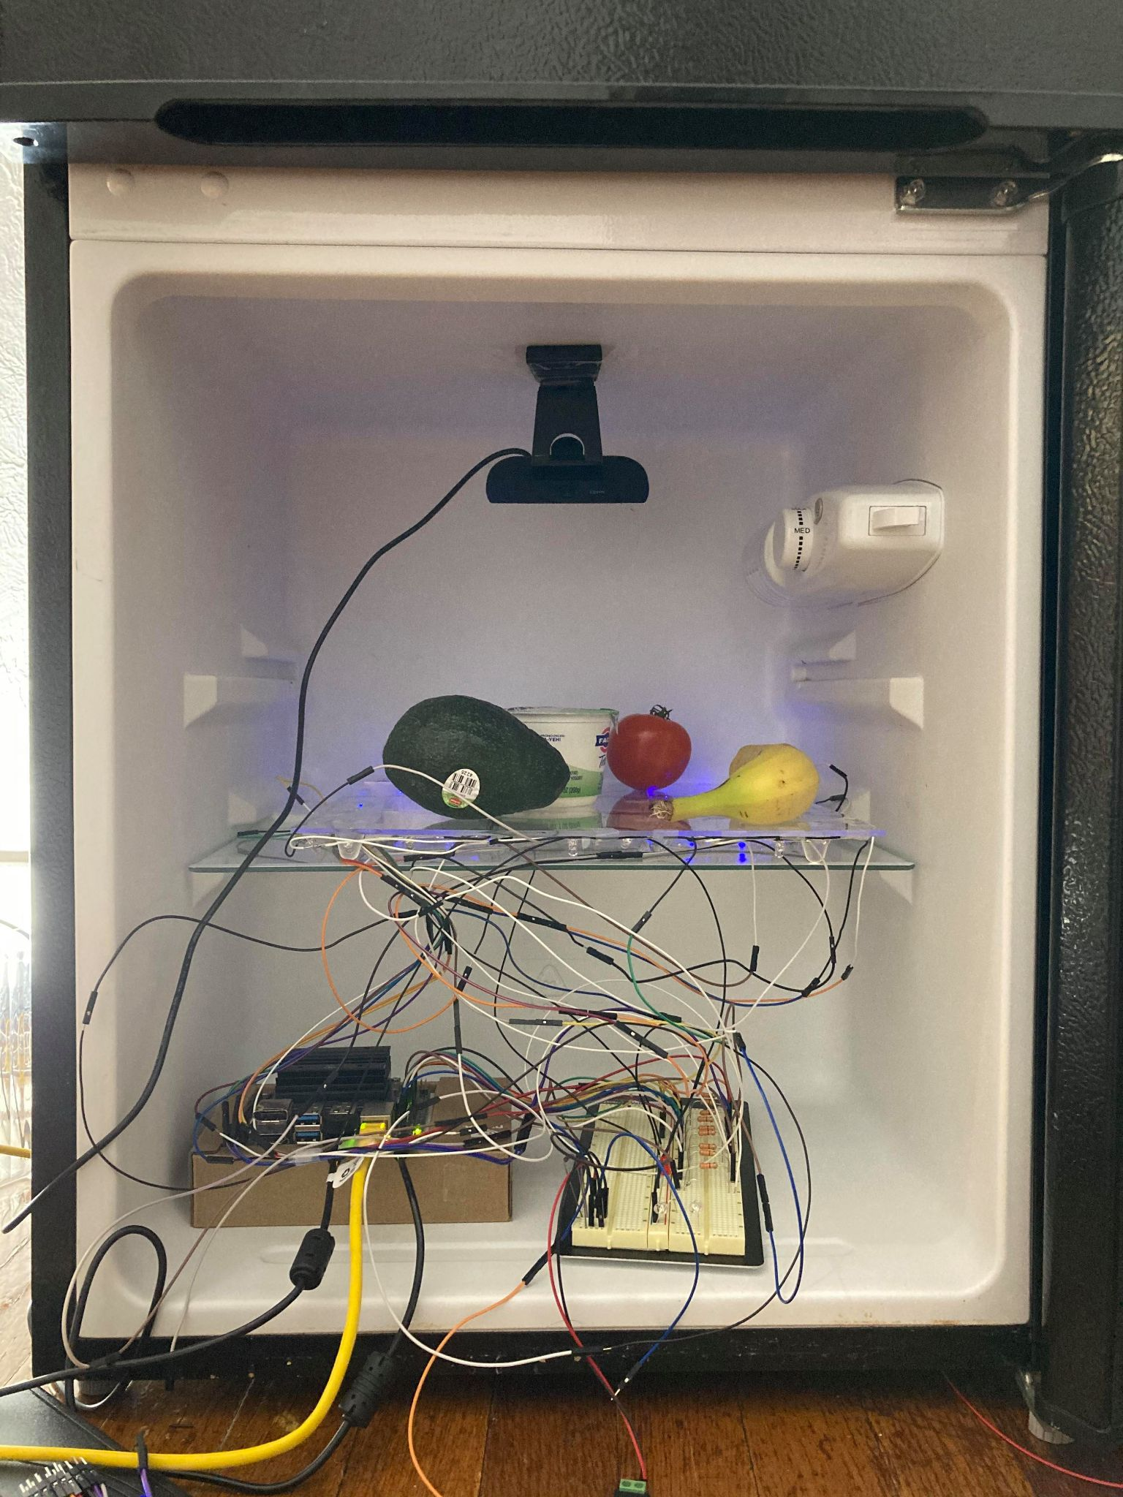
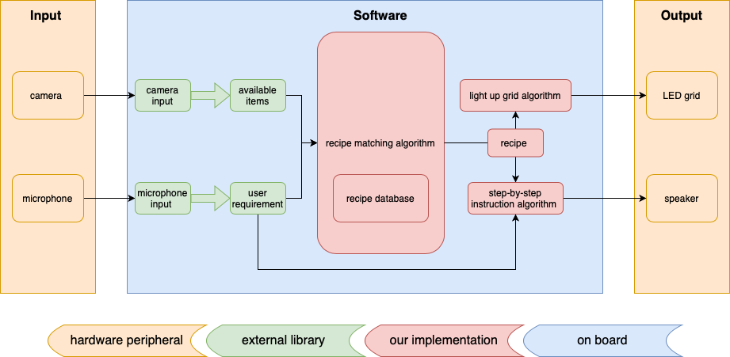
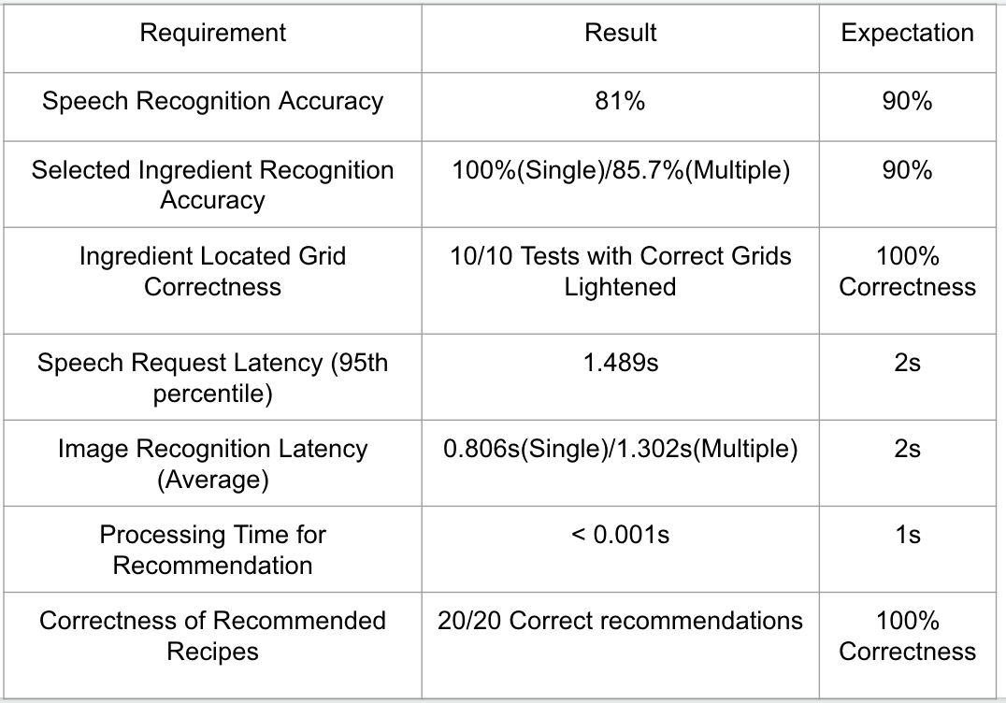
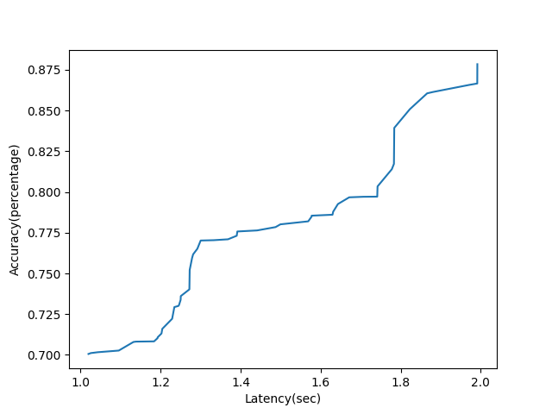
SmolKat: A Smart Kitchen Assistant
Team D3: Elena Gong, Nanxi Li, Yang Yue
Product Pitch
System Description
Our project involves building a smart kitchen assistant that tracks the user’s available items in their fridge and based on the available items and user’s preference, suggests a specific recipe to the user. SmolKat will then guide the user to different items in the refrigerator that need to be picked out to make the recipe. The full scope of our implementation involves computer vision to track the standard items in the refrigerator(85.7% Accuracy, 1.3s Latency), speech-to-text functionality to interpret user’s preference(81% Accuracy, 1.5s Latency), a software recommendation database of recipes and ingredients required(100% Correct Recipe), and a physical guide (LEDs, 100% Correct Grid Lightning) that will direct the user to the appropriate items to complete the recipe.
Speech Recognition: Convert user speech input to words (requests, like “vegan”, “non-dairy”)
Image Recognition: Camera takes pictures as input, return recognized ingredient names(“beef”, “squash”, “banana”) and object locations
Recipe Recommendation: Takes the processed requests and ingredients list as input, filter out the appropriate recipes with instructions as output, and send instructions to user email
LED Grids: The grids that holds the corresponding ingredients will light up for user to find them easily
Final Product
Speaker;
Speech Recognition
Label A
Camera;
Image Recognition
LED Grids: Physical Guide
System Architecture
Jetson Nano: Recommendation & Other Algorithms
Implementation Diagram (Hardware & Software)
System Evaluation
Trade-off Between Latency and Accuracy
For Image Recognition
User Email

