Slide 1
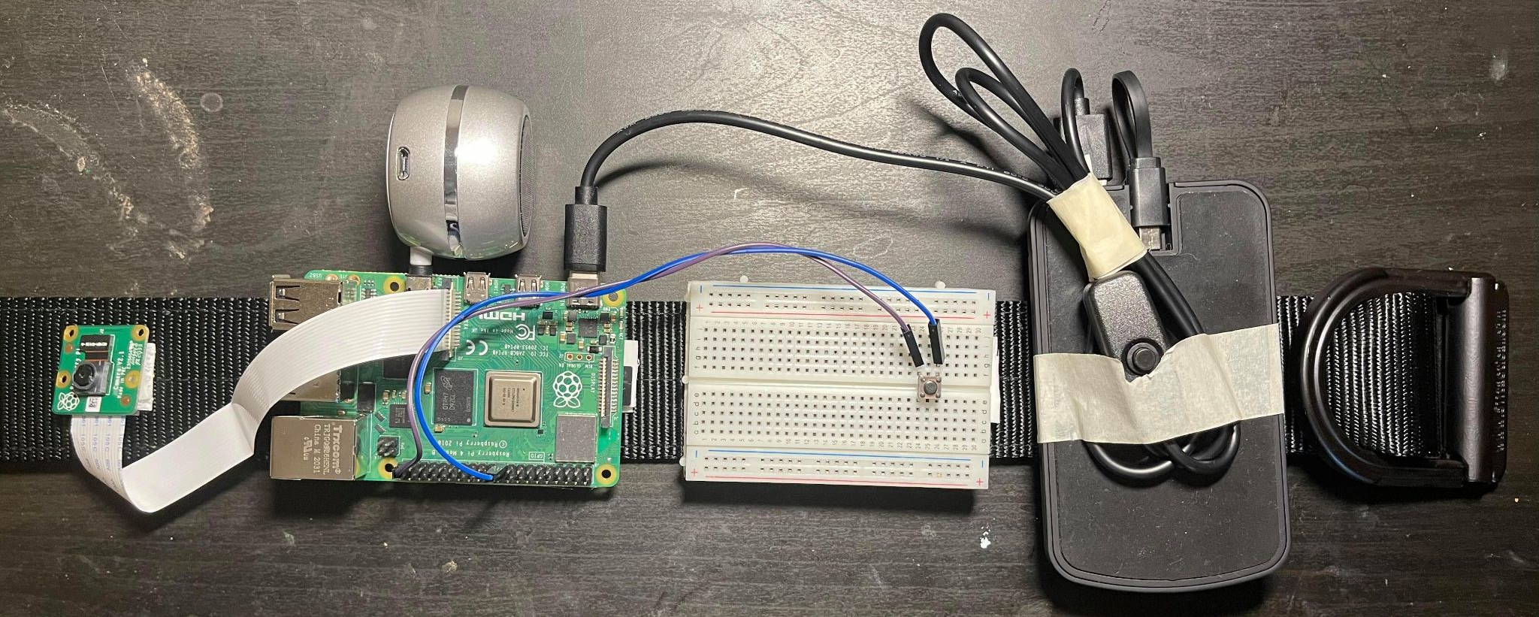
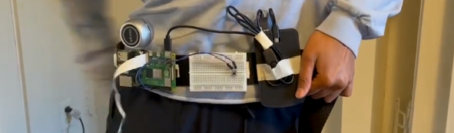
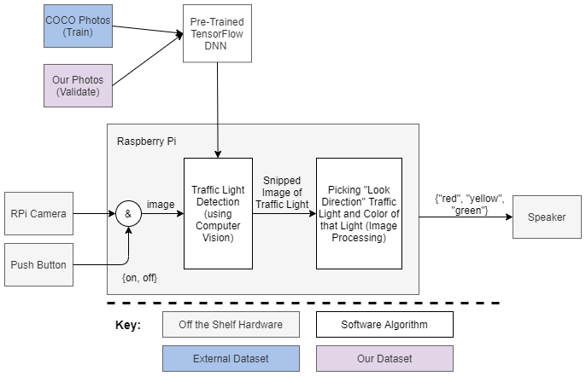
xWALK
Team D2: Jeanette de La Torre - Duran, Yasaswini Doguparthi, Shayan Gupta
Product Pitch
System Description
Many intersections lack features to facilitate crossing for the visually impaired, some even without crossing signals. Therefore, these users need assistance in knowing when to cross such intersections. A solution to this problem must be >90% accurate with <1% false positive rate and a system latency of < 0.5 sec. Our Signals and Software based approach is a wearable device that captures a photo of the intersection and, based on the traffic lights, deduces when the user should cross. Our primary target base are those visually impaired people who are training to cross these intersections, as this device can help validate their own decisions throughout the learning process. To date, we have been able to achieve a 90% accuracy, with 3% false positive rate, and an overall system latency of 26 seconds. Further work could consist of improving the image processing and CV robustness as well as using a different processor.
@yas add more?
Wearable belt with a Raspberry Pi, camera, and speaker attached that guides users when to cross.
Individual starts at crosswalk
If applicable, user turns on device and waits for beep
Presses button to start
Device takes a picture and then beeps
Device processes the color of the traffic direction facing the individual
Outputs “red”, “yellow”, “green”, or beep to indicate traffic light is not found
User can press the button again
Assembled Product: Stationary (Top) and Worn (Bottom)
Speaker
Camera
Raspberry Pi
Button
Battery
System Architecture
Overall System Block Diagram
System Evaluation
Overall Performance Metrics
Tradeoffs and Design Changes
Metric | Calculation | Original Requirements | Validation Statistics
Latency | Software runtime reports from RPi | < 0.5 sec | 26 seconds
Traffic Light and State Detection Accuracy | % frames with correctly identified lights; % correct light states | > 90% | 89.7% *
State Detection False Positive Rate | % red traffic lights labeled as green | < 1% | 3.4%*
Battery Life | use time before power off | 9 hours | 6 hours
 | Swapped Out | Swapped In
CV Model | SSD_mobilenet_v1 (highest accuracy)) | SSD_mobilenet_v2 (less accuracy, faster speed)
Stoplight Capture | Video (higher precision and complexity) | Image (lower complexity)
Device | Headband (better camera angle, uncomfortable) | Belt (less ideal angle, comfortable)
Speaker | Wired input | AUX input (easier integration)
Notes:
Export JPEG 2160 by 1296

